Slide 1

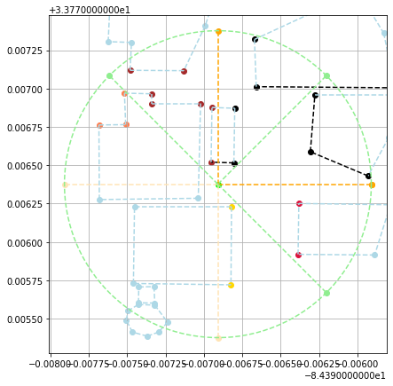
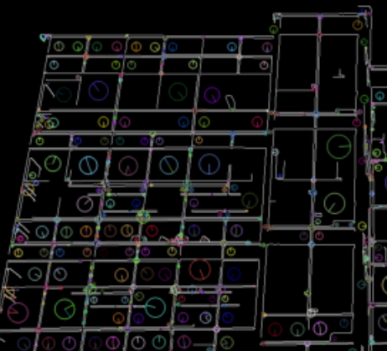
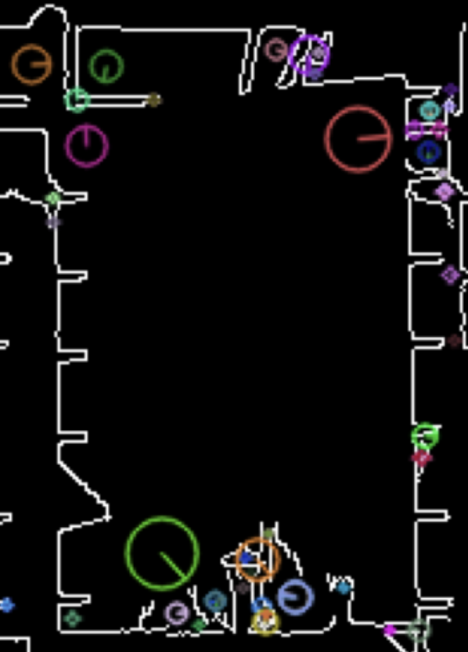
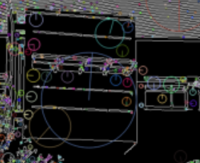
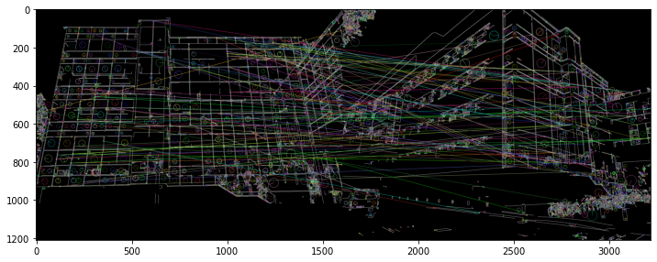
Visual Positioning
Adwait Bauskar, Sankalp Sangle
Georgia Tech
Workflow
Compass
FOV
Camera
GPS
Radius
GPS Store
Edges
in FOV
Buildings in FOV
PREPROCESS
Overlapping
Filter
Covering
Edges
Building Spans
GPS Store | Stores a graph of buildings. Every component is convex in the Euclidean Space.
Building Span | Given a reference point, find the angle range the building spans.
Covering Edges | Filter out edges that get overshadowed by other edges.
Visual Edges Set | Filter out edges based on overshadowing spans of buildings.
Feature Store | Precomputed set of features for every edge. Considers different perspectives and parts of the edge
Preprocess Highest Latency | Resize →Denoise → Gray → Gaussian Blur → Canny Edge Detection → SIFT. Same preprocessor used to generate feature store as well.
Result | Set of edge unique ids that are reported to the user.
Overlapping
Filter
Visual
Edges Set
FLANN Matcher
Feature Store
Expectation
Result

