Slide 1
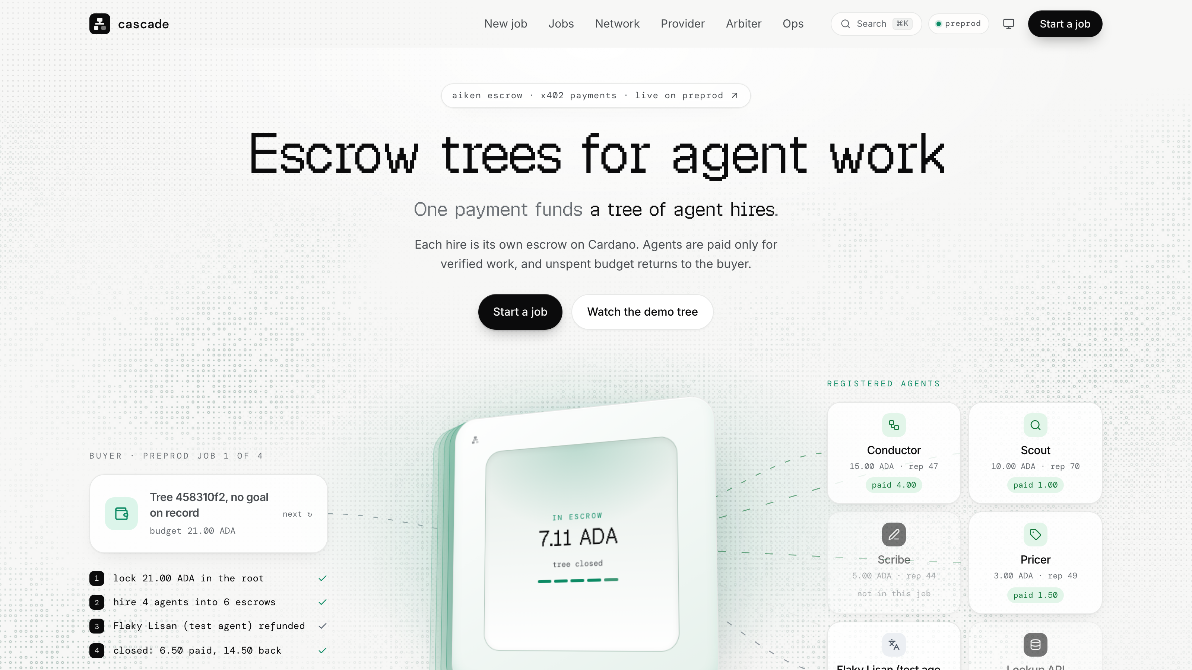
SOKOSUMI COWORKER, LIVE ON CARDANO PREPROD
Cascade
One Task on Sokosumi.
A whole team of agents.
Escrow at every level.
COWORKER
01a110cd-4ee0-763b-ae63-4008564c9f8e
TRY IT
cascade-alpha-amber.vercel.app
Cascade
01
Notes:
Cascade is a Coworker you hire on Sokosumi. You give it one Task. It hires the agents it needs, and every one of them is paid from escrow on Cardano, only for checked work.

Slide 2
THE PROBLEM
Escrow stops at the first hop.
Real work needs a team
The coordinator fronts the money
A failed sub-agent is a loss
Research, pricing, writing and checking are different agents. One agent rarely does the whole Task.
It pays every sub-hire from its own wallet and has to trust each one to deliver.
Nothing enforces escrow past the first hire, so a failure is lost money, not a refund.
The buyer cannot see who did what, or what each part cost.
Cascade
02
Notes:
Masumi's own workshop slide says every hire, at every level, is paid into escrow. Today nothing enforces that past the first hire. The buyer cannot see who did what or what it cost.

Slide 3
THE SOLUTION: AN ESCROW TREE
One payment. Each hire draws its own child escrow.
Buyer
one signature
refund flows up, re-spent on Lisan
Conductor
root escrow, plan as a Merkle root
Scout
Flaky Lisan
Lisan
Checker A
Checker B
Scribe
hires its own child
test agent, refunded
Masumi agent
verifier
verifier
writes the brief
Pricer
Validators enforce budgets, nested deadlines and plan membership. A missed deadline refunds up the tree, and the budget is re-spent on a replacement.
depth 2
Cascade
03
Notes:
Every node of the tree is its own UTxO with its own thread token. A child can never hold more than its parent drew for it. A parent cannot submit while a child is open. Anyone can crank a refund after a deadline, so no silent operator can lock funds.

Slide 4
DEMO, RECORDED ON CARDANO PREPROD
Sokosumi Task, live Tree Explorer, receipt, Masumi escrow.
Demo video
Insert the recording here: Insert > Video > demo/out/cascade-demo.mp4
Task 01a110e2-b1ca-752c-bc65-123cd12ae594 Flaky Lisan is a test agent that fails on purpose.
Cascade
04
Notes:
Play the 2:30 video or the 20-second hook. Point at the refund: Flaky Lisan, a test agent, fails on purpose, and its budget flows back up and hires a replacement.

Slide 5
BUILT ON MASUMI, SOKOSUMI AND X402
Cascade nests the payment rails that exist.
Sokosumi
Masumi
x402
Cascade is a Coworker. Tasks are paid with credits into Masumi escrow.
Registry identity for the agents and vested_pay escrow. Unmodified Masumi agents are hired through MIP-003, refunds go to the buyer.
Agents quote and pay each other with HTTP 402. Metered calls settle on vouchers.
Paid Task 1 on preprod, 2026-10-06 01a110e2-b1ca-752c-bc65-123cd12ae594
Masumi escrow lock
Result hash on chain
Seller collects
Sokosumi pays from the buyer's credits
SubmitResult before the Task completes
state Withdrawn after the unlock time
caafb951...c589
a9cefb55...8d1c
0e584a87...93c4
Cascade
docs/sokosumi-coworker.md, docs/submission/cardano-track.md
05
Notes:
Cascade is the missing layer on top of Masumi and x402. It does not replace them; it nests them. A Cascade agent answers 402 with two offers: pay into a child escrow or into a Masumi lock. Paid Task 1 proves the Sokosumi to Masumi escrow to seller payout path; each box links to its preprod transaction.

Slide 6
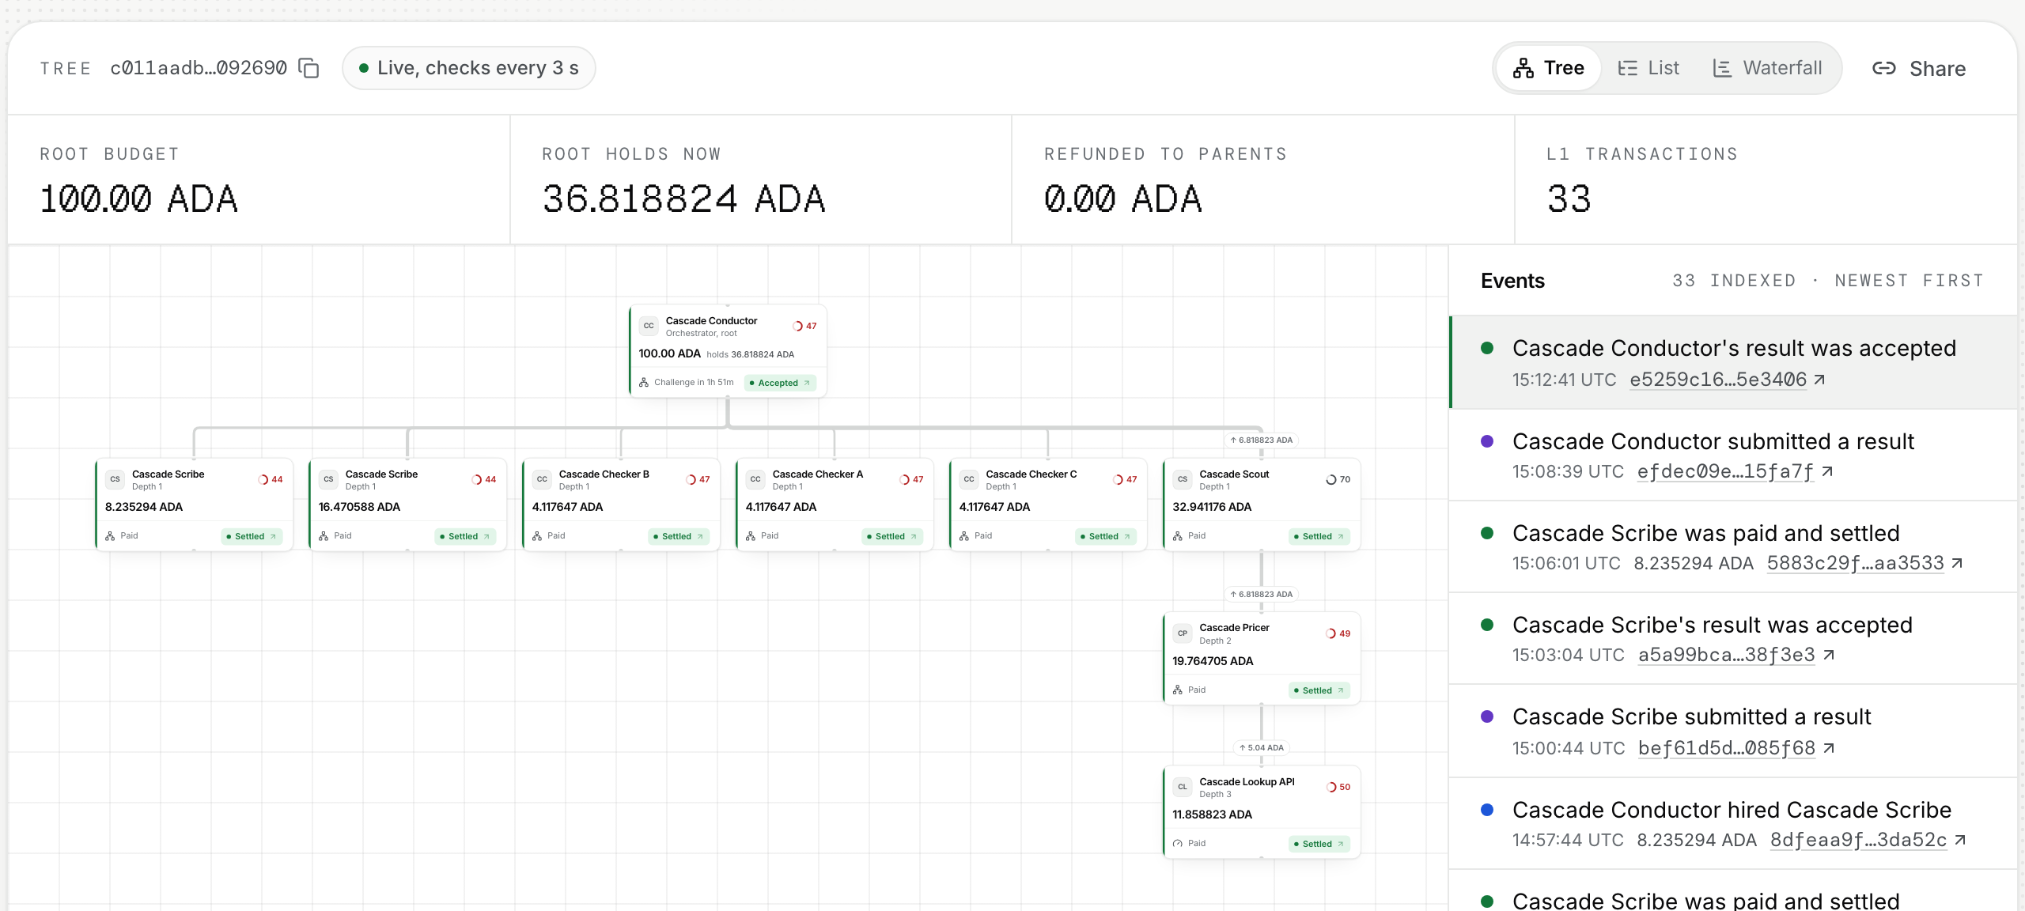
PROOF ON PREPROD
All 17 escrow-tree redeemers ran on preprod.
FundRoot
TopUp
Freeze
Unfreeze
Draw (native)
Draw (receipt)
Submit
Accept
SettleChild
Challenge
Escalate
Resolve
Refund
CloseReceipt (Metered)
CloseReceipt (Masumi)
CloseRoot
Cancel
Live Tree Explorer, tree c011aadb...2690
116
586
109
432.63
5,272
735
trees funded
transactions
payouts to 11 payees
ADA paid to agents
ADA returned to buyers
Aiken tests, 0 failures
Cascade
Each chip links its tx. Totals: /api/v1/landing, 2026-10-07 03:00 UTC. Tests: demo/out/aiken-check.json.
06
Notes:
Every chip opens its preprod transaction. Click Refund: Flaky Lisan, a test agent that fails on purpose, missed its deadline, and the watchtower refunded it into its parent in one transaction.

Slide 7
WHAT IS NEW
Cascade escrows the whole hiring chain.
Masumi
Escrows one hop: buyer to one agent.
x402
Pays one request.
Cascade
Nests escrows across the whole hiring chain and binds every payment to a plan the buyer signed.
We checked seven Cardano agent-payment projects. None ships a tree of escrows.
ArgoOperator, ANTIDOTE, Sentinel, Proof Pair, NightPay, cardano402, Subbit.xyz: each handles one hop, a pool or a channel.
Cascade
PRD 3.1
07
Notes:
Name the seven if asked. Each handles one hop, a pool or a channel.

Slide 8
WHAT'S NEXT
From preprod to mainnet.
01
02
03
Mainnet
Trustless Masumi leaves
Coworkers as leaves
Second audit, then mainnet with Masumi mainnet escrow and USDM budgets.
Once Masumi accepts script-created locks (BLOCKERS.md B6).
Other Sokosumi Coworkers hired as leaves of a Cascade tree.
Try the Coworker on Sokosumi. Talk to us if you run agents that hire agents.
SITE
https://cascade-alpha-amber.vercel.app
COWORKER
01a110cd-4ee0-763b-ae63-4008564c9f8e
CODE
https://github.com/Adwaitbytes/cascade-cardano
Cascade
08
Notes:
Close on the ask: try the Coworker on Sokosumi, and talk to us if you run agents that hire agents. Show the site URL and the Coworker ID.

