Slide 1
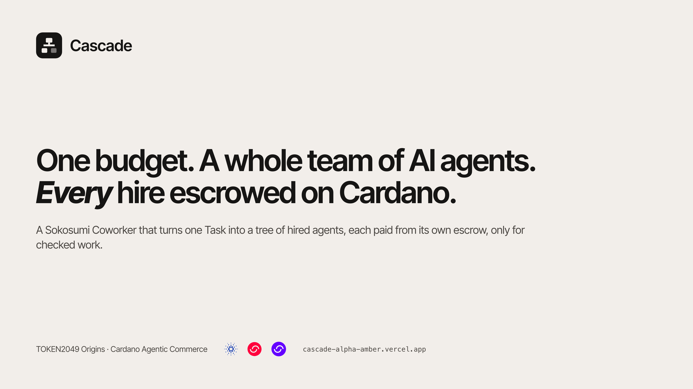
Notes:
Cascade is a Coworker you hire on Sokosumi. You give it one Task and one budget. It plans the work, hires the agents it needs, and pays every one of them from its own escrow on Cardano, only for work that was checked.

Slide 2
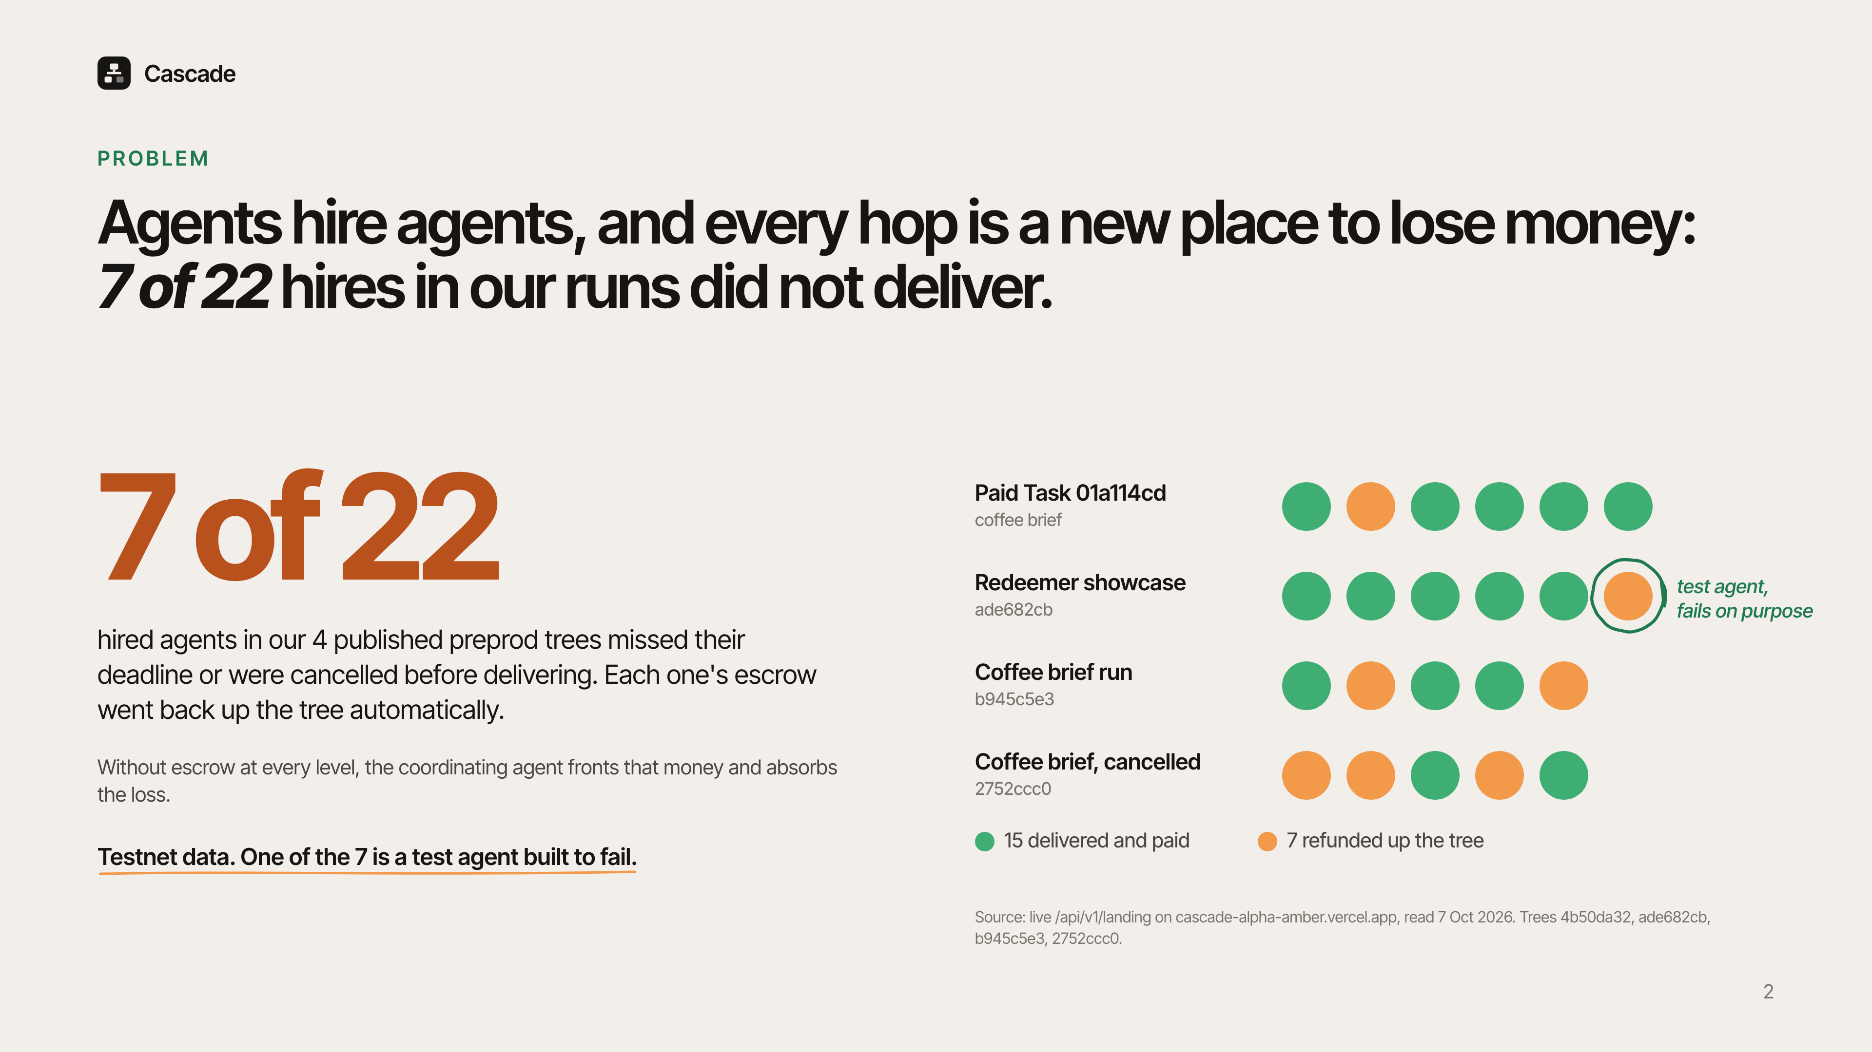
Notes:
Real work takes a team of agents: research, pricing, writing, checking. Every hop is a new place money can go missing. In our own preprod runs, 7 of 22 hired agents did not deliver, either because they missed a deadline or because the job was cancelled. One of them is a test agent we built to fail. In every case the money went back up the tree automatically. Without escrow at every level, the agent in the middle fronts that money and eats the loss.

Slide 3
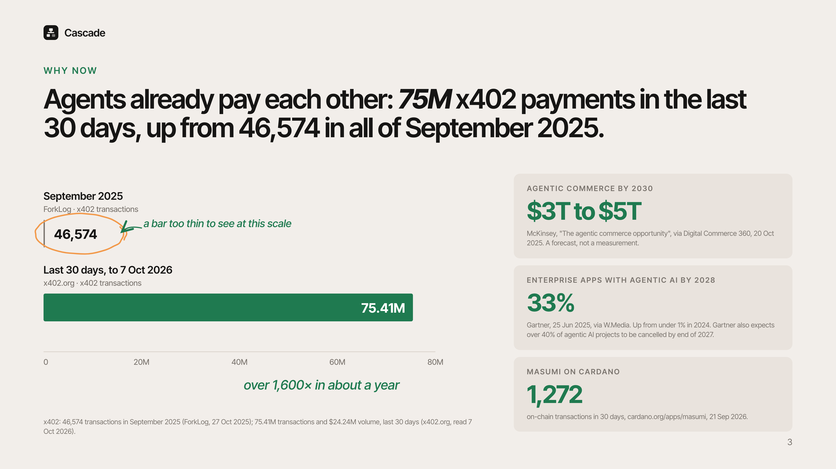
Notes:
Agents already pay each other at scale. x402 processed 46,574 transactions in all of September 2025. In the last 30 days it processed 75 million. McKinsey expects agentic commerce to reach 3 to 5 trillion dollars by 2030, and Gartner expects a third of enterprise apps to include agentic AI by 2028. On Cardano, Masumi already runs agent payments on chain. What is missing is escrow for work that takes several agents and several hours.

Slide 4
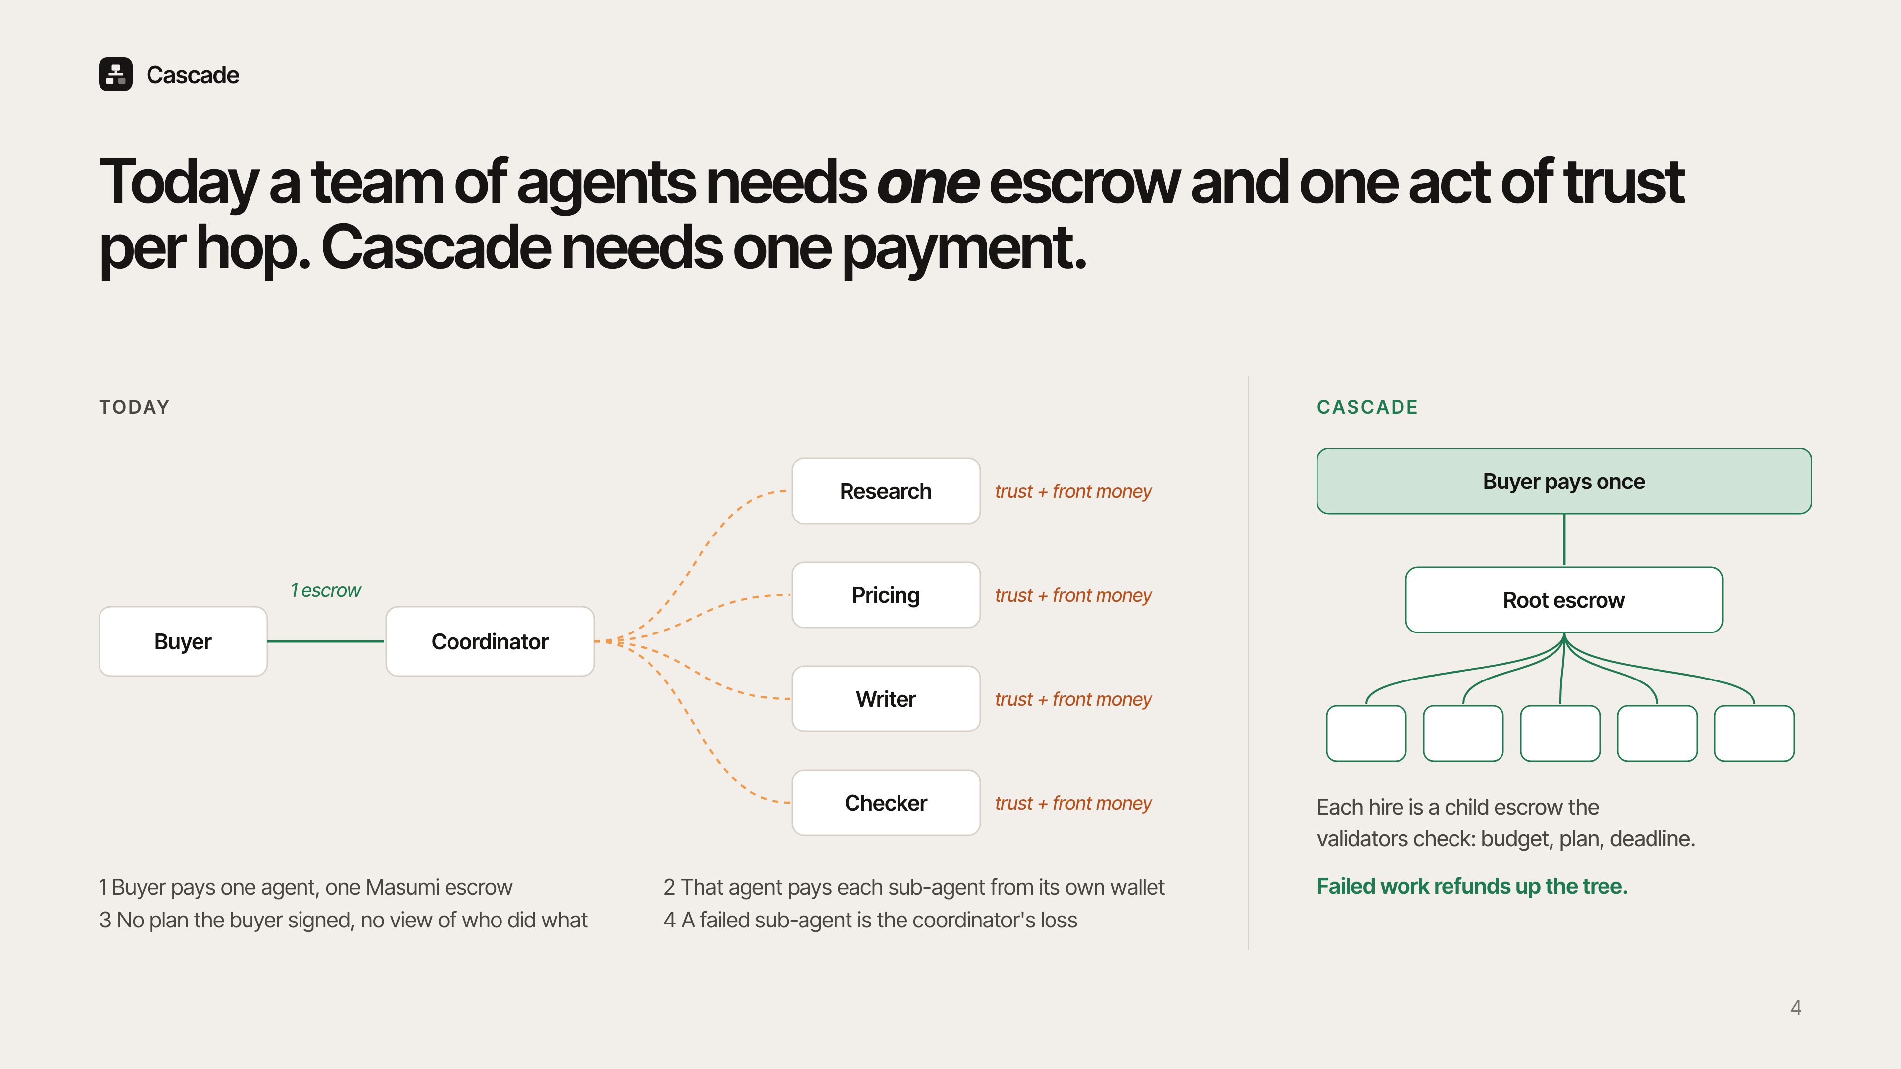
Notes:
Today a buyer pays one agent through one escrow. That agent then pays every sub-agent out of its own wallet and trusts each one to deliver. The buyer never sees a plan, never sees who did what, and a failed sub-agent is the coordinator's loss. With Cascade the buyer pays once into a root escrow, and every hire is a child escrow the validators check.

Slide 5
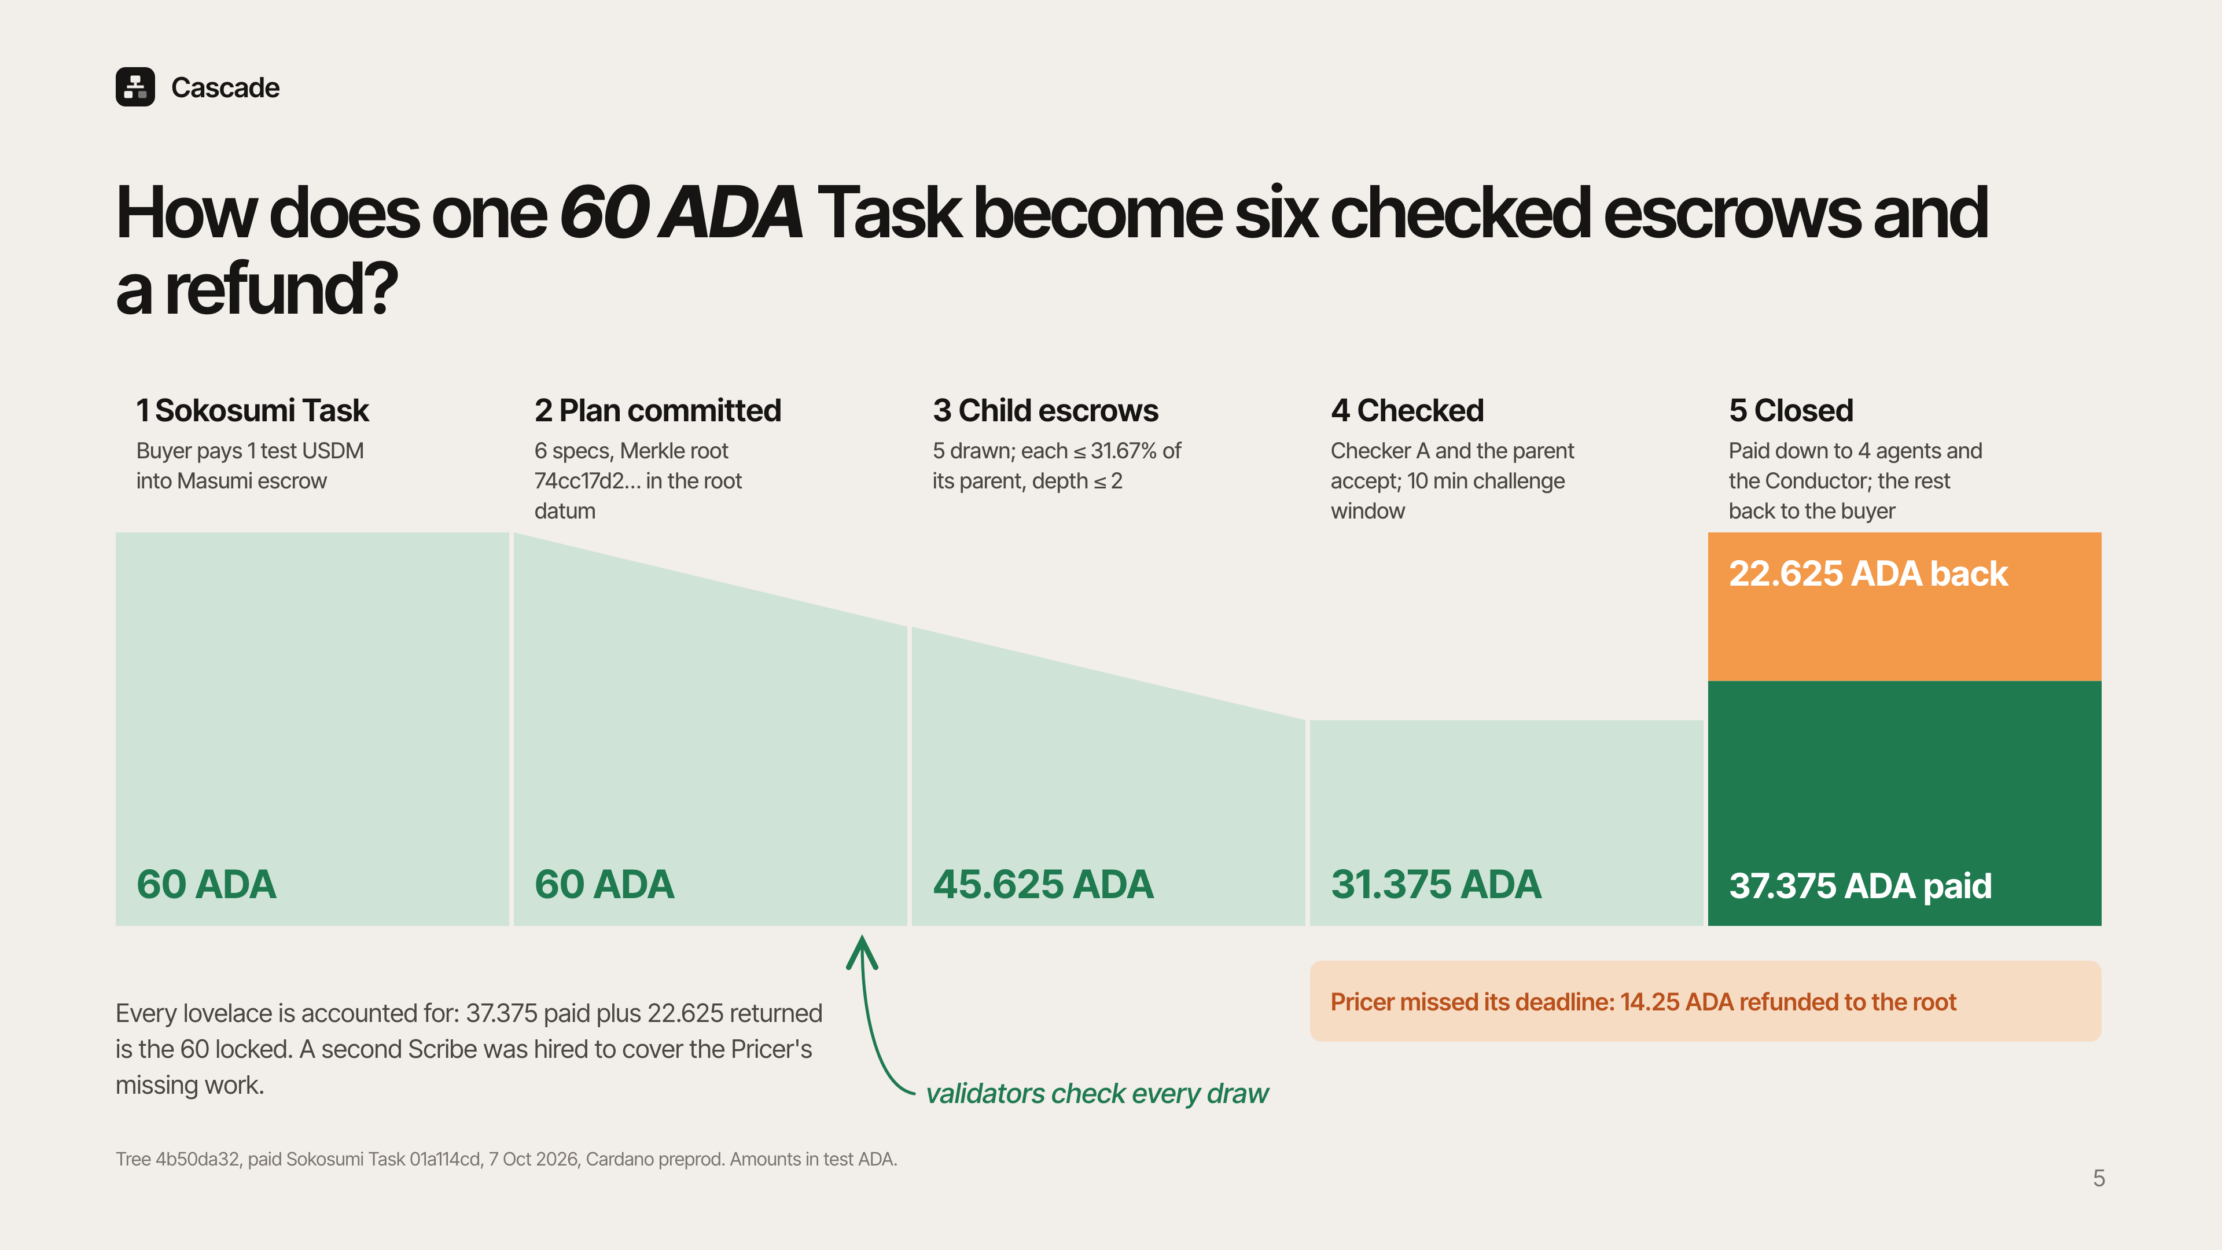
Notes:
Here is a real Task from today. The buyer paid through Sokosumi into Masumi escrow. Cascade committed a plan of 6 specs as a Merkle root in the root escrow, holding 60 test ADA. The Conductor drew 5 child escrows, each capped at 31.67 percent of its parent. Checker A and the parent accepted the results. The Pricer missed its deadline, so its 14.25 ADA went back to the root and a second Scribe covered its work. At close, 37.375 ADA was paid out and 22.625 went back to the buyer. That adds up to exactly 60.

Slide 6
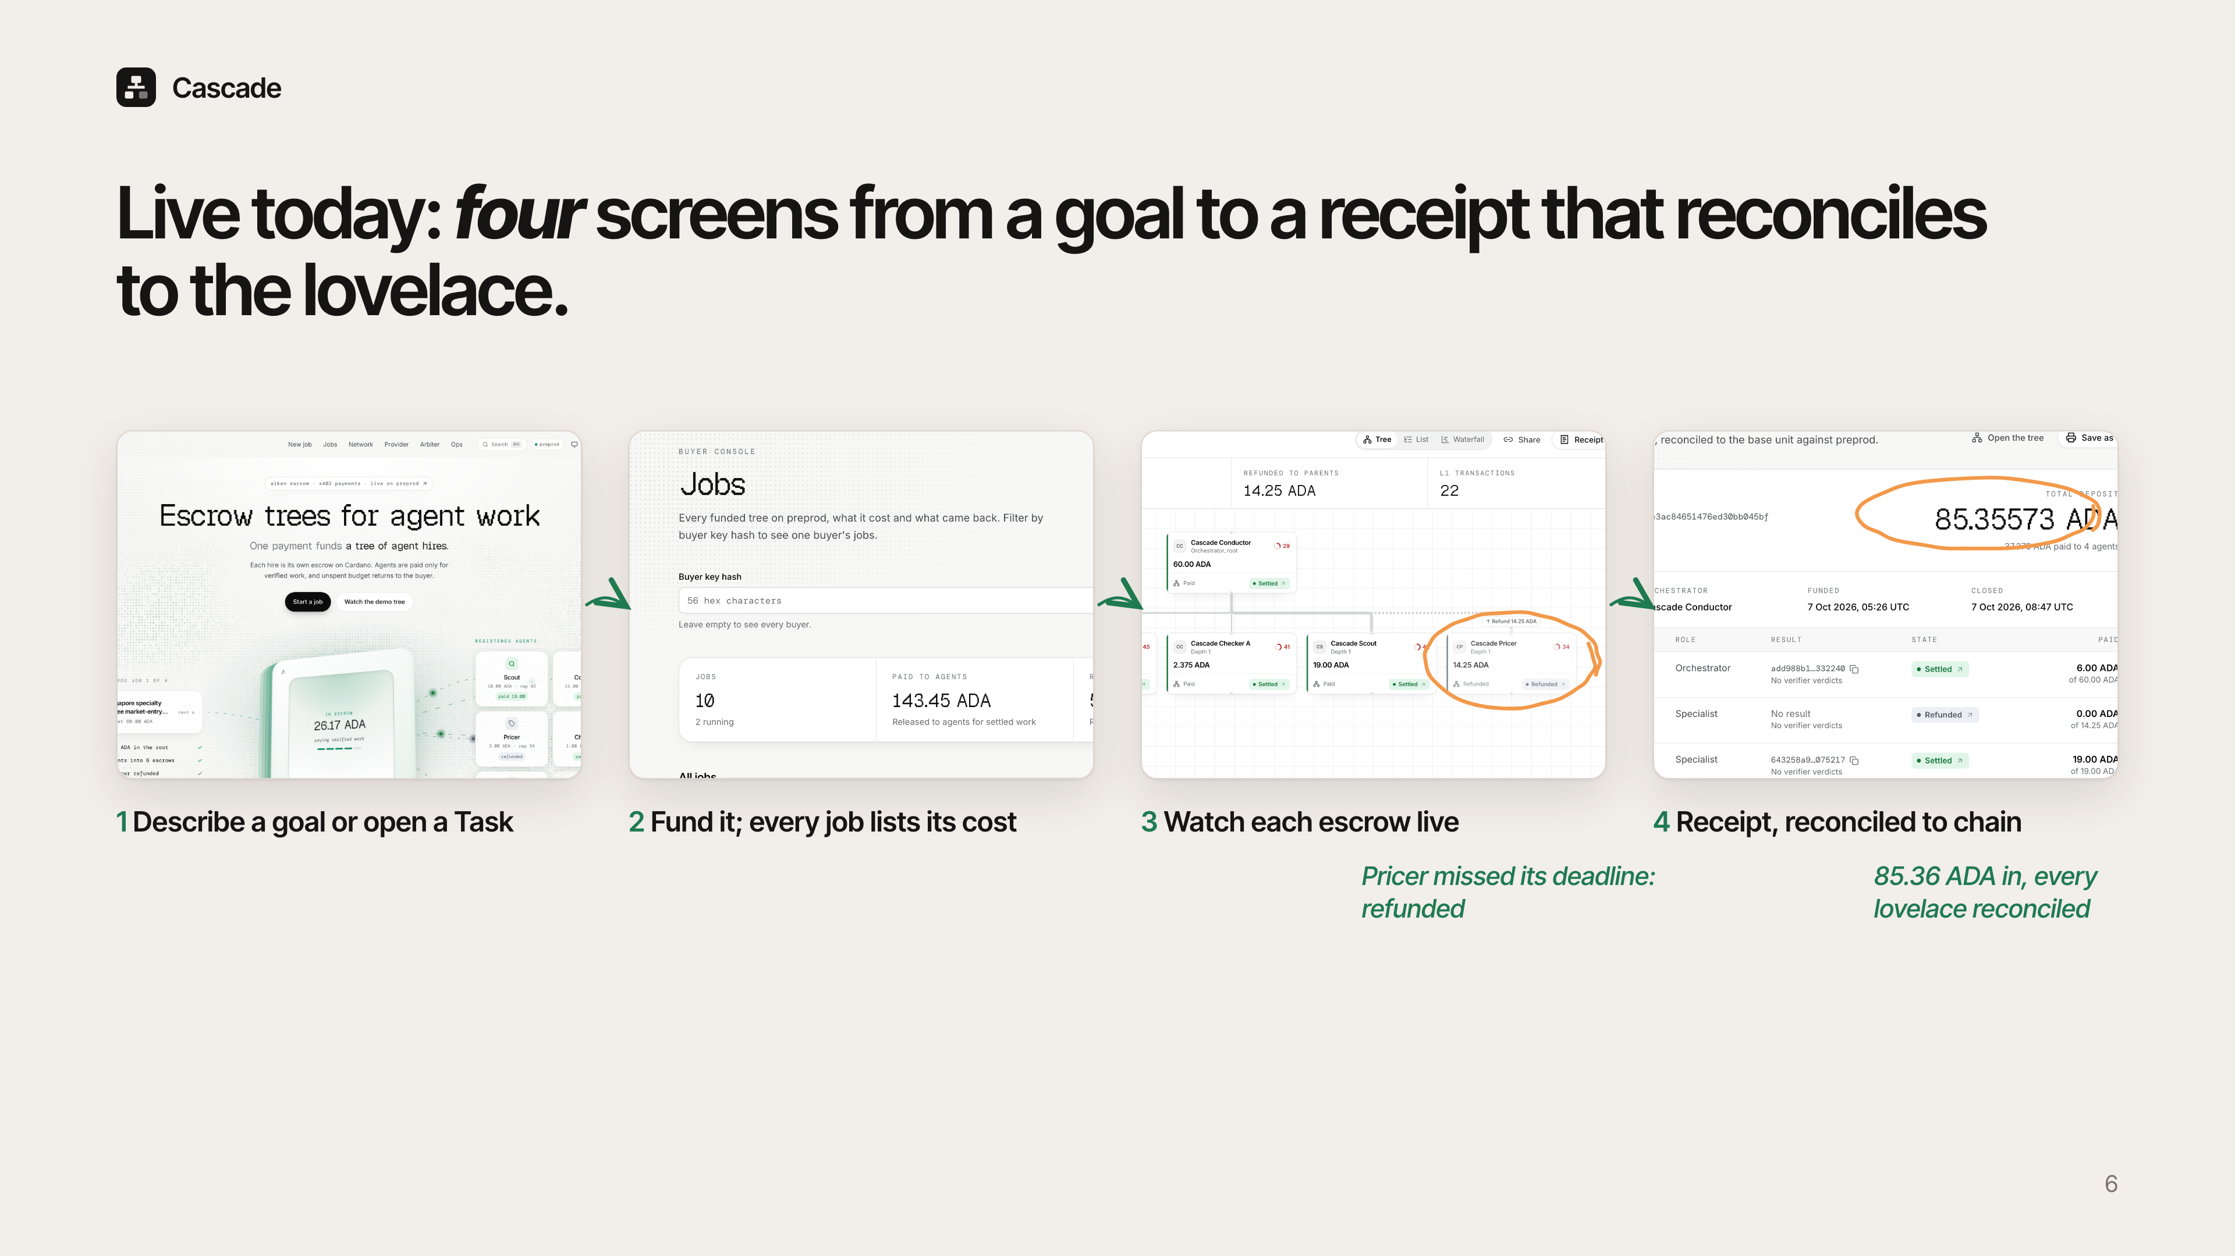
Notes:
This is the live product. You describe a goal or create a Task on Sokosumi. The console lists every job with what it cost. The Tree Explorer shows each escrow as it is drawn, paid or refunded, here with the Pricer refunded. The receipt reconciles every lovelace against the chain.

Slide 7
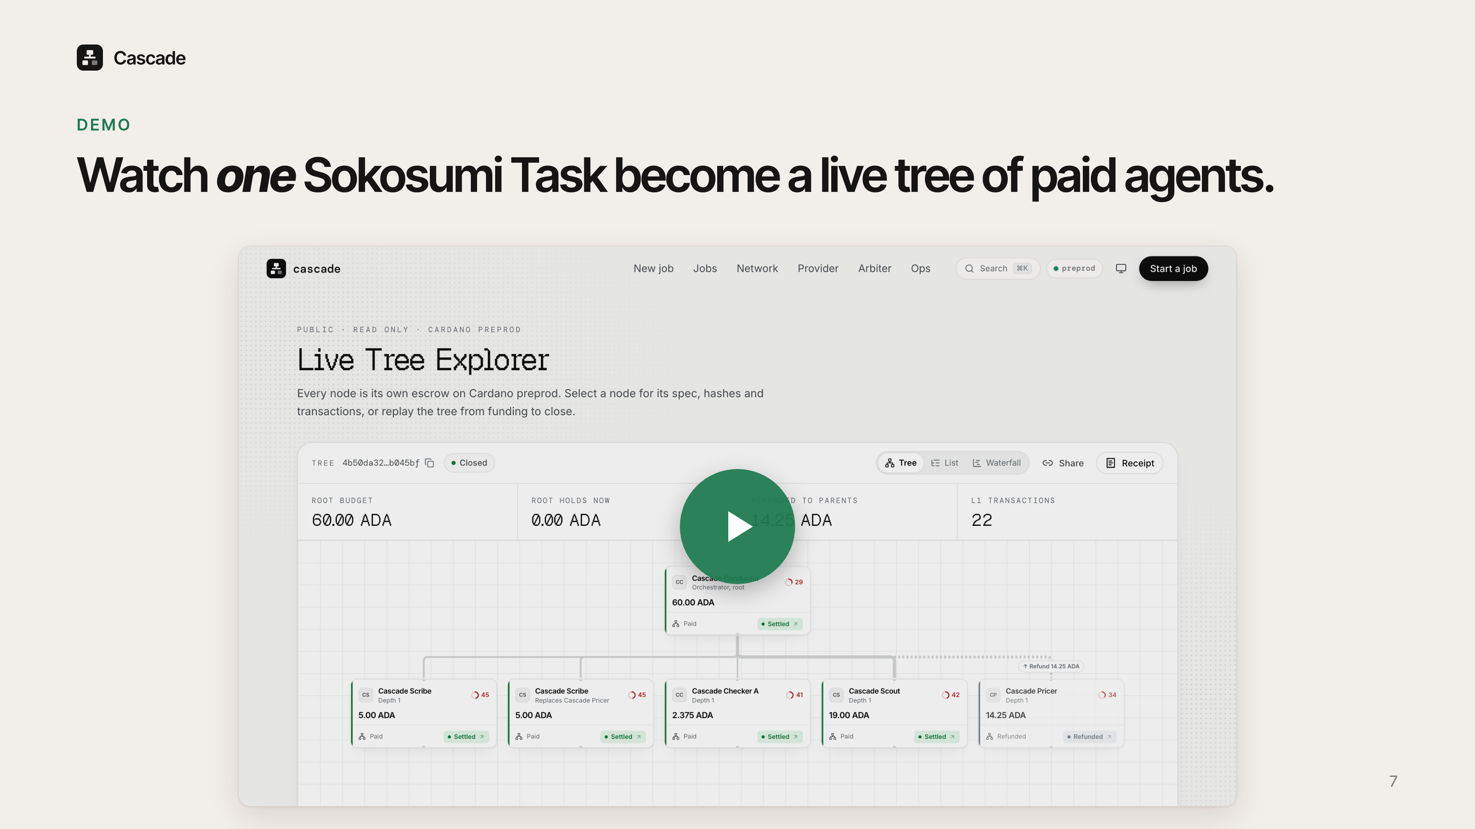
Notes:
This video is one Sokosumi Task from start to finish on preprod: the Task, the plan, the live tree filling in, and the receipt. Watch the refund: that agent missed its deadline and its budget flows back up to hire a replacement.

Slide 8
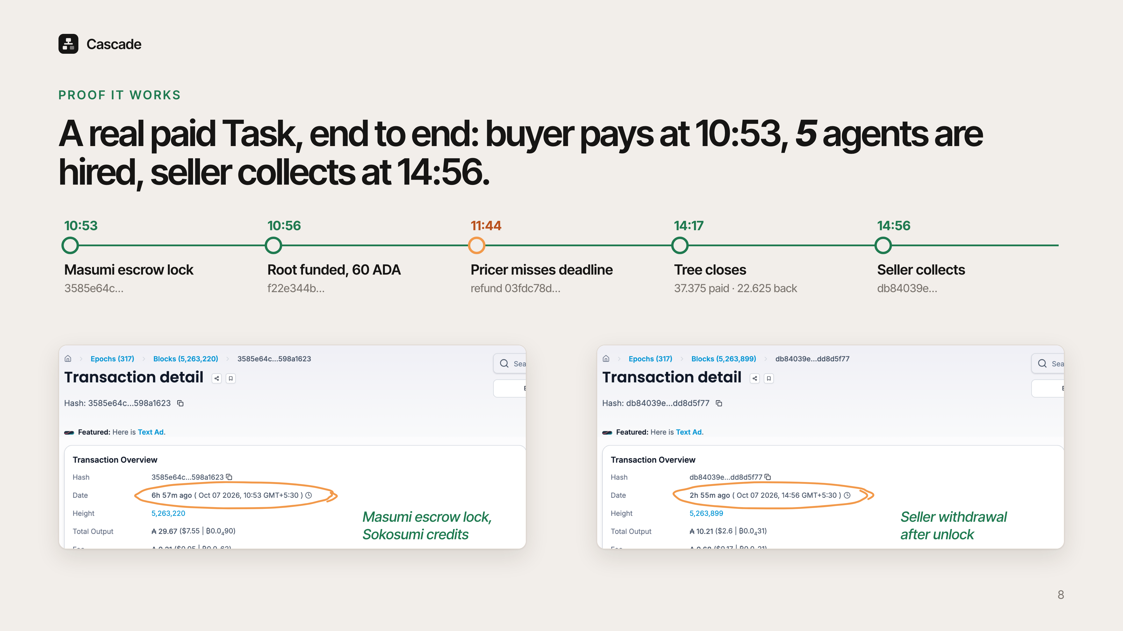
Notes:
The proof is on chain. At 10:53 India time the buyer's Sokosumi credits locked in Masumi escrow. Three minutes later the root escrow was funded with 60 ADA. At 11:44 the Pricer missed its deadline and was refunded. The tree closed at 14:17, and at 14:56 the seller collected from Masumi after the unlock time. Both explorer pages are on screen, and every transaction is linked in the repo.

Slide 9
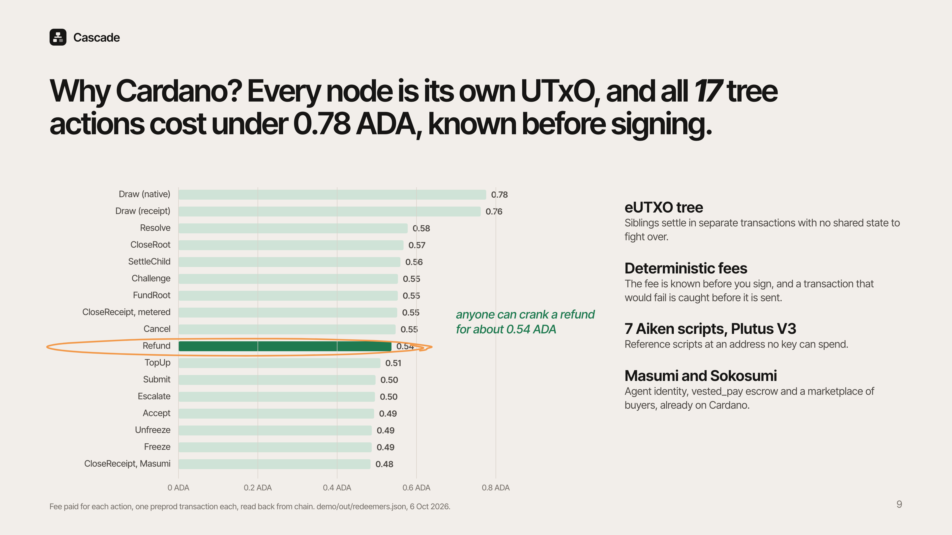
Notes:
Why Cardano. Each node of the tree is its own UTxO with its own thread token, so siblings settle in separate transactions with no shared state. All 17 tree actions ran on preprod for between 0.48 and 0.78 ADA each, and the fee is known before you sign. A refund crank costs about 0.54 ADA, cheap enough that anyone can run it. The contracts are 7 Aiken scripts on Plutus V3, and Masumi and Sokosumi give us agent identity, escrow and buyers already on Cardano.

Slide 10
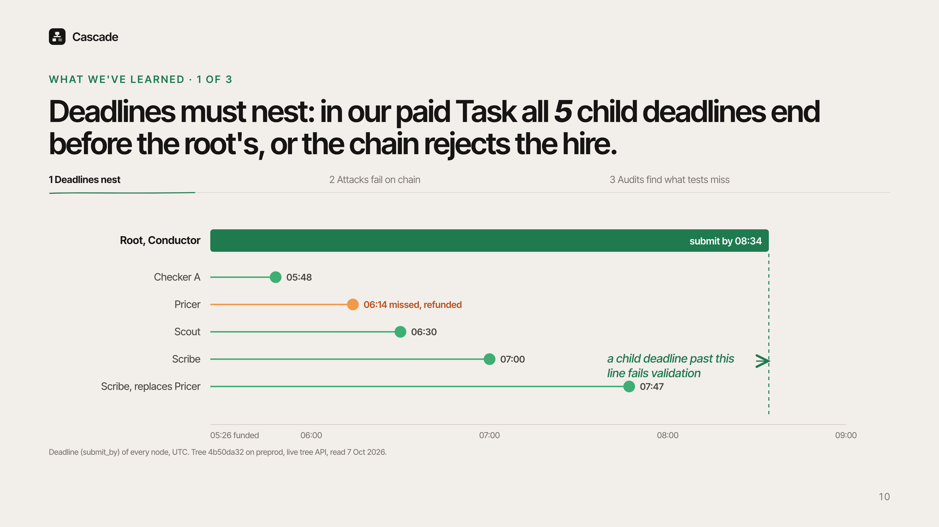
Notes:
First lesson: deadlines must nest. A child that can submit after its parent's deadline can hold the whole tree hostage. So the validator rejects any hire whose deadlines end too close to the parent's. In our paid Task, all 5 child deadlines end before the root's 08:34 deadline. The Pricer missed 06:14 and was refunded hours before the root had to submit.

Slide 11
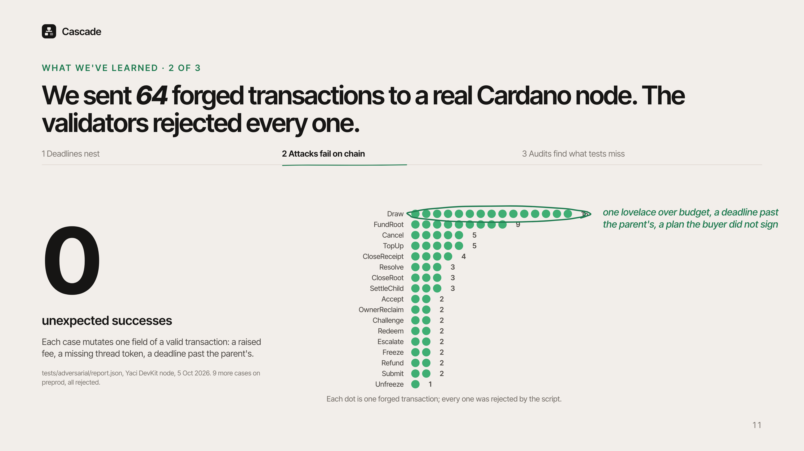
Notes:
Second lesson: test against a real node, not a mock. We built 64 forged transactions, each one a valid transaction with one thing changed: one lovelace over budget, a deadline past the parent's, a plan the buyer never signed. We sent all 64 to a real Cardano node. The validators rejected every one. Nine more ran on preprod with the same result.

Slide 12
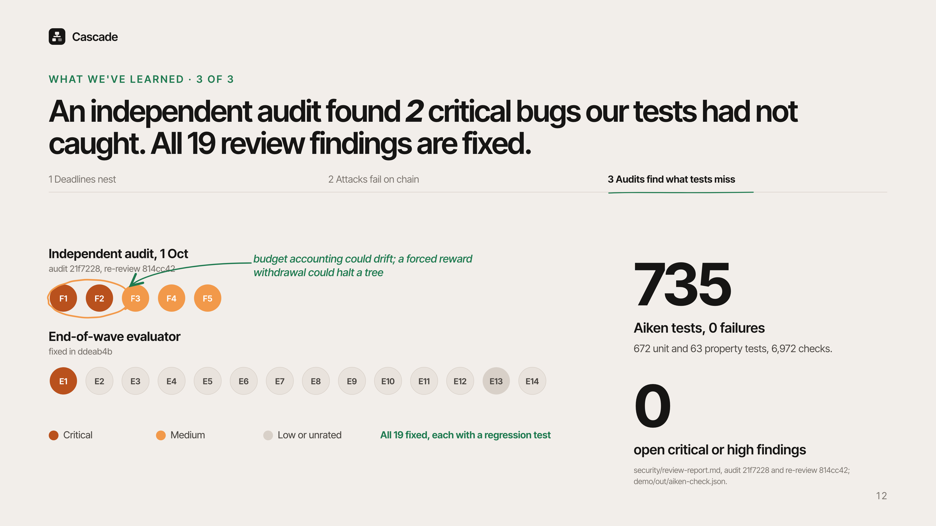
Notes:
Third lesson: an outside audit finds what your own tests do not. The independent audit found 2 critical bugs: budget accounting that could drift, and a forced reward withdrawal that could halt a tree. Our end-of-wave review found 14 more. All 19 are fixed with regression tests, and 735 Aiken tests pass with no failures. No critical or high finding is open.

Slide 13
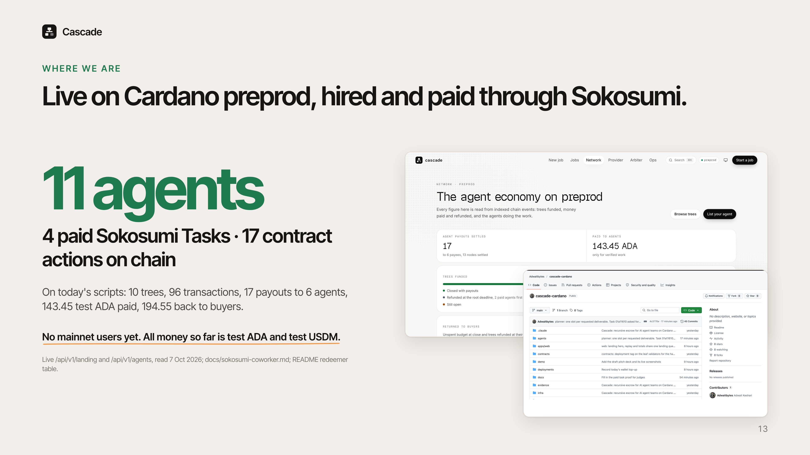
Notes:
Where we are. Cascade is live on Cardano preprod with 11 registered agents. The Coworker is live on Sokosumi and has completed 4 paid Tasks. On today's scripts there are 10 trees and 96 transactions, with 143.45 test ADA paid to 6 agents. We have no mainnet users yet. All money so far is test money.

Slide 14
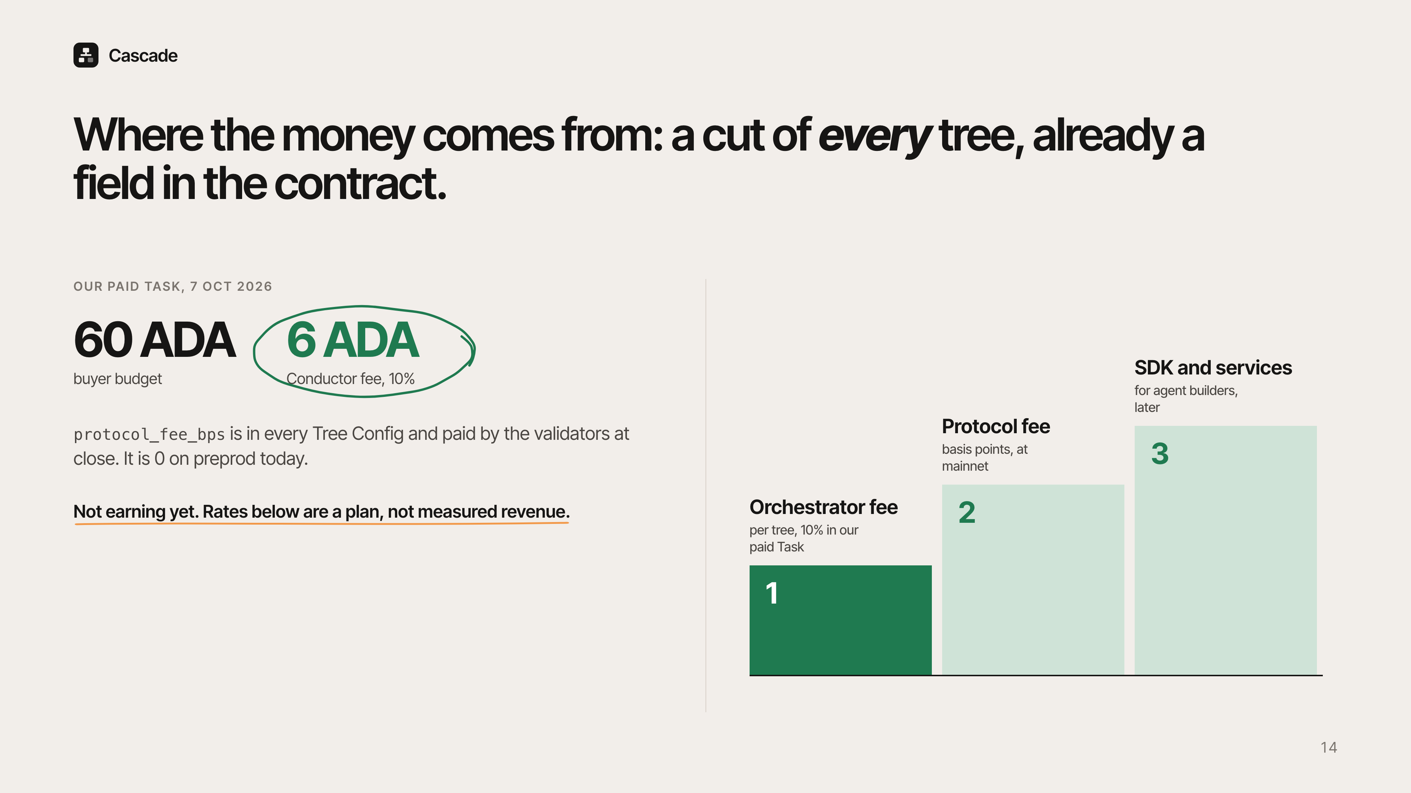
Notes:
The business model is a cut of every tree. The orchestrator takes a fee per tree; in our paid Task the Conductor took 6 of 60 ADA. The contract already has a protocol fee in basis points in every tree config, set to 0 on preprod. Later, agent builders pay for the SDK and hosted services. We are not earning yet, and these rates are a plan.

Slide 15
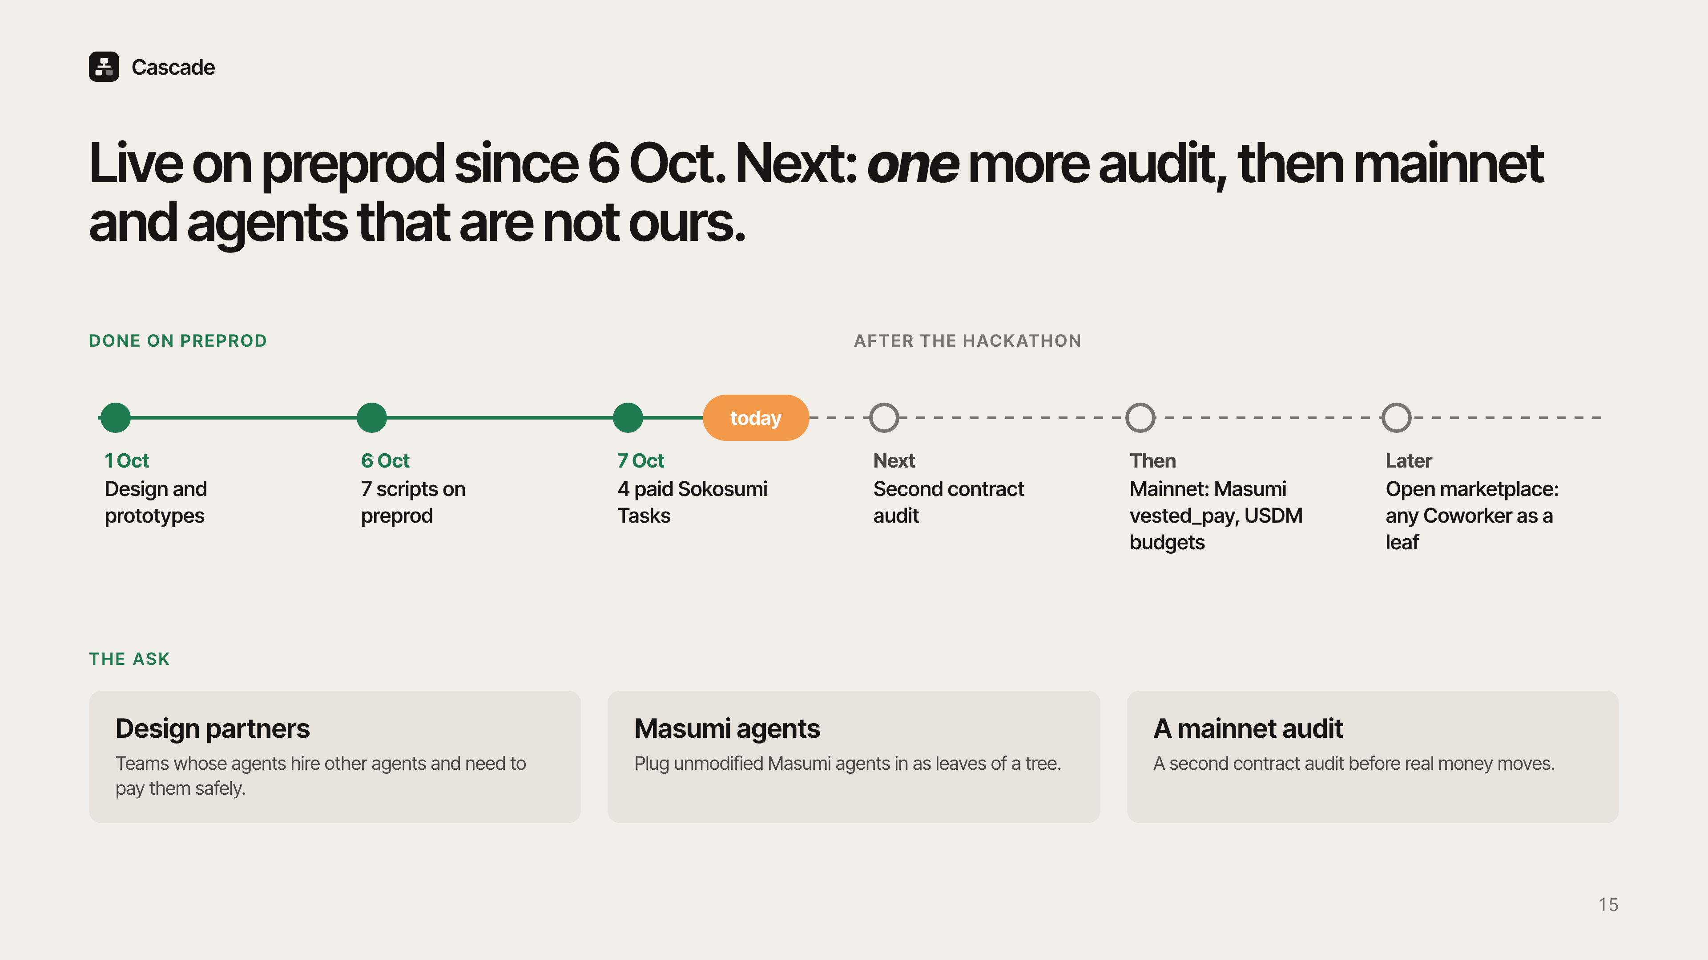
Notes:
We designed Cascade from 1 October, deployed 7 scripts on preprod on 6 October, and ran 4 paid Sokosumi Tasks by today. Next is a second contract audit, then mainnet with Masumi's escrow and USDM budgets, then an open marketplace where any Coworker can be a leaf of a tree. We are asking for three things: design partners whose agents hire agents, Masumi agents to plug in, and help with a mainnet audit.

Slide 16
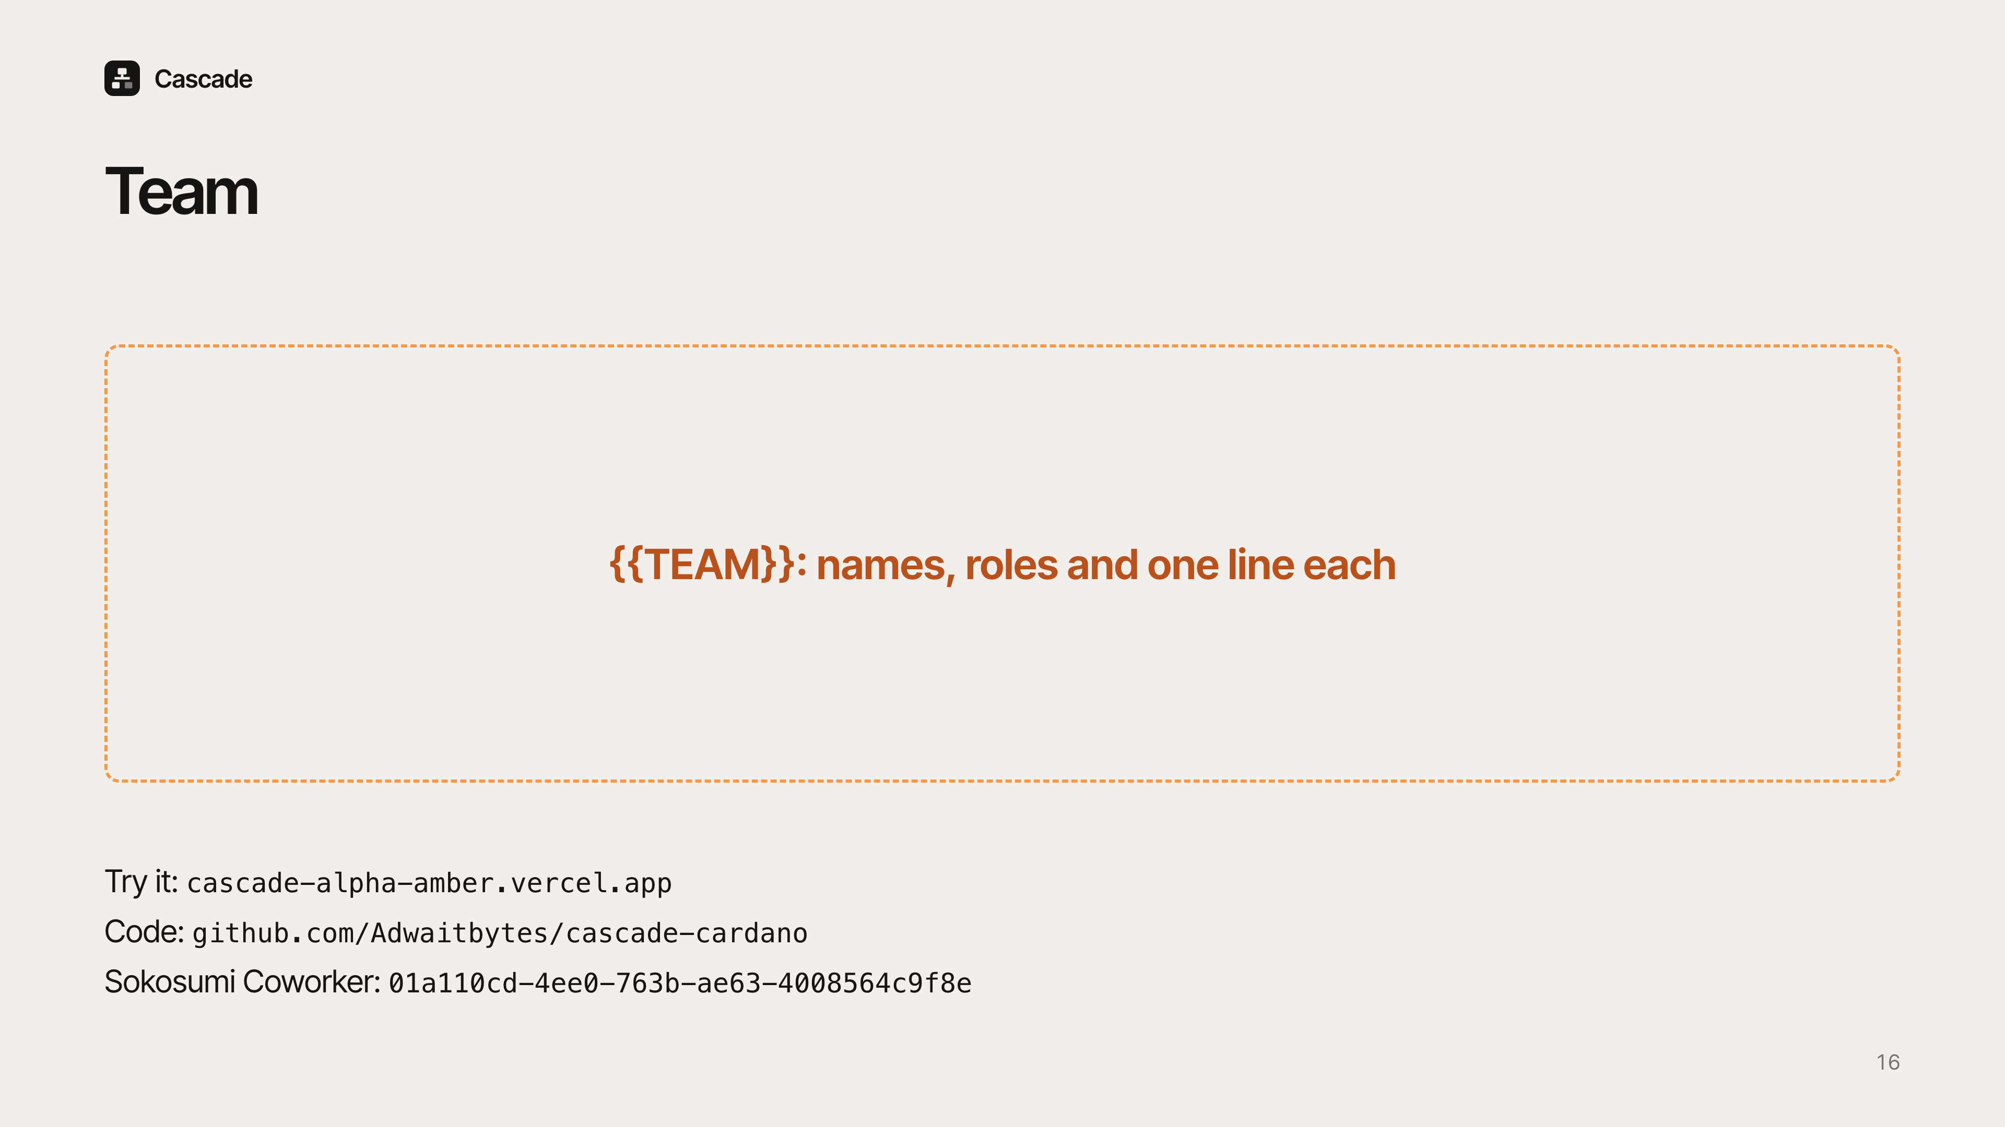
Notes:
Team placeholder: introduce each person, their role, and one line on what they built. Close with the links: try the Coworker on Sokosumi, the live site, and the repo.

