Slide 1
CROSS-CHAIN VERIFIER FOR CHAINLINK CCIP 2.0
KIRCHHOFF
Every bridge checks who signed.
We check if the money adds up.
Σ in = Σ out
CONSERVED
TOKEN2049 ORIGINS · SINGAPORE · OCTOBER 2026
Notes:
In April, one forged message created 292 million dollars from nothing. KIRCHHOFF is a Cross-Chain Verifier for Chainlink CCIP 2.0. Every bridge checks who signed. We check if the money adds up.

Slide 2
Bridges verify signatures. Nobody verifies supply
THE PROBLEM
$292M
20 chains
where rsETH holders lost value without ever touching Kelp.³
One forged message released about 116,500 rsETH from Kelp DAO's bridge on April 18, 2026.¹ The bridge trusted a single verifier.²
$340M+
Each of those bridges checked who signed.
None checked whether the money added up.
drained by bridge exploits across 14 incidents in 2026.⁴
1 Crypto Times, May 18, 2026 2 Decrypt 3 Phemex, DeFi hacks 2026 4 DexTools / PeckShield, June 2026
Notes:
On April 18, attackers forged one LayerZero message and released about 116,500 rsETH, roughly 292 million dollars, from Kelp DAO's bridge. It passed because the bridge trusted a single verifier. Holders on 20 chains lost value without touching Kelp, and bridge exploits drained over 340 million dollars across 14 incidents this year. A simple sum would have exposed the fake supply the moment it appeared.

Slide 3
Two laws, borrowed from Kirchhoff
THE INSIGHT
JUNCTION RULE · PER MESSAGE
LOOP RULE · ACROSS ALL CHAINS
Every credit has a debit
Backing covers every claim
Same message id, amount and recipient, finalized.
S₁ Arbitrum
S₂ Base
F In flight
ARBITRUM · DEBIT
matched
ETHEREUM · CREDIT
burn 10 kETH
release 10 kETH
E
home escrow
NO SOURCE CHAIN
forged
ETHEREUM · CREDIT
no debit
release 116,500
Δ = E − (ΣS + F) ≥ 0
Caught on the first transaction.
DEBIT_NOT_FOUND
Below zero, value was created from nothing.
One deterministic engine runs both rules in the CRE workflows, the CCV Judge and the backtester.
Notes:
Two rules, named after Kirchhoff's circuit laws. The Junction Rule is per message and exact: every mint or release must match one finalized burn or lock with the same message id, amount and recipient. A credit with no debit is forged, which catches the Kelp pattern on the first transaction. The Loop Rule is global: home escrow must cover the supply on every remote chain plus everything in flight. A deficit means value was created from nothing, whichever bridge did it.

Slide 4
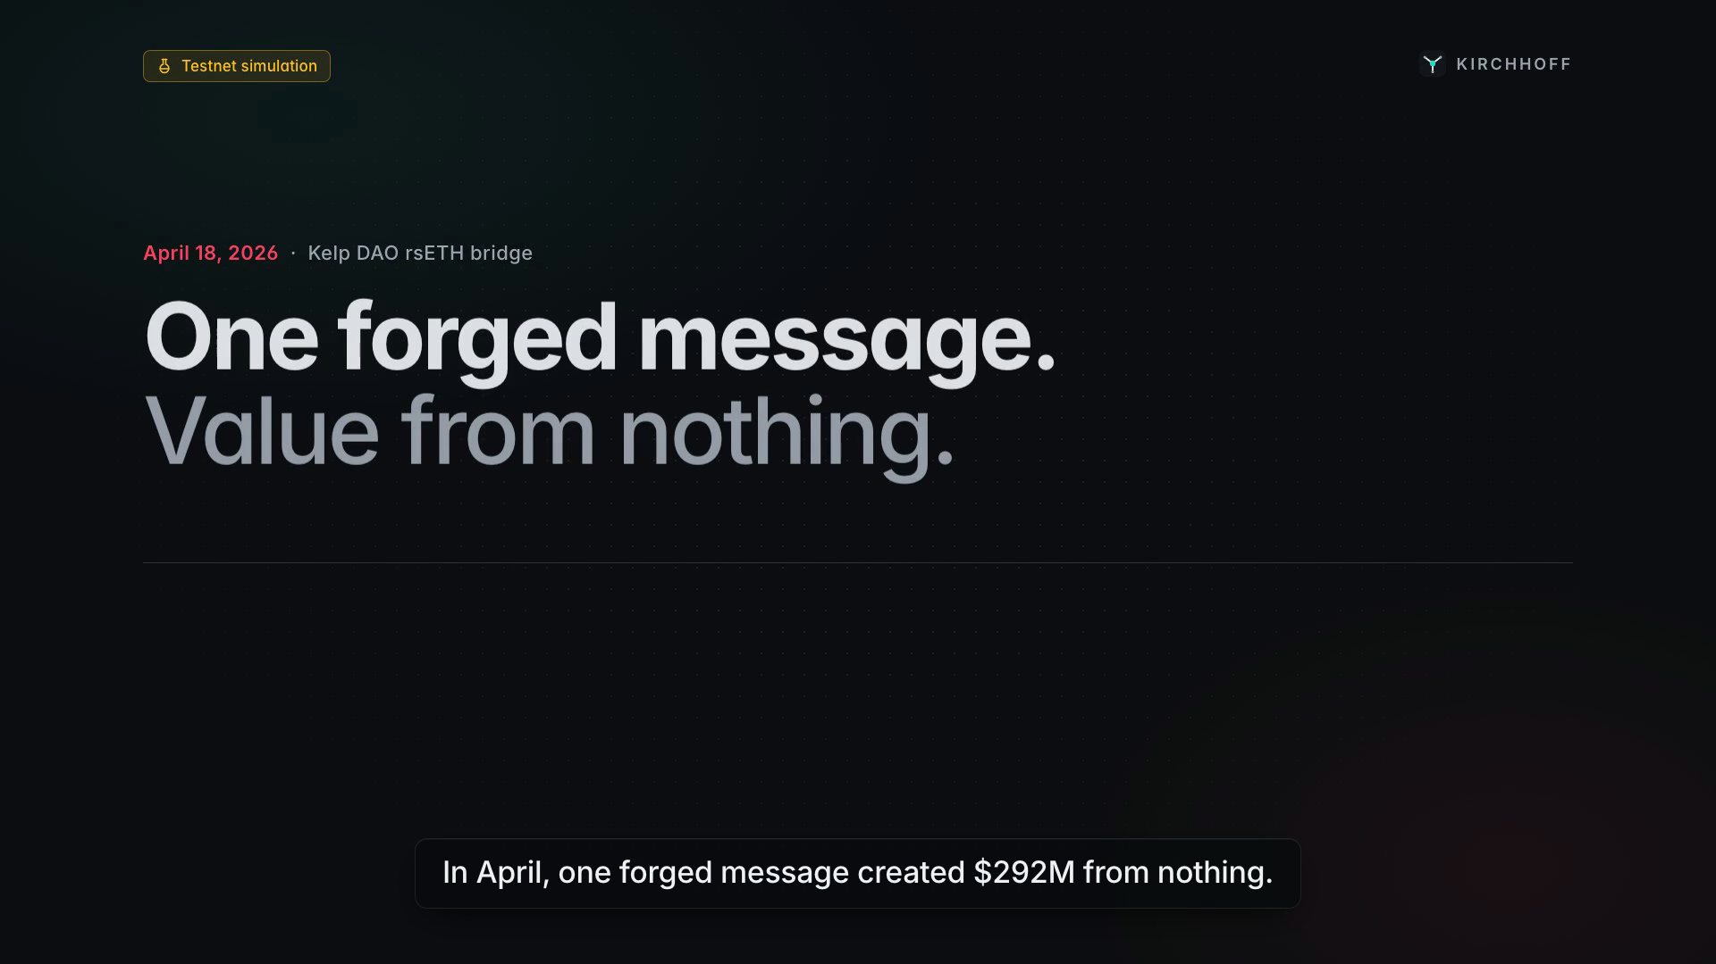
DEMO · THE KELP REPLAY, REFUSED
TESTNET SIMULATION
Notes:
Play the recording. 0:15 kETH on three chains, a normal CCIP transfer passes. 0:35 the Kelp attack on a bridge with a single verifier. 1:05 in the same CRE run, KIRCHHOFF finds a credit with no debit and writes BREACH on all three chains. 1:25 the attacker tries to spread it through CCIP and is refused. 1:50 he cannot move it, and nobody will lend against it. 2:05 on-call gets the whole story in one screen. Everything shown is a testnet simulation.

Slide 5
Consensus reads in, signed verdicts out
HOW IT WORKS
CHAINLINK CRE
ONCHAIN · EVERY CHAIN
CHAINLINK CCIP 2.0
Conservation Engine
Ledger, Feed, Quarantine
Enforcement
W1
Junction Watch
reads
Ethereum Sepolia
CCV cell + Judge
credit to debit, same run
home · escrow, Registry
POST /v1/evaluate
W2
Loop Ledger
status
Fallback B: TokenPool
Δ on all chains, 30 s cron
Arbitrum Sepolia
KirchhoffTokenPool, live
W3
Responder
reports
remote · burn-mint pool
Committee Verifier
quarantine on breach
Chainlink, signs as well
Base Sepolia
W4
Topology Watch
remote · burn-mint pool
Both must sign to execute
unlisted minters, spec
events
CONTROL PLANE · OUTSIDE THE VETO PATH
Indexer
API
Mission Control
MCP
AI: Copilot, Narrator
It can go dark. Every verdict still works.
Notes:
Four layers. The CRE Conservation Engine reads every chain with DON consensus and writes signed reports to a ConservationLedger and Conservation Feed on every chain. CCIP 2.0 enforces: each CCV cell runs our Judge as its policy hook, and our KirchhoffTokenPool, Fallback B, reverts transfers of a broken token at execution time. The Chainlink Committee Verifier still signs every message. The control plane, the UI, API and AI, only mirrors onchain state and can go offline without changing a single verdict.

Slide 6
CCIP 2.0 opened the slot. CRE makes it trustless
WHY CHAINLINK
COMMITTEE VERIFIER
CCIP 2.0 · LIVE SINCE SEPT 28, 2026
Who signed?
An issuer can require its own CCV. Verifiers set their own fee in an open marketplace.
CCIP
EXECUTOR
CRE · DON CONSENSUS
Message
Executes
W1 to W4 read three chains at pinned finalized blocks and write signed reports onchain.
KIRCHHOFF CCV
BESIDE, NEVER INSTEAD
Does it add up?
We never replace the Committee Verifier. Our FAIL withholds a signature; it never forges one.
6 / 6
12 / 15
9.31 ms
764 / 764
PRD scenarios, CRE simulate
CRE reads per W2 run
Judge p99 at 100 rps, two RPCs
engine branches covered
STATUS TODAY
Live CCV attestation onboarding is pending, so Fallback B (KirchhoffTokenPool) enforces live on CCIP testnet lanes. CRE deploy access is pending, so W1 to W4 run via cre workflow simulate.
Notes:
CCIP 2.0 launched on September 28 and lets an issuer require its own Cross-Chain Verifier: both the Committee Verifier and ours must sign before a message executes. CRE gives us DON consensus reads across chains, so no single RPC or operator can produce a verdict. We sit beside the Committee Verifier and never replace it. Honest status: live CCV attestation onboarding is pending, so our KirchhoffTokenPool enforces live on CCIP testnet lanes, and CRE deploy access is pending, so the four workflows run through cre workflow simulate.

Slide 7
Paid per message, per token, per market
BUSINESS
01
02
03
PER MESSAGE
PER TOKEN
PER MARKET
CCV verification fee
Issuer subscription
Conservation Feed
Our fee on top of the CCIP base fee, collected by CCIP on every protected transfer.
Monitoring, Incident Room, Spec Copilot onboarding, backtests and on-call paging.
AggregatorV3-compatible. Free public feed, paid SLA tier for lending markets.
FIRST CUSTOMERS
WEDGE
Liquid restaking (LRT)
Liquid staking (LST)
Wrapped BTC
Free shadow mode and a public status page. Holders ask why their token is not on it.
Tokens that cross many chains and bridges. Kelp said in May it was moving rsETH to CCIP.
Pricing is a hypothesis to validate with design partners.
Sources: Chainlink, Introducing CCIP 2.0 (verifier fees) · Unchained (Kelp moving rsETH to CCIP)
Notes:
Three revenue lines. A CCV verification fee per protected message, which CCIP 2.0 lets third-party verifiers set on top of the base fee. An issuer subscription for monitoring, the Incident Room, Spec Copilot onboarding and backtests. And the Conservation Feed: free and public, with a paid SLA tier for lending markets. First customers are multi-chain LRT, LST and wrapped BTC issuers. The wedge is free shadow mode with a public status page. Pricing is a hypothesis we will validate with design partners.

Slide 8
What we do not catch, and what ships next
LIMITS AND ROADMAP
WE DO NOT PROTECT AGAINST
ROADMAP
Theft that keeps supply conserved, like a drained admin vault
NEXT 90 DAYS
DEX price manipulation, phishing, lending bugs
Harden
Shadow
Enforce
Feed
Institutional
WEEKS 1 TO 4
MONTHS 2 TO 3
MONTHS 4 TO 6
MONTHS 6 TO 9
MONTHS 9 TO 12
Same-block swaps after a forged release, without KirchhoffGuard
Audit booked, 2 design partners
60 days, zero false BROKEN
4-cell committee, first enforced token
3 money markets read it
First institutional issuer
TEAM
THE ASK
Built in 36 hours at TOKEN2049
Chainlink CCV marketplace onboarding, CRE deploy access
350 of 466 PRD requirements done
150 Foundry + 463 TypeScript tests pass
Issuers 2 design partners: LRT, LST, wrapped BTC
Lending markets read the feed, freeze on BROKEN
Notes:
We name our limits. KIRCHHOFF does not catch theft that keeps supply conserved, like a drained admin vault, nor price manipulation, phishing or lending bugs, and it cannot undo the first release on a bridge it does not sit on; it contains it within one CRE run. Next 90 days: harden, book an audit, sign two issuer design partners, then run shadow mode on mainnet until we show 60 days with zero false BROKEN. Then enforcement with a 4-cell committee, the feed in money markets, and institutional issuers. Our ask: CCV marketplace onboarding and CRE deploy access from Chainlink, two issuer design partners, and lending markets that read the feed.

