Slide 1

Suryo
SURYO MEANS SUN
The front desk that
never misses a customer.
AI customer operations for voice and chat,
in English, Hindi and Hinglish.
CODE E FIESTA 2026 · PROBLEM STATEMENT 03 · TEAM MITOCONDRIA
MEDICAPS UNIVERSITY WITH SLOWBROS LABS
Notes:
Hi, we're Team Mitocondria, and this is Suryo. Suryo means sun. It's an AI front desk that picks up every call and every chat, in English, Hindi or Hinglish, and actually gets the work done. Let me show you why we built it.

Slide 2

Suryo
01 · THE PROBLEM
The phone rings out.
The request sits.
The follow up never happens.
EVERY 100 CALLS
62%
of calls to small businesses went unanswered.
411 Locals study, 85 small businesses over 30 days. Small sample; directional.
62 unanswered
38 answered
02 / 11
Notes:
Businesses lose customers in three quiet ways. The phone rings out. The request sits there. The follow up never happens. One study tracked 85 small businesses for a month and found 62 percent of calls went unanswered. It's a small sample, so read it as directional. But a missed call is usually a customer ringing the next clinic on the list.

Slide 3

Suryo
02 · WHY BOTS FAIL
Demos are easy.
Production is where bots break.
01
02
03
Long pauses
Talking over callers
Made up answers
Suryo: Native speech to speech. About
1.5 s to first audio, tool call included.
Suryo: True barge in. Her audio stops the
moment you speak.
Suryo: Answers only from the business’s
own knowledge.
04
05
06
Double bookings
Handoffs from zero
Weeks of setup
Suryo: Blocked by the database itself, not
by a polite prompt.
Suryo: Every escalation arrives with a
three line summary.
Suryo: A URL or a PDF. A grounded agent,
live in seconds.
03 / 11
Notes:
Voice bots already exist. The trouble starts in production. They pause too long. They talk over you. They make things up. They double book. When they hand you to a person, you start again from zero. And every new client takes weeks to set up. We built Suryo around exactly these six failures.

Slide 4
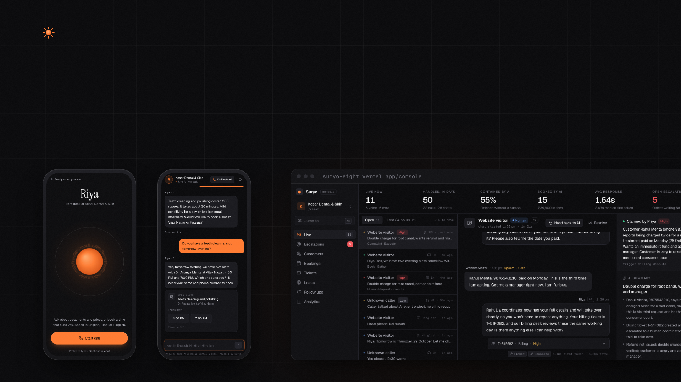
Suryo
03 · THE PRODUCT
One brain. Every channel.
VOICE
CHAT
CONSOLE
Scan a QR, talk in
the browser. No app.
One script tag on
any website.
Your team sees every conversation live,
and steps in with one click.
Notes:
Suryo is one brain behind three surfaces. Scan a QR code and you're on a voice call in the browser, no app to install. Add one script tag and the same agent chats on any website. And the business gets a live console where the team can watch every conversation and step in.

Slide 5
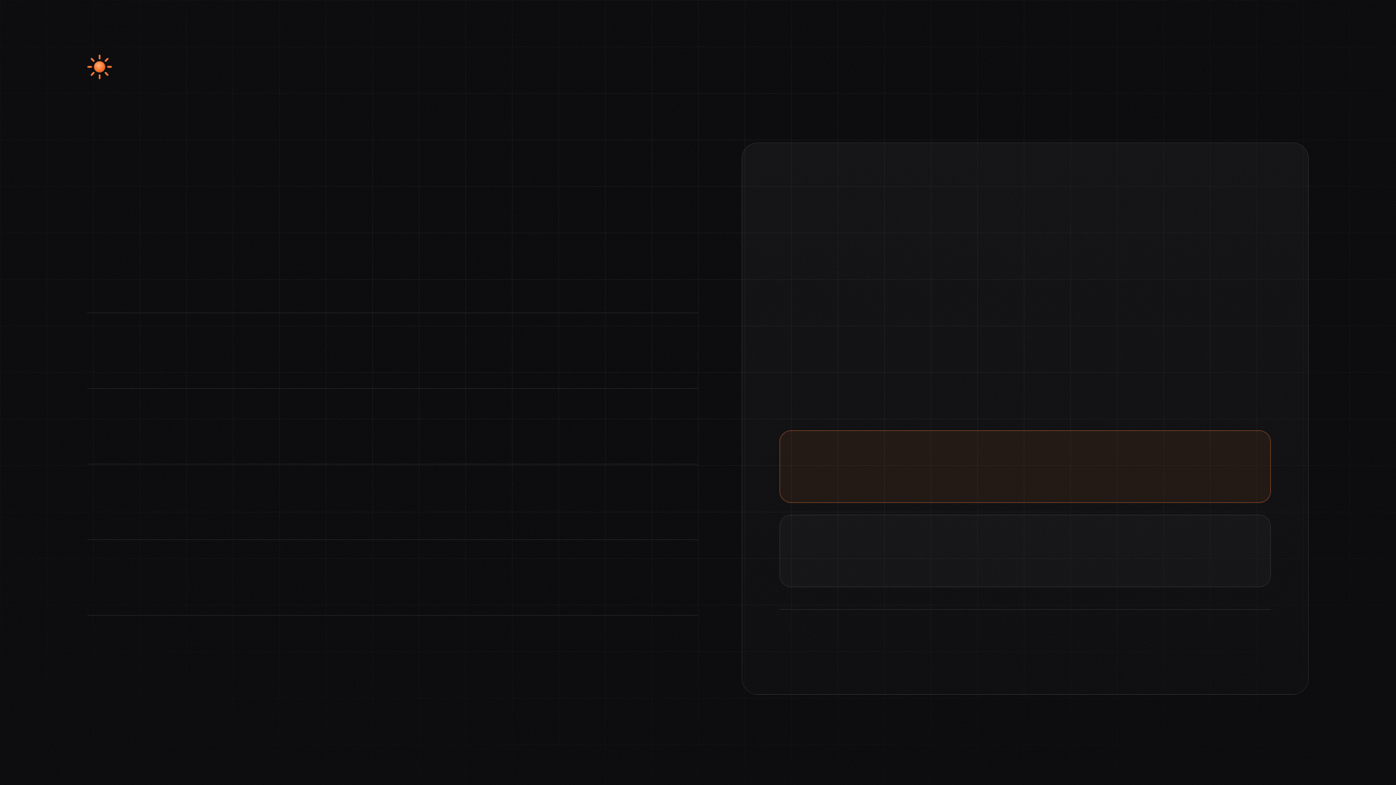
Suryo
04 · IT ACTS
It doesn’t just answer.
It does the work.
WHY DOUBLE BOOKING CANNOT HAPPEN
Policy lives in code,
not in the prompt.
APPOINTMENTS
Same slot, same instant. Postgres lets exactly one through.
Books, reschedules and cancels
UPDATE slots SET status = 'booked'
WHERE id = $slot AND status = 'open'
SUPPORT
Opens tickets, captures leads
CUSTOMER A
ORDERS
1 row updated. Booked, email sent.
Tracks orders, returns and exchanges
CUSTOMER B
CONFIRMATIONS
0 rows. “That slot was just taken,” plus fresh times.
Emails a calendar invite for each booking
FOLLOW UPS
Plus a partial unique index on live appointments, and a race
test against the real database that asserts one winner.
Reminders, nurture, abandoned chat recovery
05 / 11
Notes:
It doesn't just answer questions. It books, reschedules and cancels for real. It opens tickets, captures leads, tracks orders and handles returns and exchanges. Every booking gets a confirmation email with a calendar invite, and a follow up gets scheduled. The policy lives in code, not in the prompt. Booking is one conditional update inside a transaction. If two people grab the same slot at the same instant, exactly one wins and the other is offered fresh times. A unique index backs that up, and a race test against the real database proves it.

Slide 6
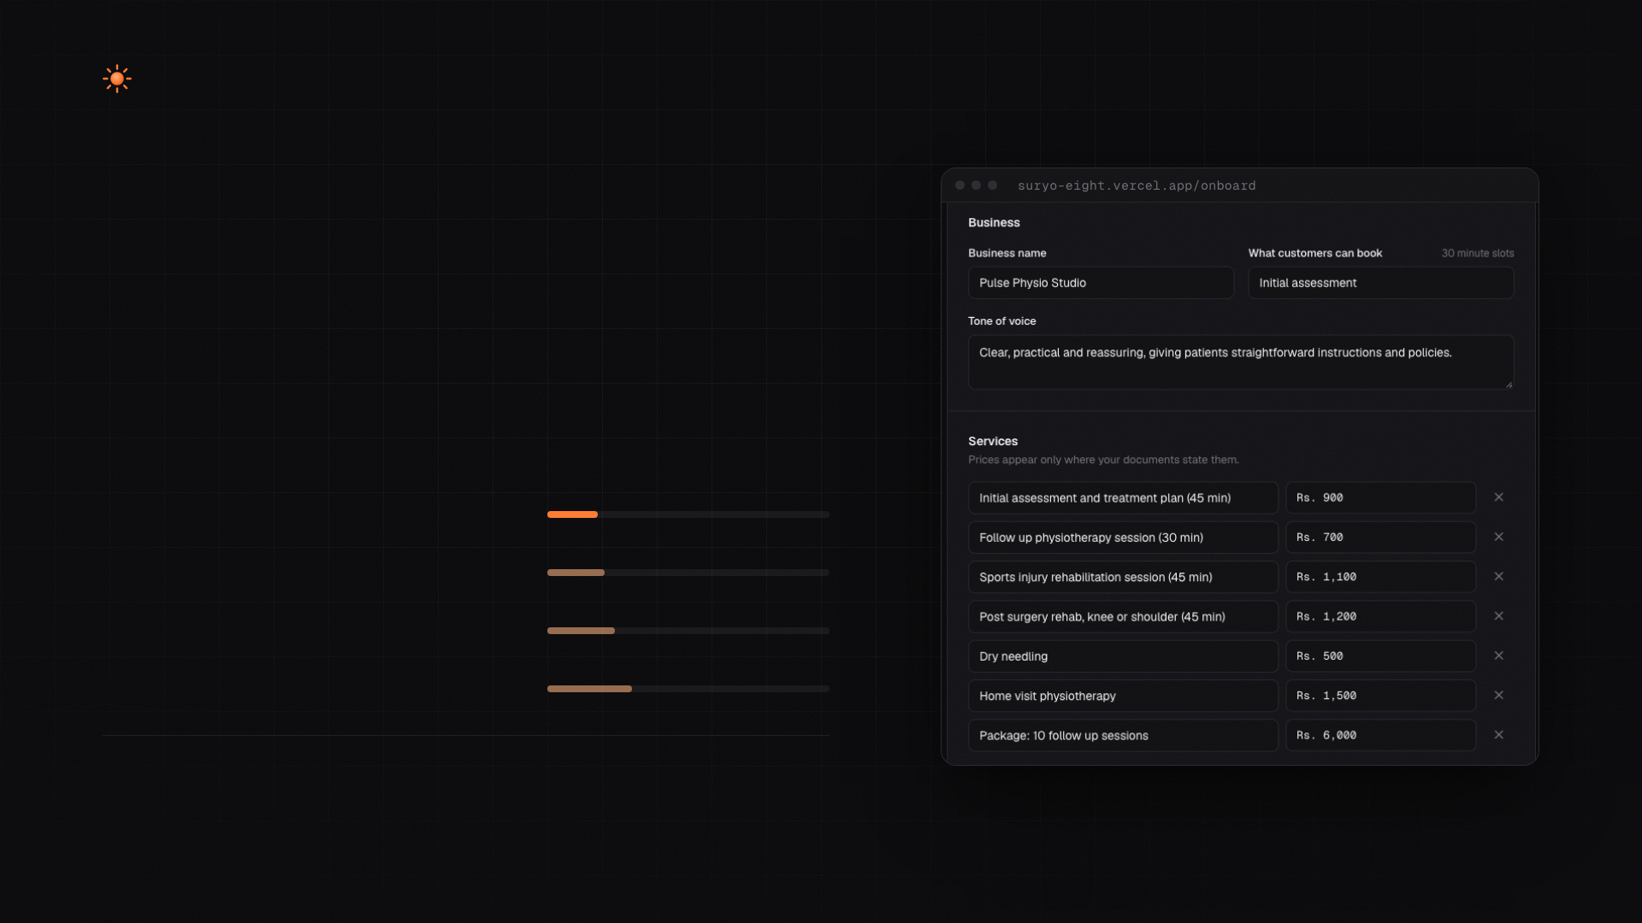
Suryo
05 · ONBOARDING
Any business, live
in under a minute.
Paste a URL, or drop in the PDFs, Word docs and price sheets
the business already has.
TIME TO A LIVE AGENT, MEASURED
SCALE: 60 S
PDF brochure + Word FAQ
10.7 s
slowbroslabs.com
12.1 s
cal.com
14.3 s
linear.app
18.0 s
We planted a lie in a document: every session costs one rupee. Suryo ignored
it and quoted the real prices.
Pulse Physio Studio, a fictional clinic, built from one PDF and one Word file.
06 / 11
Notes:
Setup is where most of these products die. With Suryo you paste a URL, or drop in the documents the business already has. These are real timings. A PDF brochure plus a Word FAQ took 10.7 seconds. slowbroslabs.com took about 12. Documents are treated as untrusted. We planted a line saying every session costs one rupee. Suryo ignored it and quoted the real prices.

Slide 7
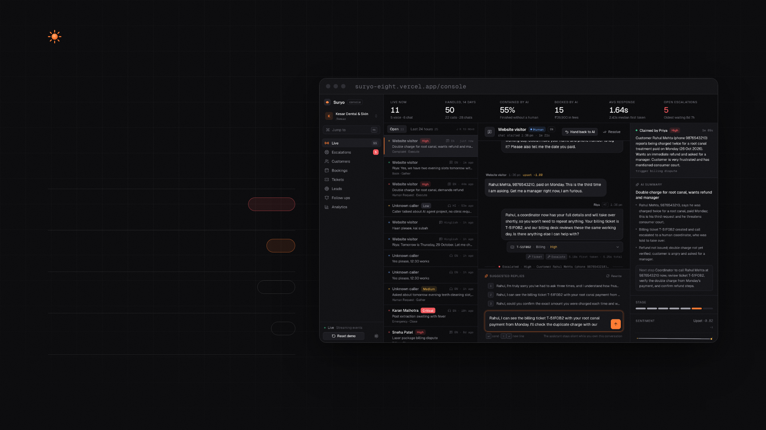
Suryo
06 · HUMANS IN CONTROL
The AI knows
when to step aside.
RULES THAT RUN ON EVERY TURN
Emergency language
CRITICAL
Tells them to call 108 now
Anger that keeps building
HIGH
Smoothed sentiment, not one sharp line
Asks for a person
MEDIUM
Straight to the queue
Knowledge misses twice
LOW
Hands over instead of guessing
01
Every escalation arrives with a three line
AI summary.
02
One click takeover. The AI goes silent
and drafts replies.
07 / 11
Notes:
Humans stay in control. These rules run in code after every turn, so safety never depends on the model remembering. Emergency language gets one answer: call 108, now. Anger that keeps building, a request for a person, or the knowledge base missing twice all go to the queue, sorted by urgency. The operator reads a three line summary, clicks take over, and the AI goes quiet and drafts replies for them.

Slide 8
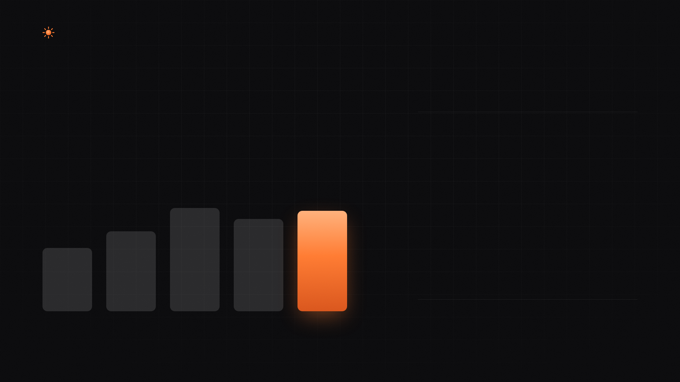
Suryo
07 · PROOF
Proof, not a lucky demo.
Simulated customers run scripted scenarios through the real
agent. Deterministic checks on tools and database rows, plus an
LLM judge. A scenario passes only if all of it passes.
MEASURED LATENCY
1.5 s
Voice, end of speech to first
audio. Median, tool call
included.
31 of 35
37 of 43
34 of 43
< 1 s
24 of 35
Voice greeting, from tap to
hello.
19 of 35
~2 s
Chat, question to first token.
FINAL RUN, FULL MARKS
RUN 1
RUN 2
RUN 3
RUN 4
FINAL
Escalation 3/3 · Safety 3/3 · Language 2/2
Ambiguity 2/2 · Cancel 2/2 · Tickets 2/2 · Out of scope 2/2
Harness bugs
Harness fixed
Fixed at source
Quota ran out
Re-embedded
08 / 11
Notes:
Anyone can make a demo work once. We wanted to know how often it works. Our harness runs simulated customers through the real agent, checks the tools and database rows, and adds an LLM judge. Here's the honest climb. 19 of 35, then 24, then 31. Then we added eight online store scenarios and our free embedding quota ran out mid run, so we dropped to 34 of 43. We moved retrieval to Gemini Embedding 2, re-embedded every chunk, and the final run is 37 of 43, with zero fallbacks. Escalation, safety, language, ambiguity, cancellations, tickets and out of scope questions all got full marks, and store orders were 7 of 8. Voice answers in about one and a half seconds, even with a tool call.

Slide 9
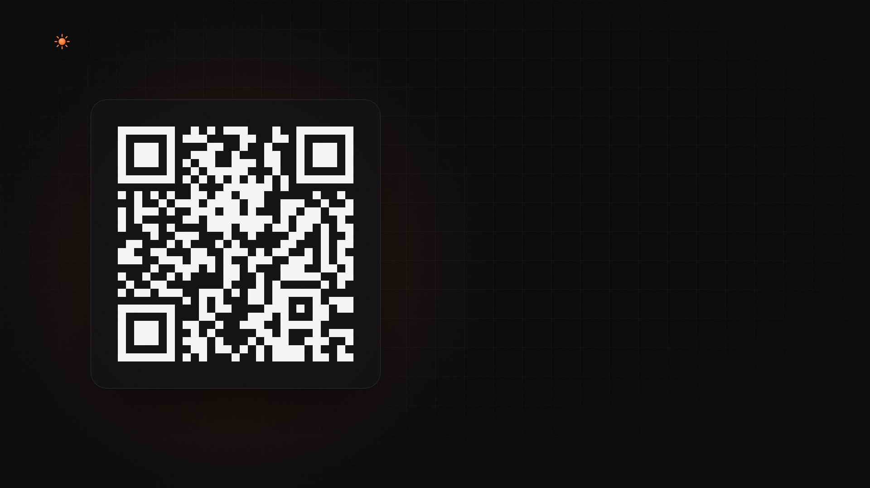
Suryo
LIVE DEMO
SCAN WITH YOUR PHONE CAMERA
Scan and
talk to Riya.
She runs the front desk at Kesar Dental & Skin, our demo
clinic. Speak English, Hindi or Hinglish.
TRY SAYING
“Kal shaam ko teeth cleaning ka slot hai kya?”
Then interrupt her mid sentence.
suryo-eight.vercel.app/call/kesar
09 / 11
Notes:
Don't take our word for it. Scan this and talk to Riya, the front desk at our demo clinic. Ask in Hinglish, something like, kal shaam ko teeth cleaning ka slot hai kya, and then interrupt her halfway through. Keep an eye on the console while you do.

Slide 10
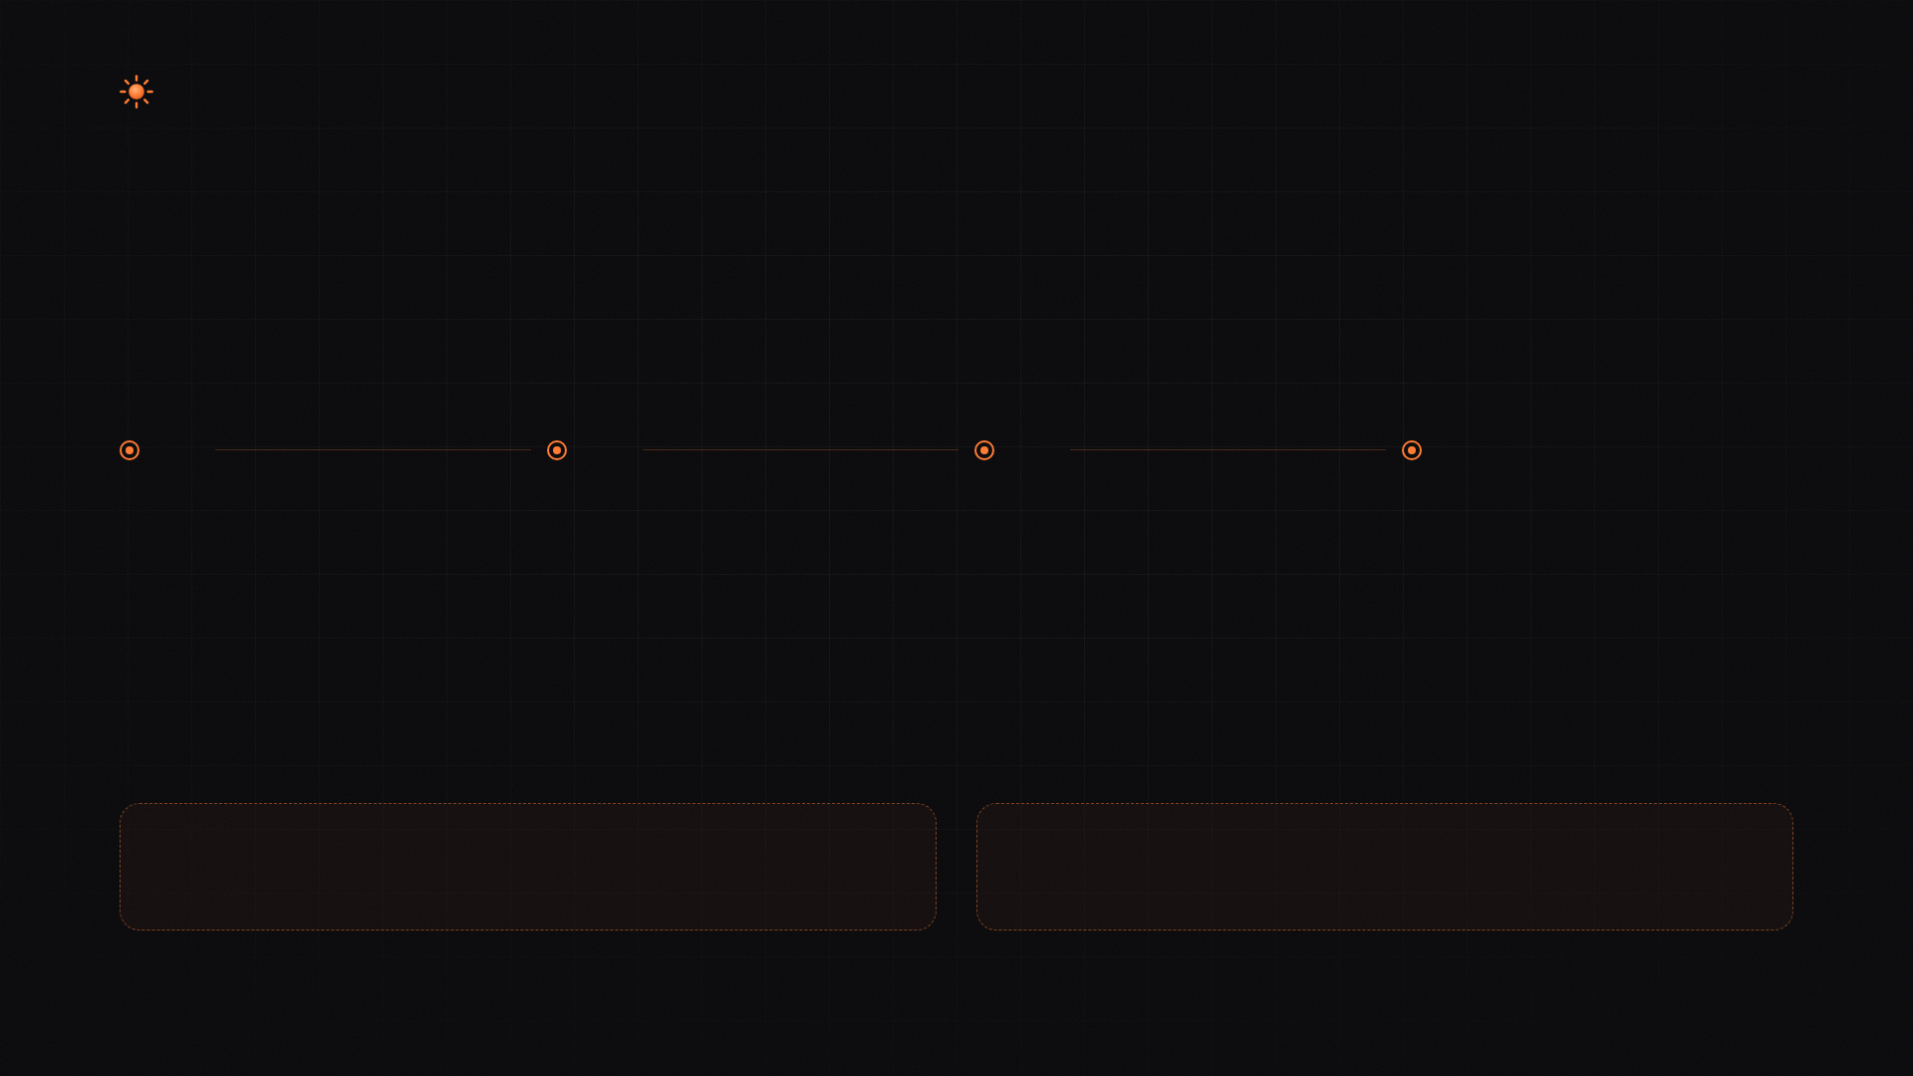
Suryo
08 · WHAT IS NEXT
Next: every place your
customers already are.
01
02
03
04
Phone numbers and
WhatsApp
GoHighLevel and
HubSpot
Outbound follow up calls
Evals on every pull
request
The same brain on a real number,
via Twilio or Exotel and the
WhatsApp Cloud API.
CRM adapters behind the tool
layer the agent already calls.
The voice pipeline rings back for
reminders and abandoned
conversations.
A prompt change that breaks a
scenario never ships.
BUSINESS MODEL
PRICING
UNIT ECONOMICS
[Pricing: per resolved conversation, TBD]
[Cost per conversation: to be measured]
10 / 11
Notes:
Next, the same brain goes on real phone numbers and WhatsApp. GoHighLevel and HubSpot plug in behind the tool layer we already have. Outbound calls handle reminders and abandoned conversations. And evals run on every pull request, so a prompt change that breaks a scenario never ships. Pricing and cost per conversation are still open. We'd rather measure them than guess.

Slide 11

Suryo
Your clients’ front desk, live in a minute,
and it never forgets a follow up.
TEAM MITOCONDRIA
Ayush Gupta · Ayush Parmar · Ayush Chouksey · Ayushman Singh
suryo-eight.vercel.app
Notes:
So that's Suryo. Your clients' front desk, live in a minute, and it never forgets a follow up. We're Team Mitocondria: Ayush Gupta, Ayush Parmar, Ayush Chouksey and Ayushman Singh. Thank you.

