Slide 1


College LAN Network
Course: 19ECE311 – Computer Networks Semester: S6 – BTech ECE

Slide 2

Team Members
Abhishek Aher – AM.EN.U4ECE22012 Adwaith Narayan – AM.EN.U4ECE22013
Karthik Nair – AM.EN.U4ECE22021
Naveen – AM.EN.U4ECE22030
Indiresh Sunkara - AM.EN.U4ECE22044

Slide 3

OBJECTIVE
This project simulates a college campus network designed for Amrita Vishwa Vidyapeetham, Amritapuri, using Cisco Packet Tracer. It features a secure, segmented LAN/WLAN infrastructure for various departments, supporting key academic operations such as:
Internet access
File sharing
Web hosting
Inter department communication
Scalable and maintainable design

Slide 4

All traffic shared the same broadcast domain, increasing vulnerability.
Existing Infrastructure:
----------------------------------------------------------------------------------
Basic, Flat Network Design All departments and hosts were part of a single unsegmented network.
Static IP Assignments No DHCP support; IPs were manually configured, leading to potential conflicts.
Outdated Network Devices Legacy switches lacked support for monitoring, VLANs, or remote management.
No Network Segmentation or Security All traffic shared the same broadcast domain, increasing vulnerability.
Poor Resource Allocation Multiple server rooms increased power and maintenance costs.
Lack of Remote Access and Firewall Protection No remote troubleshooting, monitoring, or security enforcement mechanisms.

Slide 5
Proposed Network Design -----------------------------------------------------------------------------------------------
IP-Based Switching Infrastructure High-performance switches with SNMP support for better traffic monitoring and control.
VLAN Segmentation Departments are isolated into VLANs for security, traffic control, and scalability.
Routing with RIP Protocol Dynamic routing across routers using RIP ensures adaptive path selection and reduced manual configuration.
Unified Network Backbone Combines LAN and WLAN infrastructure across departments and server rooms.
Support for Key Services Web hosting, FTP services, DNS, DHCP, and remote access integrated into the network.
High-Speed & Scalable Backbone supports up to 10 Gbps data rate with Cisco Catalyst 6509/4500 switches and Aironet access points.

Slide 6
Network Devices Used -----------------------------------------------------------------------------------------------
Cisco Catalyst 6509 & 4500 Switches Backbone switches with 10 Gbps ports and Virtual Switching System (VSS) for high-speed data transfer.
Cisco Aironet 1140 Series Access Points Scalable wireless connectivity across campus; supports full Layer 3 mobility.
Cisco UCS (Unified Computing System) Integrates compute, storage, and network — optimized for virtualization and energy efficiency.
Cisco Firewall & Security Tools Provides intrusion prevention, access control, and VPN setup for secure data flow.
Mobility Services Engine (MSE) Enables centralized control of wireless services and supports mobility-aware applications.

Slide 7

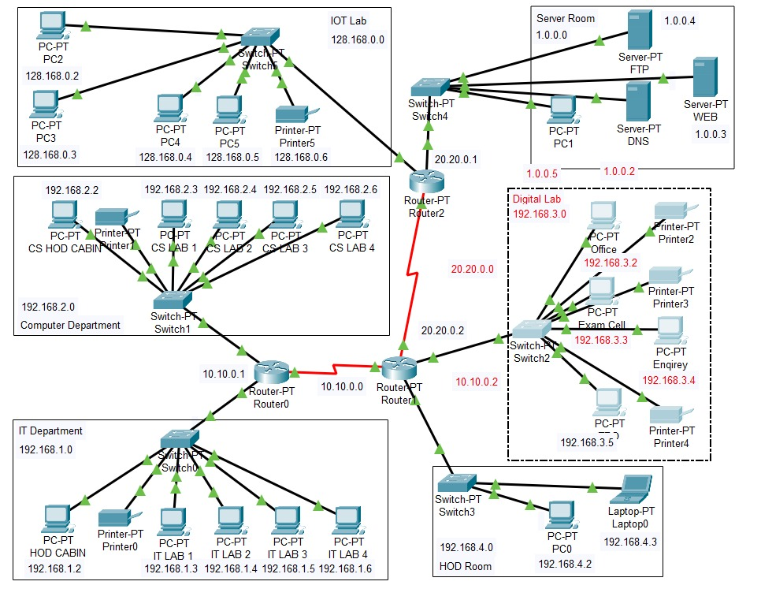
IP Addressing Plan -------------------------------------------------------------------------------------------------
Each department is assigned a separate subnet for better control, segmentation, and security.
All devices have static IPs based on their department.
Server Room, Internet Lab, and Admin areas have their own IP ranges.
Subnets:
IT Dept → 192.168.1.0/24
CS Dept → 192.168.2.0/24
Office/Admin → 192.168.3.0/24
Principal/HOD → 192.168.4.0/24
Server Room → 1.0.0.0/24
IOT Lab → 128.168.0.0/24
Inter-router comms → 10.x.x.x and 20.x.x.x

Slide 8
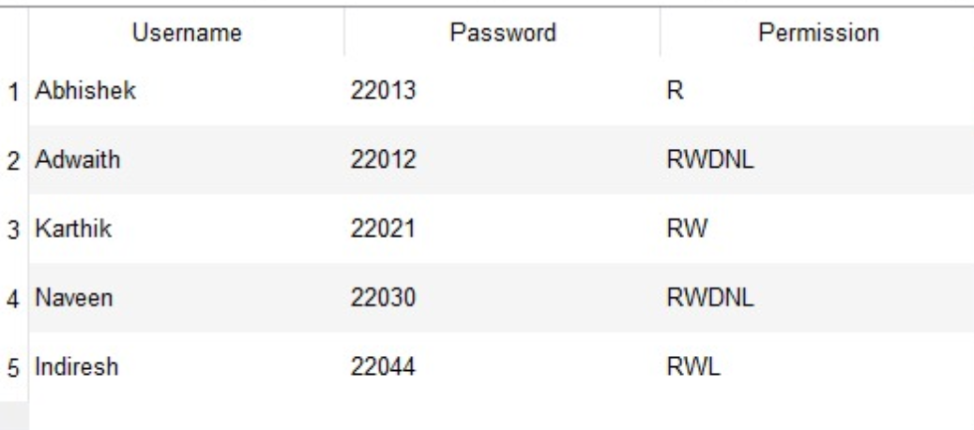
FTP Server Configuration -----------------------------------------------------------------------------------------------
Server IP: 100.50.20.3 (Static IP) Configured User Accounts & Permissions:

Slide 9

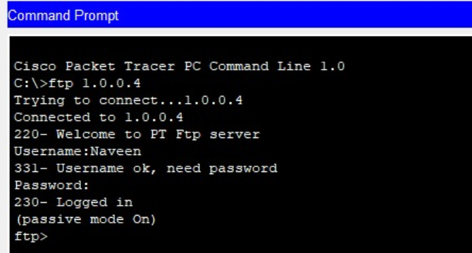
FTP Command Demonstration -----------------------------------------------------------------------------------------------------
FTP client on a PC connected to FTP Server at 1.0.0.4
Username: Naveen, login successful
Passive mode enabled for data transfer
Server response verified via welcome message and login status

Slide 10

Results --------------------------------------------------------------------------------------------------
Full network connectivity achieved All devices across different VLANs successfully communicated via RIP routing.
Services functioning correctly FTP, Web Hosting, and DNS services tested and confirmed operational.
Improved network performance Segmentation via VLANs reduced unnecessary broadcast traffic.
Enhanced security and manageability Layer 3 switches and IP-based design improved traffic control and monitoring.
Successful simulation The complete network was simulated and tested in Cisco Packet Tracer.

