Slide 1


College LAN Network
Course: 19ECE311 – Computer Networks Semester: S6 – BTech ECE

Slide 2

Team Members
Abhishek Aher – AM.EN.U4ECE22012 Adwaith Narayan – AM.EN.U4ECE22013
Karthik Nair – AM.EN.U4ECE22021
Naveen – AM.EN.U4ECE22030
Indiresh Sunkara - AM.EN.U4ECE22044

Slide 3

OBJECTIVE
This project simulates a college campus network designed for Amrita Vishwa Vidyapeetham, Amritapuri, using Cisco Packet Tracer. It features a secure, segmented LAN/WLAN infrastructure for various departments, supporting key academic operations such as:
Internet access
File sharing
Web hosting
Inter department communication
Scalable and maintainable design

Slide 4
Proposed Network Design -----------------------------------------------------------------------------------------------
IP-Based Switching Infrastructure High-performance switches with SNMP support for better traffic monitoring and control.
VLAN Segmentation Departments are isolated into VLANs for security, traffic control, and scalability.
Routing with RIP Protocol Dynamic routing across routers using RIP ensures adaptive path selection and reduced manual configuration.
Unified Network Backbone Combines LAN and WLAN infrastructure across departments and server rooms.
Support for Key Services Web hosting, FTP services, DNS, DHCP, and remote access integrated into the network.
High-Speed & Scalable Backbone supports up to 10 Gbps data rate with Cisco Catalyst 6509/4500 switches and Aironet access points.

Slide 5
Network Devices Used -----------------------------------------------------------------------------------------------
Cisco Catalyst 6509 & 4500 Switches Backbone switches with 10 Gbps ports and Virtual Switching System (VSS) for high-speed data transfer.
Cisco Aironet 1140 Series Access Points Scalable wireless connectivity across campus; supports full Layer 3 mobility.
Cisco UCS (Unified Computing System) Integrates compute, storage, and network — optimized for virtualization and energy efficiency.
Cisco Firewall & Security Tools Provides intrusion prevention, access control, and VPN setup for secure data flow.
Mobility Services Engine (MSE) Enables centralized control of wireless services and supports mobility-aware applications.

Slide 6

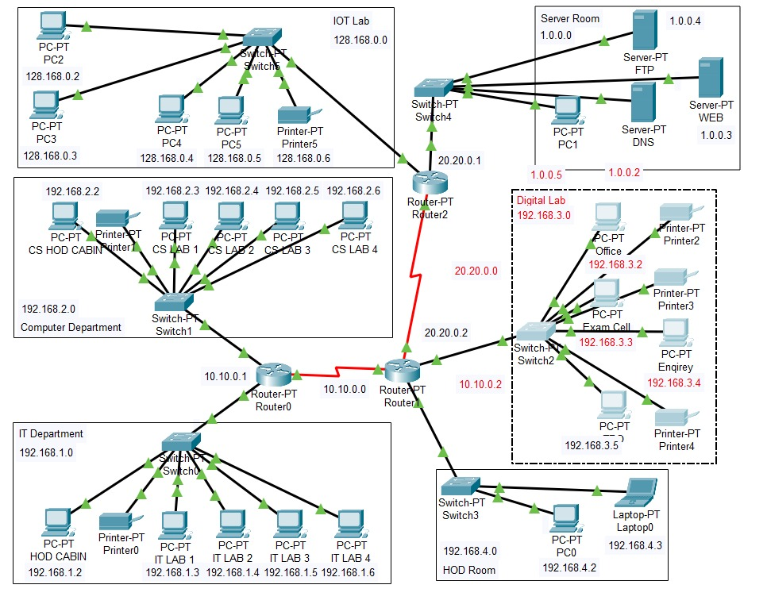
IP Addressing Plan -------------------------------------------------------------------------------------------------
Each department is assigned a separate subnet for better control, segmentation, and security.
All devices have static IPs based on their department.
Server Room, Internet Lab, and Admin areas have their own IP ranges.
Subnets:
IT Dept → 192.168.1.0/24
CS Dept → 192.168.2.0/24
Office/Admin → 192.168.3.0/24
Principal/HOD → 192.168.4.0/24
Server Room → 1.0.0.0/24
IOT Lab → 128.168.0.0/24
Inter-router comms → 10.x.x.x and 20.x.x.x

Slide 7
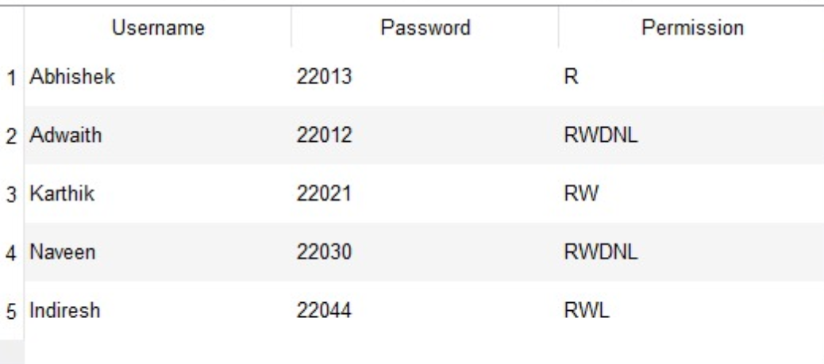
FTP Server Configuration -----------------------------------------------------------------------------------------------
Server IP: 100.50.20.3 (Static IP) Configured User Accounts & Permissions:

Slide 8

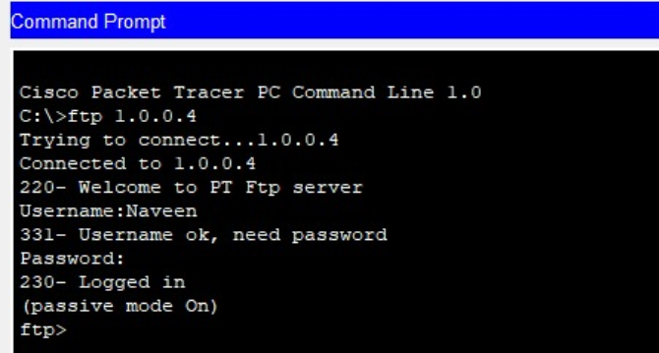
FTP Command Demonstration -----------------------------------------------------------------------------------------------------
FTP client on a PC connected to FTP Server at 1.0.0.4
Username: Naveen, login successful
Passive mode enabled for data transfer
Server response verified via welcome message and login status

Slide 9
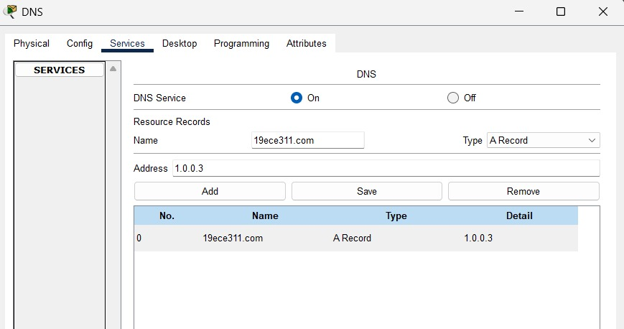
DNS Server Configuration -----------------------------------------------------------------------------------------------
IP: 1.0.0.3 Name:19ece311.com
DNS (Domain Name System) translates domain names into IP addresses for easy access.
In this setup, the domain 19ece311.com is mapped to IP address 1.0.0.3 using an A Record.
When a client enters 19ece311.com, the DNS resolves it to 1.0.0.3, directing the browser to the correct web server.
This setup allows users to access web pages using names instead of numeric IPs, simulating real-world networking.

Slide 10
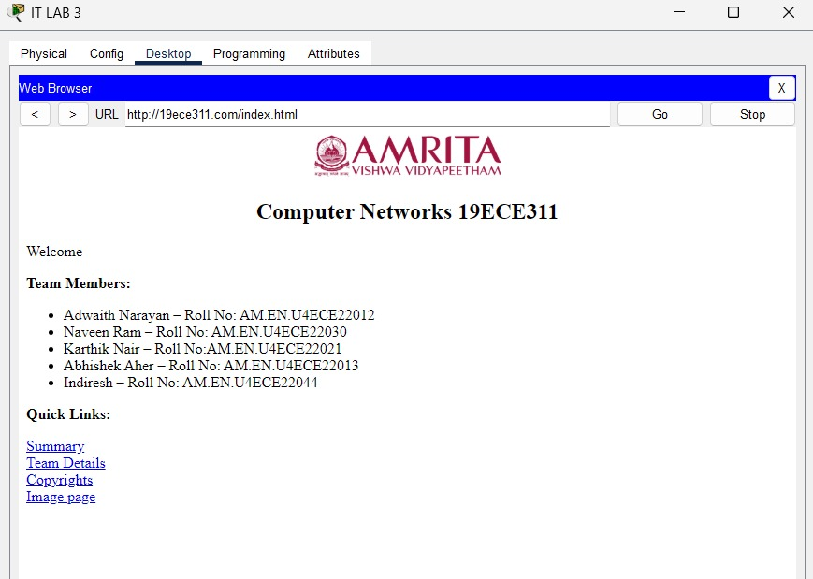
Web hosting Demonstration -----------------------------------------------------------------------------------------------------
Enable HTTP on Server: Turn on the HTTP service in the server under the Services tab.Upload Web Pages: Add or edit files like index.html and images using the Web Page or File Manager section.
Assign IP Address: Give the server a static IP (e.g., 1.0.0.4) for clients to access the hosted site.
Client Access: Open the browser in a PC and enter the server’s IP to view the website.
Testing Web Navigation: Simulates basic website hosting and browsing within a local network.

Slide 11

Future works --------------------------------------------------------------------------------------------------
Integration of QoS (Quality of Service):Prioritize network traffic like VoIP, video streaming, or online classes to ensure better performance during high load.
Network Security Enhancements:Add firewalls, VLAN-based access control, and intrusion detection systems (IDS) to simulate a more secure campus network.
IoT Device Integration:Simulate smart classrooms or labs using IoT devices for automation, and connect them securely within the network..
Cloud-Based Resource Simulation:Extend the project to include cloud storage access or cloud-hosted applications used by departments or students.

Slide 12
Results --------------------------------------------------------------------------------------------------
Full network connectivity achieved All devices across different VLANs successfully communicated via RIP routing.
Services functioning correctly FTP, Web Hosting, and DNS services tested and confirmed operational.
Improved network performance Segmentation via VLANs reduced unnecessary broadcast traffic.
Enhanced security and manageability Layer 3 switches and IP-based design improved traffic control and monitoring.
Successful simulation The complete network was simulated and tested in Cisco Packet Tracer.

