Slide 1
Hack4innovation
Submitted By
Group –A

Slide 2

Why 80% of India's engineers remain unemployable in the software sector?

Slide 3


Slide 4



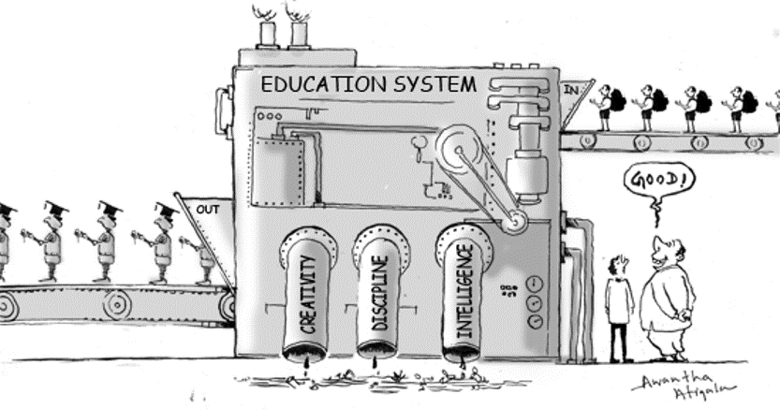

Slide 5


Theory vs practical
Outdated learning & exam culture

Slide 6


Slide 7


