Slide 1
Freight Forwarding Company (FFC)
Team # 3 Vishwa Srivastava Kartiki Bhargava Chethana Bohini Srinivas Adwaith Ajith Menon

Slide 2
Agenda
Business Background & Scope
Business Needs
Process & Information Flow (As-Is & To-Be)
Database Design
Queries

Slide 3
Business Background & Scope
Business Model
Key Stakeholders
Scope
Freight Forwarding Company
Facilitates shipments of various types of goods between different ports
Acts as a bridge between customers/exporters and shippers (shipping lines)
Makes money via referral commissions to shippers
Freight Forwarding Company (FFC)
Customer (Exporter)
Customer Sales Executive
Customer Operations Executive
Customer Support Executive
Customer Documentation Executive
Only sea route based shipping consignments are considered
Process starts when enquiry is made by exporter
Process ends when ETA at the port of delivery is updated and case status is updated to “success”

Slide 4
Business Needs
Business Needs
Important KPIs
Have visibility into status of client queries
Monitor profitability across shipping lines
Track shipping line’s available carrying capacity at any given point of time
Predict likelihood of query conversion
Gross Revenue Growth (Q-o-Q)
% Customer Query Conversion
Commission/shipping line
Key Success Criteria
For FFC to stay in business, it must ensure superior customer experience (CX) and competitive quotes from the shipping lines to the customer (exporters)

Slide 5
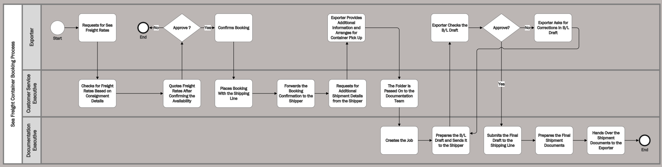
Process & Information Flow: As-is Swim Lane
Too many dependencies on customer service executive
Incomplete information from exporter leading to multiple follow-ups
Multiple responsibilities leading to bottlenecks in processing of customer cases

Slide 6
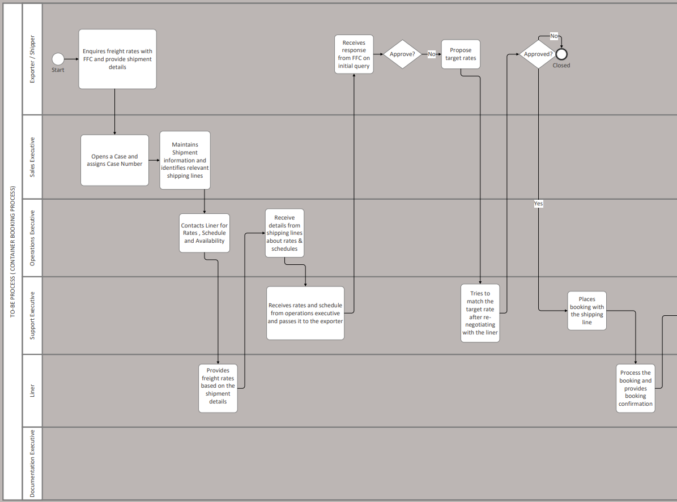
Process & Information Flow: To-Be Swim Lane 1/2
Improved Online Customer Portal ( reduced need for manual follow-ups)
Higher Customer Satisfaction & Net Promoter Score
Added distinct roles within FFC Customer Service Team

Slide 7
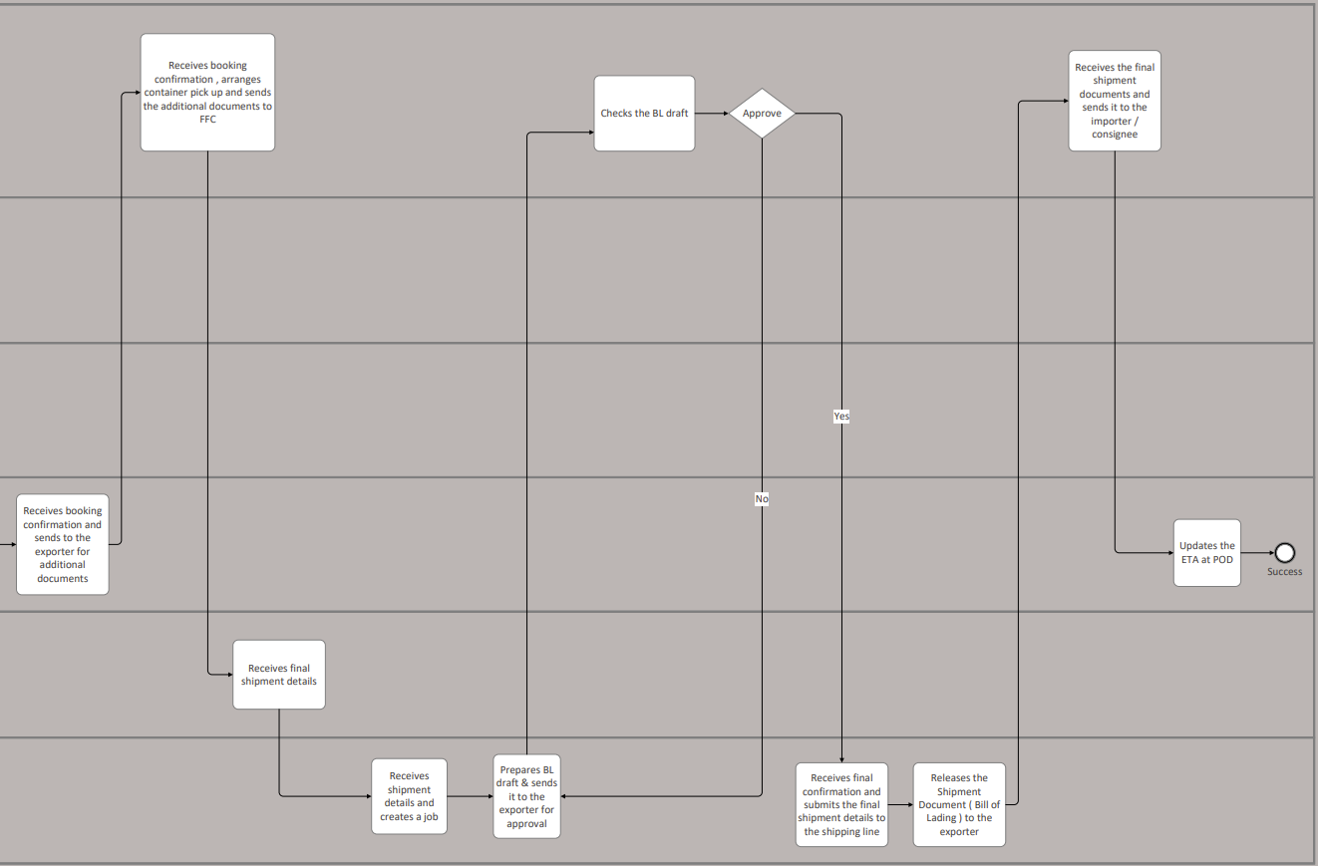
Process & Information Flow: To-Be Swim Lane 2/2

Slide 8
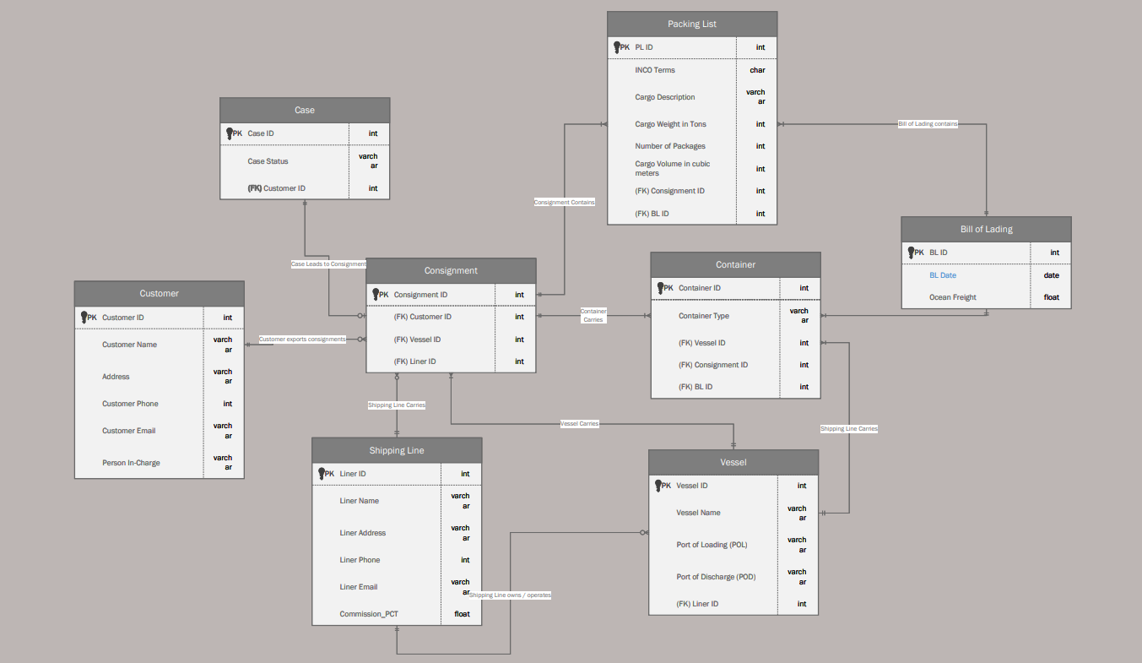
Database Design – Entity Relationships

Slide 9
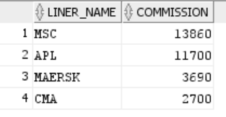
Queries – 1/5
Query 1
SELECT SHIPPING_LINE.LINER_NAME, SUM(DISTINCT SHIPPING_LINE.COMMISSION_PCT*BILL_OF_LADING.OCEAN_FREIGHT) AS COMMISSION
FROM SHIPPING_LINE INNER JOIN CONSIGNMENT ON SHIPPING_LINE.LINER_ID=CONSIGNMENT.LINER_ID INNER JOIN CONTAINER ON CONSIGNMENT.CONSIGNMENT_ID=CONTAINER.CONSIGNMENT_ID INNER JOIN BILL_OF_LADING ON BILL_OF_LADING.BL_ID=CONTAINER.BL_ID GROUP BY SHIPPING_LINE.LINER_NAME ORDER BY COMMISSION DESC;
Shipping lines have different referral commission %ages. FFC CEO would monitor how profitable each shipper is for their business. This serves them into developing relationships
Business Problem
Impacted Stakeholders
FFC owner
Customer Service Executives – referring shippers to the clients
Monitoring
Monthly - After revenue is booked on the last day of month
Output
The output shows commissions revenue generated from across each shippers. Monitoring the output on a monthly basis would help FFC gain clarity on its partner development strategy

Slide 10
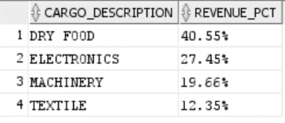
Queries – 2/5
SELECT PACKING_LIST.CARGO_DESCRIPTION, (TO_CHAR(ROUND(SUM(DISTINCT SHIPPING_LINE.COMMISSION_PCT*BILL_OF_LADING.OCEAN_FREIGHT)/31950*100,2))||'%') AS REVENUE_PCT FROM SHIPPING_LINE INNER JOIN CONSIGNMENT ON SHIPPING_LINE.LINER_ID=CONSIGNMENT.LINER_ID INNER JOIN CONTAINER ON CONSIGNMENT.CONSIGNMENT_ID=CONTAINER.CONSIGNMENT_ID INNER JOIN BILL_OF_LADING ON BILL_OF_LADING.BL_ID=CONTAINER.BL_ID INNER JOIN PACKING_LIST ON PACKING_LIST.BL_ID= BILL_OF_LADING.BL_ID GROUP BY PACKING_LIST.CARGO_DESCRIPTION ORDER BY REVENUE_PCT DESC;
Query 2
Business Problem
Various shipping categories impact profitability differently. FFC can use this information to better predict monthly sales.
Impacted Stakeholders
FFC Owner
Monitoring
Monthly - After revenue is booked on the last day of month
Output
As observed in the output, dry food shipping contributes to ~41% of overall revenue. Knowing that FFC gets major requests for this category, they can create custom shipping plans

Slide 11
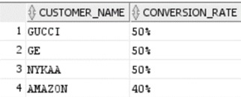
Queries – 3/5
Query 3
SELECT CUSTOMER.CUSTOMER_NAME,
TO_CHAR(ROUND(SUM(CASE WHEN CASES.CASE_STATUS='SUCCESS' THEN 1 ELSE 0 END)/COUNT(CASES.CASE_ID)*100,2))||'%'
AS CONVERSION_RATE FROM CASES INNER JOIN CUSTOMER ON CASES.CUSTOMER_ID=CUSTOMER.CUSTOMER_ID GROUP BY CUSTOMER.CUSTOMER_NAME ORDER BY CONVERSION_RATE DESC;
Business Problem
To analyze the likelihood of a customer conversion would help FFC allocate business resources better. Historical conversion rates provides insight to this data.
Impacted Stakeholders
Customer Sales Executive
Monthly
Monitoring
Monthly - After the new cases have been logged for the next month
Output
The report lists down conversion rate per customer. For instance, output indicates 50% of the times GUCCI cases being converted. FFC can further segment these customers to industry to target related customers

Slide 12
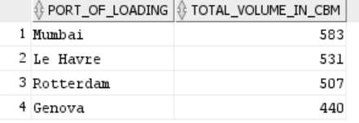
Queries – 4/5
Query 4
SELECT VESSEL.PORT_OF_LOADING,SUM(PACKING_LIST.CARGO_VOLUME) AS TOTAL_VOLUME_IN_CBM
FROM PACKING_LIST
INNER JOIN CONSIGNMENT
ON
CONSIGNMENT.CONSIGNMENT_ID=PACKING_LIST.CONSIGNMENT_ID
INNER JOIN VESSEL
ON VESSEL.VESSEL_ID=CONSIGNMENT.VESSEL_ID
GROUP BY VESSEL.PORT_OF_LOADING
ORDER BY TOTAL_VOLUME_IN_CBM DESC;
Business Problem
Capacity and Connectivity of ports play an important role in referring customers to the shipping line
Impacted Stakeholders
Customer Operations Executive
Monitoring
Monthly
Output
The query returns the volume of cargo shipped from each port of loading; The volume offered by each port can be matched to customer requirement by the customer operations executive.

Slide 13
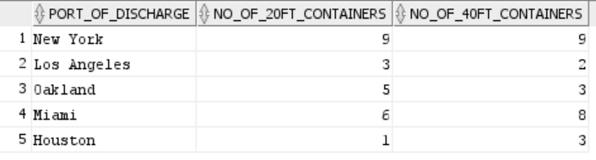
Queries – 5/5
Query 5
SELECT VESSEL.PORT_OF_DISCHARGE,
SUM(CASE WHEN CONTAINER.CONTAINER_TYPE='20FT' THEN 1 ELSE 0 END) NO_OF_20FT_CONTAINERS ,
SUM(CASE WHEN CONTAINER.CONTAINER_TYPE='40FT' THEN 1 ELSE 0 END) NO_OF_40FT_CONTAINERS
FROM VESSEL
INNER JOIN CONTAINER ON CONTAINER.VESSEL_ID = VESSEL.VESSEL_ID
GROUP BY VESSEL.PORT_OF_DISCHARGE;
Business Problem
Competitive shipping rates impact customer retention. FFC can provide competitive rates, when they can match shipping capacity with customer needs better.
Impacted Stakeholders
Customer Operations Executive (COE)
Weekly - After every weekly feeder vessel has reached the destination
Monitoring
Output
The report lists the number of containers that have reached / are available at each port of discharge (for each type). The analysis of supply and demand can help COEs to offer best freight rates to customers.

Slide 14
Learning
FFC earns a more than 60% of their revenue from top 2 shipping lines
Container availability can have a major impact on ocean freight rates
Ports where the volume of cargo shipped out is high should be the FFC’s priority while filing freight rate contracts with the shipping line
Customer conversion rate is an important metric that can help FFC to find ‘low-cost high revenue’ customers

Slide 15
THANK YOU

