Slide 1
The Battle of the Neighbourhoods
Submitted by:
ADWAYT PRADEEP NADKARNI

Slide 2
Background
The city of New York, is the most populous city in the United States.
It provides lot of business opportunities and business friendly environment. It has attracted many different players into the market.
It is a global hub of business and commerce. The city is a major centre for banking and finance, retailing, world trade, transportation, tourism, real estate, new media, traditional media, advertising, legal services, accountancy, insurance, theatre, fashion, and the arts in the United States.
This also means that the market is highly competitive. As it is a highly developed city so cost of doing business is also one of the highest.
Thus, any new business venture or expansion needs to be analyzed carefully. The insights derived from analysis will give good understanding of the business environment which help in strategically targeting the market. This will help in reduction of risk. And the Return on Investment will be reasonable.

Slide 3
Problem Description
To set up a restaurant one needs to take into account the population density of a place, cost of setting up the establishment, availability of the ingredients, competitors and many other factors.
Not only that people may have varied preferences and tastes in food. This means it is important to note the variety of food also plays a big hand.
Places people may visit regularly like public parks, corporate establishments, gyms, shopping malls, banks, etc are good places to setup a restaurant for a steady flow of customers, but are met with severe competition from other restaurants.
Hence it is important choose the correct location to start its first venture. If this is successful they can replicate the same in other locations. First move is very important, thereby choice of location is very important.

Slide 4
Target audience
To predict the correct location, the restaurant is to be located such that it is regularly visited and favoured by its customers.
The target is the general public and the neighbourhood should be in and around neighbourhood of New York city.
The Management also expects to understand the rationale of the recommendations made.
This would interest anyone who wants to start a new restaurant in New York city.

Slide 5
Data
The aim is to find the ideal place to set up a restaurant such that setup cost is low, competition is least, customers are high and place is ideal to start a new restaurant such that it is profitable for the restaurant owner and will help in reduction of risk.
1) Location Data
New York City map will be used for this project. link: https://geo.nyu.edu/catalog/nyu_2451_34572
This New York City neighbourhood Names point file was created as a guide to New York City’s neighbourhoods that appear on the web resource, “New York: A City of Neighbourhoods.” Best estimates of label centroids were established at a 1:1,000 scale, but are ideally viewed at a 1:50,000 scale.

Slide 6
2) Consumer Product
Farmer's market and Food boxes datsaet. link: https://data.cityofnewyork.us/dataset/DOHMH-Farmers-Markets-and-Food-Boxes/8vwk-6iz2
This data is collected to help inform New Yorkers of the various farmers market locations around the city.
These markets are physical sites where shoppers can purchase fresh-locally grown produce within the five boroughs.
The Health Bucks program at the New York City Department collects this data from market to compile a list and a map of all New York City farmers markets and food box locations.
The data is collected from market operators each spring and is updated upon hearing from market operators and community members about market closings, openings, updated hours of operation, and location changes. This data changes often and is only as accurate as the feedback we receive from farmers markets. This data changes frequently.

Slide 7
3) Population Density in New York
Cuisine of New York city link: https://en.wikipedia.org/wiki/Cuisine_of_New_York_City
The cuisine of New York City comprises many cuisines belonging to various ethnic groups that have entered the United States through the city.
Almost all ethnic cuisines are well represented in New York City, both within and outside the various ethnic neighborhoods.
New York City was also the founding city of New York Restaurant Week which has spread around the world due to the discounted prices that such a deal offers.

Slide 8
4) Corporate buildings in New York :
link : https://en.wikipedia.org/wiki/Economy_of_New_York_City
The economy of New York City encompasses the largest municipal and regional economy in the United States.
Anchored by Wall Street in Lower Manhattan, New York City has been characterized as the world's premier financial centre.
It is home to the New York Stock Exchange and NASDAQ, the world's two largest stock exchanges by both market capitalization and trading activity.
In 2012, the New York metropolitan area generated a gross metropolitan product (GMP) of over US 1.33 trillion with a population of 20.3 million people. The Combined Statistical Area produced a GMP of over US 1.55 trillion.
Both are ranked first nationally by a wide margin and being roughly equivalent to the GDP of South Korea.

Slide 9
4) New York Venue Co-ordinates:
Foursquare API to explore neighbourhoods in New York City.

Slide 10
Methodology
The data of places in New York and their latitudes and longitudes are acquired from a .json file: https://ibm.box.com/shared/static/fbpwbovar7lf8p5sgddm06cgipa2rxpe.json
This data is then used to make markers on the NY map for better visualization. These are the places we are likely to setup a restaurant.
Now, it is necessary to see the population density of a region, the overall revenue of that region to setup a business model and what cuisine is preferred by the majority.

Slide 11
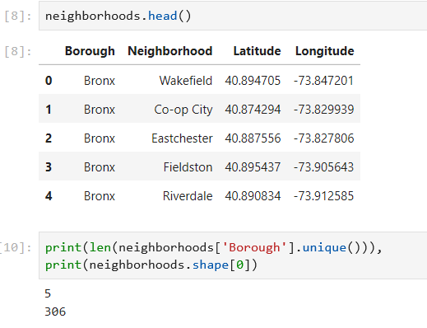
This data is then used to make markers on the NY map for better visualization. These are the places we are likely to setup a restaurant.

Slide 12
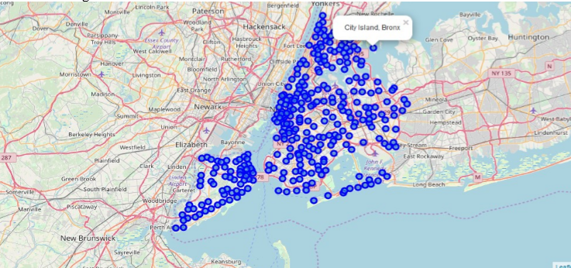
A map of New York city and the places acquired from the json file in blue.

Slide 13
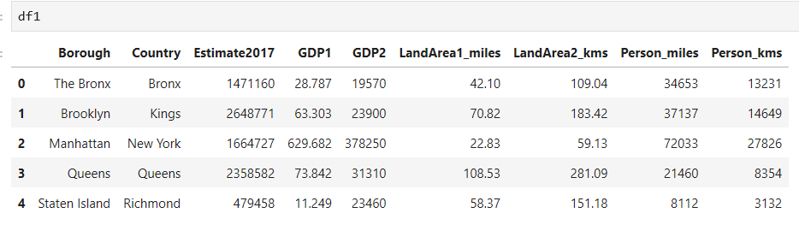
Manhattan has the highest GDP amongst other cities

Slide 14
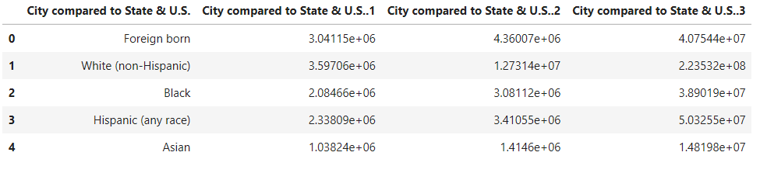
White(non-Hispanic) has the population density in NY.

Slide 15
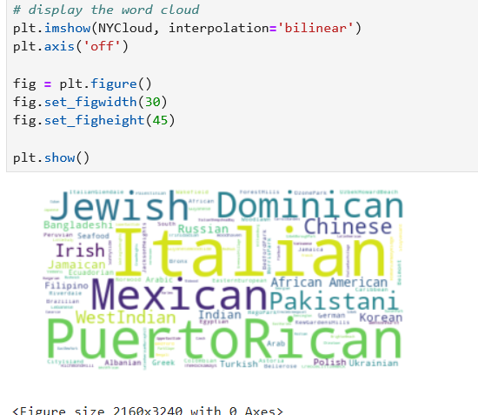
Overall likeliness to eat a particular cuisine by New York city citizens.

Slide 16
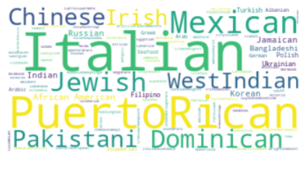
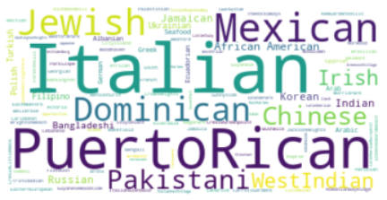
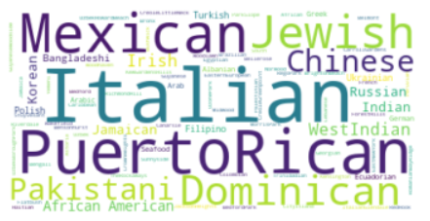
Overall likeliness to eat a particular cuisine by people of Bronx.
Overall likeliness to eat a particular cuisine by people of Queens.
Overall likeliness to eat a particular cuisine by people of Brooklyn.

Slide 17
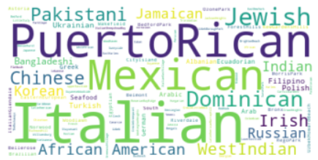
Overall likeliness to eat a particular cuisine by people of Manhattan.

Slide 18
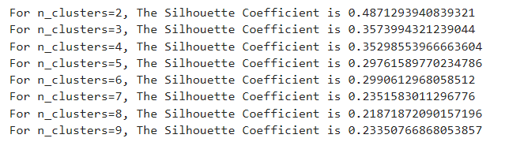
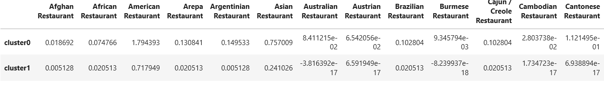
The silhouette score for different values of k.
Silhouette score for different clusters in which cluster 0 is ideal locations which haven’t been ventured and cluster 1 is location which is least ideal

Slide 19
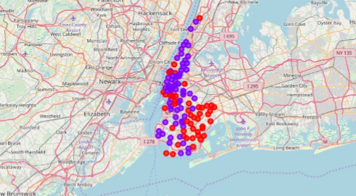
Cluster 0 (Non-saturated, purple) and Cluster 1 (Saturated, red)

Slide 20
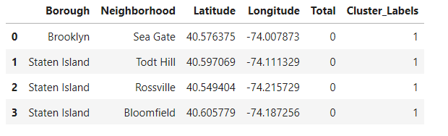
Final Result: Places which haven’t been ventured and have scope in the future

Slide 21
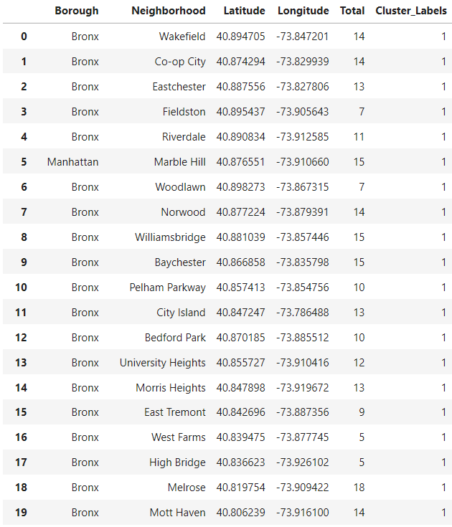
Final Result: Least favorable places with the highest competition

Slide 22
Result
The best places to setup a restaurant given the conditions taken into account are:
Seagate, Brooklyn @ [40.576, -74.007]
Todt Hill, Staten Island @ [40.5970, -74.111]
Rossville, Staten Island @ [40.5494, -74.2157]
Bloomfield, Staten Island @ [40.6057, -74.1872]

