Slide 1
IT3708 - Bio-Inspired Artificial Intelligence
Ole J. Mengshoel
ole.j.mengshoel@ntnu.no
Professor, Department of CS, NTNU, Trondheim
Week 2, Spring 2023 Semester

Slide 2
Review: Course Contents and Mechanics (Brief – see Blackboard for Jan 13. for details. In case of an inconsistency, today’s information takes precedence.)

Slide 3

Course Objective and Description
https://www.ntnu.no/studier/emner/IT3708
In 2023: A total of 3 projects will count for 70% of the grade. Projects will vary in size and points given, with each project lasting around 3 – 5 weeks. It is recommended to start early on projects!
In 2023: An end-of-semester exam will count for 30% of the grade. This will be a 90 minute exam.

Slide 4
Course Materials Include
Two main textbooks
“Evolutionary Optimization Algorithms,” by D. Simon, Wiley 2013
“Introduction to Evolutionary Computing,” 2nd Edition, by A. E. Eiben and J. E. Smith, Springer 2015
Lecture slides
Other materials, such as articles and papers
To be announced
(Other textbooks
“Genetic Algorithms in Search, Optimization, and Machine Learning,” by D. E. Goldberg, Addison-Wesley, 1989
“Multi-Objective Optimization using Evolutionary Algorithms,” by K. Deb, John Wiles & Sons, 2001
“Bio-Inspired Artificial Intelligence: Theories, Methods, and Technologies,” by D. Floreano and C. Mattiussi, MIT Press, 2008
…)

Slide 5
Course Topics: Bio-Inspired Artificial Intelligence (BioAI)
Introduction and background to BioAI
Optimization via BioAI
Hillclimbing or Stochastic Local Search
Genetic Algorithms
Evolutionary Programming
Evolution Strategies
Genetic Programming
Evolutionary Algorithm Variants
Differential Evolution
Ant Colony Optimization
Particle Swarm Optimization
Hybrid BioAI
Applications of BioAI
Theory of BioAI
Roughly, substantial parts of Part I and Part II from Simon’s book and Eiben and Smith’s book. Plus selected topics from Part III / Part IV of both books and other sources.
This list of topics is subject to change; specifics will be provided later.

Slide 6
Course Staff
Lecturers:
Ole Jakob, Xavier
ole.j.mengshoel@ntnu.no
xavier.sanchezdz@ntnu.no
The Student (or Teaching) Assistants:
Anum, Helle, Martin
anum.masood@ntnu.no
hellevha@stud.ntnu.no
martieh@stud.ntnu.no
Coordinating Student Assistants: Anum, Helle
Main areas of responsibility for the Student Assistants:
Assist with the projects (exercises), as is typically the case in NTNU courses, including help with the “demo days”
Answer questions from students, during lab sessions and via Blackboard – especially as they related to programming projects
Potentially other things: to be decided (TBD)

Slide 7
Reference Group for Course
Need ~3 students to take part in 2 short meetings this semester
Minimal time commitment
Need to make yourself available to other students
So that you can represent your own and their inputs to the course
Benefits:
Impact on the course this and later semesters
Valuable collaboration and connections
Sign up at break, after the lecture, or by email:
ole.j.mengshoel@ntnu.no
xavier.sanchezdz@ntnu.no

Slide 8

Questions or
comments so far?
Faculty

Slide 9
Optimization
Combinatorial (discrete-valued) optimization
Optimization of a (fitness) function f of the form f(x) where x is a vector of discrete-valued (for example, bitstrings, sequences, …) variables
Continuous (real-valued) optimization
Optimization of a (fitness) function f of the form f(x) where x is a vector of real-valued variables
Evolutionary algorithms (EAs) can be used for both combinatorial and continuous optimization
Why EAs? They make very few assumptions compared to other optimization methods
When using calculus, for example, one can easily compute a function’s derivative in order to do continuous optimization
In some cases, for example for computer simulations, one cannot easily compute derivatives but EAs can still be used
Today our focus will be on combinatorial optimization via evolutionary algorithms, especially genetic algorithms

Slide 10
Evolutionary Computing
Chapter 3
10

Slide 11
Chapter 3: What is an Evolutionary Algorithm?
Scheme of an EA
Main EA components:
Representation / evaluation / population
Parent selection / survivor selection
Recombination / mutation
Examples of behavior
Typical EA behaviour
EAs and global optimisation
EC and neighbourhood search

Slide 12
Scheme of an EA: General scheme of EAs
Parent selection
Parents
Intialization
Recombination
(crossover)
Population
Mutation
Termination
Offspring
Survivor selection

Slide 13
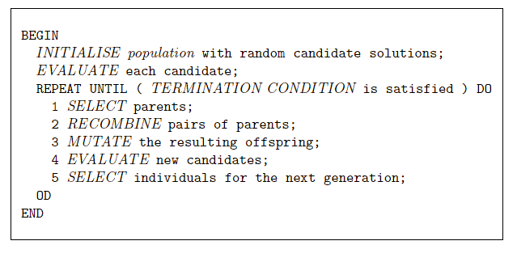
Scheme of an EA: EA scheme in pseudo-code

Slide 14
Scheme of an EA: Common model of evolutionary processes
Population of individuals
Individuals have a fitness
Variation operators: crossover, mutation
Selection towards higher fitness
“survival of the fittest” and
“mating of the fittest”
Neo Darwinism:
Evolutionary progress towards higher life forms
=
Optimization according to some fitness-criterion
(optimization on a fitness landscape)

Slide 15
Scheme of an EA: Two pillars of evolution
There are two competing forces: exploration and exploitation.
Any EA needs to carefully balance these two forces.
Increasing population diversity by genetic operators
mutation
recombination
Push towards novelty
Decreasing population diversity by selection
of parents
of survivors
Push towards quality
Exploration
Exploitation

Slide 16
Main EA components: What are the different types of EAs
Historically different flavours of EAs have been associated with different data types to represent solutions
Binary strings: Genetic Algorithms
Real-valued vectors: Evolution Strategies
Finite state Machines: Evolutionary Programming
LISP trees: Genetic Programming
These differences are largely irrelevant, a good strategy in general is to:
choose representation to suit problem
choose variation operators to suit representation
Note: Selection operators only use fitness and so are independent of representation

Slide 17
EA Representation

Slide 18
Main EA components: Representation (1/2)
Role: provides code for candidate solutions that can be manipulated by variation operators
Leads to two levels of existence
Phenotype: object in original problem context, the “outside”
Genotype: code to denote that object, the “inside” (chromosome, “digital DNA”)
Sometimes, in simple problems, the two levels degenerate into one
Implies two mappings:
Encoding : phenotype → genotype
Decoding : genotype → phenotype
Chromosomes contain genes, which are in (usually fixed) positions called loci (sing. locus) and have a value (allele)
Similar to attribute(s) – or feature(s) – and value(s) in machine learning

Slide 19
Main EA components: Representation (2/2)
Example: Suppose that the phenotype space is a closed interval [l, u] of integers, and that we represent integer values by their binary code.
Phenotype space
Genotype space
Encoding
(representation)
10010
18
10
2
9
1001
Decoding
(inverse representation)
In order to find an arbitrary global optimum, every feasible solution must be represented in genotype space

Slide 20
EA Fitness

Slide 21
Main EA components: Evaluation (fitness) function
Fitness function is a.k.a.: quality function or objective function
Role of a fitness function f:
Represents the task to solve, the requirements to adapt to (can be seen as “the environment”)
Enables selection (provides basis for comparison)
e.g., some phenotypic traits are advantageous, desirable, e.g. big ears cool better, these traits are rewarded by more offspring that will expectedly carry the same trait
Assigns a single real-valued fitness to each phenotype which forms the basis for selection
So the more discrimination (different values) the better
Few assumptions are made about f:
Computability is (typically) assumed – for example by means of simulation
Differentiability is (typically) not assumed – unlike in calculus
Typically we talk about fitness being maximised
Some problems may be best posed as minimisation problems, but conversion is trivial

Slide 22
EA Population

Slide 23
Main EA components: Population (1/2)
Role: holds the candidate solutions of the problem as individuals (genotypes)
Formally, a population is a sequence or multiset of individuals, i.e., repetitions are, in general, possible
Recall: in a set, we do not allow repetition
Population is the basic unit of evolution, i.e., the population is evolving, not the individuals
Selection operators act on population level
Variation operators act on individual level

Slide 24
Main EA components: Population (2/2)
Some sophisticated EAs also assert a spatial structure on the population, e.g., a grid
Selection operators usually take whole population into account, i.e., reproductive probabilities are relative to current generation
Diversity of a population refers to the number of different fitness values, phenotypes, or genotypes present (note: these are not necessarily the same thing)
Fitness diversity
Phenotypic diversity
Genotypic diversity

Slide 25
EA Selection

Slide 26
Main EA components: Selection mechanism (1/3)
Role of selection:
Identifies individuals in two places in an EA:
to become parents (a.k.a. parent selection)
to survive (a.k.a. survivor selection)
Pushes population towards higher fitness
Usually probabilistic
high quality solutions more likely – but not guaranteed – to be selected than low quality
even worst individual in current population usually has non-zero probability of being selected
This stochastic nature of selection can aid escape from local optima

Slide 27
Main EA components: Selection mechanism (2/3)
Example: roulette wheel selection – individuals A, B, C
Fitness f(A) = 3
1/6 = 17%
Fitness f(B) = 1
B
A
C
Fitness f(C) = 2
Total fitness of A, B, C: 3+1+2 = 6
3/6 = 50%
2/6 = 33%
In principle, any selection mechanism can be used for
parent selection as well as for survivor selection

Slide 28
Main EA components: Selection mechanism (3/3)
Survivor selection is a.k.a. replacement
In the literature where “replacement” is used, “selection” typically means “parent selection”
Most EAs use a fixed population size: need a way of going from (parents + offspring) to next generation
This is the role of survivor selection
Often deterministic (while parent selection is usually stochastic)
Fitness based : e.g., rank parents + offspring and take best
Age based, in a small way: make as many offspring as parents and delete all parents
Sometimes survivor selection a combination of stochastic and deterministic (elitism)

Slide 29
EA Variation Operators

Slide 30
Main EA components: Variation operators
Role of variation: to generate new candidate solutions
Usually divided into two types according to their arity (number of inputs):
Arity = 1 : mutation operators
Arity > 1 : recombination operators
Arity = 2 : typically called crossover
Arity > 2 : formally possible, seldom used in EC
There has been much debate about relative importance of recombination and mutation
Historically, there has been a bias toward one or the other variation operator type depending on the EA class
Nowadays many EAs use both
Variation operators must match the given representation

Slide 31
Main EA components: Mutation of bitstrings (1/2)
1 1 1 1 1 1 1
before
after
1 1 1 0 1 1 1

Slide 32
Main EA components: Mutation (2/2)
Role of mutation: cause small, random variance
Acts on one genotype and delivers another
Element of randomness is essential and differentiates it from other unary heuristic operators
Importance ascribed depends on representation and historical dialect:
Binary GAs – background operator responsible for preserving and introducing diversity
Evolutionary programming (EP) for Finite State Machines (FSMs) or continuous variables – only search operator
Genetic programming (GP) – hardly used
May guarantee connectedness of search space and hence convergence proofs

Slide 33


Main EA components: Recombination of bitstrings (1/2)
Parents
cut
cut
1 1 1 1 1 1 1
0 0 0 0 0 0 0
1 1 1 0 0 0 0
0 0 0 1 1 1 1
Offspring

Slide 34
Main EA components: Recombination (2/2)
Role of recombination: merge information from parents into offspring
Choice of what information to merge is stochastic
Most offspring may be worse, or the same as the parents
Hope is that some offspring are better by combining elements of genotypes that lead to good traits – high fitness
Principle has been used for millennia by breeders of plants and livestock

Slide 35
EA: Starting and Stopping

Slide 36
Main EA components: Initialisation / Termination
Initialisation often done at random:
Need to ensure even spread and mixture of possible allele values
Can include existing solutions, or use problem-specific heuristics, to “seed” the population
Termination condition checked every generation:
Reaching some (known/hoped for) fitness
Reaching some maximum allowed number of generations
Reaching some minimum level of diversity
Reaching some specified number of generations without fitness improvement

Slide 37
Questions?
Faculty

Slide 38
Evolutionary Computing
Chapter 6:
Genetic Algorithms
38

Slide 39
Chapter 6: Popular Evolutionary Algorithm Variants
Historical EA variants:
Genetic Algorithms
Evolution Strategies
Evolutionary Programming
Genetic Programming
More recent versions:
Differential Evolution
Particle Swarm Optimisation
Estimation of Distribution Algorithms
Learning Classifier Systems

Slide 40
Genetic Algorithms: Quick Overview
Developed: USA in the 1960s
Early names: J. Holland, K. DeJong, D. Goldberg
Typically applied to:
discrete function optimization
benchmark
straightforward problems binary representation
Holland’s original GA is now known as the simple genetic algorithm (SGA)
The SGA is also in focus in D. Goldberg’s book “Genetic Algorithms in Search, Optimization, and Machine Learning”
Other GAs use different:
Representations
Mutations
Crossovers
Selection mechanisms
…

Slide 41
Genetic Algorithms: SGA technical summary tableau
Representation | Bit-strings
Recombination | 1-Point crossover
Mutation | Bit flip
Parent selection | Fitness proportional – implemented by Roulette Wheel
Survivor selection | Generational
These methods are part of the simple genetic algorithm (SGA).

Slide 42
Genetic Algorithms: SGA reproduction cycle - Overview
Select parents for the mating pool
(size of mating pool = population size)
Shuffle the mating pool
Apply crossover for each consecutive pair with probability p_{c}, otherwise copy parents
Apply mutation for each offspring (bit-flip with probability p_{m} independently for each bit)
Replace the whole population with the resulting offspring

Slide 43
Genetic Algorithms: An example after Goldberg ’89
Simple problem: max x² over interval {0,1,…,31}
GA approach:
Representation: binary code, e.g., 01101 ↔ 13
Population size: 4
1-point xover, bitwise mutation
Roulette wheel selection
Random initialisation
We show one generational cycle done by hand

Slide 44
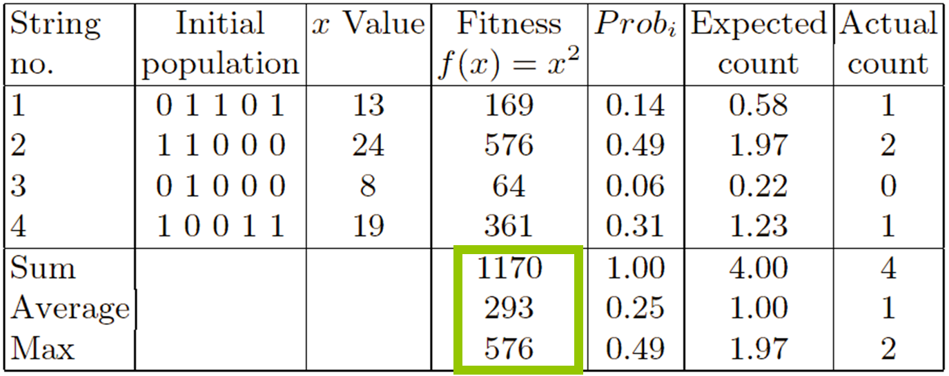
X² example: Selection
Genotype
space
Phenotype
space
These values are what we are seeking to improve.
Fitness
statistics

Slide 45
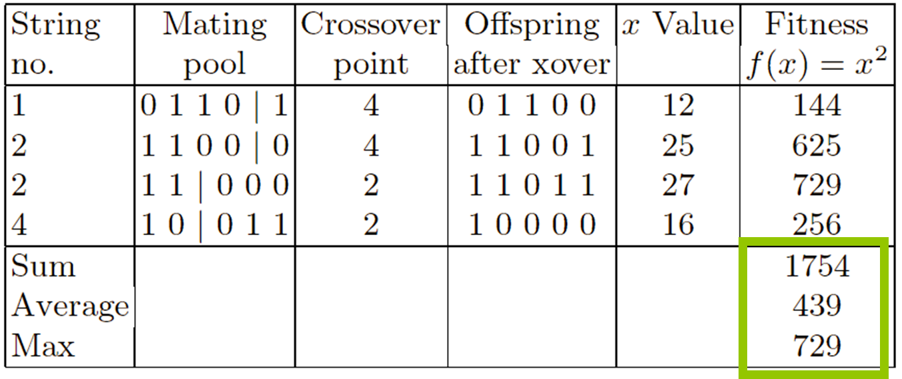
X² example: Crossover
Genotype
space
Phenotype
space
Substantial improvements from original values on previous slide.
Fitness
statistics

Slide 46
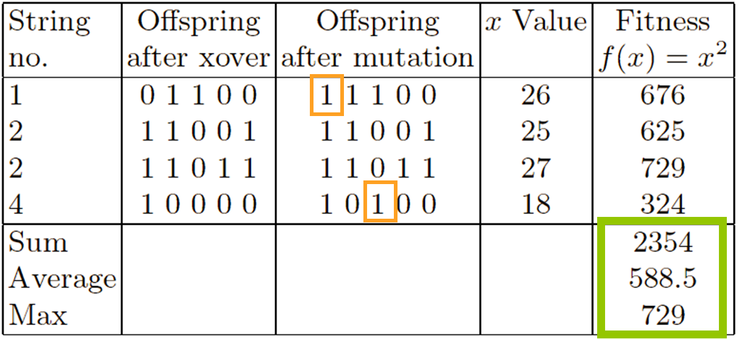
X² example: Mutation
OJM remark 26.1.22: Because there is a typo in the book here, there are follow-on mistakes in fitness and statistics in the table also.
Genotype
space
Phenotype
space
28
Fitness
statistics
Further improvements from the values on previous slide, but not in Max.

Slide 47
Simple Genetic Algorithm: Details
47

Slide 48
Simple Genetic Algorithm (SGA): The Data Structures
Individual:
Genotype or string (bitstring): b = 0111
Phenotype (value): x = 7
Fitness (objective function): f(x)
Other: parents, crossover and mutation sites, …
Population
Array [1 … pop-size] of Individual
Two populations
Current population of individuals: pop_{new},
Old (or previous) population of individuals: pop_{old}
48

Slide 49
Simple Genetic Algorithm (SGA): The Main Operators
Reproduction (selection): Picks an individual (or bitstring) in the population using roulette wheel selection
Roulette wheel slots weighted in proportion to bitstring fitness values
An individual x has portion of roulette wheel = f(x)/sum-fitness
Crossover: Takes two parents (bitstrings), crosses over to create two children (bitstrings) with crossover probability p_{C}
One-point crossover is traditionally used
Crossover location varies
Mutation: Flips a bit in a bitstring with mutation probability p_{M}
Fitness: Decodes, if needed, an individual’s genotype (bitstring) b to phenotype (value) x, computes fitness f(x) – else f(b)
Initialize: Initialize, uniformly at random
Generation: Create the next generation from the current one
49

Slide 50
Simple Genetic Algorithm (SGA): Pseudo-Code for the Top Level Loop
SGA(p_{C}, p_{M}, pop-size, f, g_{max})
g ← 0
Initialize(pop_{old,} pop-size)
Repeat
g ← g + 1
pop_{new} ← Generation(pop_{old,} p_{C}, p_{M}, pop-size, f)
pop_{old} ← pop_{new}
Until g >= g_{max}
More about this on the next slide
50

Slide 51
Simple Genetic Algorithm (SGA): Pseudo-Code for Generation Loop
Generation(pop_{old,} p_{C}, p_{M}, pop-size, f)
j ← 1
Repeat
m₁ ← selection(pop-size, sum-fitness, pop_{old})
m₂ ← selection(pop-size, sum-fitness, pop_{old})
crossover(pop_{old}[m₁], pop_{old}[m₂], pop_{new}[j], pop_{new}[j+1])
mutation(pop_{new}[j]); mutation(pop_{new}[j+1])
fitness(pop_{new}[j], f); fitness(pop_{new}[j+1], f)
j ← j + 2
Until j > pop-size
Return pop_{new}
51

Slide 52
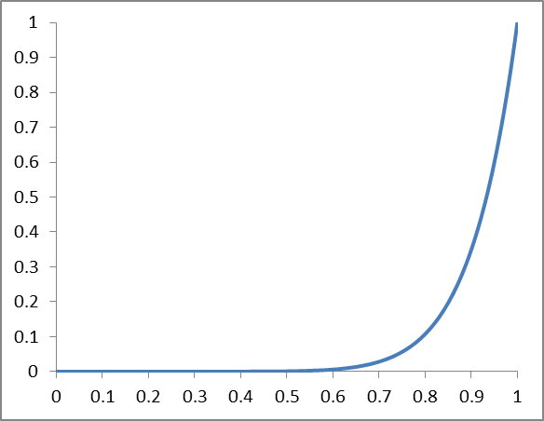
Simple Genetic Algorithm (SGA): Simple Experiment
Fitness function to maximize: f(x) = x¹⁰, 0 ≤ x ≤ 1
bitstring-length = 30
Probability of crossover: p_{C} = 0.6
Probability of mutation: p_{M} = 0.0333
Size of populations: pop-size = 30
Number of generations: g_{max} = 7
Results:
Generation 0: Average total fitness = 0.0347
Generation 1: Average total fitness = 0.1732
…
Generation 7: Average total fitness = 0.8100
The optimized of the SGA parameters (crossover, mutation, population size, …) depends on the application at hand.
52

Slide 53
Convergence of SGA – A Closer Look
f(x) = x¹⁰
Represents “most” individuals in the population at a certain generation
SGA performance over generations:
Generation 0: Average total fitness = 0.0347
Generation 1: Average total fitness = 0.1732
…
Generation 7: Average total fitness = 0.8100
53

Slide 54
A Few Genetic Algorithms
Genetic Algorithms as part of a general theory of adaptation – see “Adaptation in Natural and Artificial Systems” by Holland, 1975
Simple Genetic Algorithms (SGA) – see “Genetic Algorithms in Search, Optimization and Machine Learning” by Goldberg, 1989
A general genetic algorithm - see later slides
Genetic Algorithm Batch-Incremental Learning (GABIL) – see “Using Genetic Algorithms for Concept Learning” by De Jong, Spears, and Gordon, 1993
Focused on machine learning
Crowding GA – Focus on maintaining better than SGA
Topic of later lecture
Continuous GA – Operating on real values instead of bitstrings
Differential Evolution – Not introduced as a GA or an EA, but closely related to GAs
…
54

Slide 55
Simple Genetic Algorithm: Summary
Crossover, binary strings:
Genetic algorithms, focused on here, are one type of evolutionary algorithm
Fitness function f
Population of candidate solutions (genomes)
Selection, using f, decides which candidate solutions survive from current to next generation
Starts out with an initial generation, randomly initialized
Operations:
Mutation: change one candidate solution
Crossover: change two candidate solutions
The operations are applied over multiple generations – “survival of the fittest”
10000011011101111001
11101011001000111100
10001011001000111100
1110 0011011101111001
Mutation, binary strings:
00011011101111001010
10011011101110001010
55

Slide 56
Questions?
Faculty

Slide 57
Evolutionary Computing
Chapter 3
57

Slide 58
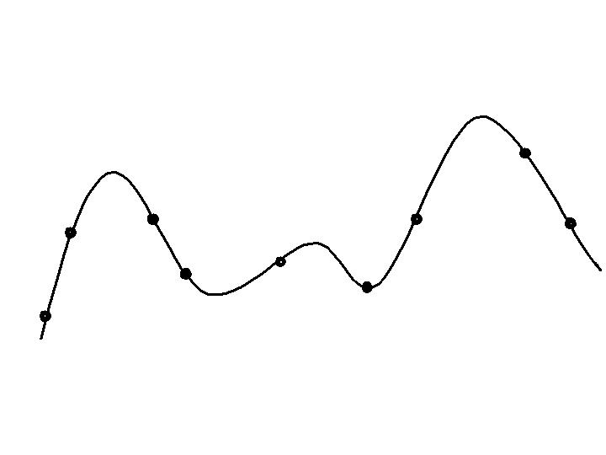
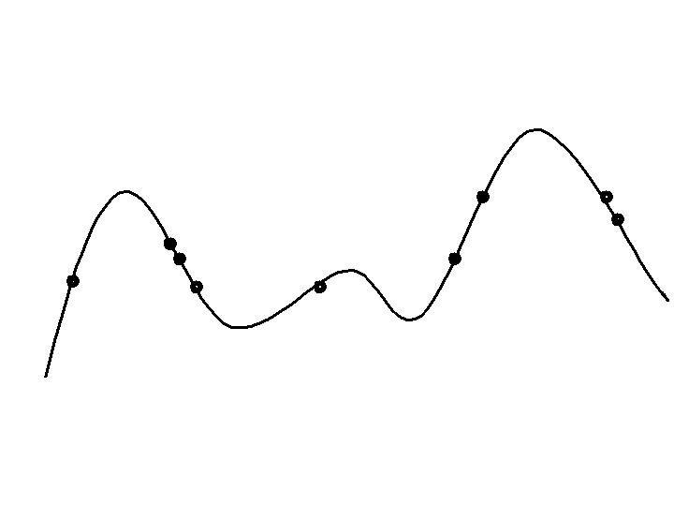
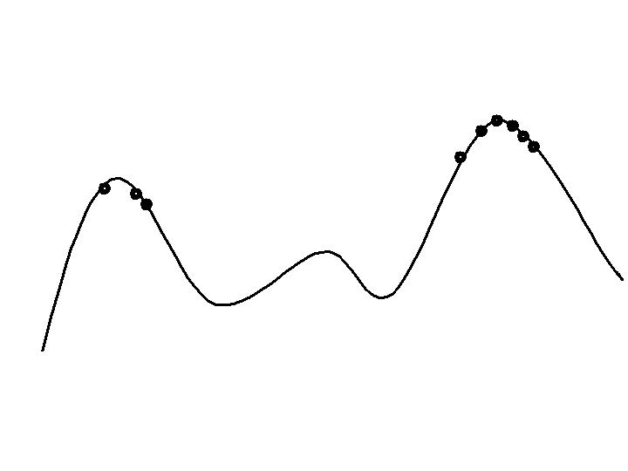
Typical EA behaviour: Stages
Stages in optimising on a 1-dimensional fitness landscape
Early stage:
quasi-random population distribution
Mid-stage:
population arranged around/on hills
Late stage:
population concentrated on high hills

Slide 59
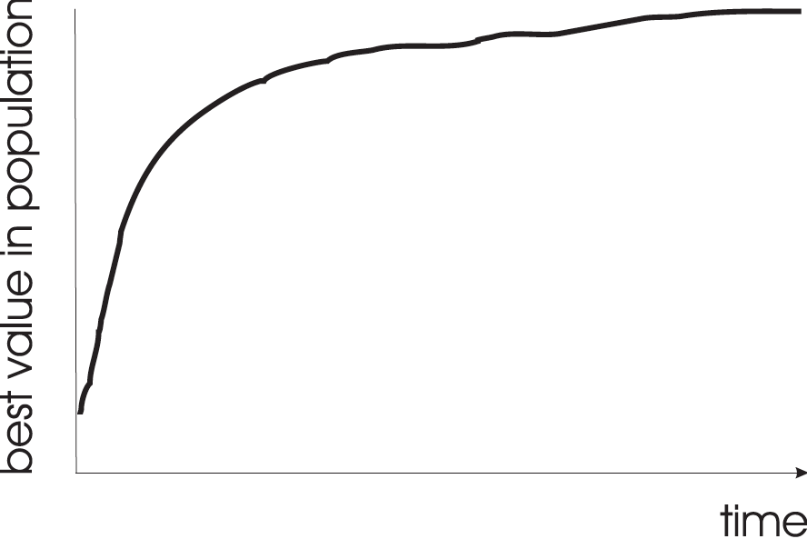
Typical EA behaviour: Typical run: progression of fitness
Typical run of an EA shows so-called “anytime behavior”

Slide 60
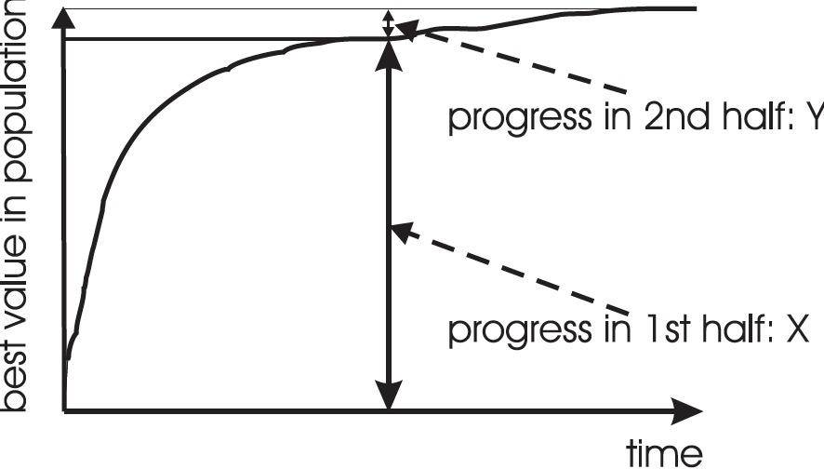
Typical EA behaviour: Are long runs beneficial?
Answer:
It depends on how much you want the last bit of progress
May be better to do more short runs

Slide 61
Typical EA behaviour: Is it worth expending effort on smart initialisation?
Best fitness in population
F
F: fitness after smart initialisation
T: time needed to reach level F after random initialisation
T
Time (number of generations)
Answer: it depends
- Possibly good, if good solutions/methods exist.
- Care is needed, see chapter/lecture on hybridisation.

Slide 62
Typical EA behaviour: Evolutionary Algorithms in context
There are many views on the use of EAs as robust problem solving tools
For most problems a problem-specific tool may:
perform better than a generic search algorithm on most instances,
have limited utility,
not do well on all instances
Goal is to provide robust tools that provide:
evenly good performance
over a range of problems and instances

Slide 63
Typical EA behaviour: EAs as problem solvers: Goldberg view (1989)
Special, problem tailored method
Evolutionary algorithm
Performance of methods on problems
Random search
Scale of “all” problems

Slide 64
Typical EA behaviour: EAs and domain knowledge
Trend in the 90’s:
adding problem specific knowledge to EAs
(special variation operators, repair, etc)
Result: EA performance curve “deformation”:
better on problems of the given type
worse on problems different from given type
amount of added knowledge is variable
Recent theory suggests the search for an “all-purpose” algorithm may be fruitless

Slide 65
Typical EA behaviour: EAs as problem solvers: Michalewicz view (1996)
EA 4
EA 2
EA 3
EA 1
Performance of methods on problems
P
Scale of “all” problems

Slide 66
EC and global optimisation
Global Optimisation: search for finding best solution x* out of some fixed set S
Deterministic approaches
e.g., box decomposition (branch and bound etc)
Guarantee to find x* ,
May have bounds on runtime, usually super-polynomial
Heuristic Approaches (generate and test)
rules for deciding which x ∈ S to generate next
no guarantees that best solutions found are globally optimal
no bounds on runtime
“I don’t care if it works as long as it converges”
vs.
“I don’t care if it converges as long as it works”

Slide 67
EC and neighbourhood search
Many heuristics impose a neighbourhood structure on S
Such heuristics may guarantee that best point found is locally optimal, e.g., hillclimbers:
But problems often exhibit many local optima
Often very quick to identify good solutions
EAs are distinguished by:
Use of population
Use of multiple, stochastic search operators
Especially variation operators with arity > 1
Stochastic selection

Slide 68
Recap of EC metaphor (1/2)
A population of individuals exists in an environment with limited resources
Competition for those resources causes selection of those fitter individuals that are better adapted to the environment
These individuals act as seeds for the generation of new individuals through recombination and mutation
The new individuals have their fitness evaluated and compete (possibly also with parents) for survival.
Over time, natural selection causes a rise in the fitness of the population

Slide 69
Recap of EC metaphor (2/2)
EAs fall into the category of “generate and test” algorithms
They are stochastic, population-based algorithms
Variation operators (recombination and mutation) create the necessary diversity and thereby facilitate novelty
Selection reduces diversity and acts as a force pushing quality

Slide 70
Questions?
Faculty

