Slide 1
IT3708 - Bio-Inspired Artificial Intelligence
Ole J. Mengshoel
ole.j.mengshoel@ntnu.no
Professor, Department of CS, NTNU, Trondheim
Week 3, Spring 2023 Semester

Slide 2
Variations on Evolutionary, Especially Genetic, Algorithms
Vanilla Evolutionary Algorithms (EAs) often need to be tailored to work well in particular applications:
Set (hyper)parameters and use EA variations that are optimized to the problem at hand
Encodings that are suitable to sequence problems (TSP, …), Problems with constraints, …
Carefully balance exploration and exploitation
Variations on an EA may thus for example include:
Use representations in an EA that go beyond the “default” representations
Use EA variation operators that are tailored to an application
Tailoring the EA to handle constraints found in an application
Today’s presentation is about some such variations
With a focus on the Genetic Algorithm (GA)
2

Slide 3
Evolutionary Computing
Chapter 4: Binary, and Integer Representation
3

Slide 4
Chapter 4: Representation, Mutation, and Recombination
Role of representation and variation operators
Most common representation of genomes:
Binary
Integer
Real-Valued or Floating-Point
Permutation
Tree
4

Slide 5
Scheme of an EA: General scheme of EAs
Parent selection
Parents
Intialization
Recombination
(crossover)
Population
Mutation
Termination
Offspring
Survivor selection
5

Slide 6
Role of representation and variation operators
First stage of building an EA and most difficult one: choose right representation for the problem
Variation operators: mutation and crossover
Type of variation operators needed depends on chosen representation
In practice, the two issues are intertwined
There’s also a relationship to constraints, handled later
6

Slide 7
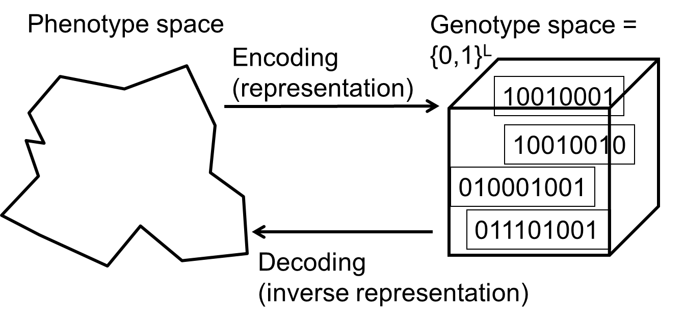
Binary Representation
One of the earliest representations
Genotype consists of a string of binary digits
7

Slide 8
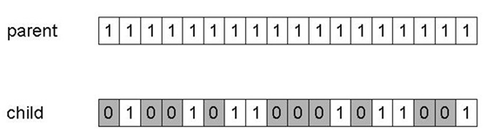
Binary Representation: Mutation
Alter each gene independently with a probability p_{m}
p_{m} is called the mutation rate
Typically between 1/pop_size and 1/chromosome_length
Mutation can have variable effect
If problems: may help to use Gray coding, where consecutive integers have a Hamming distance of one
Note: Here the number of mutations is unusually high.
8

Slide 9
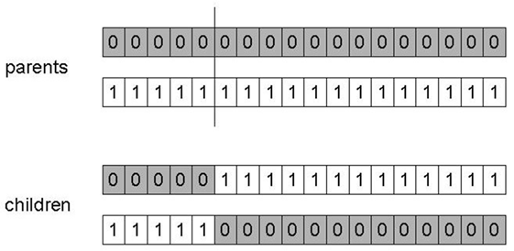
Binary Representation: 1-point crossover
Choose a random point on the two parents
Split parents at this crossover point
Create children by exchanging tails
P_{c} typically in range (0.6, 0.9)
9

Slide 10
Binary Representation: Alternative Crossover Operators
Why do we need other crossover(s)?
Performance with 1-point crossover depends on the order that variables occur in the representation
More likely to keep together genes that are near each other
Can never keep together genes from opposite ends of string
This is known as Positional Bias
Can be exploited if we know about the structure of our problem, but this is not usually the case
10

Slide 11
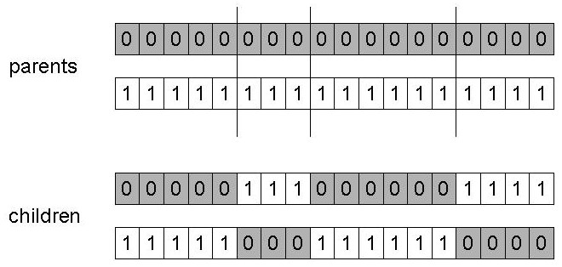
Binary Representation: n-point crossover
Choose n random crossover points
Split along those points
Glue parts, alternating between parents
Generalisation of 1-point (still some positional bias)
11

Slide 12
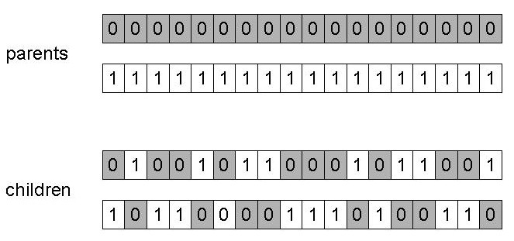
Binary Representation: Uniform crossover
Assign 'heads' to one parent, 'tails' to the other
Flip a coin for each gene of the first child
Make an inverse copy of the gene for the second child
Inheritance is independent of position
First child
Second child
12

Slide 13
Binary Representation: Crossover OR mutation? (1/3)
Decade long debate: which one is better / necessary / main-background
Answer (at least, rather wide agreement):
it depends on the problem, but
in general, it is good to have both
both have distinct roles
mutation-only-EA is possible, xover-only-EA would not work
13

Slide 14
Binary Representation: Crossover OR mutation? (2/3)
Exploration: Discovering promising areas in the search space, i.e. gaining information on the problem
Exploitation: Optimising within a promising area, i.e. using information
There is co-operation AND competition between them
Crossover is explorative, it makes a big jump to an area somewhere “in between” two (parent) areas
Mutation is exploitative, it creates random small diversions, thereby staying near (in the area of ) the parent
14

Slide 15
Binary Representation: Crossover OR mutation? (3/3)
Only crossover can combine information from two parents
Only mutation can introduce new information (alleles)
Crossover does not change the allele frequencies of the population (thought experiment: 50% 0’s on first bit in the population, ?% after performing n crossovers)
To hit the optimum you often need a “lucky” mutation
Assuming operators are restricted to crossover and mutation
15

Slide 16
Integer Representation
Nowadays it is generally accepted that it is better to encode numerical variables directly (integers, floating point variables)
Some problems naturally have integer variables, e.g., image processing parameters
Other problems take categorical values from a fixed set, e.g., {blue, green, yellow, pink}
N-point / uniform crossover operators work
Extend bit-flipping mutation to:
Make it more likely to move to similar value (“creep”)
Adding a small (positive or negative) value to each gene with a certain probability p.
Reset randomly (esp. with categorical variables)
With a certain probability p, a new value is chosen at random
Same recombination as for binary representation
16

Slide 17

Questions?
Faculty

Slide 18
Evolutionary Computing
Chapter 5: Fitness, Selection, and Population Management
18

Slide 19
Chapter 5: Fitness, Selection and Population Management
Selection is a fundamental force for evolutionary systems
Important dimensions of selection include:
Computation of fitness
Population management models
Selection operators
Preserving diversity
19

Slide 20
Scheme of an EA: General scheme of EAs
Most common in EAs: An EA algorithm with a fixed population size μ. Selection is (1) from μ parents to create λ offspring and then (2) to restrict to μ individuals – making up the new population.
Parent selection
Parents
μ parents
Intialization
Recombination
(crossover)
Population
Mutation
μ individuals
λ offspring
Termination
Offspring
Survivor selection
20

Slide 21
Population Management and Selection
21

Slide 22
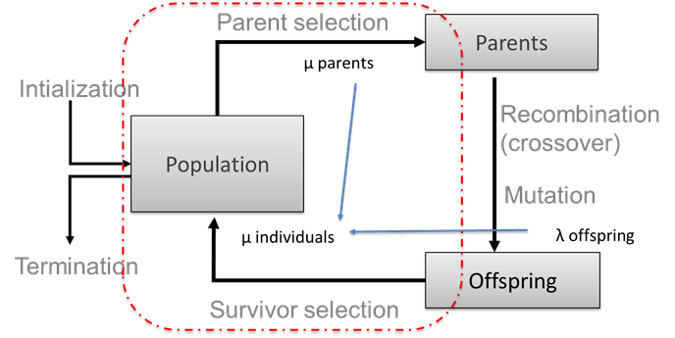
Population Management Models: Fitness based competition
Selection typically occurs in two places in an EA:
Selection from current generation to take part in mating (parent selection)
Selection from parents + offspring to go into next generation (survivor selection)
Selection operators work on whole individual
i.e., they are representation-independent!
Distinction between selection
Operators: define selection probabilities
Algorithms: define how these probabilities are approximated and implemented
22

Slide 23
Population Management Models: Introduction
Two different population management models exist:
Generational genetic algorithm (GGA) – where for example:
each individual survives for exactly one generation
the entire set of parents is replaced by the offspring
Steady-state genetic algorithm (SSGA) – where for example:
one offspring is generated per generation
one member of population replaced
Most EAs use either the GGA or the SSGA mode:
The simple genetic algorithm (SGA) of Goldberg uses GGA
Whitley’s GENITOR is a steady-state GA - SSGA
Generation Gap (GG) is a key parameter:
The proportion of the population replaced at each iteration
How parameter GG varies:
For GGA: GG = 1
For SSGA: GG = 1/pop_size
23

Slide 24
Parent Selection
24

Slide 25
Parent Selection: Uniform
Parents are selected by uniform random distribution whenever an operator needs one/some:
Uniform parent selection:
Is unbiased - every individual has the same probability to be selected
Needs to be coupled with replacement selection pressure
When working with extremely large populations, over-selection can be used
Overselection amounts to splitting the population into two groups: “best fit” (minority group) and “the rest” (majority group)
A heuristic: 80% of parents are picked from the “best fit” (minority group)
25

Slide 26
Parent Selection: Fitness-Proportionate Selection (FPS)
Probability for individual i to be selected for mating in a population size μ with FPS is
Limitations of FPS include:
One highly fit member can rapidly take over if rest of population is much less fit: Premature Convergence
At end of runs when fitnesses are similar, loss of selection pressure
Highly susceptible to function transposition
Scaling raw fitness f(i) to scaled fitness f’(i) can fix last two problems
Scaling by windowing:
where β is a function (e.g., average) of fitness over last t generations
Sigma scaling normalizes fitness, taking population’s mean fitness and standard deviation into consideration
26

Slide 27
Parent Selection: Rank-Based Selection (RBS)
Attempt to remove problems of FPS by basing selection probabilities on
Relative – according to rank in population – rather than
Absolute fitness P_{FPS}(i)
Idea of RBS: Rank population according to fitness and then base selection probabilities on “rank” (or “prize”)
Fittest individual has rank or prize μ-1 (or μ) and
Worst fit individual has rank or prize 0 (or 1)
This imposes a sorting overhead on the algorithm, but this is usually negligible compared to the fitness evaluation time
However, fitness evaluation time varies dramatically from application to application
27

Slide 28
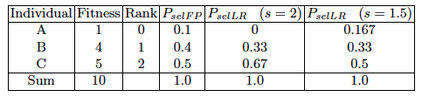
Rank-Based Selection: Linear Ranking
Probability of selecting individual with rank (prize) i:
Parameterised by factor s: 1 < s ≤ 2
Measures advantage of best individual
Larger s means greater advantage to best individual
Simple 3-individual example:
28

Slide 29
Rank-Based Selection: Exponential Ranking
Linear Ranking is limited in selection pressure, thus Exponential Ranking is introduced
Probability of selecting individual with rank (prize) i:
Exponential Ranking can allocate more than 2 copies to fittest individual
Normalisation constant factor c depends on population fitness
Sample mating pool using the selection probability distribution via roulette wheel selection, stochastic universal sampling, etc.
Probability is 0 for i = 0; probability increases as i increases
29

Slide 30
Parent Selection: Global versus Local Computation for Selection
All methods above rely on global population statistics
In other words, the fitness of all individuals need to be known in order to compute the fitness of a single individual
Issue 1: How realistic is the computation of global population statistics in the natural world (ref. bio-inspired AI)?
Issue 2: Such computation could be a bottleneck, esp., on parallel machines, with very large populations
Is there a way to avoid global computation of population statistics?
Yes, there are local approaches, for example tournament selection
30

Slide 31
Parent Selection: Tournament Selection
Idea for a procedure – Tournament Selection – using only local fitness information:
Pick k members at random, then select the best of these
Repeat to select more individuals
Probability of selecting individual i will depend on:
Rank of i, i.e., how fit the individual is
Size of sample k
higher k increases selection pressure
Whether contestants are picked with replacement
Picking without replacement increases selection pressure
Whether fittest contestant always wins (deterministic) or this happens with probability p
31

Slide 32
Survivor Selection (a.k.a. Replacement)
32

Slide 33
Survivor Selection
Goal: Managing the process of reducing the working memory of the EA:
From a set of μ parents and λ offspring in the current generation
To a set of μ individuals forming the next generation
The parent selection mechanisms can also be used for selecting survivors
But often parent and survivor selection are often different
Survivor selection can be divided into (at least) these approaches:
Age-Based Selection
Fitness is not taken into account – for example in SGA
In SSGA can implement as “delete-random” (not recommended) or as “first-in-first-out” (a.k.a. delete-oldest)
Fitness-Based Replacement
Similarity-Based Replacement
In crowding methods
Details to follow
33

Slide 34
Fitness-based replacement (1/2)
Elitism
Always keep at least one copy of the fittest solution so far
Widely used in both population models (GGA, SSGA)
GENITOR: a.k.a. “delete-worst”
From Whitley’s original SSGA (he also used linear ranking for parent selection)
Rapid takeover: use with large populations or “no duplicates” policy
Round-robin tournament
P(t): μ parents, P’(t): μ offspring
Pairwise competitions in round-robin format:
Each solution x from P(t) ∪ P’(t) is evaluated against q other randomly chosen solutions
For each comparison, a "win" is assigned if x is better than its opponent
The μ solutions with the greatest number of wins are retained to be parents of the next generation
Parameter q allows tuning selection pressure
Typically q = 10
34

Slide 35
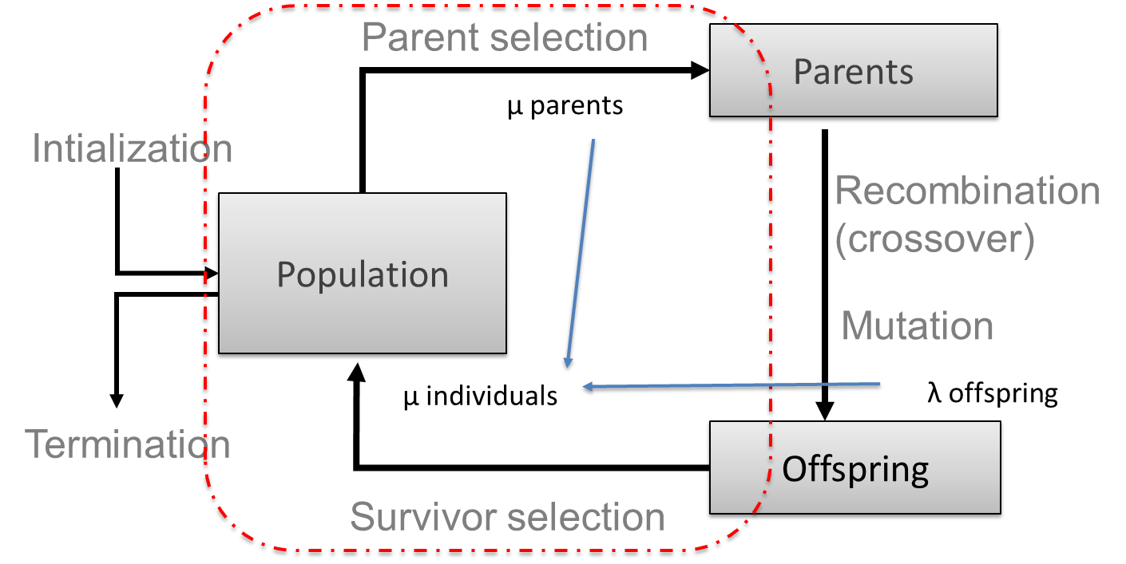
Fitness-based replacement (2/2)
(μ,λ)-selection
based on offspring only (λ > μ)
choose best μ individuals
(μ+λ)-selection
based on parents and offspring
choose best μ individuals
Often (μ,λ)-selection is preferred:
Better in leaving local optima
Better in following moving optima
λ ≈ 7 • μ is a traditionally good setting (decreasing over the last couple of years, λ ≈ 3 • μ seems more popular lately)
35

Slide 36
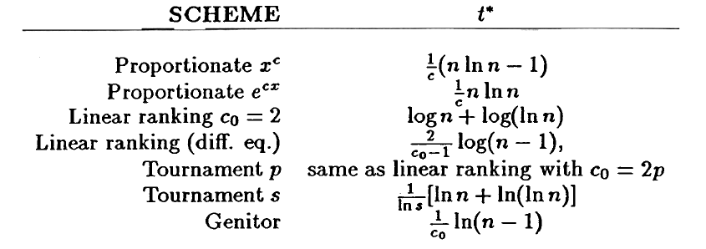
Takeover Time
Takeover time τ* is a measure to quantify the selection pressure
The number of generations it takes, under certain assumptions, until the application of selection completely fills the population with copies of the best individual found
Typically, considering the repetitive application of selection alone
Goldberg and Deb in “A Comparative Analysis of Selection Schemes Used in Genetic Algorithms” showed
All converge in something like O(logn), where n is population size, except proportionate selection which is O(nlogn)
36

Slide 37
Selection and Selection Pressure: Summary
Intuition: Selection plays a role in creating selection pressure in the Evolutionary Algorithm
Selection pressure:
Can be defined mathematically as [Simon 2013, p. 199] as:
Φ = Pr(selection of best fit) / Pr(selection of average fit)
But can also be understood more intuitively
In your EA, look out for:
Too high selection pressure: The problem of premature convergence, the population converges (quickly) to individuals at a local optimum
Too low selection pressure: The problem of too little convergence, the fitness of the population doesn’t increase much – optima are not found before the algorithms terminates
[Simon 2013, p. 199]: «If the selection method is overly biased towards selecting fit individuals, then the population may converge too quickly to a uniform solution […]. However, if a selection methods is not biased strongly enough towards fit individuals, then the EA may not be able to properly exploit the information that is present in the most fit individuals»
37

Slide 38
Questions?
Faculty
38

Slide 39
Preserving Diversity
39

Slide 40
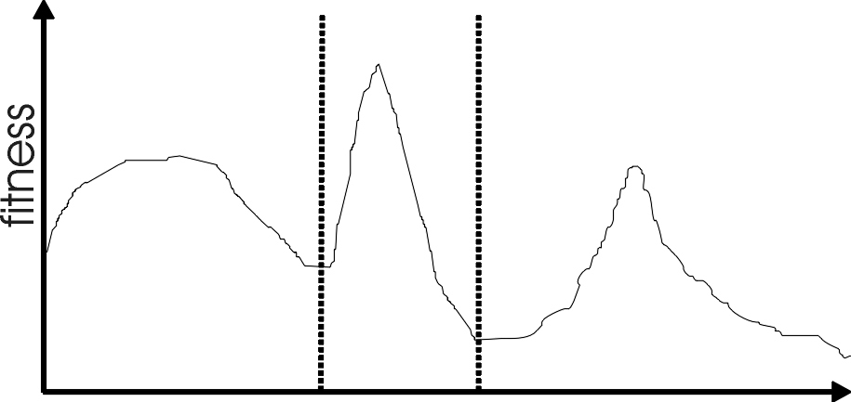
Multimodality - Example
Most interesting problems have more than one locally optimal solution.
Multimodality is realistic to assume in “real-world” problems, unless one has information to the contrary.
There are three local optima in this landscape with different sizes basins of attraction. The global optimum is in the middle, and the leftmost local optimum has a broader peak than the rightmost, despite having a smaller basin of attraction.
40
Notes:
There are three local optima in this landscape with different sizes basins of attraction. The global optimum is in the middle, and the leftmost local optimum has a broader peak than the rightmost, despite having a smaller basin of attraction.

Slide 41
Multimodality: Genetic Drift
Finite population with global mixing and selection eventually convergence around one optimum
Why is this a problem?
It may be the “wrong optimum” – i.e., not a global optimum
Premature convergence
Often might want to identify several possible optima
Not only a global optimum
Sub-optima can be more attractive, if the fitness function is not perfect
Diversity preservation is important in multi-objective optimisation (when more than one objective function is used)
41
Notes:
Might want to identify several peaks e.g. for design example where you might want solution from a broad peak as it may be more stable to minor perturbations

Slide 42
Approaches for Preserving Diversity: Introduction (1/2)
Different spaces for preserving diversity:
Genotype space
Set of representable solutions
Phenotype space
The end result
Neighbourhood structure may bear little relation with genotype space
Algorithmic space
Equivalent of the geographical space on which life on earth has evolved
Structuring the population of candidate solutions
42

Slide 43
Approaches for Preserving Diversity: Introduction (2/2)
Explicit versus implicit approaches
Implicit approaches:
Impose an “equivalent” of geographical separation
Impose an “equivalent” of speciation
Explicit approaches
Make similar individuals compete for resources (fitness)
Make similar individuals compete with each other for survival
43

Slide 44
Preserving Diversity: Explicit Approach - Crowding
44

Slide 45
Explicit Approaches for Preserving Diversity: Crowding (1/2)
Attempts to distribute individuals amongst niches
Relies on the assumption that offspring will tend to be close to parents
Uses a distance metric in phenotype or genotype space
Randomly shuffles and pairs parents, produces offspring
Sets up the parent versus child tournaments by minimizing distances …
45

Slide 46
Explicit Approaches for Preserving Diversity: Crowding (2/2)
… Sets up the parent versus child tournaments by minimizing distances
Suppose that there are two parents, p₁ and p₂, plus two offspring, o₁ and o₂,
Then, match and rename the two parents and the two offspring such that:
d(p₁,o₁) + d(p₂,o₂) < d(p₁,o₂) + d(p₂,o₁), and
Then, let o₁ compete with p₁ and o₂ compete with p₂
46

Slide 47
Crowding methods
47

Slide 48
Crowding in GAs
Crowding applies in the survival stage of GAs; phases:
Grouping: individuals are grouped (paired), often but not necessarily with their offspring, according to a similarity metric
Replacement (competition): for each group (pair), one or more winners are picked – remain in the population
Crowding variants in evolutionary algorithms:
Preselection [Cavicchio, 70]
Crowding factor [DeJong, 75]
Simulated annealing [Kirkpatrick et al., 83]
Gene-invariant GA [Culberson, 92]
Deterministic crowding [Mahfoud, 95]
Parallel recombinative SA [Mahfoud & Goldberg, 95]
Restricted Tournament Selection [Harik, 95]
Probabilistic crowding [Mengshoel & Goldberg, 99]
Generalized crowding [Galan & Mengshoel, 10]
Adaptive generalized crowding [Mengshoel et al., 13]
…
48

Slide 49
Early Crowding Schemes
Offspring are likely to be similar to parents
Preselection [Cavicchio, 70] [Mahfoud, 92]
For each offspring, CF individuals from the current population are selected
CF denotes ‘crowding factor’, usually CF = 2 [DeJong, 75]
The offspring will replace most similar selected individual
Deterministic crowding [Mahfoud, 92]:
Each child competes with one of its two parents according to genotypic (Hamming) distance d
If d(p1, c1) + d(p2, c2) < d(p1, c2) + d(p2, c1)
p1 competes against c1 p2 competes against c2 else p1 competes against c2 p2 competes against c1
49

Slide 50
Crowding Flowchart
Start
Select parents p₁ and p₂
Cross over, create c₁ and c₂
Mutate, create c’₁ and c’₂
See previous slide
No
Match (p₁, c’_{x}) and (p₂, c’_{y})
Yes
Done?
Compete pairs, keep winners
This is done according to a replacement rule, which varies between crowding schemes.
50

Slide 51
Crowding Algorithms: Intuition
Applied in the survival stage of GAs
Phases of crowding:
Grouping phase: individuals are grouped (paired) according to a similarity metric - often Hamming distance
Replacement (competition) phase: for each group (pair), a winner is picked - remains in the population
Intuitively:
Competitions are between individuals that are close in (Hamming or other) space
This may seem like a small difference from traditional evolutionary algorithms, but it has a substantial impact of how the algorithm behaves, namely:
In crowding, individuals “spread out” in the search landscape – diversity is maintaned to a larger extend than in traditional evolutionary algorithms
51

Slide 52
Deterministic Crowding
Assume parent p competes against child c for survival
P_{c}: probability that child c replaces parent p in the population
Replacement rule for Deterministic Crowding:
52

Slide 53
Simulated Annealing in Crowding
Replacement rule for Boltzmann Crowding:
Replacement rule for Metropolis Crowding:
53

Slide 54
Probabilistic Crowding
Assume parent p competes against child c for survival
P_{c}: probability that child c replaces parent p in the population
Replacement rule for Probabilistic Crowding:
54

Slide 55
Generalized Crowding
Replacement rule for Generalized Crowding:
Underlying idea: fitness scaling Φ of the least fit among p and c is done before Probabilistic Crowding is applied
Otherwise, similar to Probabilistic Crowding
Special cases:
φ = 0: Deterministic Crowding
φ = 1: Probabilistic Crowding
Thus, Φ can apply more fine-grained selection pressure “between” DC and PC, and even go beyond: φ >1
55

Slide 56
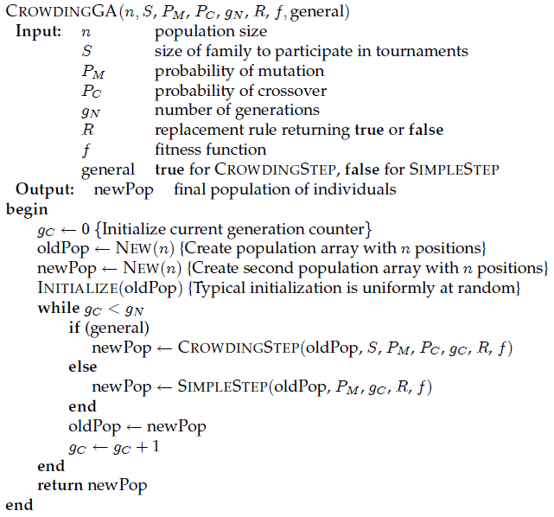
Pseudo-Code, Probabilistic Crowding (1)
Crowding with both mutation and cross-over
Crowding with only mutation
56

Slide 57
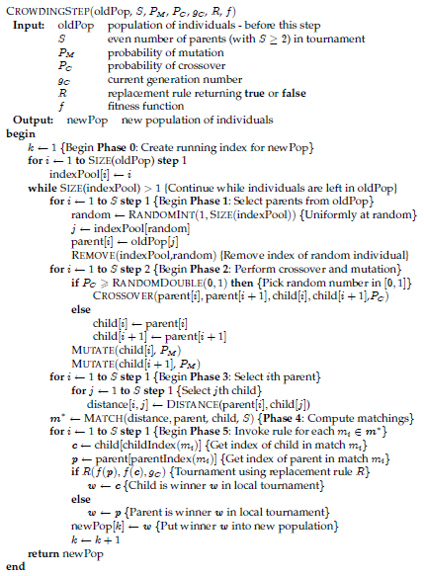
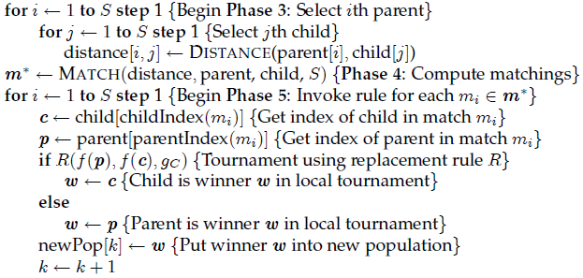
Pseudo-Code, Probabilistic Crowding (2)
Crowding with both mutation and cross-over
Key parts
57

Slide 58
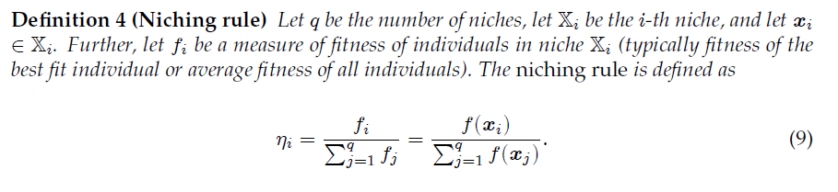
Crowding and Niching
Assume a number of niches partition the search space {0,1}^{m}
Notation x ∈ X means that x is in niche X ⊆ {0,1}^{m}
Niching rule gives n × η_{i} individuals to the i-th niche, n is population size, the niche count
This rule is a “baseline” or “gold standard” for niching:
An analytical prediction of how individuals eventually distribute across niches
Note, the rule does not reflect algorithm dynamics
However, a dynamic variant of this analysis is possible
58

Slide 59
CROWDING Experiments
59

Slide 60
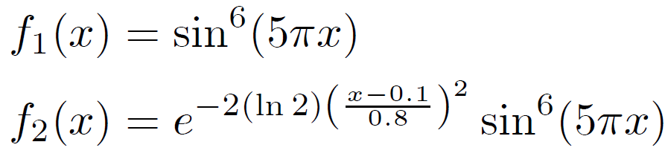
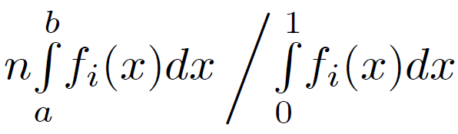
PC Experimental Functions
Simple case:
Use q = 2 or q = 8 discrete niches, uniform jumping probability between niches
Complex case:
Discretization, for interval [a,b) and population size n, of complex case:
60

Slide 61
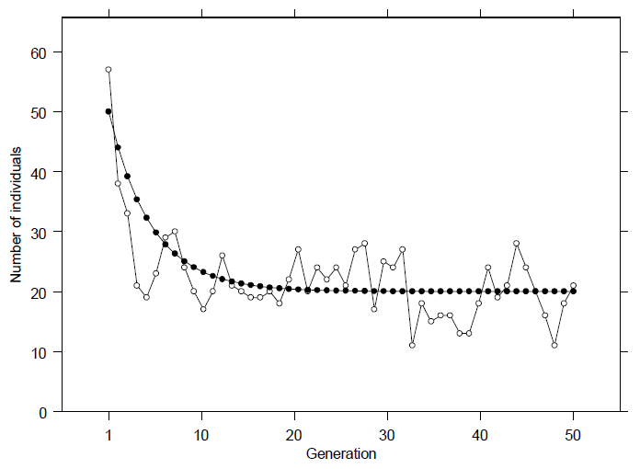
PC Experiments: Two Niches (1)
Allocation out of 100 individuals to one of two niches:
Design:
Predicted niche count (dynamic)
Idealized niches and operators
Results:
Convergence around theoretical value – niching rule
Some noise as expected
Actual niche count (one run)
Predicted niche count (static): niching rule
61

Slide 62
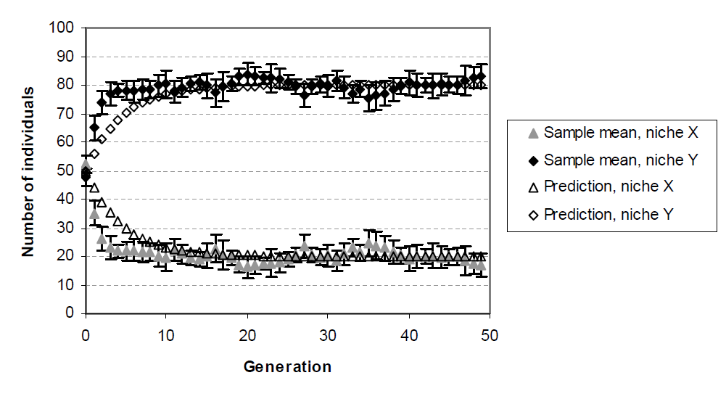
PC Experiments: Two Niches (2)
Actual niche count (multiple runs): average with error bars
Predicted mean niche count
62

Slide 63
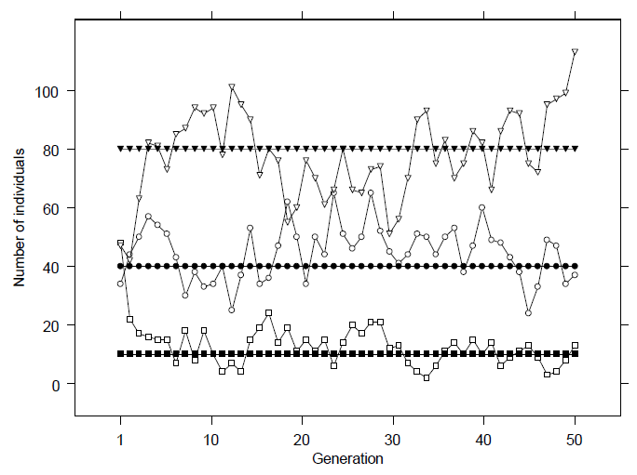
PC Experiments: Eight Niches (1)
Allocation out of 360 individuals to three of eight niches:
Predicted mean niche count at equilibrium – niching rule
Actual niche count (one run)
Design:
Idealized niches and operators
Results:
Convergence around theoretical value
Some noise
63

Slide 64
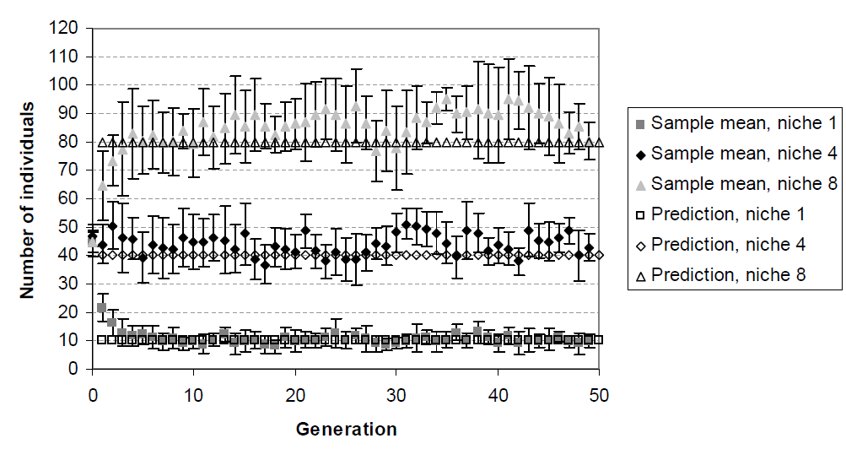
PC Experiments: Eight Niches (2)
Actual niche count (multiple runs): average with error bars
Predicted mean niche count at equilibrium
64

Slide 65
PC Experiments: Five Niches
Design: Traditional niches and operators
Results: Convergence around predicted value
Prediction according to niching rule
65

Slide 66
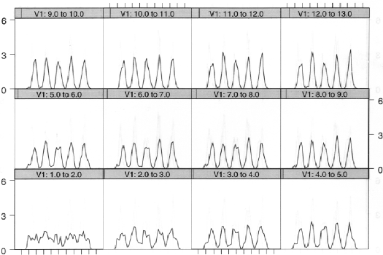
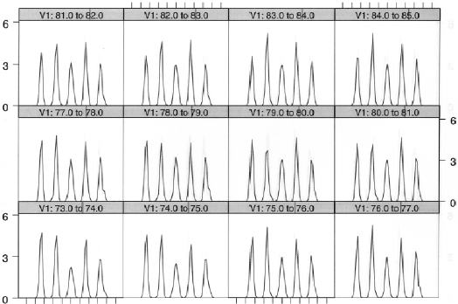
GeneralPCGA on f₁ function (1)
66

Slide 67
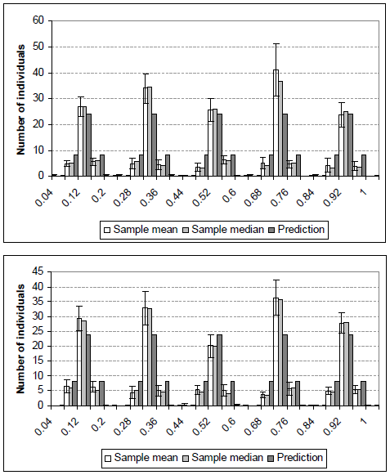
GeneralPCGA on f₁ function (2)
Variant with mutation only (M).
Prediction according to niching rule
Variant with mutation and cross-over (M+C).
67

Slide 68
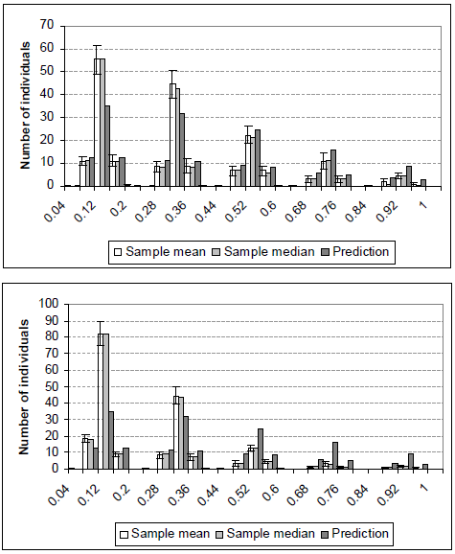
GeneralPCGA on f₂ function (1)
Variant with mutation only (M).
Prediction according to niching rule
Variant with mutation and cross-over (M+C).
68

Slide 69
GC Experiments
Bayesian network: Directed acyclic graph (DAG) whose nodes {X₁,…,X_{n}} represent random variables (here, discrete random variables)
Explanation: assignment of values, {x₁,…,x_{n}}, to the random variables
Computing the Most Probable Explanation (without evidence):
Maximize joint probability, P(x₁,…,x_{n})
An NP-hard problem in general
Two types of experiments:
Experiments with Alarm-ρ network:
DAG is the well-known Alarm BN
conditional probabilities were created randomly: ρ×100% are equal to 0 - the more zeros, the more difficult the search space is for our GAs
Experiments with well-known BNs: Barley, Hepar II, and Water
69

Slide 70
GC Experiments: Barley, Hepar II, and Water
Barley and Hepar II: no zeros (a lower φ leads to better performance)
Water: 29.45% of zeros in the conditional probability tables (φ =1 is superior to the rest)
70

Slide 71
Preserving Diversity: Summary
71

Slide 72
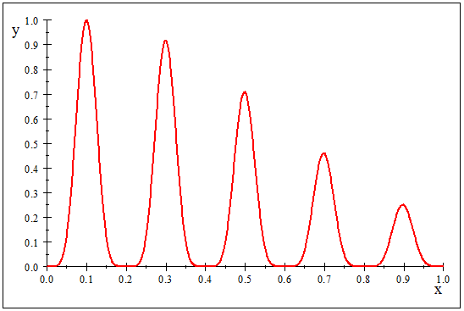
Multi-Modality: GA Convergence
Idealized: Traditional GA (for example, simple GA)
Idealized: Niching GA
Represents individuals – (part of) population
72

Slide 73
Summary for Maintaining Diversity
Explicit versus implicit approaches for maintaining diversity in an EA population
Explicit approaches
Make similar individuals compete with each other for survival – deterministic, probabilistic or generalised crowding
Make similar individuals compete for resources (fitness) – fitness sharing
Implicit approaches:
Impose an “equivalent” of geographical separation, speciation – island model or cellular EAs
This lecture
Later lecture(s)

Slide 74
Questions?
Faculty
74

