Slide 1


ML Capstone Review 1: Air Quality Prediction
Progress review for regression and classification tracks. Team: Adithya, Adwit, Tharun.
Minimalist academic style • Clean white background • Subtle blue/green accents

Slide 2
Scope & Review 1 Objectives
Regression Track
Classification Part A
Deliverables
EDA, preprocessing, feature engineering, regression models & evaluation
Dataset prep, five classifiers, comparison & class-wise analysis
Notebooks, visuals, model comparison tables, rubric alignment
Max 5 bullets per slide — this card sets expectations for Review 1.

Slide 3

Regression — Dataset & EDA (Adithya)
Dataset audit: shape, dtypes, missing values
Feature distributions & outlier inspection
Correlation heatmap & feature–target relationships
Key insight placeholders (to be filled from notebook)
Placeholder: Notebook screenshot of EDA

Slide 4

Regression — Preprocessing & Baselines (Adithya)
Task | Status / Notes
Missing value handling | Imputed / documented strategy
Encoding & scaling | One-hot / StandardScaler
Train-test split | Time-aware / random (notebook note)
Baseline models | Linear, Ridge, Lasso, ElasticNet
Placeholder: Baseline metrics table image

Slide 5

Advanced Regression Models (Adwit)
Models implemented: Polynomial, Decision Tree, Random Forest
Also: Gradient Boosting, SVR, KNN Regression
Focus: performance improvement and robustness
Placeholder: code snippet / model training timeline

Slide 6


Regression Evaluation & Analysis (Adwit)
Pred vs Actual
Metrics
Tuning
Residuals
Evaluation emphasises: standard metrics, tuning, residual diagnostics, and selection of best model.
Placeholder: Residual and Predicted vs Actual plots (notebook)

Slide 7

Classification — Data Prep & Analysis (Tharun)
Step | Notes
Dataset audit | Missing values, features selected
Class distribution | Imbalance checks & strategies
Preprocessing | Encoding, scaling, split
Placeholder | Notebook screenshot of preprocessing

Slide 8




Classification Models (Tharun)
Logistic Regression
KNN
Gaussian NB
Decision Tree & SVM
Instance-based approach
Fast probabilistic model
Baseline linear classifier
Nonlinear and margin-based classifiers
Placeholder: Confusion matrix and classification report images

Slide 9
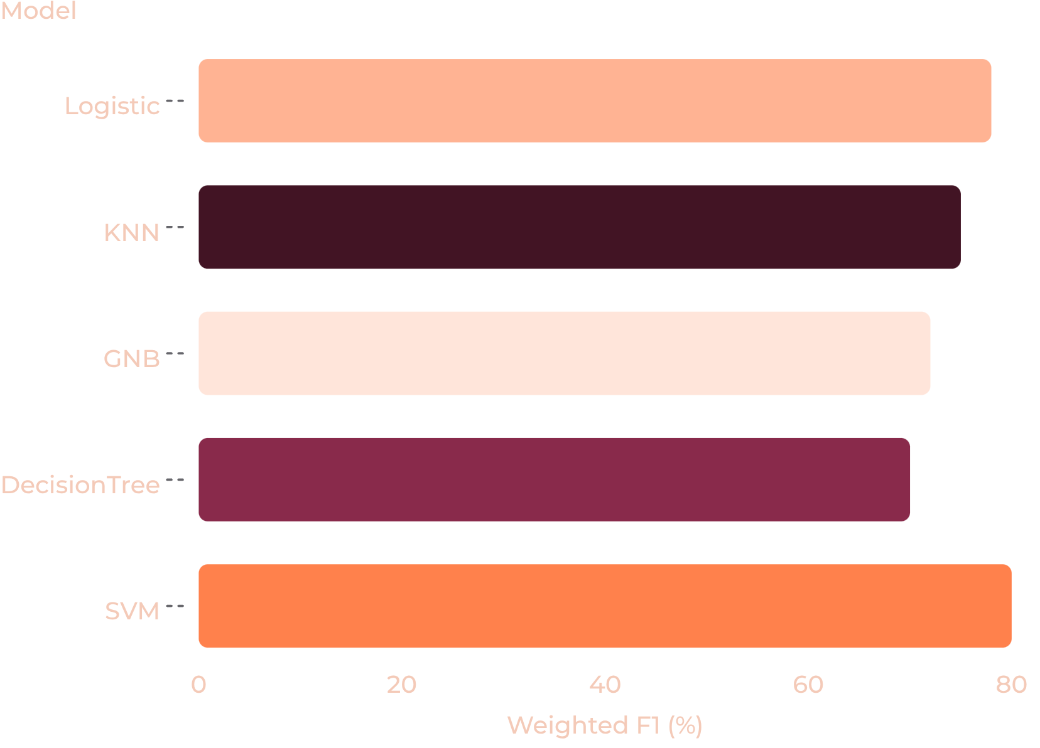
Classification Evaluation (Tharun)
Metrics: Accuracy, Weighted F1, Confusion Matrix
Class-wise performance analysis
Decision thresholds & calibration checks
Visual placeholders for confusion matrices
Placeholder values — replace with notebook results before final review.

Slide 10

Team Progress, Integration & Next Steps
01
02
Notebook integration
Finalize comparisons
Merge individual notebooks; ensure reproducible runs
Compile model comparison tables and select top models
03
04
Visuals & Documentation
Final review prep
Improve plots, add captions, complete markdown
Prepare slides, sanity-check metrics, GitHub commit
Responsibilities summary:
Adithya | Adwit | Tharun
EDA, preprocessing, regression baselines | Advanced regressors, tuning, residual analysis | Classification prep, models, evaluation
Next meeting: present updated notebooks and final model selection

