Slide 1
presenters - Aditya S. Jha & Adarsh Vishesh PROPOSED TOPIC - Sorting Visualizer SUBMITTED TO - Yogesh Sir
Sorting Visualizer using PYTHON

Slide 2
ABSTRACT
This paper outlines a study that tested the benefits of animated sorting algorithms for teaching. To visualize, two sorting algorithms, an application in python was developed . A visualization of data is implemented as a bar graph, after which a data sorting and algorithm may be applied. The resulting animation is then performed either automatically or by the user, who then sets their own pace. This is a research on the computer science curriculum's approach to learning algorithms. The experiment featured a presentation and a survey, both of which asked students questions which may illustrate improvements in algorithm comprehension. These findings and reactions are catalogued in this document and compared to earlier investigations.
Keywords: Sorting Algorithms, React Visualizer, Selection Sort, Merge Sort, Bubble Sort, Insertion Sort, Heap Sort.

Slide 3
Introduction
Sorting algorithms are used to sort a data structure according to a specific order relationship, such as numerical order or lexicographical order. This operation is one of the most important and widespread in computer science. For a long time, new methods have been developed to make this procedure faster and faster. There are currently hundreds of different sorting algorithms, each with its own specific characteristics. They are classified according to two metrics: space complexity and time complexity.

Slide 4
What is Sorting?
Sorting refers to ordering data in an increasing or decreasing fashion according to some linear relationship among the data items.
Sorting can be done on names, numbers and records. Sorting reduces the For example, it is relatively easy to look up the phone number of a friend from a telephone dictionary because the names in the phone book have been sorted into alphabetical order.

Slide 5
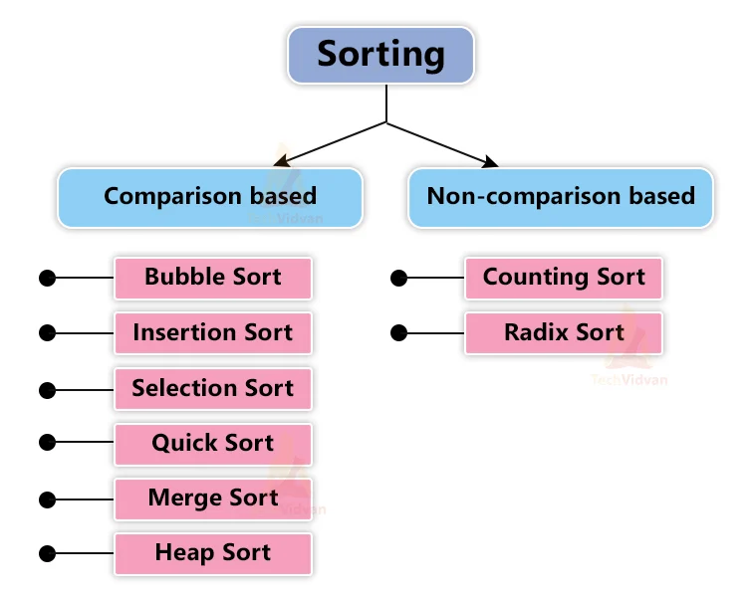
Types of Sorting
1.Selection sort.
2.Bubble sort.
3.Insertion sort.
4.Selection sort.
5.Merge sort.
6.Quick sort.
7.Heap sort.
8.Radix Sort.

Slide 6
Technologies Used
Tkinter
Random Modules
Basic Python
Random Functions

Slide 7
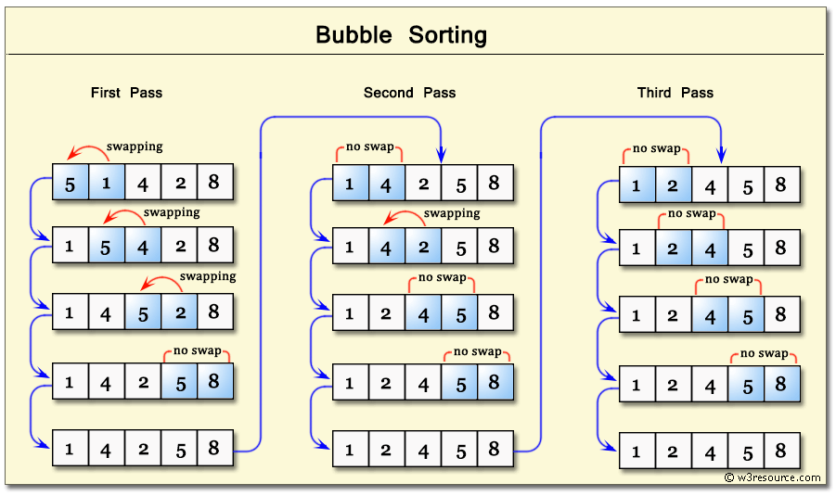
Bubble Sort
Bubble sort, sometimes referred to as sinking sort, is a simple sorting algorithm that repeatedly steps through the input list element by element, comparing the current element with the one after it, swapping their values if needed.
For Example-

Slide 8
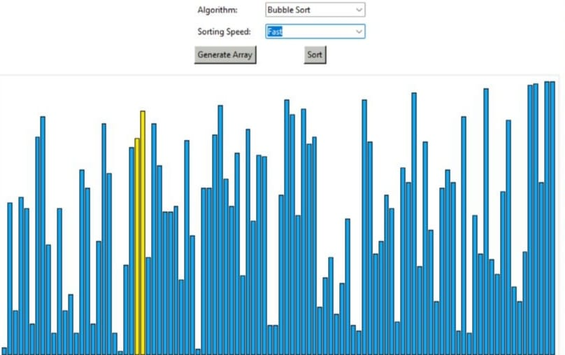
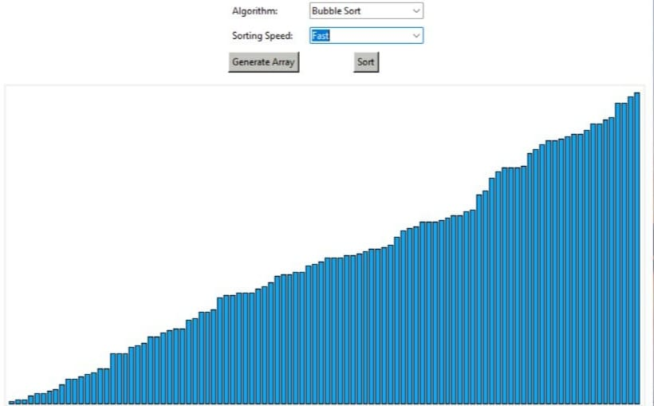
Bubble Sort in Sorting Visualizer
Unorganised Chart
Organised Chart

Slide 9

Uses of Sorting Visualizer
Educational purposes.
Teachers can use it to make their students visualize how the different types of sorting works.
Students can learn by their own with help of this application. It can be used to easily understand the complex nature of different types of sorting algorithms

Slide 10
Reference OR Resources
1. YouTube, Google.
2. https://www.python.org/
3. Books Used-Python Crash Course by Eric Matthes & Head-First Python, 2nd edition
Paul Barry
THANK YOU
For your attention

