Slide 1
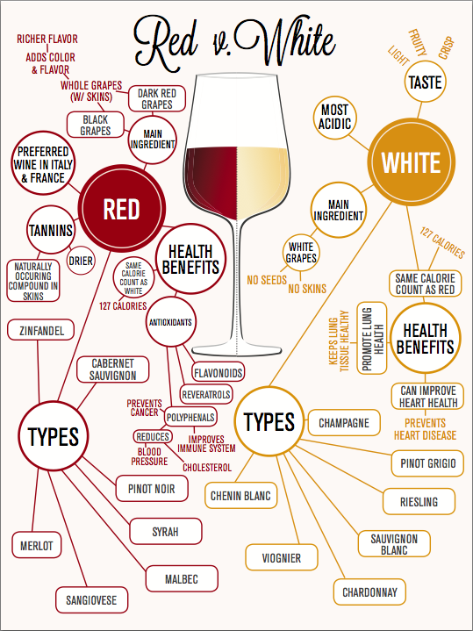
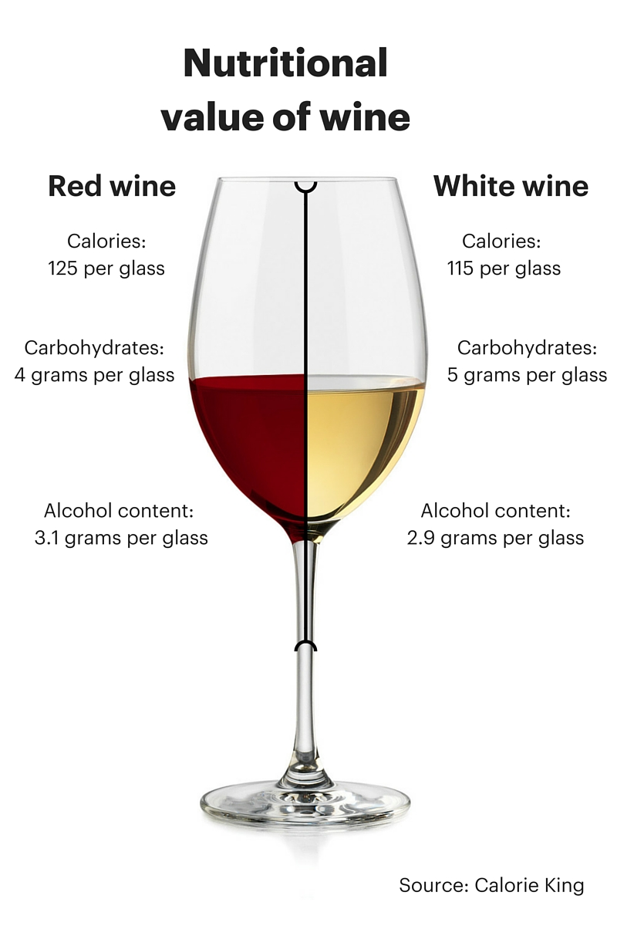

Slide 2
Wine Quality Prediction - Using Machine Learning to predict the physicochemical properties that make a good wine!
By: Adwoa && Owura

Slide 3
Data: Kaggle
Source
https://archive.ics.uci.edu/about
The two datasets are related to red and white variants of the Portuguese "Vinho Verde" wine.
Due to privacy and logistic issues, only physicochemical (inputs) and sensory (the output) variables are available (e.g. there is no data about grape types, wine brand, wine selling price, etc.).
Features
Fixed acidity
Volatile acidity
Citric acid
Residual sugar
Chlorides
Free sulfur dioxide
Total sulfur dioxide
Density
PH
Sulphates
Alcohol
Quality (between 0 and 10)

Slide 4
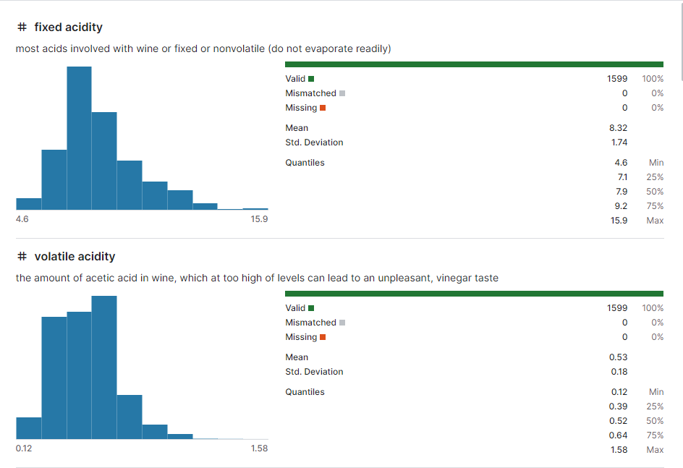
Features Explained: Fixed Acidity && Volatile Acidity

Slide 5
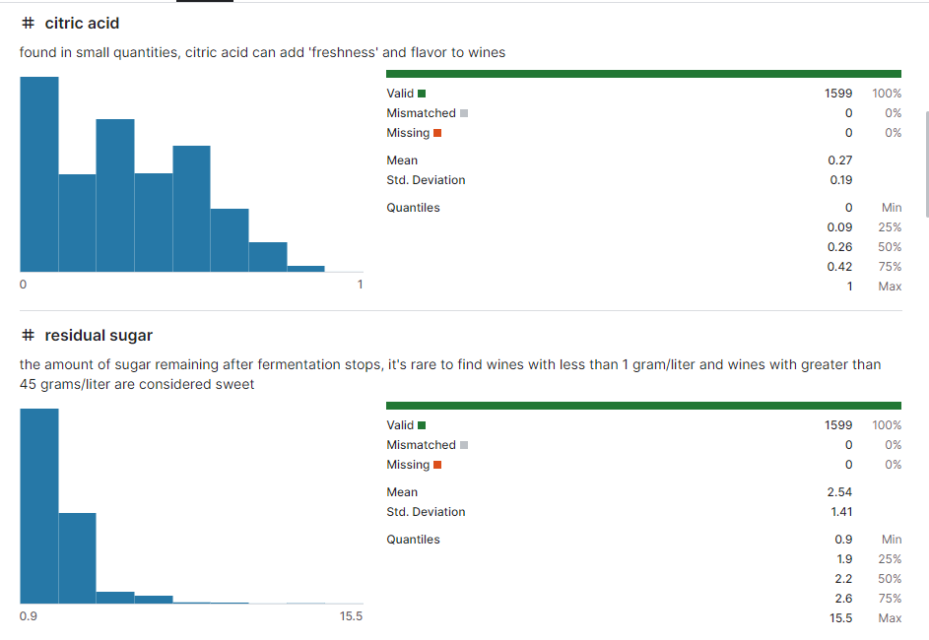
Citric Acid & Residual Sugar

Slide 6
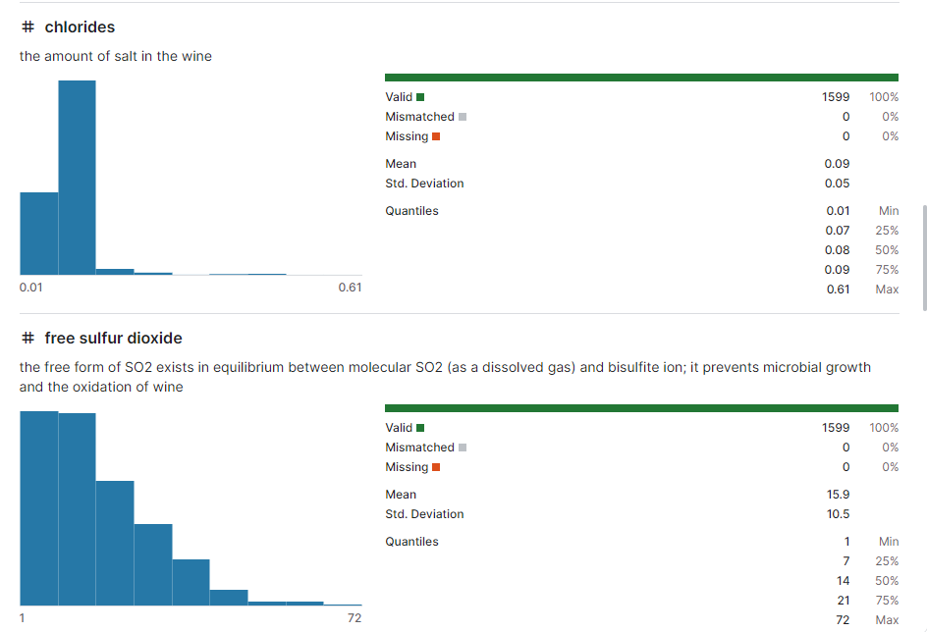
Chlorides && Free Sulfur Dioxide

Slide 7
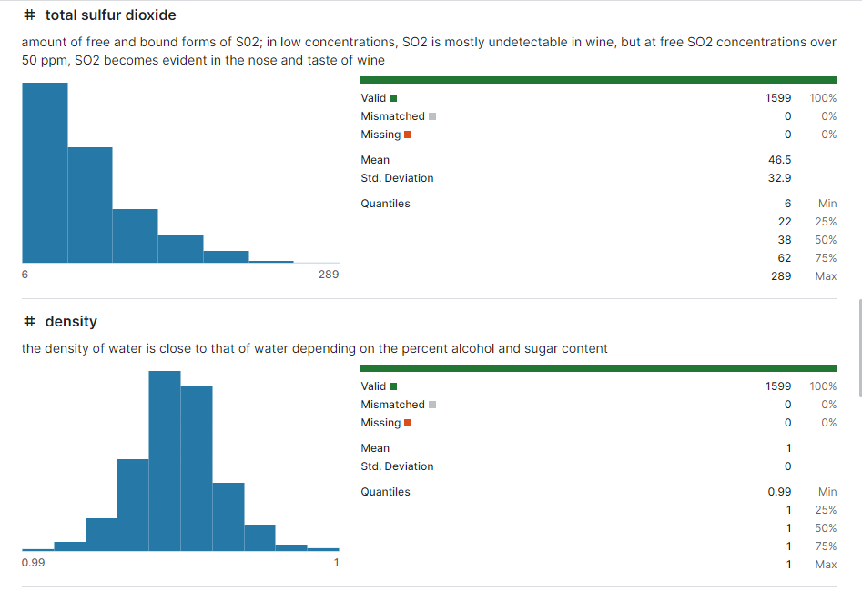
Total Sulfur Dioxide && Density

Slide 8
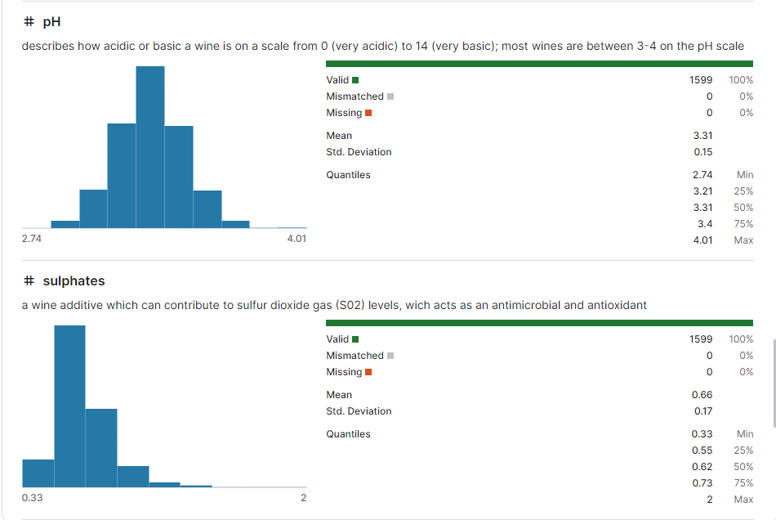
pH && Sulphates

Slide 9
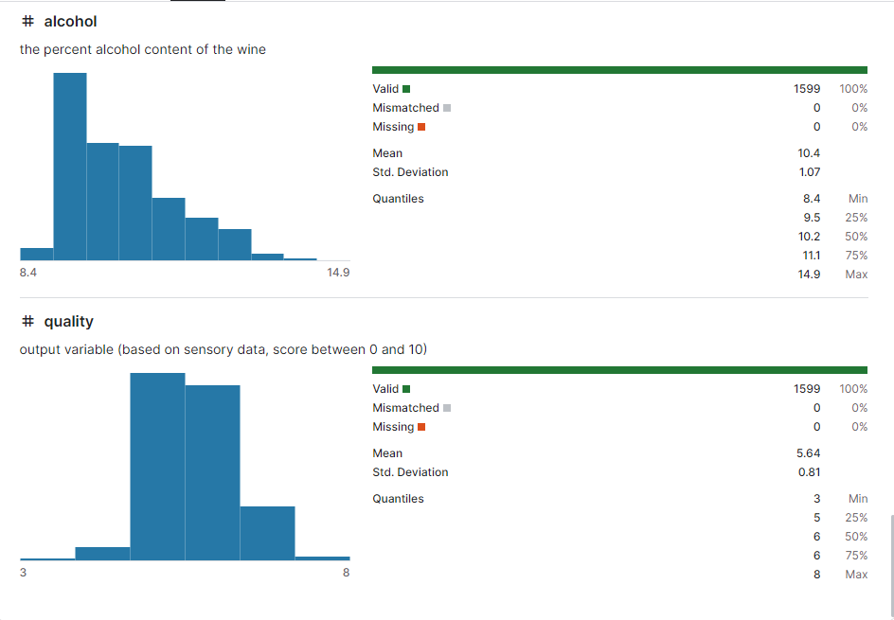
Alcohol && Quality

Slide 10
Exploratory Data Anlysis
Red Wine v White Wine

Slide 11
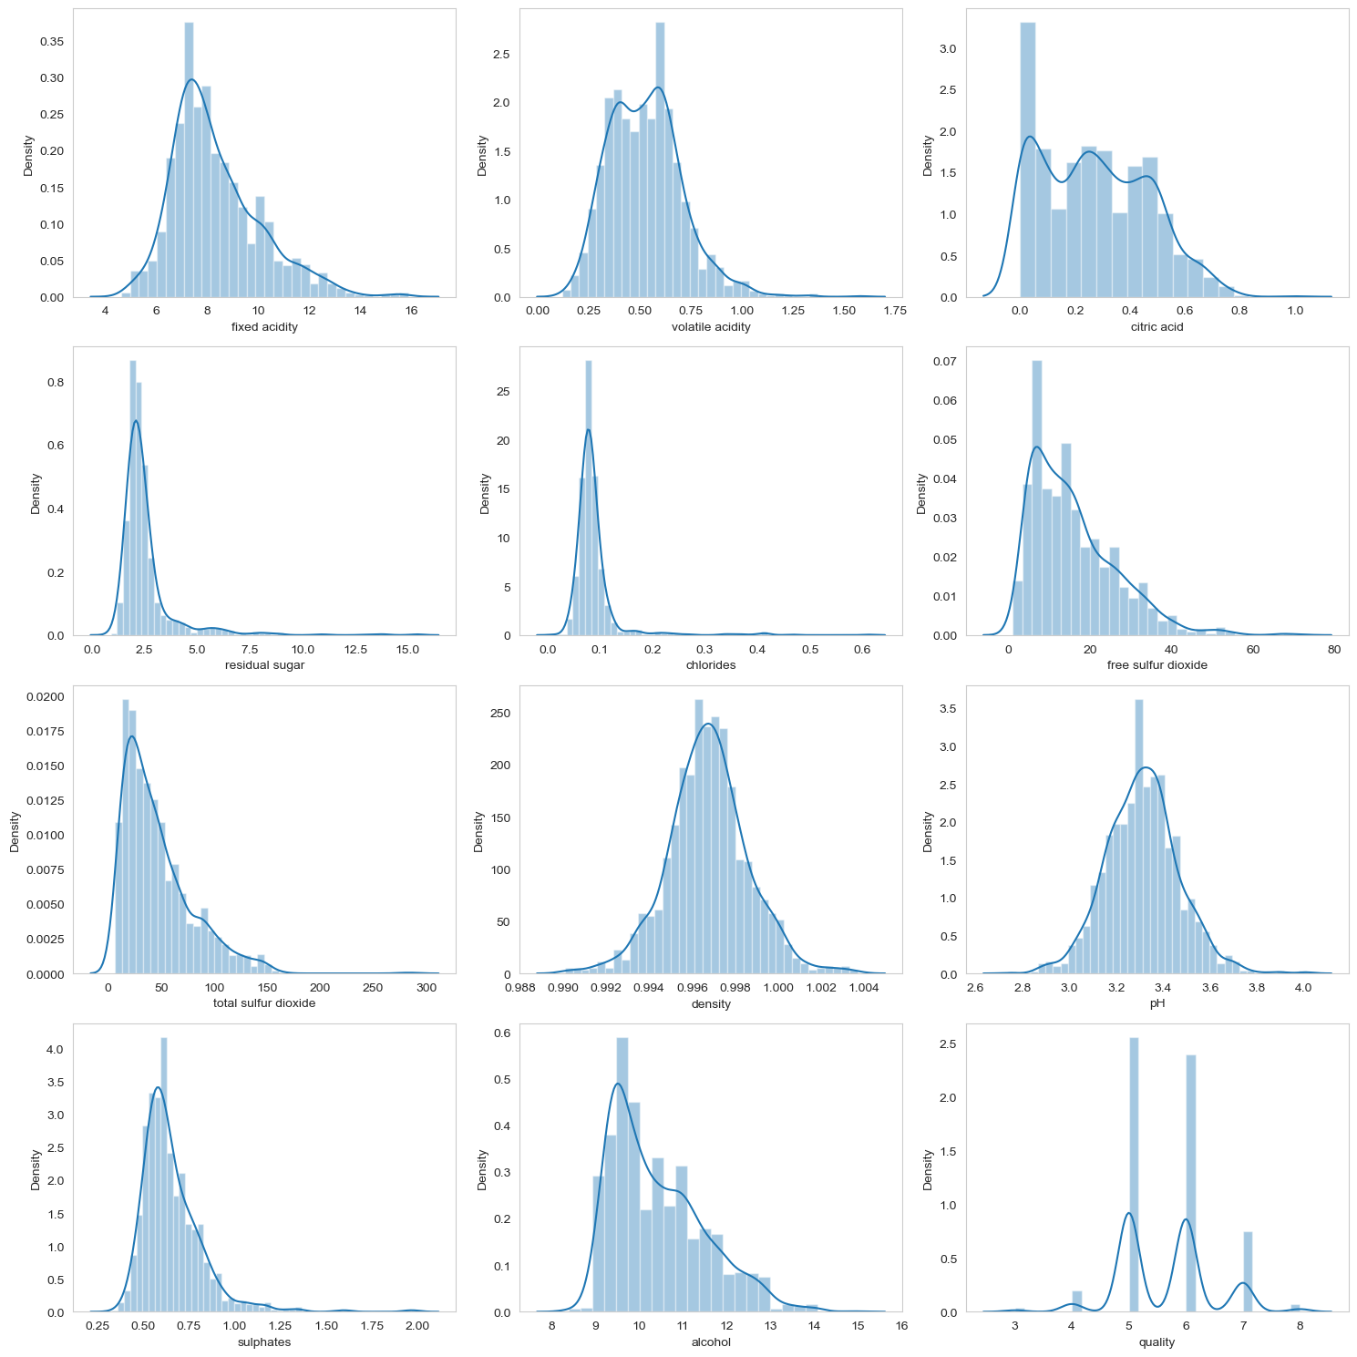

Slide 12
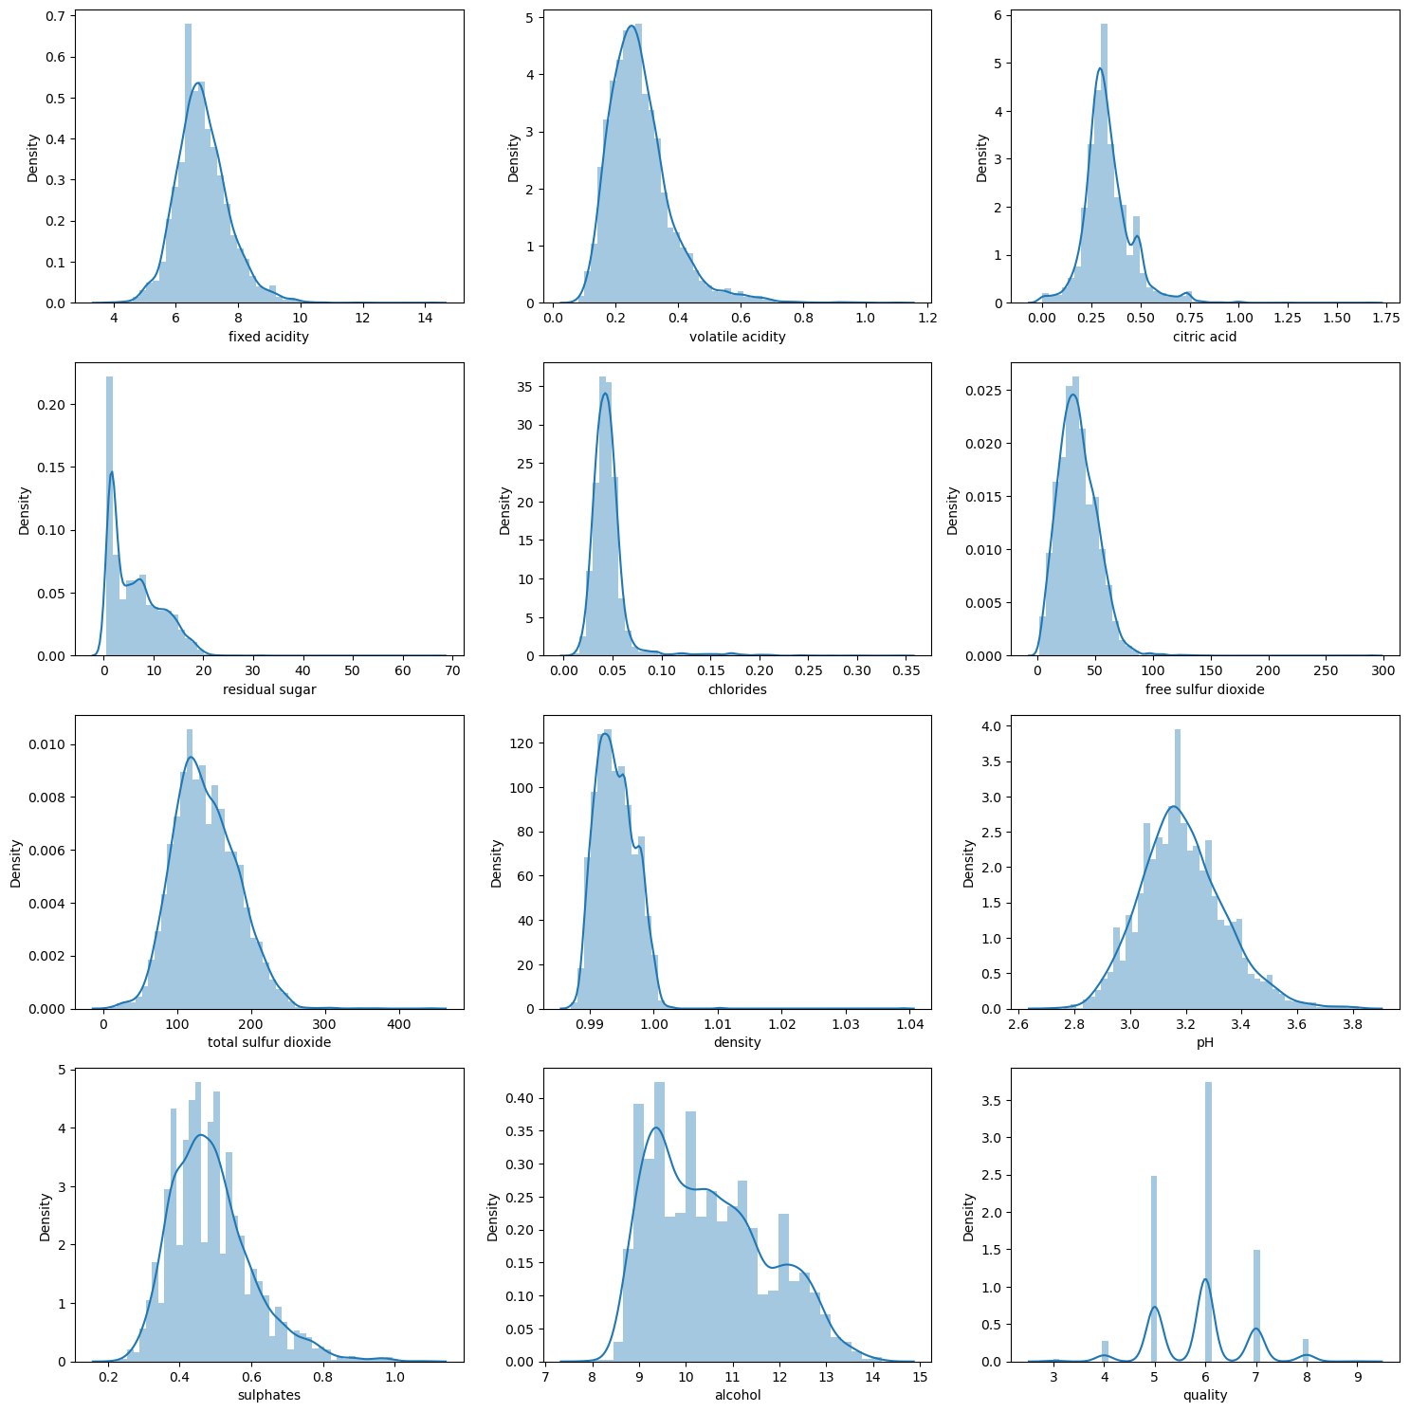

Slide 13
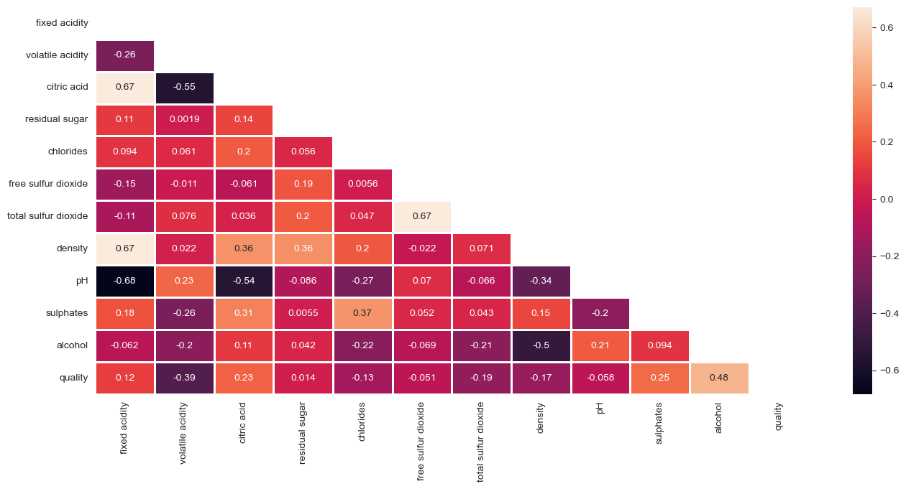
Red Wine - Heatmap

Slide 14
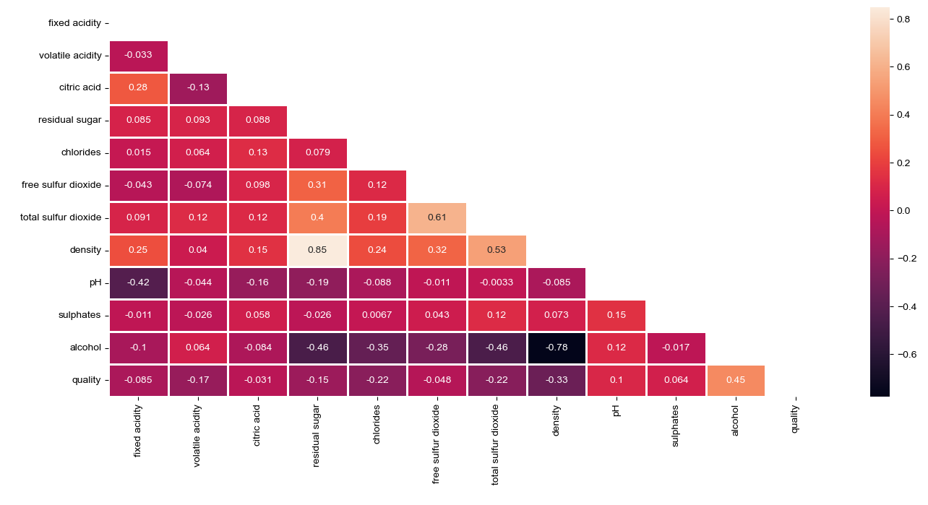
Heatmap - White

Slide 15
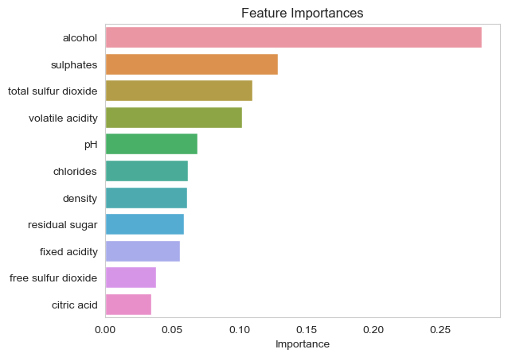
Random Forest Feature Importance - Red

Slide 16
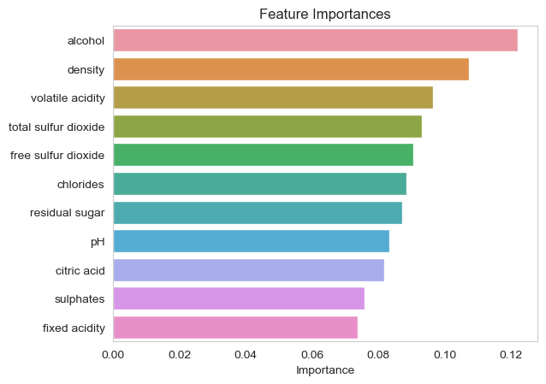
Random Forest Feature Importance - White

Slide 17
Models Implemented:
Logistic Regression
KNN
Decision Tree
Random Forest
Gradient Boosting
LGBM
CatBoost
MLPClassifier

Slide 18
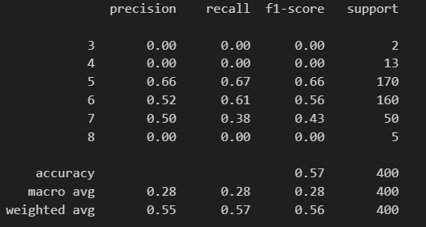
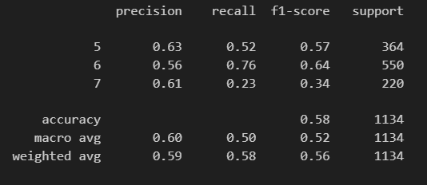
LOGISTIC REGRESSION
Red Wine Performance Metrics
White Wine Performance Metrics

Slide 19
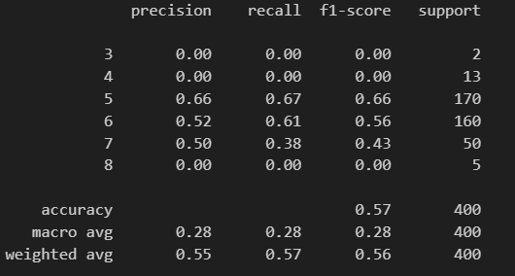
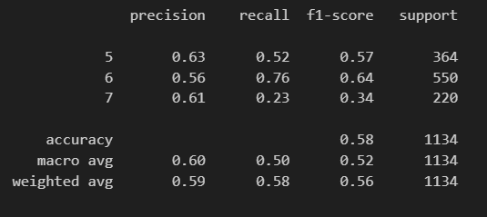
KNeighbors Classifier
Red Wine Performance Metrics
White Wine Performance Metrics

Slide 20
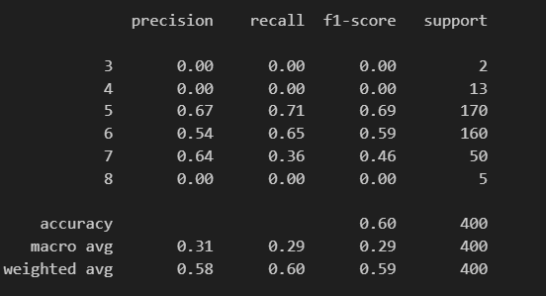
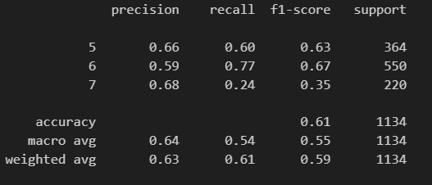
Support Vector Classification
Red Wine Performance Metrics
White Wine Performance Metrics

Slide 21
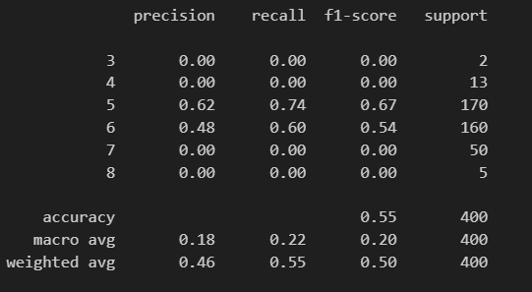
Stochastic Gradient Descent
Red Wine Performance Metrics
White Wine Performance Metrics

Slide 22
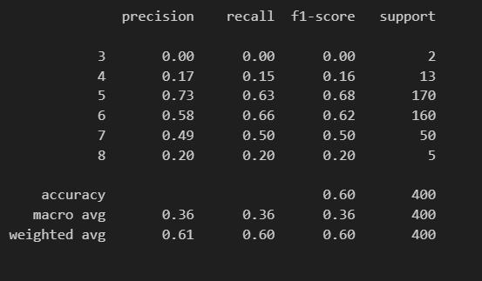
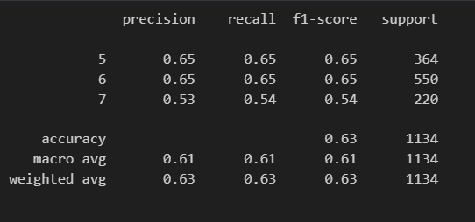
Decision Tree
Red Wine Performance Metrics
White Wine Performance Metrics

Slide 23
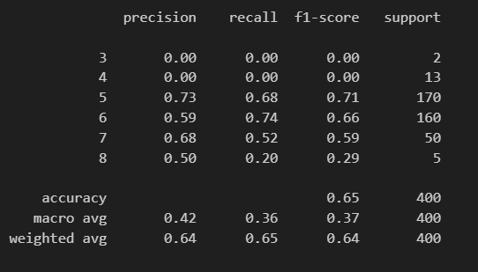
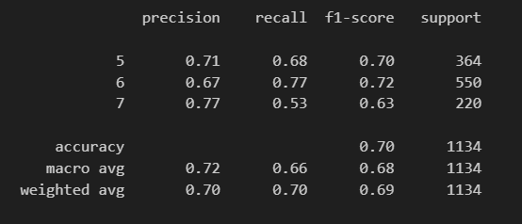
Random Forest
Red Wine
White Wine Performance Metrics

Slide 24
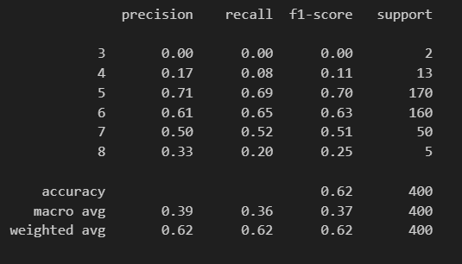
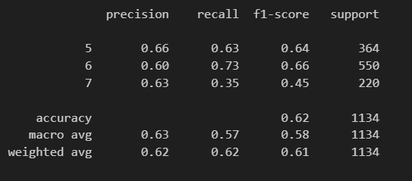
Gradient Boosting Classifier
Red Wine
White Wine

Slide 25
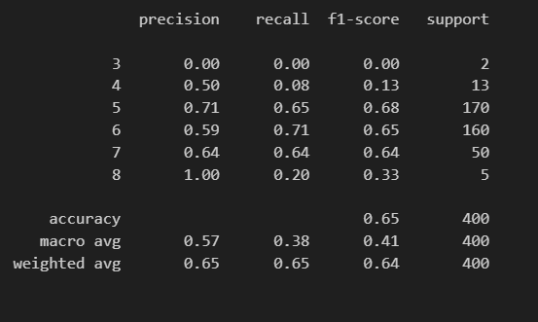
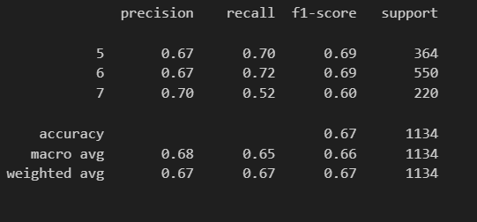
Light Gradient Boost Classifier
Red Wine
White Wine

Slide 26
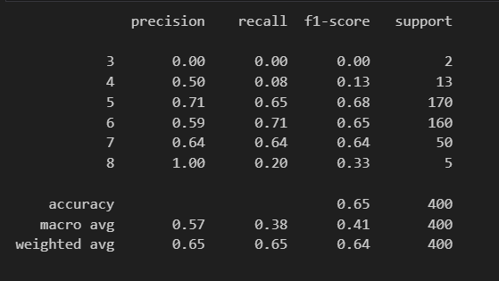
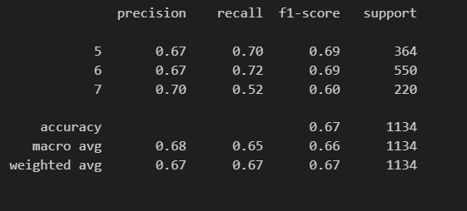
CatBoost Classifier
Red Wine
White Wine

Slide 27
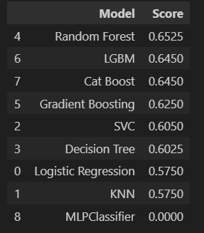
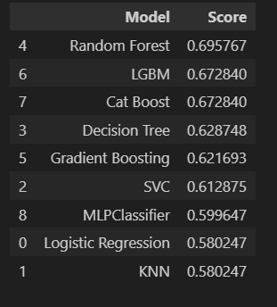
Models Score Dataframe
Red Wine
White Wine

Slide 28
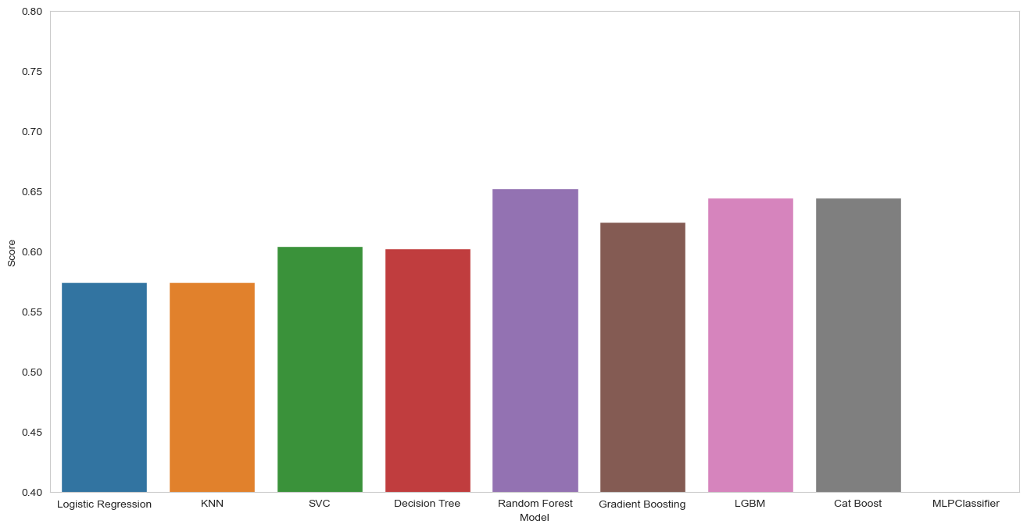
Graphical Representation - Red Wine

Slide 29
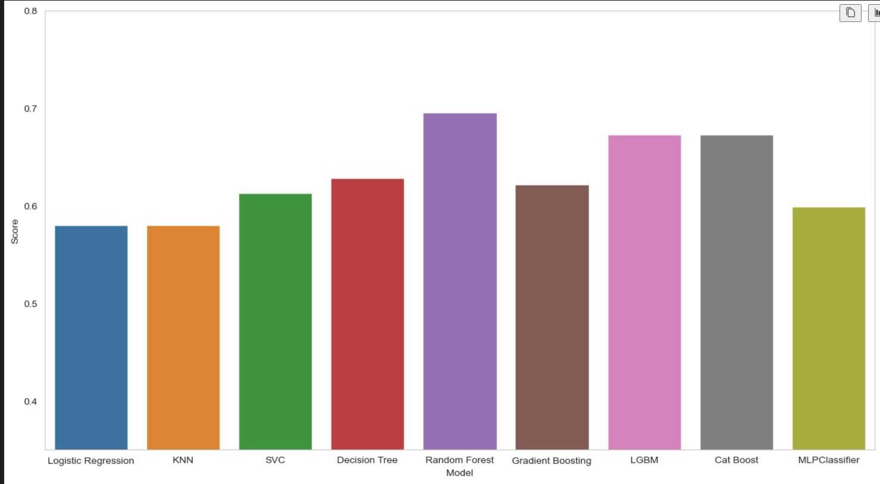
Graphical Representation - White Wine

Slide 30
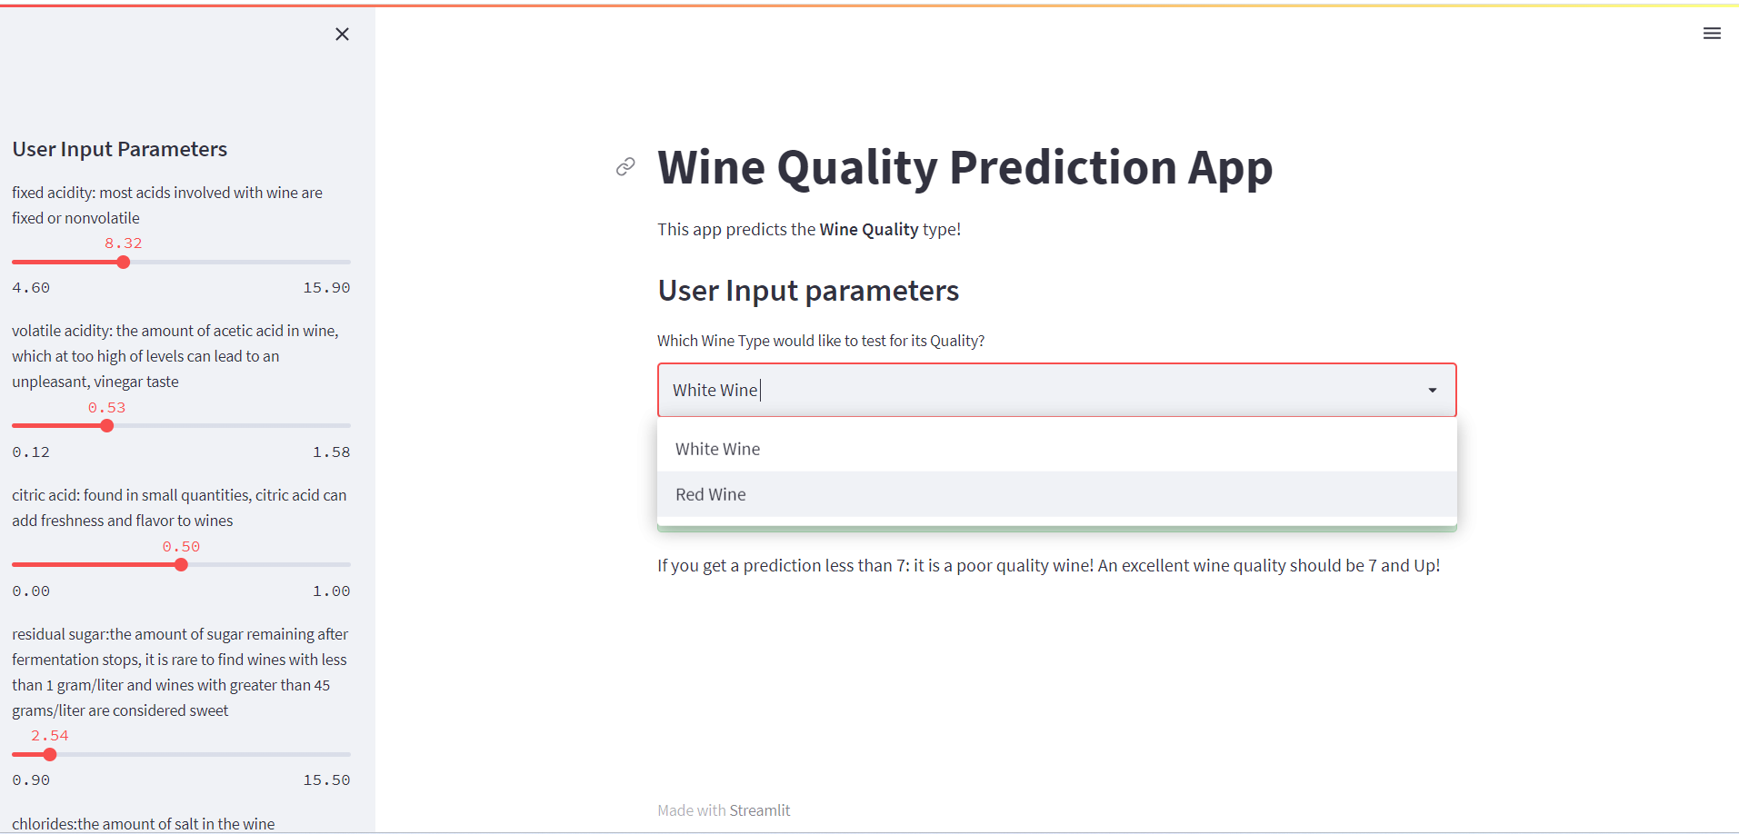

Slide 31
Streamlit App Demonstration

Slide 32
Data Sources
https://www.kaggle.com/code/pathaksharma/red-wine-classification/input
https://archive.ics.uci.edu/dataset/186/wine+quality

Slide 33
Future Improvements
We would have love to get the datasets that gave specifics to the grape types, wine brand, and wine selling price to give our users a fair idea of the best quality of wines available on the market
Incorporate additional features or data sources such as wine origin or production process to improve prediction accuracy.
Experiment with advanced machine learning algorithms or ensemble techniques to further enhance model performance.
Enhance the user interface and visualization capabilities of the Streamlit application based on user feedback.

