Slide 1
Regression Testing
Software Quality Webcast
Monica Luke
mluke@us.ibm.com
IBM Software, Rational
April 2013

Slide 2

Agenda
What & why of Regression testing
Leveraging Automation
Managing the regression suite
Maximizing your team

Slide 3
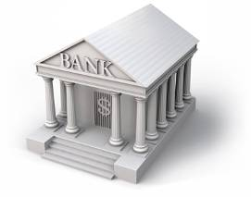

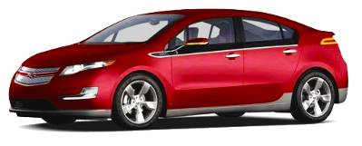
Innovation is being driven by software
Mobile banking will be
the most widely used banking
channel by 2020, if not sooner
The average 2010 automobile
contains more lines of software
code than a fighter jet
Are we compliant?
Will it perform?
Is it secure?
Source: Mobile banking: A catalyst for improving bank performance, Deloitte, 2010;
and This Car Runs on Code, Robert Charette, IEEE Spectrum, 2009.

Slide 4

Software quality is a major problem across all industries
Software is blamed for more major business problems than any other man-made product.
Poor software quality has become one of the most expensive topics in human history
  $150+ billion per year in U.S.
  $500+ billion per year worldwide.
Projects cancelled due to poor quality are 15% more costly than successful projects of the same size and type.
Source: Capers Jones, 2011
Based on 675 companies, 35 government/military groups, 13,500 projects, 50-75 new projects/month, 24 countries, 15 lawsuits

Slide 5

Regression Testing
The objective of a test is to find defects
  New features or software are typically buggy. We want to “shake that out”
The objective of a regression test is to NOT find defects
  Validate that the software is the same as the previous release, build, milestone
Regression testing results are an important tool in
determining software quality

Slide 6

One way to not find defects is to not run any regression tests

Slide 7

Does it work as expected?
Regression testing defines application stability
  It performs as it has in the past
  All the changes did not introduce failures in things that used to work
  It greatly impacts the perception of quality
Patch releases require a lot of regression tests
  Small number of product changes
  But still have to validate all existing functionality
  It’s really important to build automation in v1….
  so it’s ready for all those patches!

Slide 8

It’s a delicate balance
Like pretty much everything about software development
Mature products tend to have a lot of expectations about things that have worked in the past
  And a lot of tests to prove it
  What if they aren’t automated?
If you run everything that’s ever been run in the past (automated or manual)
  How long will that take?
  How much value does it add?
  What level of confidence does that imply?

Slide 9


Making the technical decision on how to automate
API
  Product change is usually behind the API, not TO the API
  Focus on API sequencing used by the GUIs & customer scenarios
  SOA or other services make this available
GUI
  Stability: Work with the product development team to consider GUI as a feature that needs to be stabilized in iterations
  Valuable GUI automation is available before the end of the release

Slide 10
Automation choices…
Design your automation solution to leverage your architecture and reduce maintenance
GUI
API Tests –
Integration scenarios
Unit Test & TDD

Slide 11


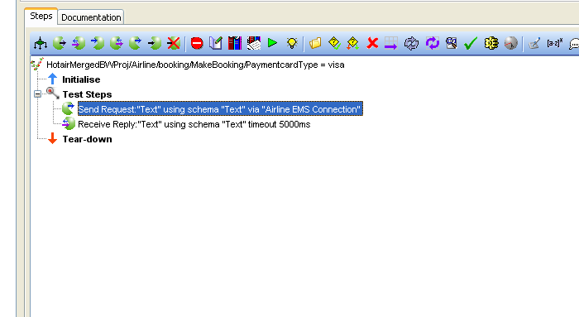
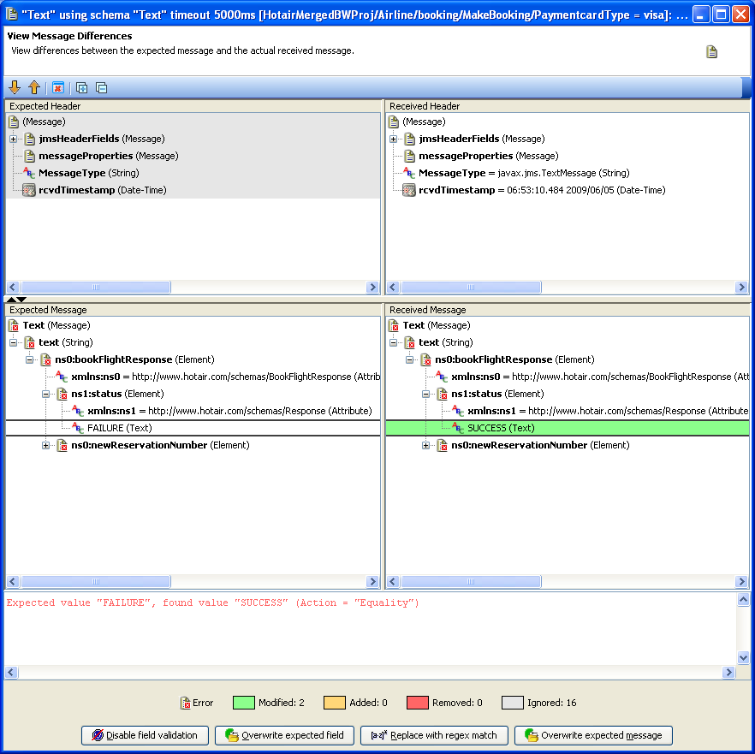
Automating APIs
Automate regression testing throughout the testing lifecycle
Test across all technologies, from web services, to mainframe, mobile, etc.
Test complex systems-of-systems integration
Rational Test Workbench: Integration testing
Notes:
IBM INTERNAL USE ONLY

Slide 12
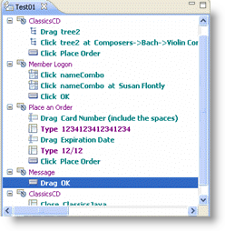
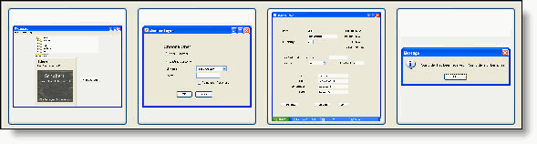
Automating GUIs
Increase repeatability through automated test playback
Test more critical functions faster with automation
Track and communicate progress and regressions throughout the testing lifecycle
Rational Test Workbench: GUI Functional testing
Notes:
IBM INTERNAL USE ONLY

Slide 13




















What about running those tests?
System dependencies are a key challenge in setting up test environments
  It takes too long
  It takes too much hardware
  It’s too complicated
  No one knows how to set up EVERYTHING
Public Cloud
Private Cloud
Routing
Service
App Under Test
Content
Providers
EJB
Business Partners
Collaboration
Third-party
Services
Archives
Shared
Services
Portals
Messaging Services
File systems
Directory Identity
Data Warehouse
Mainframe
Enterprise Service Bus
Heterogeneous Environments

Slide 14
Automate test environment setup
Public Cloud
Private Cloud
Routing
Service
App Under Test
Content
Providers
Business Partners
App Under Test
Collaboration
EJB
Third-party
Services
Archives
Shared
Services
Portals
Capture
& Model
Messaging Services
File systems
Directory Identity
Databases
Mainframe
applications
Third-party
Services
Enterprise Service Bus
Packaged apps, messaging services, etc.
Data Warehouse
Mainframe
Virtual Services
Heterogeneous Environments
Virtual Services simulate the behavior of an entire application or system during testing
Virtual Services can run on commodity hardware, private cloud, public cloud
Each developer, tester can easily have their own test environment
Developer and testers continue to use their testing tools (Manual, Web performance, UI test automation)
Rational Test Virtualization Server

Slide 15
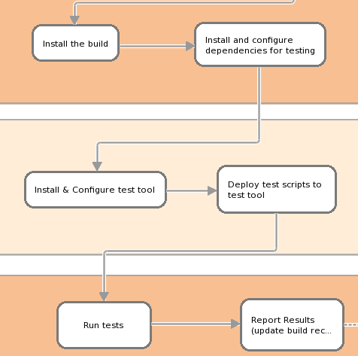
Lights out testing? – Paging DevOps!
Service Virtualization
IBM SmartCloud Continuous Delivery

Slide 16
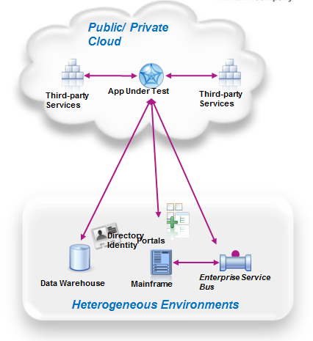
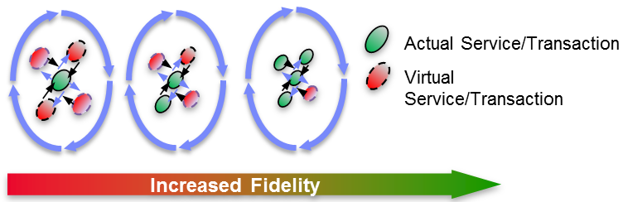
Regression suite environments
Risk and efficiency questions
  How close to production does the test environment need to be?
  Balancing setup time & cost against fidelity
How many patches? How many runs?
How much change?
Rational Test Virtualization Server + IBM SmartCloud Continuous Delivery

Slide 17

Water, water everywhere
What do I do with all these tests?
Successfully building tests leads to, um, too many tests
Even if it’s all automated it can take too long to run everything
  And do you need to ?
  How to define the right amount of test coverage for a regression suite?

Slide 18
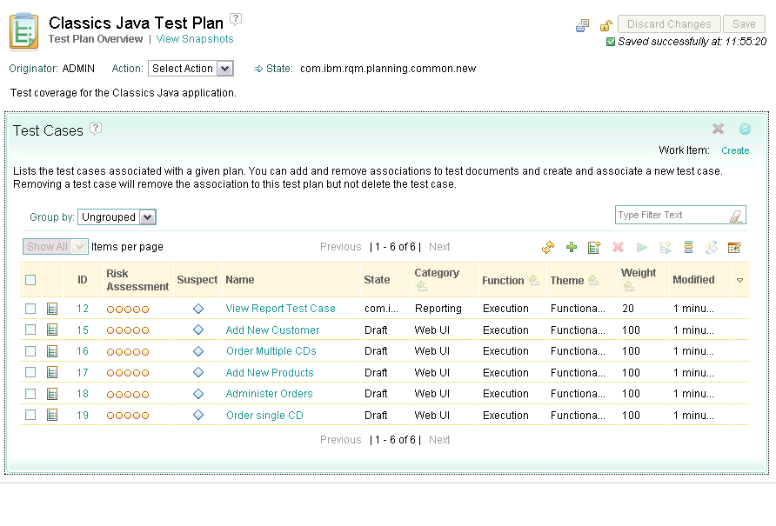
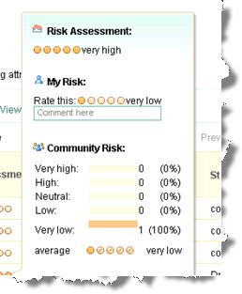
Planning for risk management
Collaborative planning of risk mitigation strategy
Risk assessments captured in Test Plan and Test Cases
Base project planning on qualitative risk analysis
Test Case will contain a risk failure score and a risk priority score
Documented risk related decisions
IBM Rational Quality Manager

Slide 19
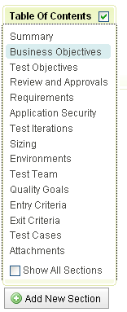
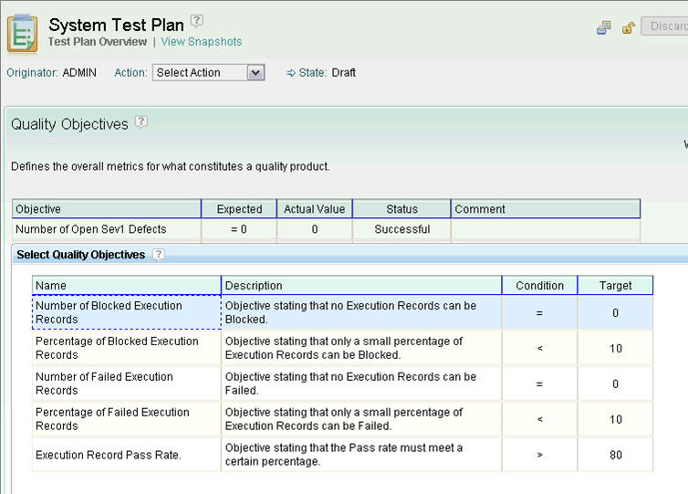
Comprehensive real-time test planning
Visibility across the entire team
A Test Plan is a dynamic view, not an artifact
  Defines test process, scope, strategy
  Can be tailored to specific process. certification, or qualification standards
  Activities are connected to the execution and always reflect up-to-date information
A Test Plan is a realtime dashboard into a set of business objectives
  Quality criteria are clearly defined, and can be reused across projects, iterations
  All team members are working towards the same objectives
  Reporting and dashboards inform all stakeholders on status and progress
IBM Rational Quality Manager

Slide 20
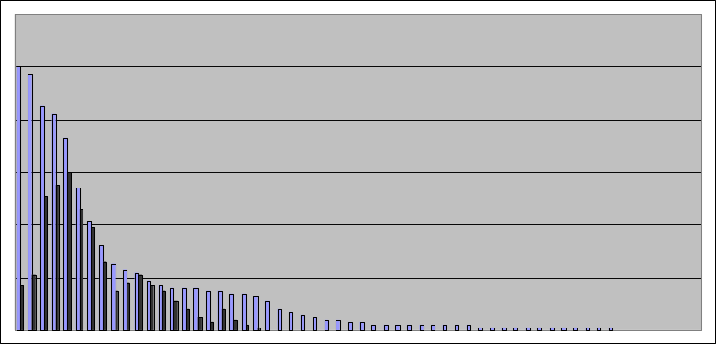
Automate where it matters most!
Assume a new feature, or a change in Requirements… Executing the full regression tests is expensive and often unrealistic!
What about several suites of automated regression tests…
  Highest Return: Execute tests that contribute to high coverage of the requirements, then any others…
  Quickly Lower Risk: Execute tests for the most critical requirements, then any others…
  Practically Safe: Execute tests for all the critical requirements, then any others…
    Especially since often ~20% of the test cases are covering ~80% of the business value
Requirements Coverage
High requirements
①
Most critical Requirements
②
Low contribution
③
Test Suites
IBM Rational Quality Manager

Slide 21






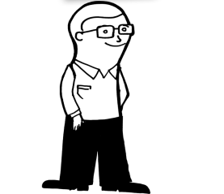

Maximize your team’s productivity
Planners
  Plan for regressions
  Choose the right areas to regress
  Report on regression test results
Do’ers
  Create regression tests
  Maintain regression tests suites
Automated Do’ers
  Execute regression tests
  Automate test execution

Slide 22



Leverage traceability
Requirements Composer
Team Concert
Quality Manager
Collection
Plan
Test Plan
Story
Work Items
Test Cases
Story
Story xyz
Test Cases
Test Scripts
Test Scripts
Requirements
Defects
Test Results
Requirements
Defects
Test Results
Rational Collaborative Lifecycle Management

Slide 23




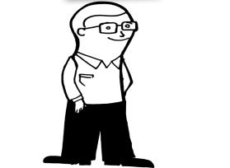

Build in regression testing as a matter of habit
Planners
  Plan for regressions – every release, every update
  Choose the right areas to regress – high use, high risk areas
  Report on regression test results – every build, every milestone
Do’ers
  Create regression tests – update regression suite after each release
  Maintain regression tests suites – re-run the suite and update after each release
Automated Do’ers
  Execute regression tests – use tools to integrate regression runs into your builds

Slide 24
Regression testing: quality differentiator for your team
Your team will be honored for a high degree of business value.
High software quality will become a product differentiator
  $$$
  Growth
Projects will exceed expectations!

Slide 25

Summary
A Goldilocks problem
  It’s easy to have too much or too little regression testing
  Prepare for pruning the regression suites
Build automation destined to be regression testing as soon as possible
  Consider this use case when deciding what to automate and how
  Your organization’s patch support and cycle is a focus
Combining automation techniques is powerful
  Automate test setup through service virtualization
  Automate APIs for service testing, functional tests and customer scenarios
  Automate via the GUI for end-user experience validation

Slide 26


Slide 27

www.ibm.com/software/rational
© Copyright IBM Corporation 2011. All rights reserved. The information contained in these materials is provided for informational purposes only, and is provided AS IS without warranty of any kind, express or implied. IBM shall not be responsible for any damages arising out of the use of, or otherwise related to, these materials. Nothing contained in these materials is intended to, nor shall have the effect of, creating any warranties or representations from IBM or its suppliers or licensors, or altering the terms and conditions of the applicable license agreement governing the use of IBM software. References in these materials to IBM products, programs, or services do not imply that they will be available in all countries in which IBM operates. Product release dates and/or capabilities referenced in these materials may change at any time at IBM’s sole discretion based on market opportunities or other factors, and are not intended to be a commitment to future product or feature availability in any way. IBM, the IBM logo, Rational, the Rational logo, Telelogic, the Telelogic logo, and other IBM products and services are trademarks of the International Business Machines Corporation, in the United States, other countries or both. Other company, product, or service names may be trademarks or service marks of others.

