Slide 1

StickyMinds.com and Better Software magazine presents…
How to Build a Testing Center of Excellence
Sponsored by Cognizant
This event aired on July 8, 2008.

Slide 2

TCOE
Building
Testing
centers of Excellence
© 2007, Cognizant Technology Solutions. Confidential

Slide 3
Agenda
Testing CoE
Voice of Customers
TCoE Models
Scope
Activities
Critical Success Factors
Key Considerations
TCoE Ecosystem
Q&A
© 2007, Cognizant Technology Solutions. Confidential

Slide 4

Testing is expensive
BAs perform the role of QA
Testing is time-consuming
Inconsistency in testing approach
No testing value-adds
Testing in one group is high
Increasing Business User Demand,
Diversified Technologies and
locations with different approaches
Lack of standards, tools, metrics,
templates for quality assessment,
comparison across projects
© 2006, Cognizant Technology Solutions. Confidential
© 2007, Cognizant Technology Solutions. Confidential

Slide 5
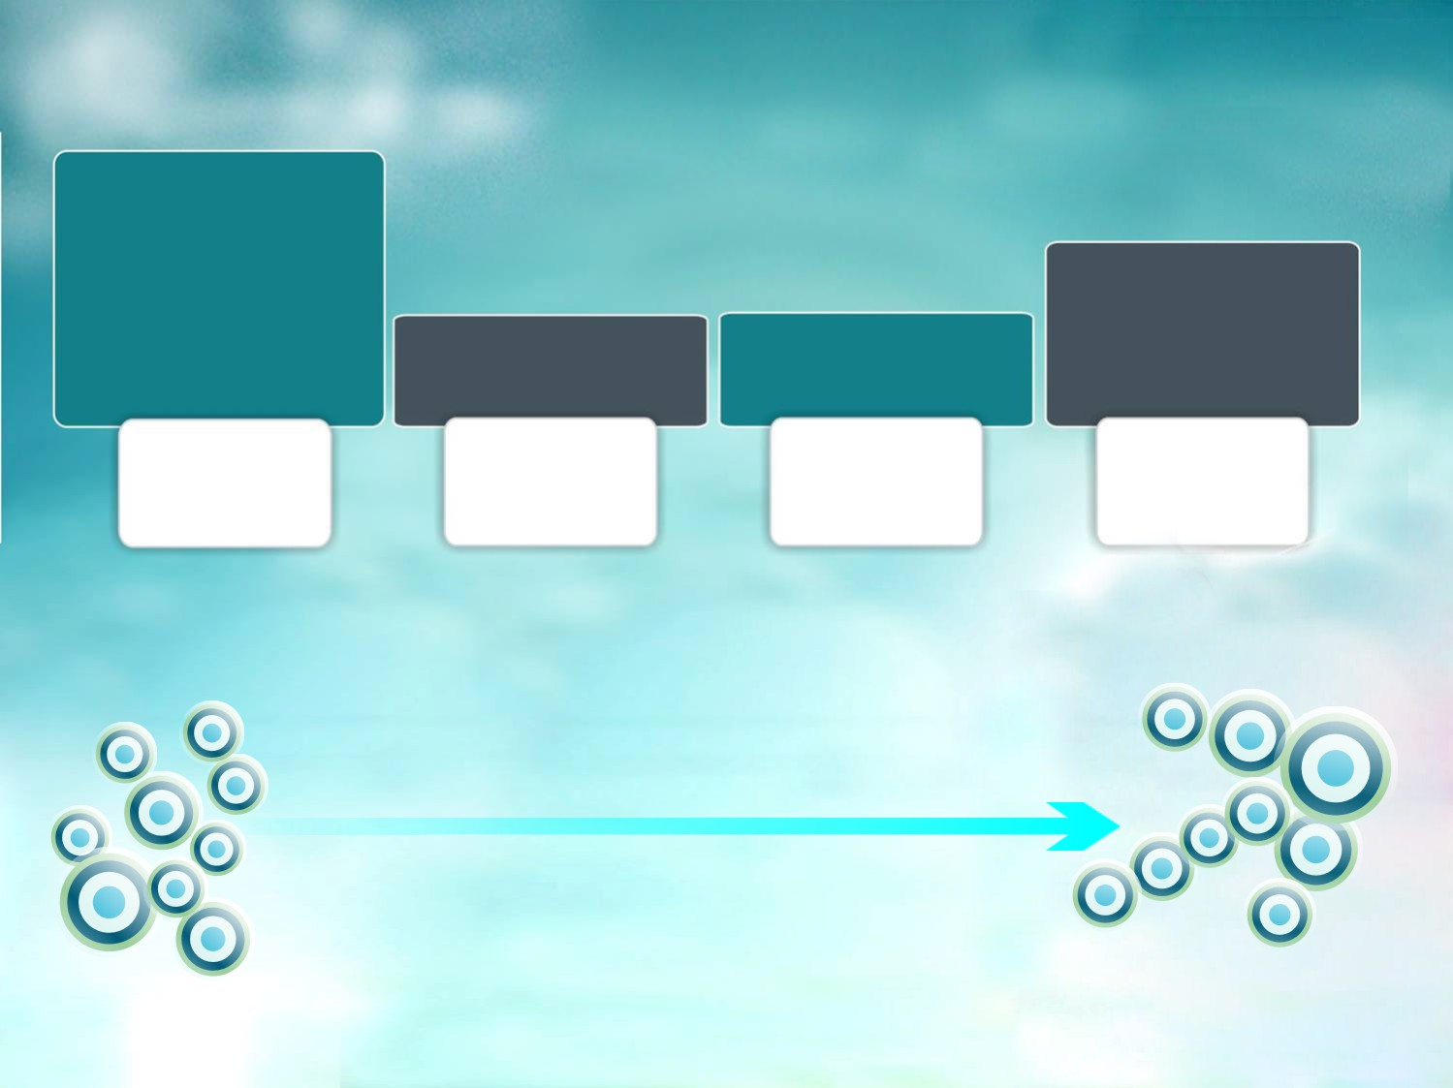

  Definition | Development |
  Maintenance of test processes,
  standards & templates
  Facilitation of Test Management Community
  Metrics Reporting & Management
  Test Process Training
  Continuous Process Improvement (CPI)
  Provision of Functional, UAT & liaison services
  Flexible resource pool creation
  Provision of specialized testing services
  Provision | Administration | Support of Test Infrastructure and Test Tools
  Provision of NFT Services & Test Automation Services
  Technical Test Consultancy
Testing
Process CoE
Testing
Tools/ Infrastructure CoE
NFT &
Automation CoE
Shared
Testing Team
centralized
Decentralized
© 2007, Cognizant Technology Solutions. Confidential

Slide 6
Continuous Integration
Build / Dependency Management
Unit / Test Drivers
Listeners / Configuration Management
BDD
Design Patterns
Helpers / Utility Functions
Test Automation Tools
Reporting
Java / .NET
Technology
Stacks
Standard process
& Frameworks
Common Tools,
Infrastructure & Automation
Solution
Accelerations/
Best practices

Slide 7
Testing Process CoE
Programming Languages
Java
.NET
External Systems
Selenium WebDriver - Web
LeanFT – Thick Client
SoapUI – Webservices
Java/C# - API / Services
Java – database
Mobile – Responsive apps (Selenium)
Bamboo (CI)
Maven (Build/Dependency Management)
Unit Testing – TestNG/jUnit MSTest/nUnit
CI and Config
Tools
BDD – Cucumber / Serenity / Specflow
Design Patterns – PageObjectPattern / PageFactory
Drivers / Helpers
Utility Functions
Loggers
TestNG Reports
BDD reports – Cucumber / Serenity / Specflow
Custom HTML Reports
Test Management - Xray
Framework
Reporting
Source Control
SVN
Git/TFS

Slide 8
Infrastructure & Tools CoE
Services
Critical Success Factors
Tool evaluation
Testing tools technical support
Test tool license management & administration
Tool process standardization
Tool optimization
Clear understanding of opportunities for operational efficiencies
Demand forecasting mechanism
Tool/Infrastructure utilization & Optimization
Service Level Agreements
Activities
Key Considerations
Tools inventory
Tool evaluation
Capacity planning & Platform optimization
ROI Analysis
Tool licensing & procurement policy
Pre Setup
Tool standardization for testing activities such as requirement management, defect management etc.
Leverage vendor organization’s tool partnership
Tool set integration
Alternative tool pricing model
Maintain tools inventory
Tool administration, upgrades, license
management & tools training
Monitoring & maintenance
Incident management workflow
Post Setup
© 2007, Cognizant Technology Solutions. Confidential

Slide 9
NFT & Automation CoE
NFT
Services
Critical Success Factors
Performance testing
Security testing
Usability testing
Workload Modeling
Value-Adds
Uniform Automation/Performance Testing guidelines & scripting standards
Reusable Automation/Performance testing framework & work load models
Defined Non Functional/automation testing requirements
Technical consultancy
Feasibility analysis
Automation
Test Automation
Framework design and Implementation
Activities
Key Considerations
Review/Refine & publish scripting standards and guidelines
Resource sharing & allocation models
ROI Analysis
Team identification
Scope for Regression & Test Automation based on scheduled releases
Utilize Tools CoE for standards & guidelines definition
Utilize Process CoE for propagation of best practices
Pre Setup
Feasibility analysis & Proof of concepts
Construct reusable frameworks
Technical Training/Support
Technical test consulting
Post Setup
© 2007, Cognizant Technology Solutions. Confidential

Slide 10
Shared Testing Team
Basic
Services
Critical Success Factors
Functional testing
System testing/SIT
Acceptance testing
Support & Consultancy
Identification of core vs. non-core business functions.
Strong Governance Model
KPI identifications
Management by Metrics
Specialized
Defect Management
Test Life Cycle modeling
Test Strategy conceptualization
Compliance testing
DW testing
Agile testing
SOA testing
Product/Package testing
Activities
Key Considerations
Establish test management office
Scope analysis & demand forecasting
Engagement & Sourcing model
Institute training program
KPI definition
Tracking mechanism to measure achievements over period of time against established goals
Cross-functional training
Effective collaboration of Business Analysts and QA
Pre Setup
Resource allocation
Skill assessment and training
Test program management
Construct knowledge assets
Post Setup
© 2007, Cognizant Technology Solutions. Confidential

Slide 11
Piloting for Success
Shared Testing
Tools
Pre-requisites
Defined basic processes
Standardized tool management
Defined scope and schedule
Tool licensing & procurement policy
System Testing
Scope
System Integration Testing
Test Management
UAT support
Pilot Length
3-6 months
4-8 weeks
Business Disruption
High
Medium
Data Generation & Sanitization
Reporting utilities, portlets
Pilot Accelerators
Knowledge Repository
Dash-boards
Increased Test Coverage
Traceability
Short-term
Established Quality gates
Effective defect management
Objective Go/No-Go decisions
Benefit Realization
Improved productivity & test effectiveness
Long Term
Reduced defect leakage
Management by metrics
Cycle time reduction
Quality Gains
Project types
New project OR AVM Project
Existing projects
© 2007, Cognizant Technology Solutions. Confidential

Slide 12
Piloting for Success
Automation
Non-functional testing
Defined automation scripting standards
Defined NFT requirements
&guidelines
Pre-requisites
Tools Inventory
Defined NFT scripting standards & guidelines
Tool Evaluation
Feasibility analysis
Tool licensing & procurement policy
Feasibility Analysis
ROI Analysis
Performance
Scope
Proof of Concepts
Security (Application Vulnerability Assessment &
Reusable framework
Usability
Proof of concepts
Pilot Length
Minimum 4 releases per year
6-8 weeks
Business Disruption
Low
Medium
Automation framework
Tool driven testing
Pilot Accelerators
Skilled resources
Leveraging existing labs
Skilled resources
Consistency
Identifying bottlenecks & vulnerabilities
Short-term
Improved Coverage
Benefit Realization
Reusability
Enhanced user experience
Long Term
Reduced maintenance
Customer retention
Cost Savings
Project types
Release-based
New projects AND Web-based
© 2007, Cognizant Technology Solutions. Confidential

Slide 13

TCoE Ecosystem
T e s t i n g C e n t e r O f E x c e l l e n c e
Service Spectrum
System Testing | System Integration testing | Regression Testing | Test Automation | UAT
Process COE
Infrastructure & Tools COE
Test
Metrics
Management
Test
Program
Management
Process Maintenance
Process Definition
Metrics Program
Test Process Training
Continuous Process Improvement
Best Practice implementation
Tool Maintenance & Support
Test Automation
Tool Implementation
Tool Provision
>
Testing
Center of
Excellence
>
Test
Planning &
Estimation
Test
Reporting
Test Design
&
Build
Test
Execution &
Management
>
Core – Flexible
resourcing
Standard process
& Frameworks
Common Tools,
Infrastructure & Automation
Solution
Accelerations/
Best practices
Governance
structure
© 2007, Cognizant Technology Solutions. Confidential

Slide 14

Good Luck
on your TCOE Journey
© 2007, Cognizant Technology Solutions. Confidential

Slide 15

Have a question for the speaker?
Ask now.
Q & A

