Slide 1


Reducing False Positives
&
Presents

Slide 2

QASource & automation
100,000+ automated test cases
100+ Selenium engineers
500+ years collective automation experience
100+ automation frameworks
Notes:
Evaluated and has knowledge of over 100+ tools/technologies.
Expertise in Web, Mobile (Native & Web), Client Server, API, Webservice automation testing and also in Performance, Load, Security testing.
Developed 15+ different types of automation frameworks from scratch on various languages (Java, Ruby, Python, Perl, .Net, PHP, JavaScript, Jscript)
Framework types: Keyword driver, data driver, BDD, page object pattern and hybrid

Slide 3
Question #1
Attendees poll
How many years of experience do you have with Selenium?
< 2 years
2-4 years
5+ years
Question #2
What is the size of your automation suite?
< 100
test cases
100-250
test cases
250-500
test cases
500+
test cases
Question #3
What is the most important reason why you invest in automation?
Save Time/ Release Faster
More QA Coverage
Save Money

Slide 4

Anand Ramakrishnan
QA Director, QASource
15+ years of automation experience
Directing a team of 150 engineers
M.S. in Computer Applications
M.S. in Cyber Law & Security
Notes:
Well versed with automating Desktop, Client Server, Web Based or Mobile application platforms.
Expertise in automation tools like Selenium, QTP, TestComplete, Squish, Telerik Test Studio & Watir etc.
Mobile automation tools like Appium, Calabash, Robotium, Instruments & Monkey talk
Instrumental in development of various data driven, keyword driven, behavior driven and page object model based frameworks from scratch.
Heads our Advanced Technology Group where we continuously evaluate and build new automation tools and frameworks.

Slide 5
Key learnings & takeaways
What are false positives and why do they occur
Common causes and the challenges
How to implement key strategies to reduce them
Case studies and real world examples
FREE step by step guide to creating CSS locators
Notes:
Thanks Rick.
Hi Everyone,
Hope you all are doing good today.
First of all, I want to welcome you all on today’s webinar on “Reducing False Positives in Automation Testing”.
Please feel free to type in your questions and we will try answer them during the end when we break for Q & A.
During the course of the webinar we will be learning
What are false positives?
What causes these false positives
Key strategies of reducing them
Some case studies and real world examples of good and practices from our past experiences
Most importantly how we would benefit by resolving these false positives!
Why implementing these strategies are essential

Slide 6
What are false positives?
Tests that are marked as failed, when in reality they should have passed or should functionally work.
Notes:
So let’s get started: The first question that comes to our mind is -- what are false positives in automation?
Pause
False positives are tests that fail where in reality they should have passed
as there is no breakage/defect in the product functionality that led to these failures.
For a layman we would call these false alarms!!!
False positives reflect that our automation suites are unstable, and we cannot be confident about the outcome of these tests.
Over the years they have always proved to be the nemesis for automated tests/solutions.
We will dig more into why? As we move on.
Pause

Slide 7

Why do false positives occur?
Automation Approach
Implemented Framework
Written Test
Notes:
This brings us to an interesting question: Why do false positives occur?
It could be because of our automation approach
The first reason could be the problem in our automation approach, like
If we did not structure our test data properly then it could lead to false positives during recursive/iterative execution of such tests on multiple data sets due to the current residual data created in the system. For example, we have seen some automation frameworks use hard coded test data in test scripts, which is a major reason for causing false positives.
It could because of the way we have implemented our framework
An example of this could be, automation testers tend to use the same instance of browser driver to run multiple tests, which in the end, would leave references of failed tests in the system and will result in false positives.
Or it could be because of the way we have written our tests.
Not writing modular tests could lead to duplicate lines of code in different tests. Where false positives can occur if automation engineer does not make changes uniformly in all the required tests.
Which brings us to a point that we should spending the right amount of time upfront while designing the approach and implementing our automation frameworks.
So, I suppose everyone would be eager to know what causes these false positives – Let’s take a look..

Slide 8
Potential causes for false positives
Relying on UI
Change in UI element properties
Shared environment
Reference data change
Slow performance
Manual intervention
Relying on sequence of execution
Notes:
Relying on UI
Which means, if we use indexes, coordinates or xpaths for object identification that would render our tests brittle and even a small change of position of an object in the UI could break our tests.
Change in UI element properties
Where if the underlying class name, ID or CSS is changed by the developer our tests would break and result in false positives.
Shared environment
Where the same environment is being used for functional as well as automated testing.
However if you are a sauce user you are already ahead of the curve as you will spinning up dedicated environments during executions.
Reference data change
Where one script changes the configuration data needed by another test. For example an admin user script revokes the rights of a user group to view reports where on the other at the same time in another test a user from that user group is trying to view the reports. Such cases would result is false positives.
Slow performance
AUT or the test execution environment as the tests would fail due to slowness in application performance.
Manual intervention
Some testers tend to setup tests data or pre-requisites or clearing residual data in the system manually before or after execution of test suites and if such steps are missed they lead to false positives.
Relying on sequence of execution
Another example is where automation engineers rely on sequence of tests while executing test suites. In such a case any failure in the sequence will directly impact the whole suite, as the test under execution has no information about the success/failure of the previous tests.

Slide 9

Impacts on automation
Frustration for engineering team
Ignoring failures
Risk of missing potential bug
Wasting time investigating failures
Decrease in productivity
Increasing cost of automation
Uncertainty of application health
Notes:
Now that we have discussed the background and basics of false positives, we must understand its impacts.
Let’s think about this for a moment!
Every time a test fails or produces an unexpected outcome, it requires investigation.
Repetitive failures would frustrate the engineers and eventually they tend to start ignoring these failures.
Ignoring failing tests increases your risk of overlooking a potential bug, which go on to production and prove fatal for your release.
As this is not an option, automation engineers generally tend to baby-sit these tests that are producing false positives, which in turn decreases productivity and momentum of our automation as we continue to spend more time investigating failures.
With all the uncertainty about application health and the time spent in trying to solve these false positives, the automation maintenance costs tend to increase.
Ultimately, it boils down to a situation which makes you think! where should you be spending more time? Investigating false positives! or in automating new tests!
Before we move on to discuss the solutions to these challenges

Slide 10
Attendees poll
What is the rate of false positives
in your automation?
5% or less
5% to 15%
15% to 20%
20% or more
Notes:
I would like to know from you what is the rate of false positives in your automation?
Is it 5% or less
5% to 15%
15% to 20%
Or
20% or more
If you don’t the exact rate of false positives you can still answer based on what you remember from you most recent test runs.
It is primarily to understand, if our attendees have similar challenges to what we discussed before and how much they are impacted!
I will wait for a minute or so for everyone to reply to polling question.
As you all are polling:
I would like talk about the reason, on why I chose to deliver on this topic. Few days back, as I went through selenium communities and forums, I saw many engineers and managers discussing about their paint points due to false positives, and I helped them out with key strategies to resolve their issues. This prompted me to think about reaching out to a wider audience and help the community to implement these key strategies which we had learnt from our past experiences.
The poll shows that majority of our attendees are impacted with this challenge of false positives.
So, Let’s start with discussing one such case study.

Slide 11

Case study
Complex workflow application
Rich interactive UI
2500+ automated test cases
Page object pattern approach
Multiple OS, browsers and environments
Notes:
Automated test Cases of workflow application involving to data model, business logic and reporting etc using Selenium Web driver
Automated over 2500.
Followed Page object pattern approach for automation
Executing regression suites on multiple platforms and languages
Scenarios related to data model, business logic and reporting etc.

Slide 12
Challenges
Frequent UI Changes
Synchronization issues
Memory leak issue
ROOT CAUSE
CHALLENGES
Elements identified using Xpath
Hardcoded waits
No tear down
Notes:
Frequent UI changes
Synchronization issues with application
Memory leak issue

Slide 13

Keys to reducing false positives
Deploy application on optimal configurations
Notes:
The first of the 8 key measures is that we need to deploy the application on optimal configurations.
It is a simple step but a very important one.
This decreases the risk of slow performance, which can cause false positives and it can also ensure good performance while accessing the application.
Sauce can setup such optimal configurations

Slide 14
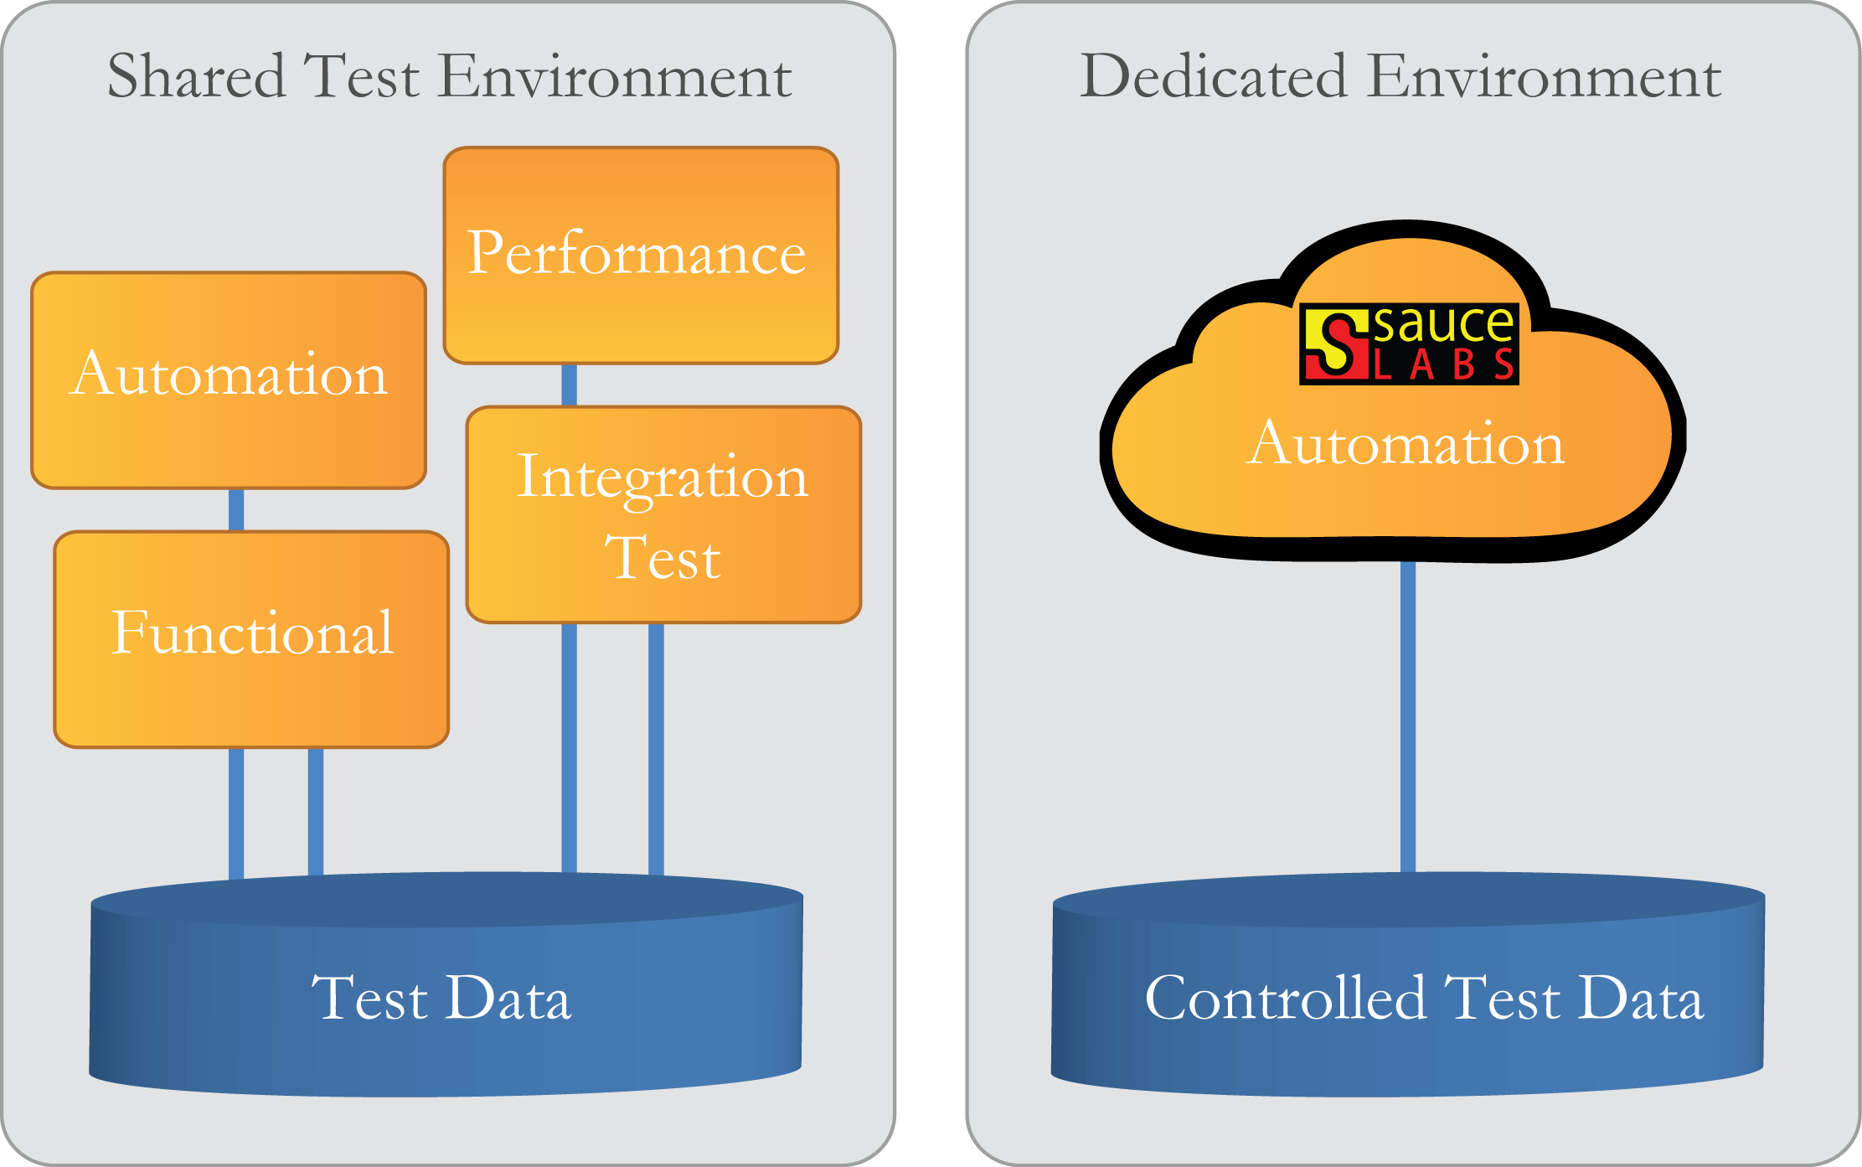
Keys to reducing false positives
Controlled environment for automation
+
Notes:
The 2nd of 8 keys is to have a controlled environment for automation is essential in order to reduce false positives.
Think about it!
If both the manual and automation team shared the application instance, then there is a chance of unwanted script failure during suite execution. This is because a functional testing member may have changed some settings of the application or machine during their testing effort. And the entire effort of test execution goes to waste.
Controlled environments could be your separate local environments or if you have a Sauce account you could easily spin up a controlled environment for test execution which would also relieve you from hardware and setup overheads.
As a standard practice only the automation team should have access to these environments where the application instance is deployed. So, they can execute their comprehensive regression suites corresponding to any new builds.

Slide 15
Keys to reducing false positives
Keeping tests short
Notes:
The next key is to keep in mind that it is important to keep tests short.
We should remember, the longer the test, the more brittle it becomes. The main reason why people tend to write long tests is because they want to cover an entire use case.
Moreover they think while we are at this step, we can validate a few other things you normally would with manual testing. Don’t fall for these temptations and break your scripts into multiple tests with as few steps as possible in each of them
Thus, it is extremely important to not only keep tests short, but to make sure that each test contains the important assertions as per the requirement.

Slide 16

Keys to reducing false positives
Keeping tests independent
Create User
Create Group
Search User
Add User to Group
TEST SCRIPT 1
TEST SCRIPT 2
TEST SCRIPT 3
TEST SCRIPT 4
Notes:
The 4th Key is to make sure that every test script has the ability to run in isolation and there are no script sequence dependencies between multiple scripts.
For example if you look at the diagram, suppose you have 4 test cases for creating a user, creating a group, adding user to the group and searching the user from the group. It is a, bad practice would be to maintain the scripts execution sequence like create user script will be first and then you have create group script call in the test suites.
If the test batches are not designed in this order then your tests would fail.
It is always advisable to create the script which can be run in isolation, we can use before method\before class annotations to call methods which would ensure pre-requisite data before the test is run. In this example you can create user, create group as reusable methods and invoke them before the test class to run the tests independently. This way we can keep our tests independent and they can even be run in isolation when needed.

Slide 17
Keys to reducing false positives
Using right locators for objects identification
IDs
Name
CSS locators
Notes:
The next most important key which we build into frameworks is to use the right locators for identifying objects.
This involves identifying objects with their IDs, naming properties, as well as CSS locators rather than using indexes, coordinates or xpaths. This is because xpaths, coordinates and indexes change every time the developers make changes to their UI and these make our tests brittle.
Hey, if these IDs don’t exist then your automation team will closely work with the engineering team to get these hooks or developer IDs implemented to create stable tests.
This was one of the major root cause of false positives in our workflow application case study and we went in and changed the all object identifiers to resolve the issue.

Slide 18
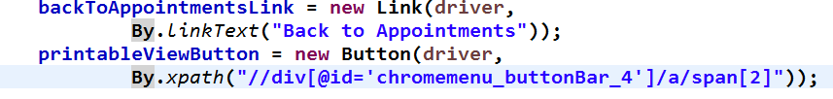
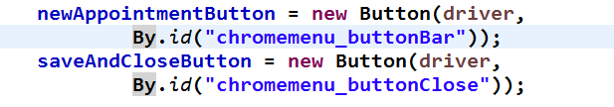
Object identification strategy
Xpath has been used instead of identifying the object uniquely
Bad Practice
Recommend ID>Name>CSS for object identification.
Good Practice
Notes:
The code we have shown here is for clicking on appointments link.
If you observe the code and you will find that elements have been identified using Xpath which is not recommended practice because your script is bound to fail whenever there is change in the object location/sequence or Xpath.
So, what could be the best approach, let’s look at the good practice
We should always make sure to identify the object uniquely using ID->Link Text->CSS

Slide 19

Keys to reducing false positives
Tear-down approach
Notes:
This essentially means that at the end of each script, we dispose of all active objects and remove test data.
This is really important because using this approach ensures that each and every script starts from a controlled, fresh state of the application. If we do not perform tear down they we might end up facing memory leaks or issues with residual objects/records in the system causing false positives.
We also fixed this particular problem in the workflow application by implementing teardown approach throughout the framework.

Slide 20
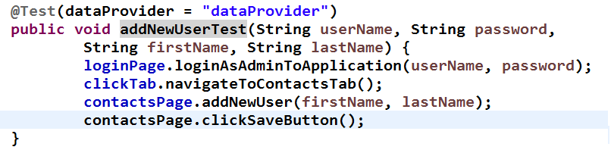
Tear down approach
No tear down approach followed to dispose footprints
Bad Practice
Notes:
In this code example you can see the code is creating a contact but not disposing off the created test data at the end of the test,
where as we should disposed off the footprints or in this case deleted the created contact.
However, if we will keep this contact in the application then, the test would fail on re-execution due to the already existing data in the system.

Slide 21
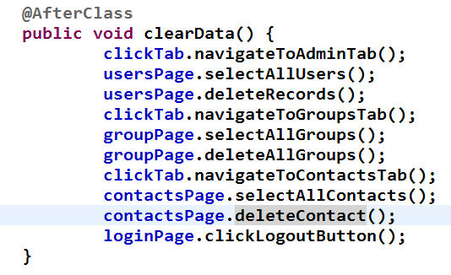
Tear down approach
Good Practice
Disposing foot prints from application
Notes:
You can see that in the @AfterClass annotation we have deleted the test data created by our previous test method to start the next execution from a controlled state.

Slide 22

Keys to reducing false positives
Dynamic object synchronization
Notes:
The next key measure that we built into our frameworks is dynamic object synchronization
How this works is simple and straightforward.
Where the control of execution waits for a defined amount of time for the application to reach to a particular state and then performs the next step instead of arbitrary waits.
If the state is reached within time, then the driver mechanism automatically executes the next line of code, else it logs the error and fails the test with proper reasons.
This not only reduces false positives, but also decreases page reloads, provides an edge in controlling Ajax elements and produces better batch results.
This was another fix we implemented in the framework to resolve false positives in our workflow application case study. With these resolutions we were able to reduce the false positives to less than 3%

Slide 23
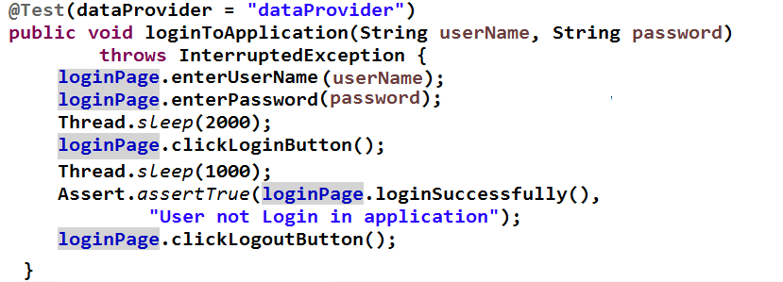
Object synchronization
Bad Practice
Hardcoded Sleep has been implemented
Notes:
This snippet is trying to login and logout of the application.
It is always considered as bad practice if you are using any hard code wait in the script because we cannot estimate the exact wait time for page load or an object to appear. Moreover, it will also add up the overall execution time of the suites.

Slide 24
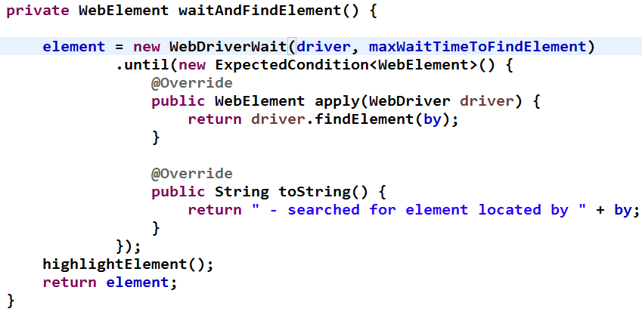
Object synchronization
Implemented library to handle objects synchronization
Good Practice
Notes:
So, in code you can see how we are instructing driver to wait for an element to appear dynamically. Here an object will be searched on a page for defined time dynamically.

Slide 25



Keys to reducing false positives
Re-execution capability
EXECUTION
TEST SUITE
EXECUTION REPORT
Pass
TEST CASE 1
TEST CASE 2
—————
—————
—————
TEST CASE N
Test case name | Status | Re-executed
TEST CASE 1 | PASS | NO
TEST CASE 2 | PASS | YES
TEST CASE 3 | FAIL | YES
_____ | _____ | _____
TEST CASE N | PASS | YES
RE-EXECUTION
LOGIC FLAG
Failed
RE-EXECUTION OF FAILED TESTS
Notes:
Last but not the least, is the Re-execution capability.
Generally we run our regression suites unmonitored as they would take more time to execute. However, with more tests getting executed in a batch there are chances of more false positives.
With re-execution built in, the framework collects a list of scripts that failed during execution.
These failed scripts are re-run in order to re-validate their actual results.
If the tests pass on re-run then they need not be investigated and the final results give a better view of actual build health, else if they fail we become double sure that the failures are product issues.
If you look the diagram, the way we have implemented this capability, is with an ability to turn it on/off using a configuration switch. Once the switch is turned on the library starts polls of the failing tests and creates a separate batch of the failed tests. Once the entire suite completes, the test engine picks up the failed test batch and re-executes those tests.
This capability can be implemented in two ways where the framework re-execute tests as soon as they fail for real-time results or we do it at the end of completion the entire test suite.
You can implement the approach that suites your setup.

Slide 26
Conclusion
Deploy application on optimal configuration
Controlled environment for automation
Keeping tests short
Keeping tests independent
Using right locators for objects identification
Tear-down approach
Dynamic object synchronization
Re-execution capability
Notes:
So in today’s webinar we have discussed what false positives and their impacts on automation testing.
We have shared 8 key strategies we have built into our frameworks to make them robust and more reliable.
Let’s recap those are:
Decreasing false positives using strategies we discussed above is important to ensure that we are able to reap benefits out of our automation.

Slide 27
Benefits of eliminating false positives
Will not miss potential bugs
Certainty of application health
Increase in productivity
Save time not investigating false positives
Decrease cost of automation
Notes:
- We will not miss potential bugs, which is an indicator of improved quality and reliability of our automated tests.
Engineering team would always have the right measure of their build health and this will help them to take decisions faster.
Increase in productivity as automation engineers can focus on adding more tests instead of spending time on investigating false positives.
Time saved can be better utilized to further enhance automation framework and test coverage.
A definite reduction in cost as less/minimal manpower would be required for analysis of false positives.
Thanks for being a great audience, I really enjoyed sharing the knowledge with you all and hope it adds value to you automation efforts.
Over to you Rick

Slide 28


Get your FREE Step by Step Guide to Create CSS Locators
qasource.com/css-locators
knowledgecenter@qasource.com

Slide 29
Q&A

Slide 30



