Slide 1






SMART INDIA HACKATHON 2026
Problem Statement ID – 26033
Problem Statement Title- Multiple intermediaries reduce farmers earnings and
increase consumer prices
Theme- Agriculture, Foodtech, Rural development
PS Category- Software
Team ID-
Team Name – Smooth operators

Slide 2


KISAN SETU APP
Smooth Operators
Proposed solution:
Create a marketplace where farmers can sell their crops directly to the customers
Bulk buyers:
1. View available listings
2. Search the best listing and contact the farmers directly to negotiate
3. Place order, check order status and manage order history
Retail customers:
View available listings
Search the best listing among the displayed options.
Sort the listings on the basis of distance, or price, or get the best AI pick.
Place order & make the payment
Check the order and delivery status
Unique features of our app:
Al based route optimisation and clustering algorithm.
Smart seller ranking system which ranks the sellers on the basis of:
30% price + 20% distance + 20% freshness + 15% reliability + 10% quality + 5% preference
Farmers:
List the crops
Update listing details like price and quantity.
View and track orders
Manage earnings
Get the demand prediction for the crops.
@SIH Idea submission- Template
2
Notes:
2

Slide 3

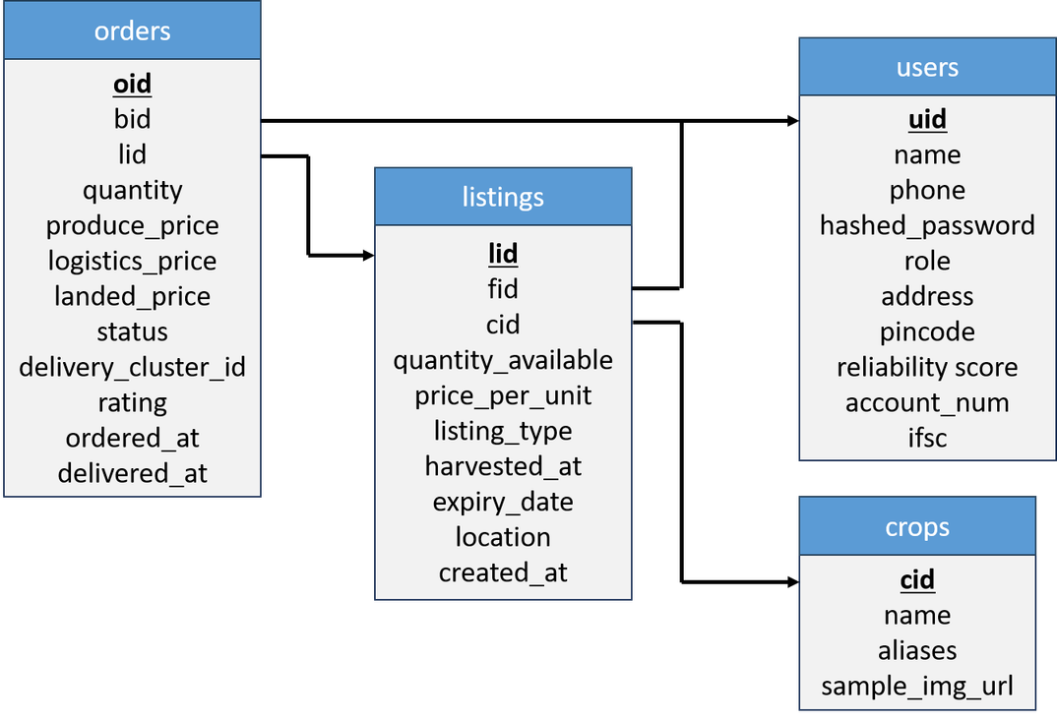
Smooth Operators
TECHNICAL APPROACH
Frontend
React
TailWind CSS
Vite
TypeScript
Node.js
i18Next
Mobile Delivery
Android Platform Tools
Backend
Capacitor
Java
Python
SQLAlchemy
JWT
PyDantic
FastAPI
OAuth2
Other Services
Render
Neon.tech
Data & Intelligence
Mappls MapMyIndia API
PostGreSQL
PostGIS
XGBoost
Our mobile app:
Scikit-Learn
GeoAlchemy2
https://github.com/Adyant-Tiwari19/Farm-Direct/blob/main/kisansetu.apk
RELATIONAL MODEL REPRESENTING OUR DATABASE
@SIH Idea submission- Template
3
Notes:
3

Slide 4

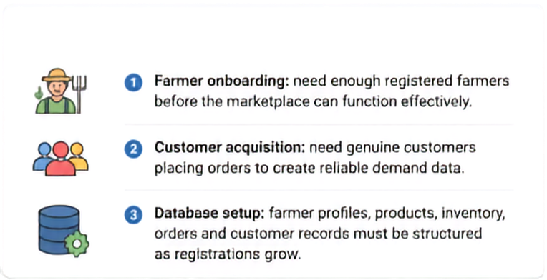






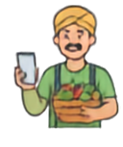


















FEASIBILITY AND VIABILITY
Smooth Operators
CHALLENGES
OUR PLATFORM FLOW
1) Farmer onboarding: Need enough registered farmers before the marketplace can function effectively.
FARMERS
PLATFORM / DATABASE
CUSTOMERS
2) Customer acquisition: Need genuine users and order data to create reliable demand data.
3) Database setup: Farmer profiles, products, inventory, orders and customer records must be structured as registrations grow.
Register & List
Provide
Manage Inventory
Track Orders
Browse Products
Place Orders
Track Deliveries
Product
Catalog
Orders &
Inventory
User
Management
Smooth Operators
FEASIBILITY
TRUST / VERIFICATION
LOGISTICS / ORDER TRACKING
The idea is feasible.
The prototype is scalable, with server capacity expandable as users increase.
Verify farmer identities,
product quality & authenticity
to build buyer trust.
Real-time order updates,
tracking & reliable
fulfillment.
@SIH Idea submission- Template
4
Notes:
4

Slide 5





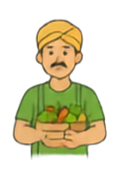


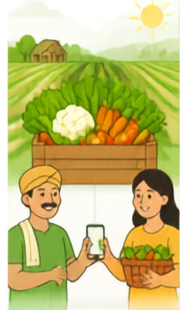
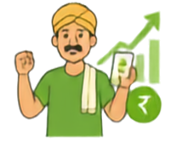

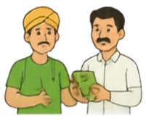


IMPACT AND BENEFITS
Smooth Operators
BENEFITS
KISAN
SETU
KISAN SETU eliminates middlemen by connecting farmers directly with customers and providing end-to-end logistics support.
Streamlined order management
and logistics handled by KISAN SETU simplify transactions for both parties.
Very few farmers can currently sell crops directly to market.
2
Empowers farmers with fair pricing and direct market access.
Customers receive fresh produce directly from farmers, ensuring quality and transparency.
Farmers are forced to sell to village middlemen at lower prices; middlemen supply the market and earn a strong trading margin, reducing farmer income.
3
3
IMPACT
5
Farmers only list their crop varieties and order booking through order completion.
TRUST & TRANSPARENCY
SCALABLE & SECURE
WIDE REACH
SUSTAINABLE IMPACT
Verified farmers, quality assurance & secure platform
Cloud infrastructure with backups, secure access & analytics
Bringing rural producers and urban consumers closer
Better income for farmers, healthy food for everyone
Notes:
5

Slide 6


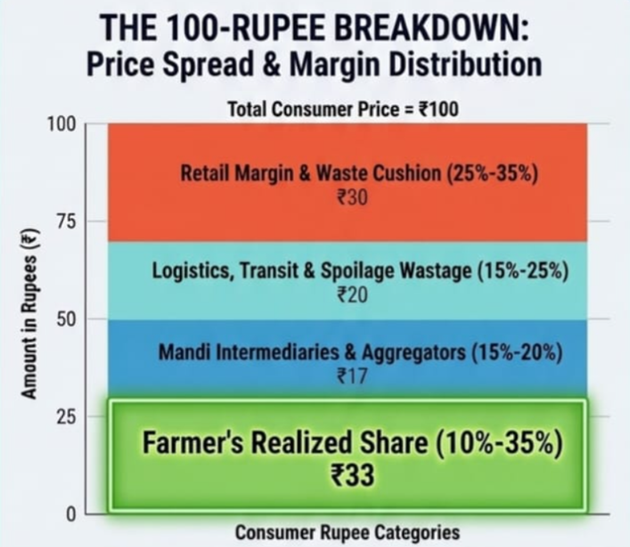
RESEARCH AND REFERENCES
Smooth Operators
Current Farm-to-Market Journey: The Existing Pipeline
Village aggregators / kaccha arhatiyas
APMC mandis / commission agents
Secondary wholesalers / inter-city transit
Sub-mandi traders / last-mile retailers
Distress sale after harvest
Evidence Base and Policy Direction
RBI vegetable value-chain study
Highlights price spread, market frictions, and post-harvest transmission issues.
NITI Aayog APMC reform analysis
Examines market structure, competition, and reform options in APMC systems.
Official PIB post-harvest loss study
Documents losses, wastage, and the need for storage and logistics upgrades.
Ground reports from Down To Earth
On-the-ground reporting shows distress sale, trader power, and farmer constraints.
The wire Farm-Gate economics – Ground report
Reason why farmers dump their tomatoes on roads while city prices stay high
@SIH Idea submission- Template
6
Notes:
6

