Slide 1

Femme-power
Vocal For Local

Slide 2
About
We have designed an app that will help to empower the local rural women to expand their traditional handicrafts and handloom culture that are being endangered with increased modernisation and industrialization.
It will help to build solutions to enable economic freedom for women.
Rural women who often went unnoticed because of backward culture and poverty will get recognition globally.
It will also help to eradicate unemployment problem for women.
Our App will help to restore the dying arts to their original glory as preserving and protecting the skills and knowledge of traditional crafts is a very important step in preserving the country’s rich heritage.

Slide 3
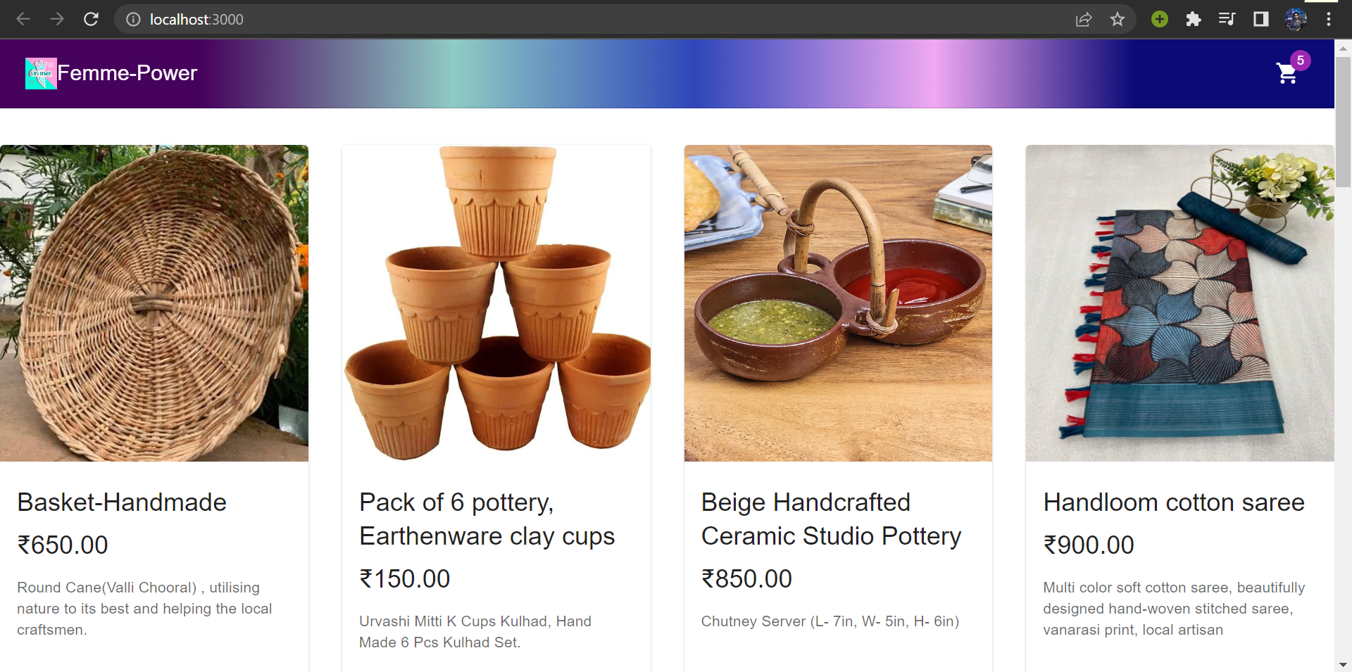
Home Page
It is designed using ReactJS. Products are imported from Commerce.js. Navbar contains a shopping cart icon which when clicked will take us to the cart page. To add items to the cart, click on the shopping cart icon on the product cards.

Slide 4
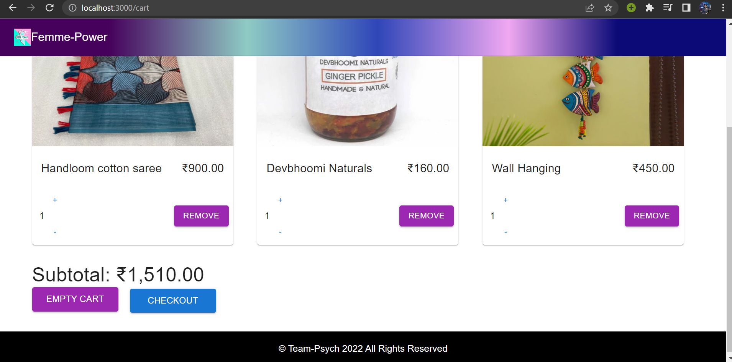
Cart Section
This page contains the selected items by the customer. It has a ‘+’ and ‘-’ button for adding or removing items from the cart. At the bottom, it shows the subtotal of all the item prices. Then, the user may checkout by clicking on checkout button.

Slide 5
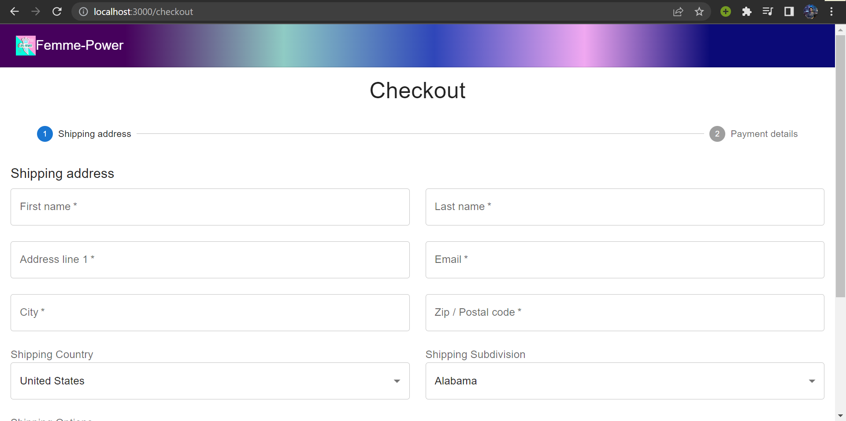
Checkout
This page contains a form that takes the user details and address before shipping. Then click on Next that will lead to the payment details page.

Slide 6
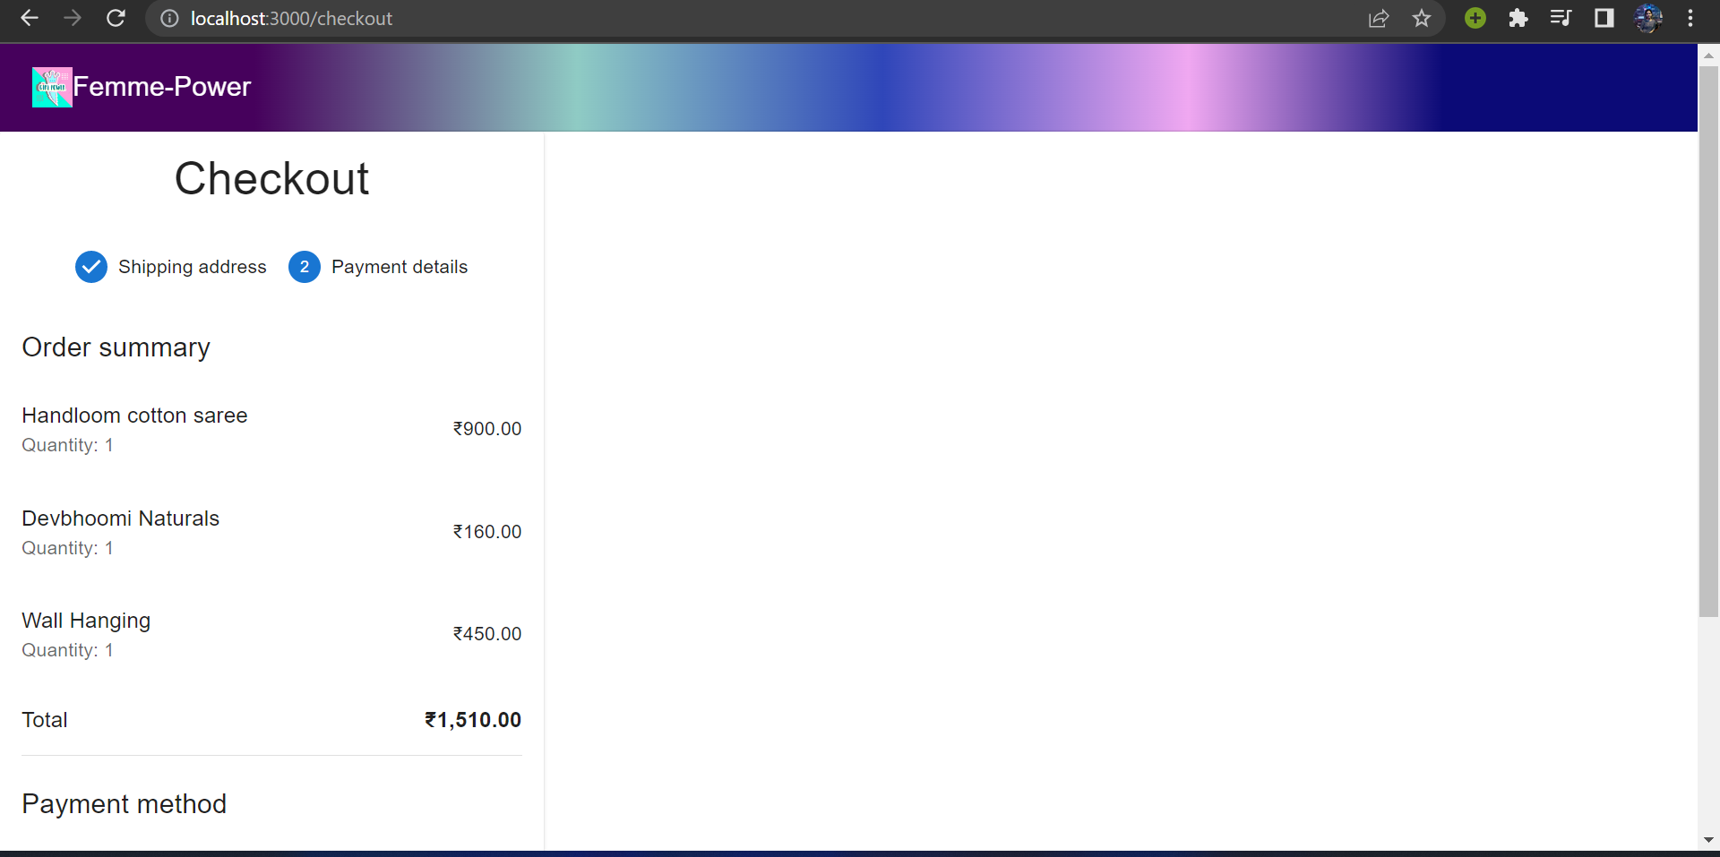
Payment gateway
It is designed using Stripe.js. Stripe Elements are a set of prebuilt UI components for building our web checkout flow. It’s available as a feature of Stripe.js, our foundational JavaScript library for building payment flows.

Slide 7
Conclusion
The app will be managed by respective people and the women may contact them, so as to publish their handicraft and handloom items. The following people will verify the products and then post it in the app for the customers to buy. This will encourage local rural women to increase participation in entrepreneurship and eradicate unemployment problem.
In a growing technology-run and industrialised world, people are increasingly forgetting the traditional crafts and moving towards new innovation. Due to this, art is loosing its grip. So, it is high time that art forms are revived and awareness spread about them in urban space
Our App will help to enable economic freedom for women. With time, we will try to improvise it, eliminate bottlenecks and add more features to it.

Slide 8
