Slide 1
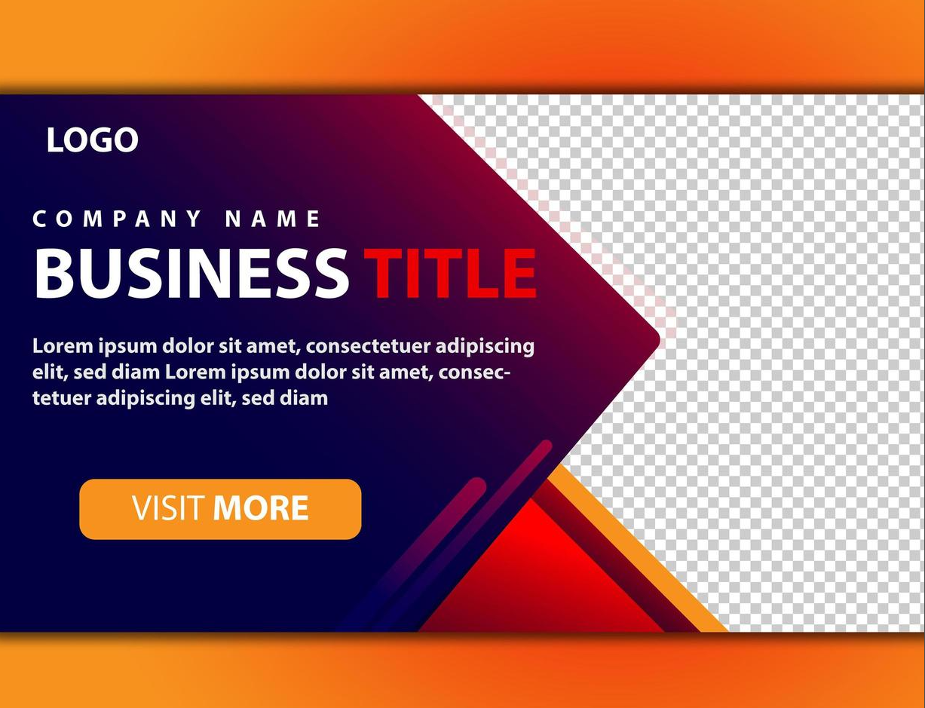
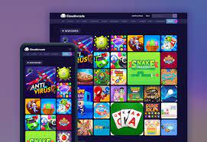
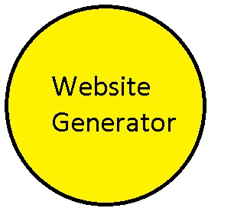
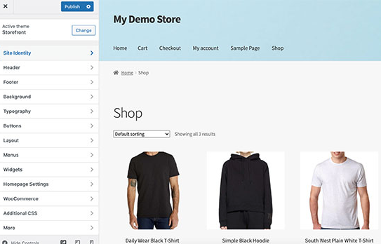
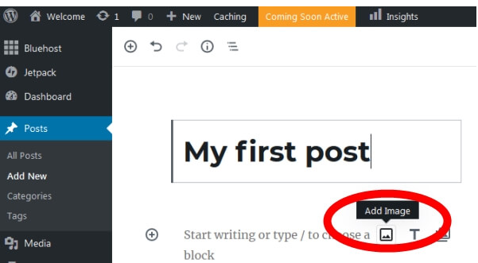
Banner:
https://www.google.com/imgres?imgurl=https%3A%2F%2Fspeckygeek.com%2Fuploads%2F2020%2F12%2FCloudArcade-HTML-Arcade-Games.png&tbnid=PV5v5nbGY_9GgM&vet=12ahUKEwjttN_G5e3-AhW8rycCHfiIC7cQMygRegUIARDgAQ..i&imgrefurl=https%3A%2F%2Fspeckygeek.com%2Fcreate-flash-arcade-game-site%2F&docid=yfCvvOyNQ0fIhM&w=800&h=550&q=create%20your%20own%20games%20webstie&hl=en-GB&client=opera-gx&ved=2ahUKEwjttN_G5e3-AhW8rycCHfiIC7cQMygRegUIARDgAQ
https://www.google.com/url?sa=i&url=https%3A%2F%2Fwww.vecteezy.com%2Ffree-vector%2Fweb-banner-template&psig=AOvVaw2M_NZvii3UkBH55-1K7ngc&ust=1683912603571000&source=images&cd=vfe&ved=0CBAQjRxqFwoTCNiI5bbl7f4CFQAAAAAdAAAAABAE
Logo:
https://www.google.com/imgres?imgurl=https%3A%2F%2Fcdn4.wpbeginner.com%2Fwp-content%2Fuploads%2F2021%2F07%2Ftheme-customizer.jpg&tbnid=P_P5VQh0LvDhIM&vet=12ahUKEwiW2qfm5-3-AhW3mycCHUl5CM4QMygCegUIARDDAQ..i&imgrefurl=https%3A%2F%2Fwww.wpbeginner.com%2Fwp-tutorials%2Fhow-to-start-an-online-store%2F&docid=WfobcQ0r9-G5QM&w=550&h=348&q=create%20your%20own%20shop%20webstie&client=opera-gx&ved=2ahUKEwiW2qfm5-3-AhW3mycCHUl5CM4QMygCegUIARDDAQ
https://www.google.com/imgres?imgurl=https%3A%2F%2Fwww.theblogstarter.com%2Fwp-content%2Fuploads%2F2019%2F06%2Finsert-image.jpg&tbnid=qRuGnTLpoK68wM&vet=12ahUKEwj97aLA5O3-AhU7picCHRyAAiUQMygEegUIARDIAQ..i&imgrefurl=https%3A%2F%2Fwww.theblogstarter.com%2F&docid=1FOkVgynLExR7M&w=600&h=323&q=create%20your%20own%20blog%20website&client=opera-gx&ved=2ahUKEwj97aLA5O3-AhU7picCHRyAAiUQMygEegUIARDIAQ

Slide 2
Website tittle
Banner
Navigation bar
Information

