Slide 1
Problem formulation
How often have you noticed problems with the network at the university?
Are there problems with the network in basements or in separate blocks?
Problems encountered in the portal during the registration process?
The university wants to strengthen its campus-wide network service. But how can this be done?
This work was done based on these problems.

Slide 2

IBot
Network Communication Service
Adilkhan Altynbek

Slide 3
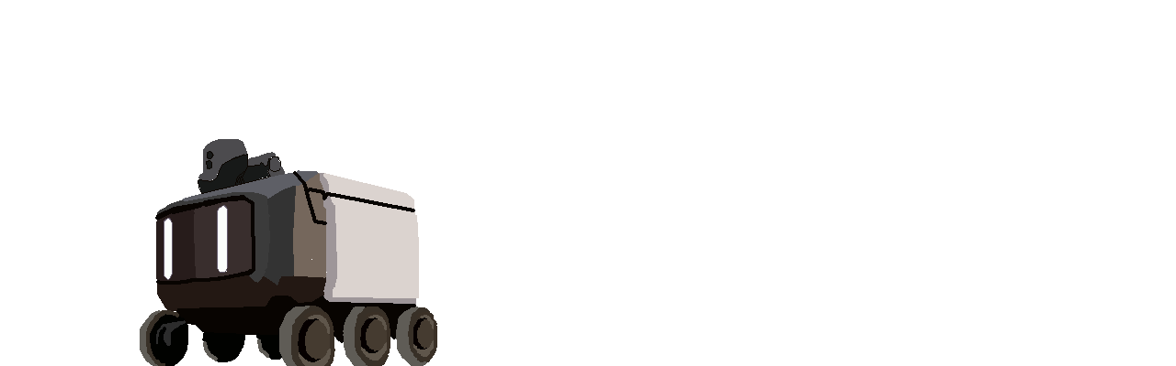
Description of ideas:
We all know what kind of robot this is, a classic cute delivery guy. This robot has very autonomous capabilities in tasks such as delivery...
But what if you give this job a device that amplifies the network signal?
This model contains motion sensors, direction and location.

Slide 4
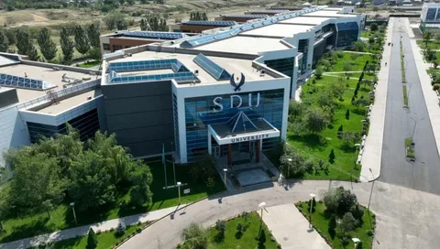
Goal:
If we take the size and location of the SDU, we can immediately assume possible problems with the Internet in its various sections, starting with remote blocks and ending with a huge flow of students in certain departments.
And for such an area, the best outcome is to provide a network and improve the quality of communication for SDU students, ensuring stable and fast Internet on campus with the help of autonomous robots with the ability to move from one point to another. And how is that? And how did we come to this? And how did we find out about this problem?

Slide 5
Interview :
I think it's worth starting with the source of the problems... I conducted several 30-minute interviews with random people at the university to identify exactly where the courier robot could be integrated, but during this task, very urgent problems were identified. And this courier was chosen by us to solve this problem...

Slide 6
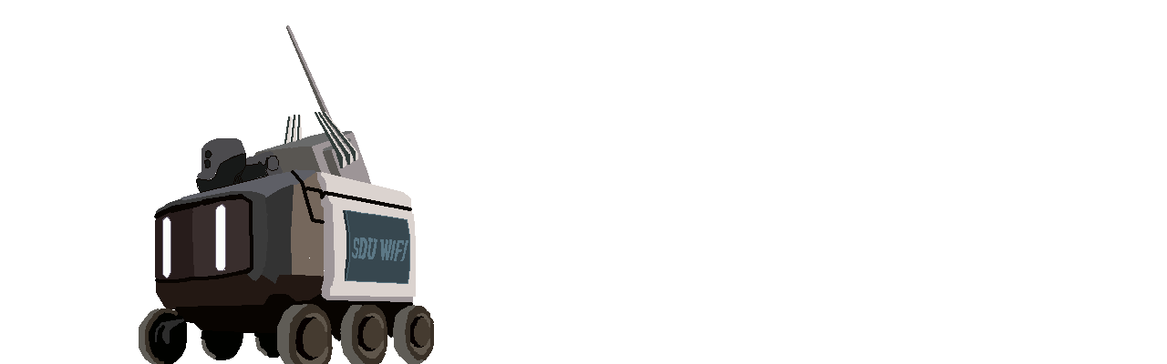
Network scanning
Signal quality sensors
Navigation system
Load analysis

Slide 7
Scenario 1
Internet Issues During an Online Lecture
Context:
A student is in the H-block classroom for an online history lecture. She notices that the internet keeps dropping out, making it difficult for her to participate.
Interaction:
-- The IBot starts scanning the classroom, driving between the rows. The screen displays information about the number of students and the signal strength.
-- While scanning, the IBot notices that there are 30 students in the classroom and the Wi-Fi signal strength is 2 out of 5.
Result:
-- The IBot stops in the center of the classroom, automatically activating the signal booster.
-- The student and her classmates notice that the internet has become more stable. They can listen to the lecture and ask questions without worrying about disconnections.

Slide 8
Storyboard for scenario 1
In the classroom: The student sits at her desk, anxiously looking at her laptop screen, where the connection to the conference is frequently disconnected.
IBot scans the classroom: IBot drives past students scanning the area and the network, its screen displays the signal strength and number of people present.
Detecting a problem: IBot detects that the signal is weaker than usual and automatically decides to stop.
Setting up the booster: IBot stops and its lights flash while it boosts the signal.
Improving the connection: Students smile when the screen displays a message that the connection has been restored and actively participate in the lecture.

Slide 9
Scenario 2
Internet Issues During an Online Lecture
Context:
A student is at an open house in the central part of campus. He tries to connect to the internet, but the network is congested and it is difficult to access the information he needs.
Interaction:
-- IBot begins scanning the event area, driving between groups of students. Information about the number of people and the signal strength is displayed on the screen.
-- While scanning, IBot notices that there are about 100 students and visitors in the area, and the Wi-Fi signal strength is 1 out of 5.
Result:
-- IBot stops in the middle of the crowd and automatically activates the signal booster.
-- Visitors and students notice that the internet is more stable.
-- They can now access online resources, share their experiences on social media, and interact with the event organizers.

Slide 10
Storyboard for scenario 2
At the event: A student stands in the crowd, looking at the screen of his phone, which is unable to connect to the internet.
IBot scans the area: IBot drives past groups of students scanning the area and the network, its screen displays the signal strength and number of people present.
Congestion detection: IBot detects that the signal is weak and there are too many people in the area, automatically deciding to stop.
Booster setup: IBot stops and its lights start to flash while it boosts the signal for those around it.
Connection improvement: Students blog when the internet is stable and can easily interact with online resources and share their experiences.

Slide 11
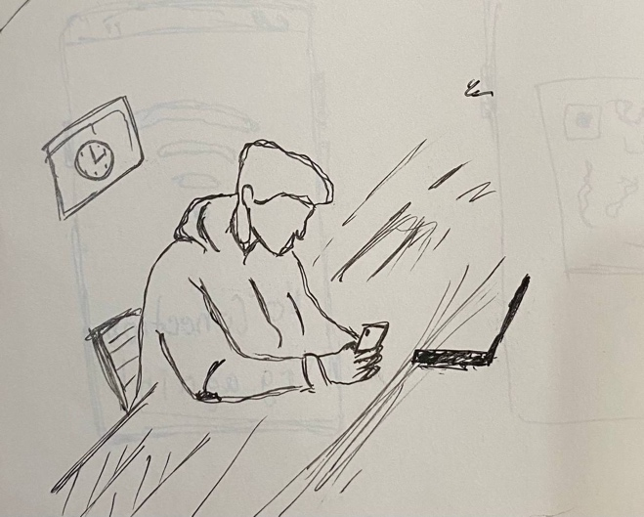
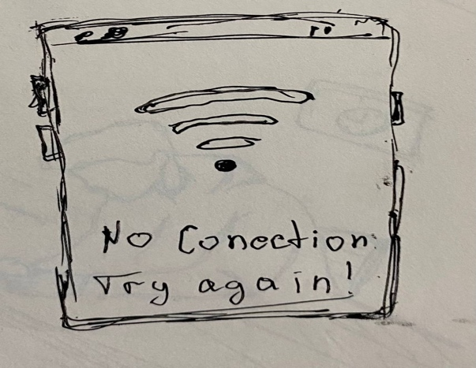
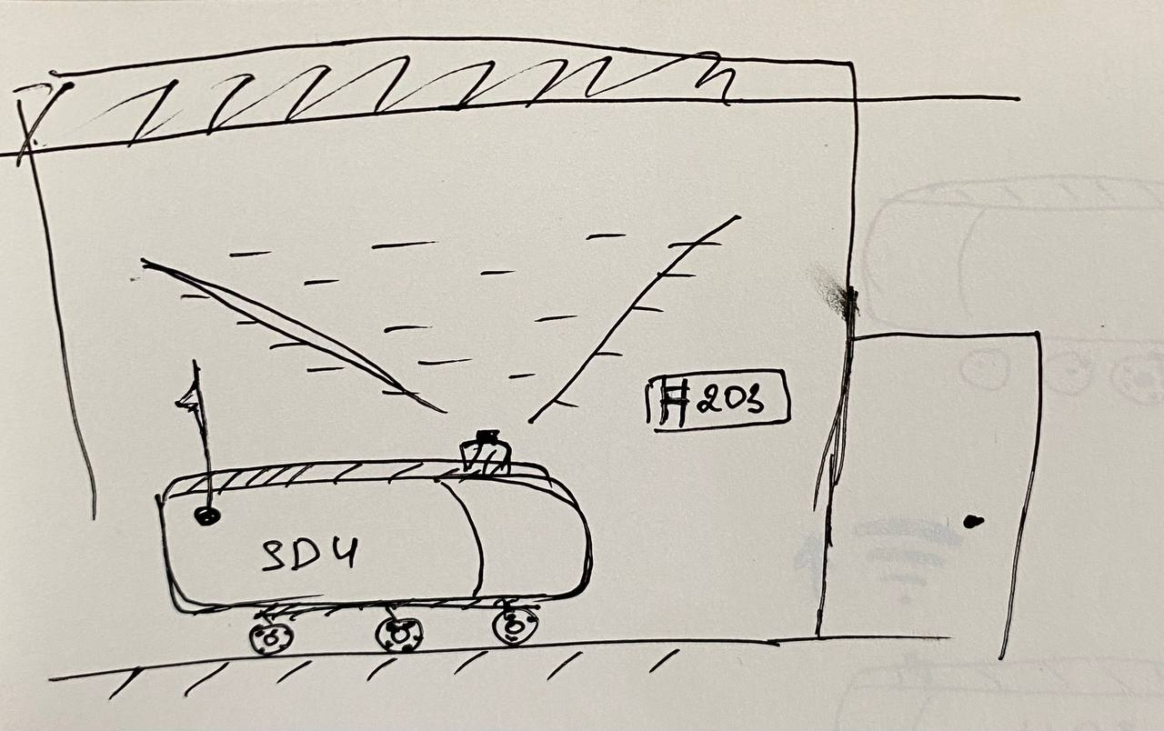
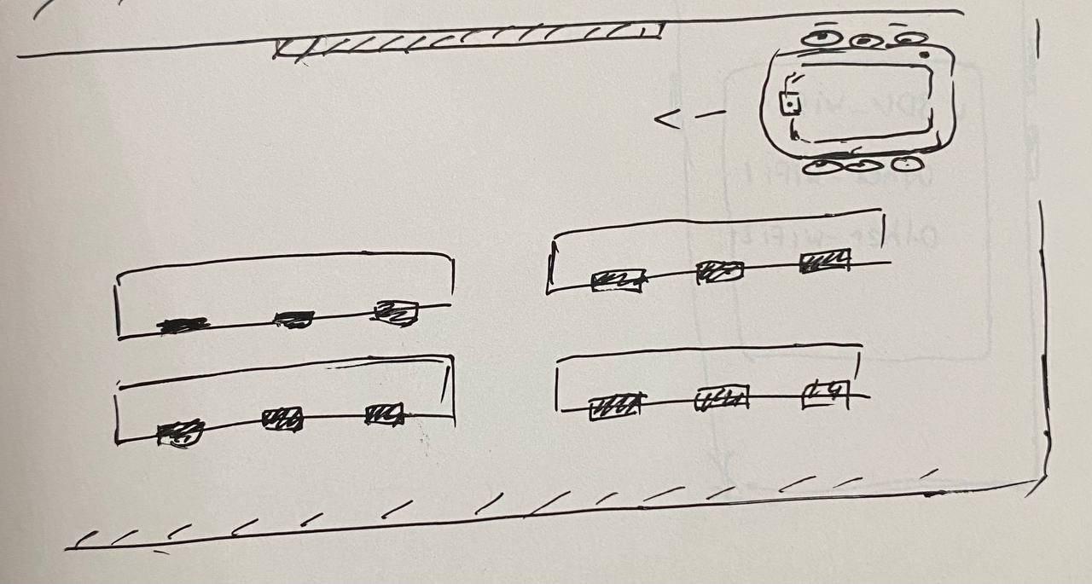
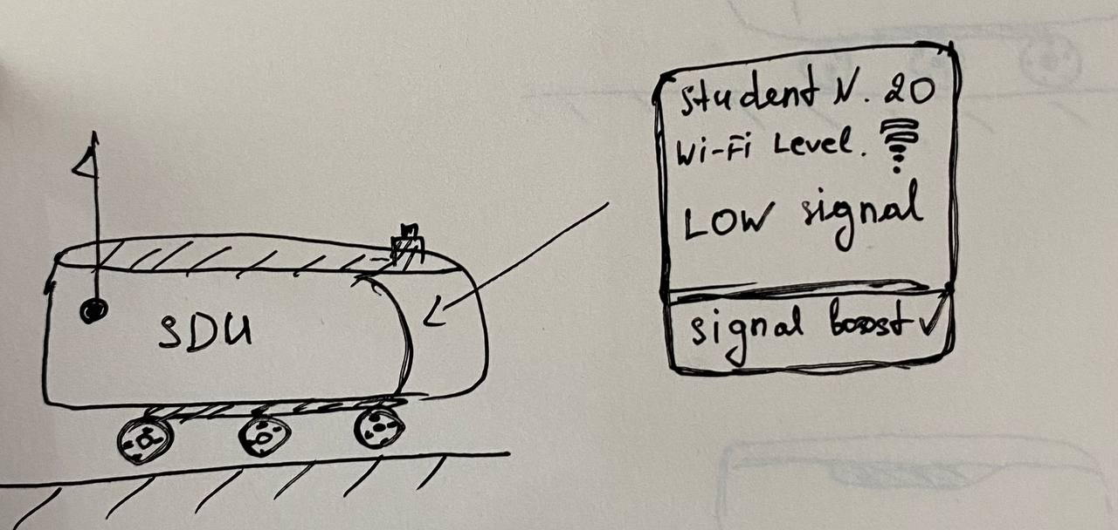
Sketches
I started with a few rough sketches to display the functionality of the modified courier robot and its approximate location of elements. As well as the estimated work process.

Slide 12
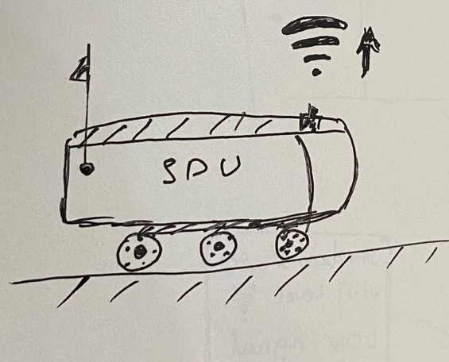
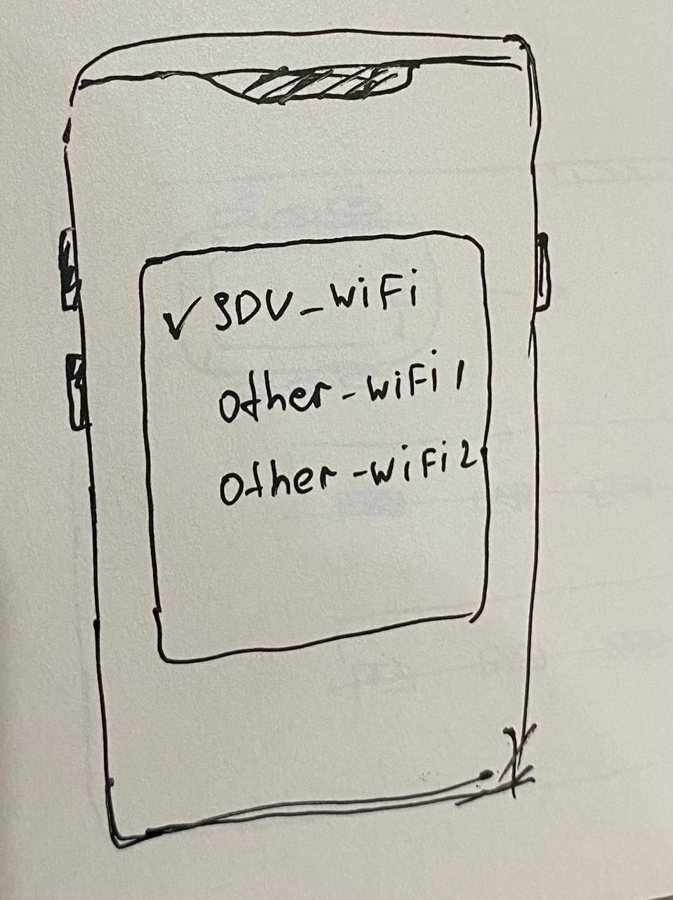
Sketches
I started with a few rough sketches to display the functionality of the modified courier robot and its approximate location of elements. As well as the estimated work process.

Slide 13
Description of the project:
The IBot Network Communication Service is an innovative solution to improve the quality of the internet connection on the SDU campus. The IBot system automatically scans various areas of the university, analyzing the quality of the network in real time. The robot helps to fix problems with the Internet connection, providing stable access to the network wherever students are.
Implementation and development strategy:
Pilot launch
Scaling
Integration with the university network
Conclusion:
The iBot Network Communication Service is not just an innovative solution for improving Internet connectivity, but also a step into the future that will provide students and teachers with comfort, security and uninterrupted work in the learning process. Thanks to this project, SDU will become an example of an advanced technological university.

Slide 14
THANKS
Adilkhan Altynbek

