Slide 1
Why SQL Introduction Before we dive into writing Structured Query Language (SQL) queries, let's take a look at what makes SQL and the databases that utilize SQL so popular. I think it is an important distinction to say that SQL is a language. Hence, the last word of SQL being language. SQL is used all over the place beyond the databases we will utilize in this class. With that being said, SQL is most popular for its interaction with databases. For this class, you can think of a database as a bunch of excel spreadsheets all sitting in one place. Not all databases are a bunch of excel spreadsheets sitting in one place, but it is a reasonable idea for this class.

Slide 2
Why Do Data Analysts Use SQL?
There are some major advantages to using traditional relational databases, which we interact with using SQL. The five most apparent are:
SQL is easy to understand.
Traditional databases allow us to access data directly.
Traditional databases allow us to audit and replicate our data.
SQL is a great tool for analyzing multiple tables at once.
SQL allows you to analyze more complex questions than dashboard tools like Google Analytics.
You will experience these advantages first hand, as we learn to write SQL to interact with data.
I realize you might be getting a little nervous or anxious to start writing code. This might even be the first time you have written in any sort of programming language. I assure you, we will work through examples to help assure you feel supported the whole time to take on this new challenge!

Slide 3
Why Do Businesses Choose SQL?
Data integrity is ensured - only the data you want entered is entered, and only certain users are able to enter data into the database.
Data can be accessed quickly - SQL allows you to obtain results very quickly from the data stored in a database. Code can be optimized to quickly pull results.
Data is easily shared - multiple individuals can access data stored in a database, and the data is the same for all users allowing for consistent results for anyone with access to your database.

Slide 4
How Databases Store Data
A few key points about data stored in SQL databases:
Data in databases is stored in tables that can be thought of just like Excel spreadsheets. For the most part, you can think of a database as a bunch of Excel spreadsheets. Each spreadsheet has rows and columns. Where each row holds data on a transaction, a person, a company, etc., while each column holds data pertaining to a particular aspect of one of the rows you care about like a name, location, a unique id, etc.
All the data in the same column must match in terms of data type. An entire column is considered quantitative, discrete, or as some sort of string. This means if you have one row with a string in a particular column, the entire column might change to a text data type. This can be very bad if you want to do math with this column!
Consistent column types are one of the main reasons working with databases is fast. Often databases hold a LOT of data. So, knowing that the columns are all of the same type of data means that obtaining data from a database can still be fast.

Slide 5
Types of Databases
SQL Databases
There are many different types of SQL databases designed for different purposes. In this course we will use Postgres within the classroom, which is a popular open-source database with a very complete library of analytical functions.
Some of the most popular databases include:
MySQL
Access
Oracle
Microsoft SQL Server
Postgres
You can also write SQL within other programming frameworks like Python, Scala, and HaDoop.
Small Differences
Each of these SQL databases may have subtle differences in syntax and available functions -- for example, MySQL doesn’t have some of the functions for modifying dates as Postgres. Most of what you see with Postgres will be directly applicable to using SQL in other frameworks and database environments. For the differences that do exist, you should check the documentation. Most SQL environments have great documentation online that you can easily access with a quick Google search.
The article here compares three of the most common types of SQL: SQLite, PostgreSQL, and MySQL.
You will use PostgreSQL for the lessons in this course, but you are not required to download it to your machine. We provide SQL workspaces in the classroom throughout the lessons. You may download PostgreSQL here if you'd like though.

Slide 6
Types of Statements
The key to SQL is understanding statements. A few statements include:
CREATE TABLE is a statement that creates a new table in a database.
DROP TABLE is a statement that removes a table in a database.
SELECT allows you to read data and display it. This is called a query.
The SELECT statement is the common statement used by analysts, and you will be learning all about them throughout this course!

Slide 7
SELECT & FROM
Here you were introduced to the SQL command that will be used in every query you write: SELECT ... FROM ....
SELECT indicates which column(s) you want to be given the data for.
FROM specifies from which table(s) you want to select the columns. Notice the columns need to exist in this table.
If you want to be provided with the data from all columns in the table, you use "*", like so:
SELECT * FROM orders
Note that using SELECT does not create a new table with these columns in the database, it just provides the data to you as the results, or output, of this command.
You will use this SQL SELECT statement in every query in this course, but you will be learning a few additional statements and operators that can be used along with them to ask more advanced questions of your data.

Slide 8
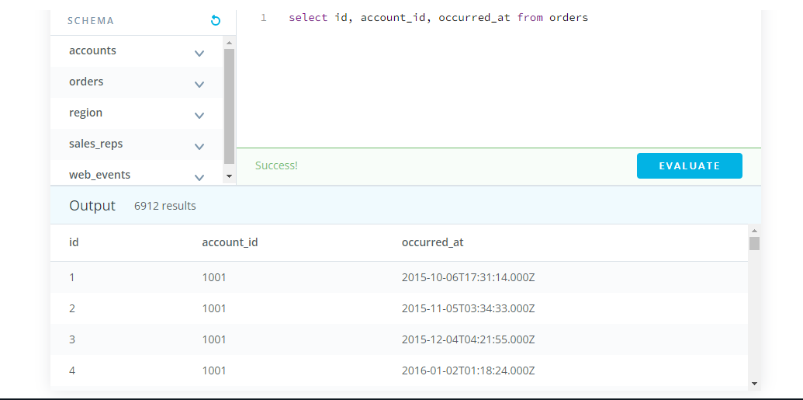
Try writing your own query to select only the id, account_id, and occurred_at columns for all orders in the orders table.

