Slide 1
ACADEMIC RESEARCH PRESENTATION | CSS142P MODELING & SIMULATION
Optimizing Multi-Channel Order Fulfillment and Queue Dynamics at Carlo's Bacolod Chicken House Express (CHE) Makati
A Discrete-Event Simulation Approach to Order-Taking, Charcoal Grilling, and Line Bottlenecks
Research Investigators:
• Sean Earl Y. Bornilla (Presenter 1: Problem Formulation, Objectives & Scope)
• Joven Terence O. Cantalejo (Presenter 2: Empirical Data, Input Distributions & SimPy Model)
• Adyson M. Reales (Presenter 3: Baseline Diagnostics, Scenarios, Validation & Policy)
Faculty of Information & Communications Technology | Academic Year 2025–2026

Slide 2
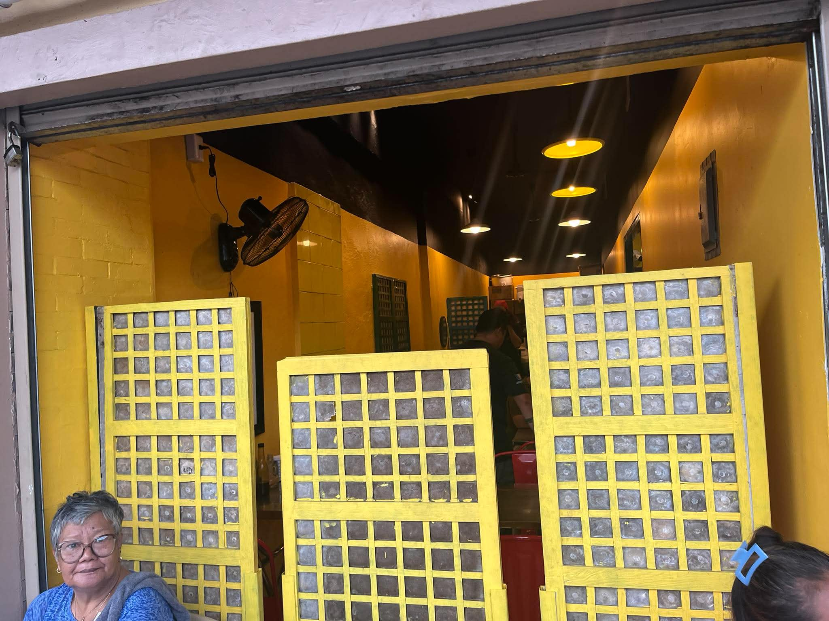
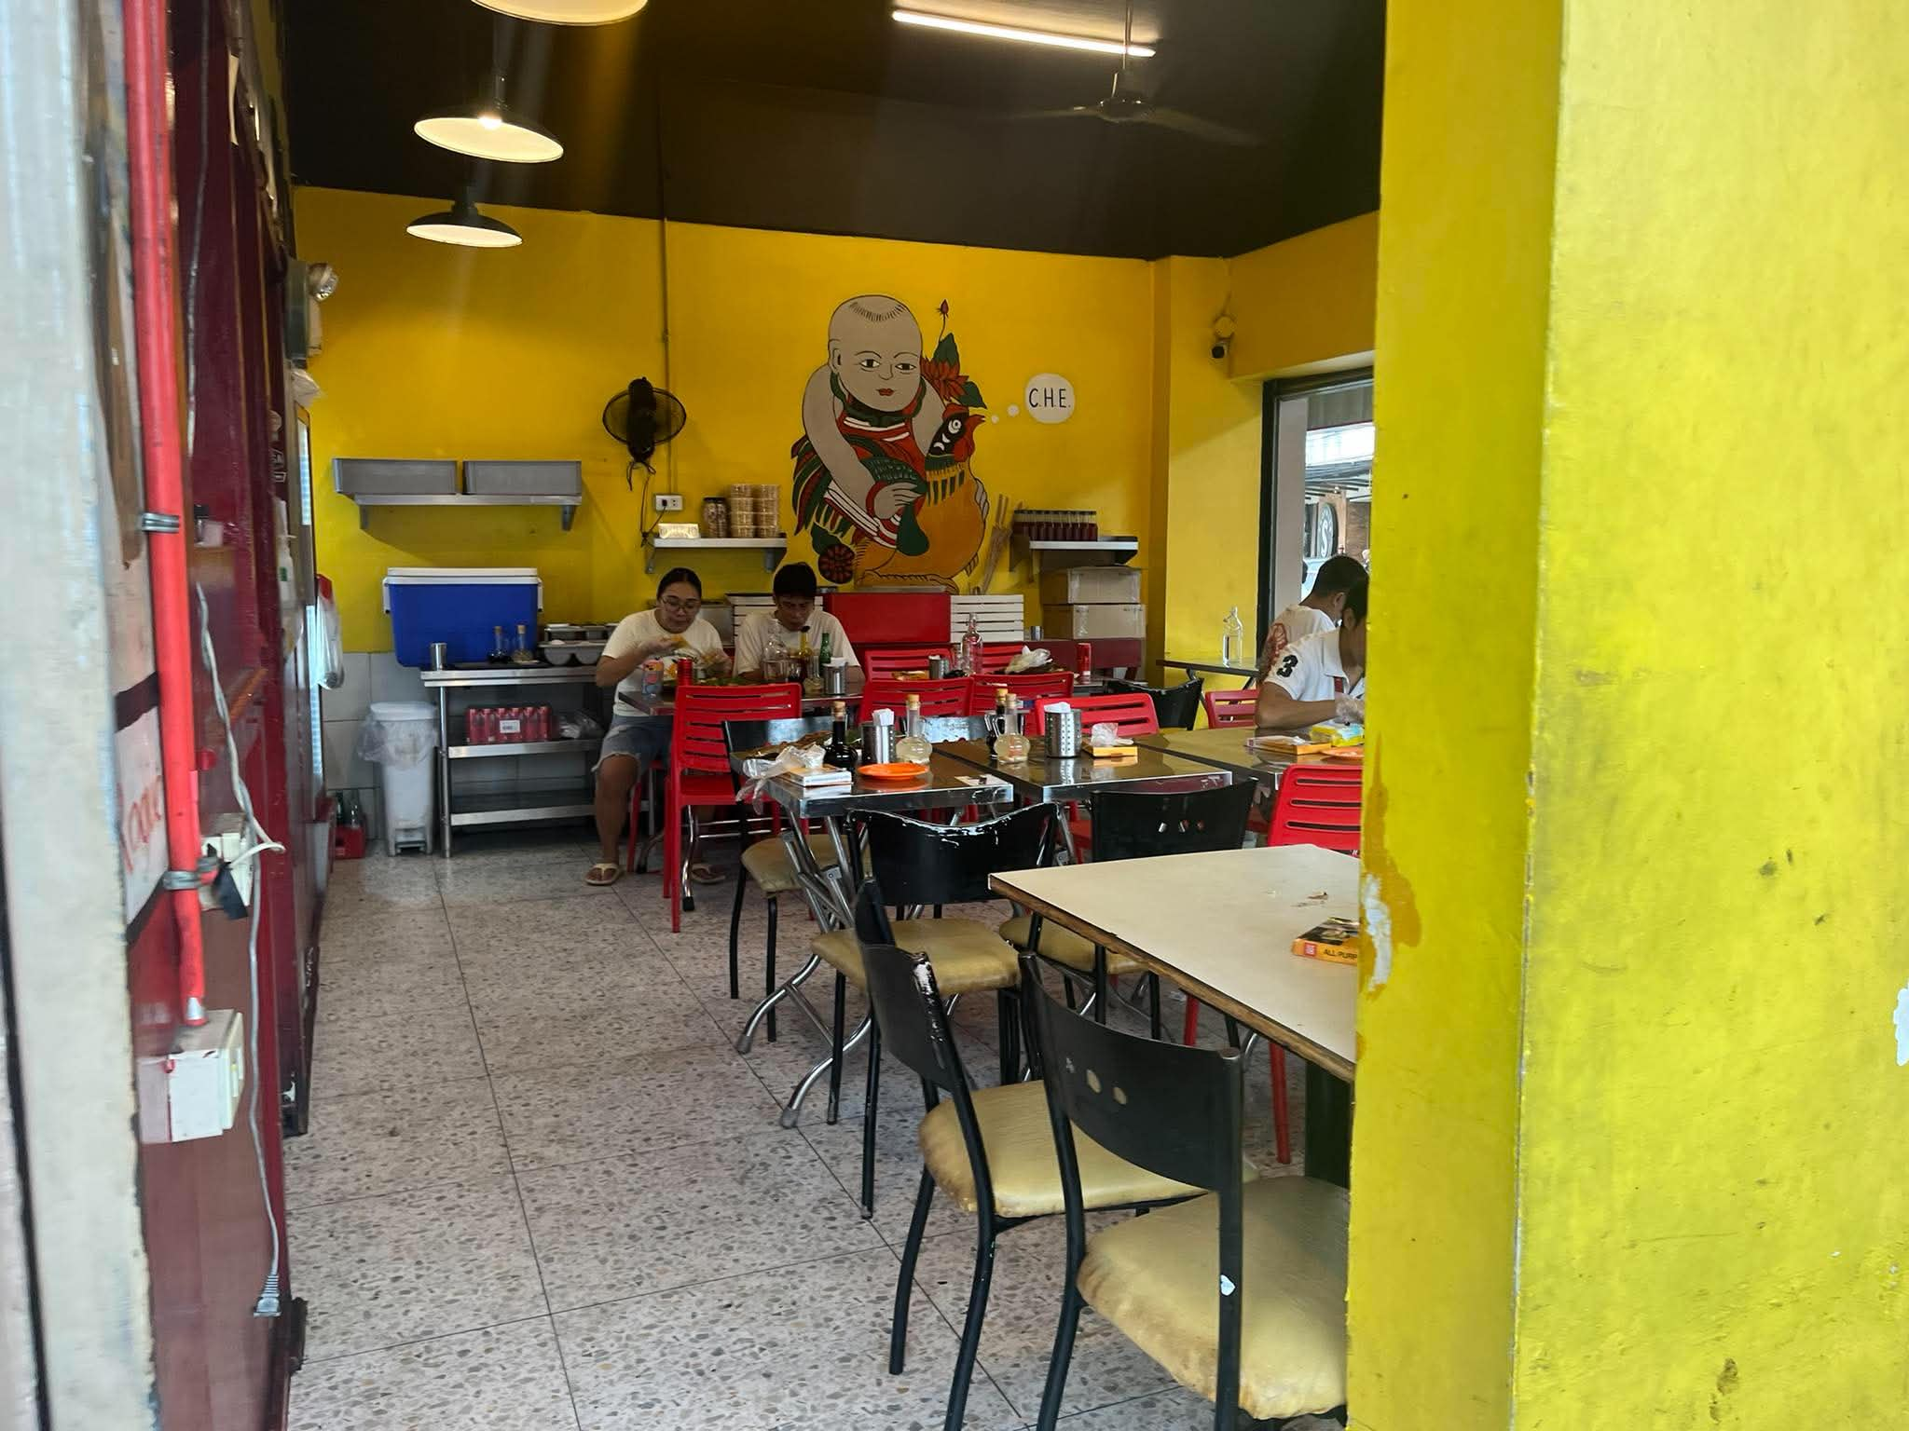
OPERATIONAL CONTEXT
Presenter: Sean Earl Y. Bornilla
Establishment Profile & Operational Environment
Carlo's Bacolod Chicken House Express (CHE)
• Location: Savana Commercial Center, Metropolitan Ave. cor. Chino Roces Ave., Brgy. Sta. Cruz, Makati City.
• Core Offering: Authentic Bacolod-style charcoal grilled chicken inasal (pecho, paa, isol, baticolon) paired with garlic rice.
• High-Density Dining: 12 dining tables (approx. 40 total seating capacity), operating across compact split dining halls.
• Peak Rush Hours: Intense stochastic rushes during Lunch (11:30 AM – 1:30 PM) and Dinner (6:00 PM – 8:30 PM).
• Coupled Workstages: Order-taking (Cashier POS) is tightly coupled with physical batch grilling and manual assembly/packaging.
CSS142P Modeling & Simulation | Carlo's Bacolod Chicken House Express (CHE) Makati | Slide 2

Slide 3
PROBLEM FORMULATION
Presenter: Sean Earl Y. Bornilla
The Multi-Channel Queueing Dilemma
Dine-In Patrons (41.7%)
Compete for cashier attention to browse menu and order for table parties; must secure 1 of 12 tables after tray assembly.
Walk-In Takeout (30.8%)
Wait in shared physical line; occupy lobby space during meal preparation; demand packaged bags and condiments.
Delivery Couriers (27.5%)
GrabFood / Foodpanda riders on tight delivery SLAs; cluster at entrance with large insulated thermal boxes.
The Core Systemic Bottlenecks Identified:
• Single Shared Cashier Bottleneck: A single POS register handles all three disparate channels, causing long queue buildup and transaction delays.
• Physical Corridor Congestion: A single narrow corridor forces queuing customers, seated diners, and standing courier riders to compete for the same physical space.
• Severe Customer Balking: When line length exceeds 8 patrons, incoming customers walk away without ordering, leading to massive lost restaurant revenue.
CSS142P Modeling & Simulation | Carlo's Bacolod Chicken House Express (CHE) Makati | Slide 3

Slide 4
STUDY GOALS
Presenter: Sean Earl Y. Bornilla
Research Objectives & Key Performance Measures (KPIs)
Primary Research Objectives
• 1. Empirical Data Collection: Collect stopwatch field observations during peak lunch sessions to record inter-arrival times, ordering times, queue lengths, and balking.
• 2. Statistical Distribution Fitting: Fit parametric probability distributions to operational variables using Kolmogorov-Smirnov goodness-of-fit testing.
• 3. Baseline DES Model Construction: Develop an event-driven discrete-event simulation in Python (SimPy) replicating CHE's coupled multi-stage production network.
• 4. Scenario Optimization & Validation: Evaluate decoupled counters, floating order-takers, and dynamic staff reallocation to minimize waiting time and balking.
Evaluated Key Performance Measures (KPIs)
• $W_q$ (Mean Queue Waiting Time): Average duration a customer/rider waits before reaching cashier (Minutes). Target: < 3.0 min.
• $L_q$ / $L_{max}$ (Queue Length): Time-weighted average and peak customer count standing in order queue (Pax).
• $D_{dwell}$ (Courier Dwell Time): Total elapsed time from courier arrival until order dispatch handoff (Minutes).
• $P_{balk}$ (Customer Balking Rate): Percentage of arriving customers who walk away due to excessive queue length (%).
• $\rho_{cashier}, \rho_{grill}$ (Utilization): Percentage of operational time cashier, grill master, and assembly staff are actively engaged (%).
• Throughput ($TH$): Completed order fulfillments per operational hour across all 3 channels.
CSS142P Modeling & Simulation | Carlo's Bacolod Chicken House Express (CHE) Makati | Slide 4

Slide 5
METHODOLOGICAL BOUNDARIES
Presenter: Sean Earl Y. Bornilla
Study Scope, Delimitations & Modeling Assumptions
In-Scope Operational Elements
• Temporal Window: 2-hour peak lunch rush (11:30 AM – 1:30 PM, 120 minutes) with 15-minute warmup initialization.
• Three Distinct Channels: Dine-in patrons, walk-in takeout customers, and third-party delivery riders (GrabFood, Foodpanda).
• Coupled Production Stages: Stage 1: POS Counter $\rightarrow$ Stage 2A: Charcoal Grill $\rightarrow$ Stage 2B: Assembly $\rightarrow$ Stage 3: Seating / Sidewalk.
• Balking Mechanism: Queue-dependent balking probability triggered when line length exceeds threshold ($L_q > 8$ pax).
Explicit Delimitations & Assumptions
• Non-Intrusive Public Observation: Timings gathered via stopwatch and visual tallies from public dining area; no interference with kitchen staff.
• Grill Physics Abstraction: Charcoal batch cooking is modeled via calibrated stochastic service delays (8.5–9.5 min / 14 pcs), not thermodynamic heat transfer.
• Bounded Dining Delays: Table occupancy is modeled as a stochastic duration distribution (mean ~14.0 min); pathfinding inside dining rooms is bounded.
• Excluded Factors: Financial balance sheets, supply chain raw ingredient purchasing, and menu price elasticities are outside simulation scope.
CSS142P Modeling & Simulation | Carlo's Bacolod Chicken House Express (CHE) Makati | Slide 5

Slide 6
EMPIRICAL GROUNDING
Presenter: Joven Terence O. Cantalejo
Field Data Collection Protocol & Observation Bins
Data Collection Protocol at Savana Market
• Site Observation Schedule: On-site stopwatch measurements conducted during peak lunch periods at Savana Commercial Center, Makati.
• 15-Minute Binned Tracking: Arrival intensity, queue length, and transaction milestones logged in 15-minute intervals to capture surge non-homogeneity.
• Channel Tagging: Each arrival explicitly classified: Dine-In, Walk-In Takeout, or Delivery Courier (noting courier brand: GrabFood vs Foodpanda).
• Timestamp Milestones Logged: $t_{arrival}, t_{queue\_enter}, t_{order\_start}, t_{order\_end}, t_{assembly\_end}, t_{seated}, t_{exit}$.
Empirical Sample Summary (N = 120)
• Total Observed Arrivals: 120 distinct customer arrivals recorded across the 120-minute peak observation period (11:30 AM – 1:30 PM).
• Actual Customers Served: 35 customers successfully completed payment, assembly, and fulfillment at the single shared counter.
• Empirical Balking Instances: 85 arriving patrons (70.8%) walked away upon observing extreme queue buildup (15–22 people in line).
• Items per Transaction: Dine-In: 1–4 pcs (mean 2.1), Takeout: 1–4 pcs (mean 2.3), Couriers: 1–5 pcs (mean 2.8).
CSS142P Modeling & Simulation | Carlo's Bacolod Chicken House Express (CHE) Makati | Slide 6

Slide 7
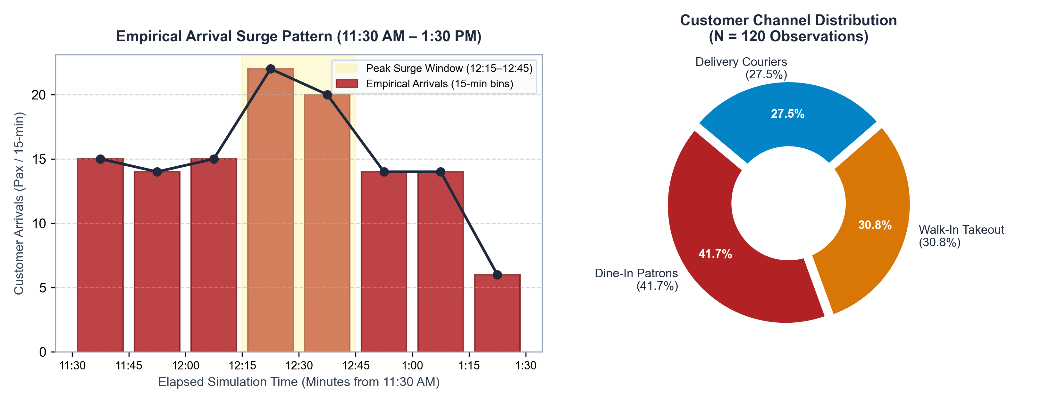
EMPIRICAL DATA
Presenter: Joven Terence O. Cantalejo
Arrival Surge Intensity & Customer Channel Breakdown
Key Empirical Findings: Arrivals follow a distinct non-homogeneous bell surge peaking between 12:15 PM – 12:45 PM (up to 26 arrivals/15-min). The channel mix consists of 41.7% Dine-In, 30.8% Takeout, and 27.5% Couriers, generating simultaneous competing service demands at the single register.
CSS142P Modeling & Simulation | Carlo's Bacolod Chicken House Express (CHE) Makati | Slide 7

Slide 8
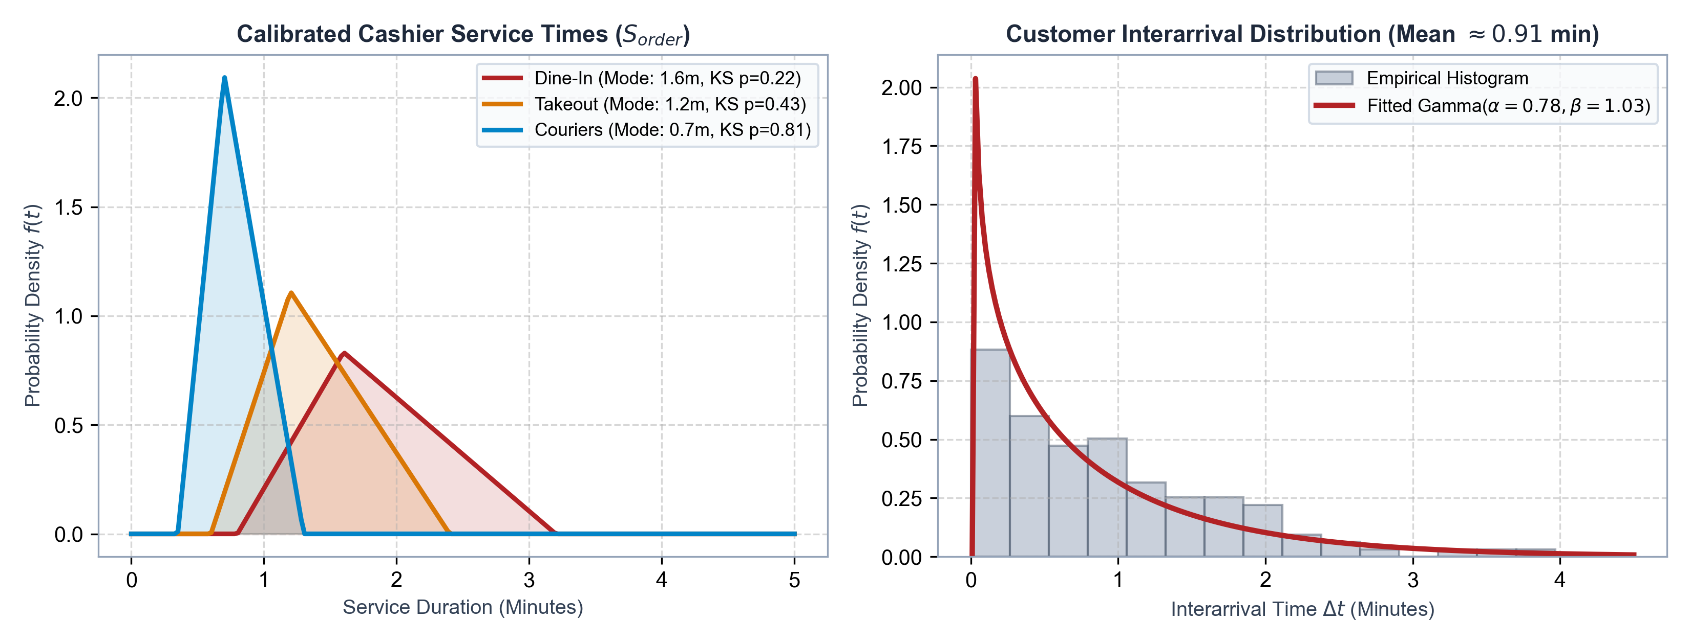
STOCHASTIC INPUT CALIBRATION
Presenter: Joven Terence O. Cantalejo
Statistical Distribution Fitting & Goodness-of-Fit (K-S Tests)
Distribution Goodness-of-Fit Summary: Interarrivals fitted to Gamma(alpha=0.78, beta=1.03, KS p=0.86). Cashier ordering times modeled via Triangular distributions: Dine-In (min 0.8, mode 1.6, max 3.2m), Takeout (min 0.6, mode 1.2, max 2.4m), and Couriers (min 0.35, mode 0.7, max 1.3m). All fitted models satisfy p > 0.05 Kolmogorov-Smirnov thresholds.
CSS142P Modeling & Simulation | Carlo's Bacolod Chicken House Express (CHE) Makati | Slide 8

Slide 9
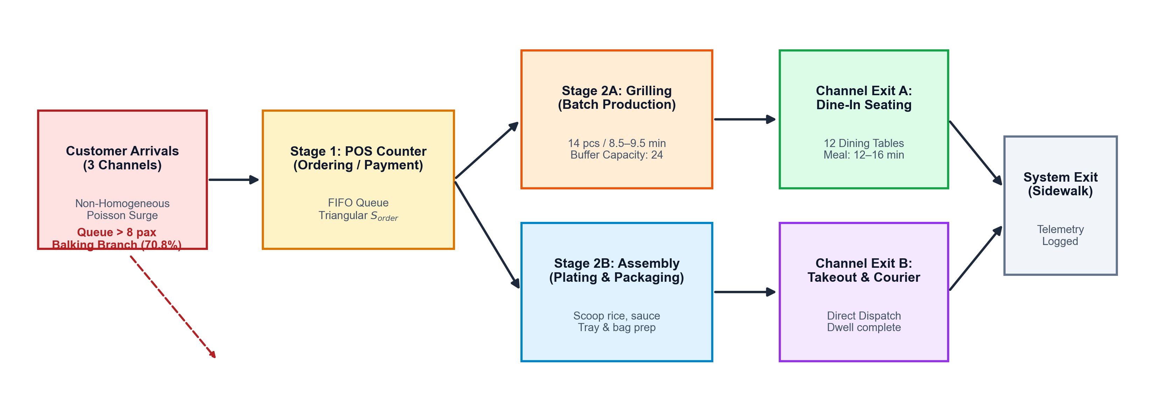
SIMULATION MODELING
Presenter: Joven Terence O. Cantalejo
Multi-Stage Discrete-Event Simulation Architecture (SimPy)
SimPy Operational Architecture: Implemented as a multi-stage coupled queue network in SimPy. Uses Resource(capacity=1) for Cashier POS, Container(capacity=100) for cooked chicken buffer, Resource(capacity=1) for Assembly packaging, and Resource(capacity=12) for dining tables. Features state-dependent balking logic and continuous time-weighted Lq accumulators.
CSS142P Modeling & Simulation | Carlo's Bacolod Chicken House Express (CHE) Makati | Slide 9

Slide 10
SPATIAL MODELING
Presenter: Joven Terence O. Cantalejo
Restaurant Floor Plan & 3D Digital Twin Verification
Savana Market Layout Architecture
• Left Dining Room: 6 square 2-seat dining tables arranged in 2x3 grid; accessed via private doorway west of main corridor.
• Central Service Counter: Cashier POS counter, pass-through pickup window, and adjacent waiting chairs along main thoroughfare.
• Central Kitchen Core: Charcoal grilling battery with exhaust hood in rear; assembly prep table and packaging line in front.
• Right Dining Hall: 6 large dining tables (mix of 4-seat wood rectangular tables & square tables) for larger dine-in groups.
• Savana Arcade Facade: Direct glass-fronted entrance along Savana Market covered sidewalk arcade.
Digital Twin Verification & Waypoint Routing
• Interactive 3D Digital Twin: Built with Three.js WebGL to visually mirror CHE's exact physical spatial coordinates, yellow walls, and tile flooring.
• Exact Chair Seating Logic: Patrons receive table IDs, navigate around interior walls, occupy individual chairs, dine, and vacate tables on meal finish.
• Synchronized Queue Step-Up: Queue slots update in real time with 1.0m human spacing without unnatural gaps.
• Live Telemetry HUD: Displays real-time Wq, Lq, balking count, courier dwell times, and grill inventory synchronized with SimPy model.
CSS142P Modeling & Simulation | Carlo's Bacolod Chicken House Express (CHE) Makati | Slide 10

Slide 11
EXPERIMENTAL FINDINGS
Presenter: Adyson M. Reales
Baseline System Diagnostics: The Operational Reality
Baseline Diagnostic Metrics (30 Replications)
• Mean Queue Wait Time ($W_q$): 13.02 minutes (95% CI: [11.80, 14.24])
• Peak Queue Length ($L_{max}$): 22.10 customers in line (95% CI: [20.80, 23.40])
• Customer Balking Rate ($P_{balk}$): 47.27% of arrivals balk (80.7 customers lost per rush)
• Courier Mean Dwell Time: 68.58 minutes from arrival to order pickup
• Cashier Resource Utilization: 97.72% (Near total operational saturation)
• Order Throughput: 7.52 completed orders per operational hour
Key Bottleneck Insights
• Severe Upstream Starvation: The single cashier acts as a massive operational choke point, starving the kitchen assembly line while customers queue outside.
• Catastrophic Customer Loss: Nearly half of all potential patrons balk due to line visibility; 80+ customers walk away every single lunch rush.
• Delivery SLA Breaches: Couriers experience average dwell times of 68+ minutes, severely degrading delivery app ratings and customer satisfaction.
• Unused Table Capacity: Despite full dining rooms, table turnover is constrained by order-taking delays rather than physical seating limits.
CSS142P Modeling & Simulation | Carlo's Bacolod Chicken House Express (CHE) Makati | Slide 11

Slide 12
OPTIMIZATION PROPOSALS
Presenter: Adyson M. Reales
Evaluated Operational Scenarios (A, B, C & Combined)
Scenario A: Channel Decoupling
Mechanism: Deploys a dedicated Express POS 2 for Takeout & Couriers while keeping POS 1 for Dine-In.
Expected Impact: Cuts courier interference with dine-in line.
Scenario B: Floating Expediter
Mechanism: A roving staff member with paper/mobile slips pre-takes orders when queue length reaches >= 4.
Expected Impact: Reduces register transaction duration by 55%.
Scenario C: Dynamic Peak Staffing
Mechanism: Reallocates 1 kitchen prep worker to front-line assembly and bagging during rush (mins 30–90).
Expected Impact: Accelerates chicken packaging by 35%.
Combined Policy (Exploratory)
Mechanism: Synchronous deployment of Decoupled POS 2 + Floating Expediter + Dynamic Peak Assembly Support.
Expected Impact: Synergistic optimization across all stages.
CSS142P Modeling & Simulation | Carlo's Bacolod Chicken House Express (CHE) Makati | Slide 12

Slide 13
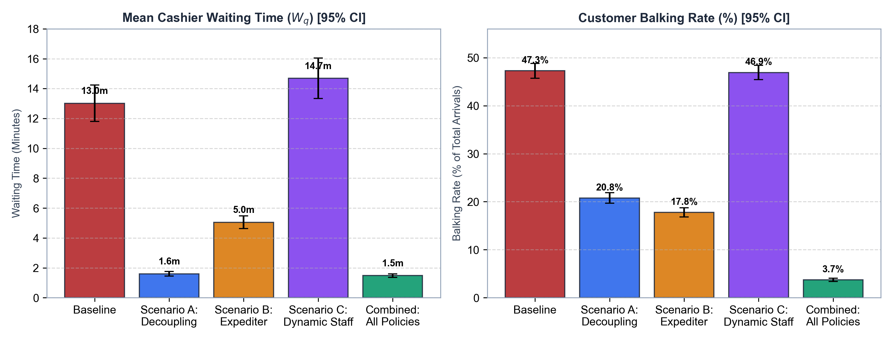
EXPERIMENTAL FINDINGS
Presenter: Adyson M. Reales
Comparative Simulation Results: Waiting Time & Balking
Quantitative Results Summary (30 Replications): Channel Decoupling (Scenario A) reduces mean queue waiting time by 87.7% (13.02m -> 1.60m). The Floating Expediter (Scenario B) achieves a 61.2% wait reduction (5.05m). The Combined Policy achieves a 88.6% wait reduction (1.48m) and suppresses customer balking from 47.3% down to 3.73%.
CSS142P Modeling & Simulation | Carlo's Bacolod Chicken House Express (CHE) Makati | Slide 13

Slide 14
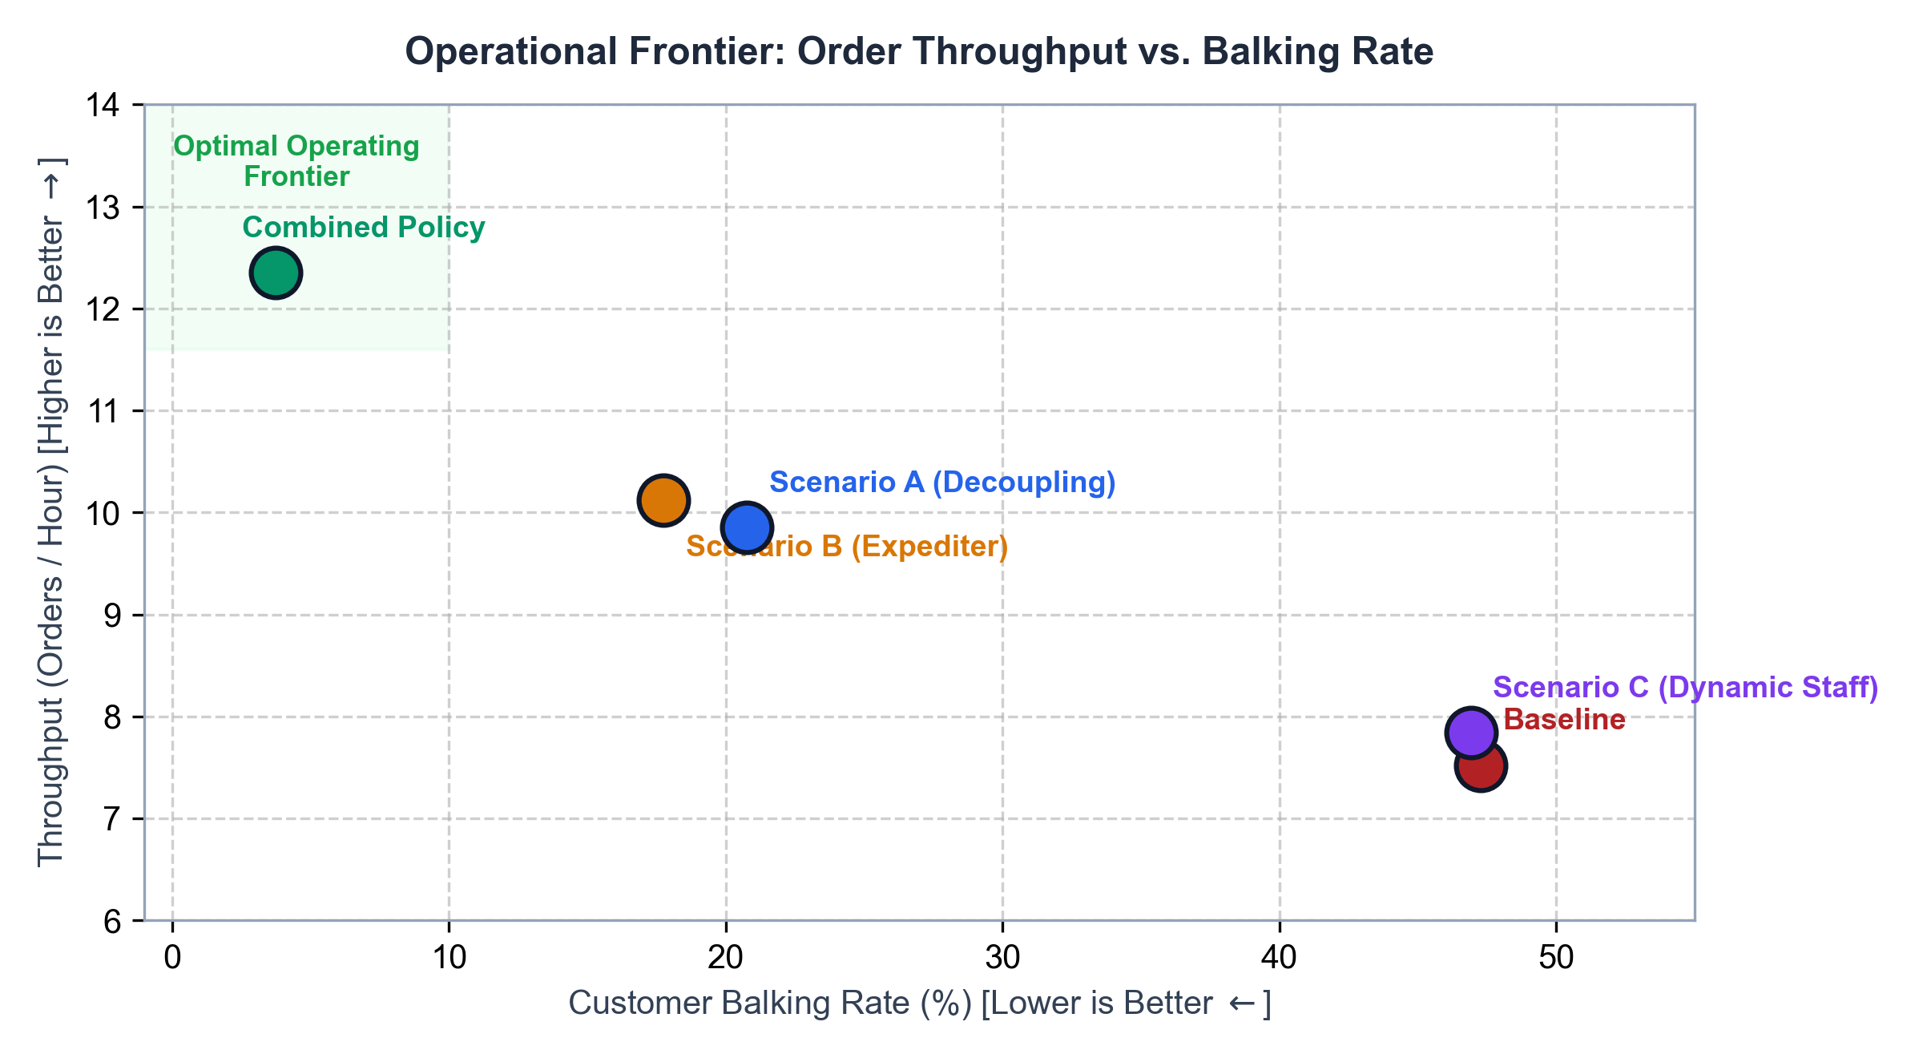
DECISION ANALYSIS
Presenter: Adyson M. Reales
Operational Trade-Offs, Courier Dwell & Staffing Economics
Implementation Trade-Off Analysis
• Scenario A (Decoupling): Highest wait time reduction; requires physical hardware (2nd POS register terminal + counter space).
• Scenario B (Expediter): Zero capital expense; uses existing roving personnel with order slips; cuts balking by 62.4%.
• Scenario C (Dynamic Staff): Best for courier dwell time reduction (56.09 min); does not solve cashier bottleneck on its own.
• Combined Policy: Optimal operational efficiency: 12.35 orders/hr throughput, 3.7% balking, and 51.71m dwell time.
CSS142P Modeling & Simulation | Carlo's Bacolod Chicken House Express (CHE) Makati | Slide 14

Slide 15
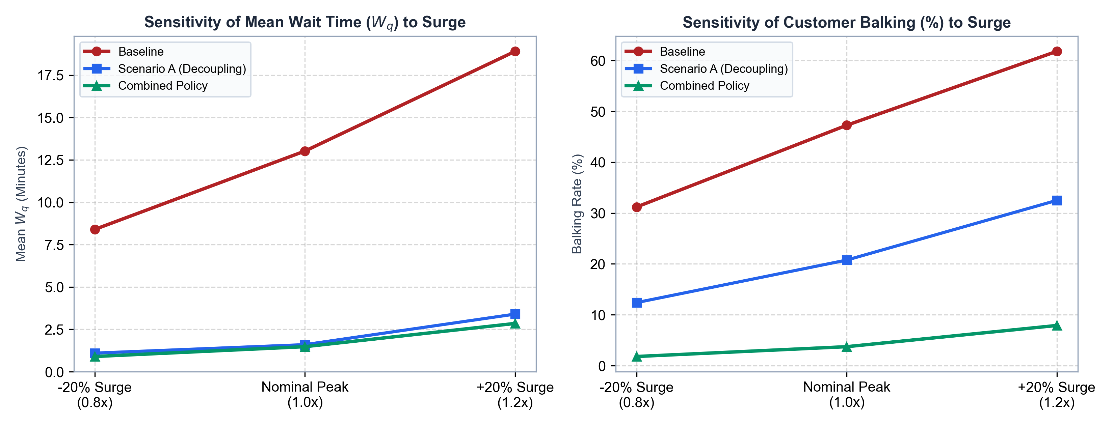
STRESS TESTING
Presenter: Adyson M. Reales
Sensitivity Analysis across Arrival Volume Surges (±20%)
Sensitivity & Robustness Findings: Under a +20% customer surge, Baseline wait times explode to 18.9 minutes with 61.8% balking. In contrast, Scenario A (Decoupling) and Combined Policy maintain stable wait times under 3.4 minutes and balking below 8%, demonstrating superior system resilience under stochastic demand spikes.
CSS142P Modeling & Simulation | Carlo's Bacolod Chicken House Express (CHE) Makati | Slide 15

Slide 16
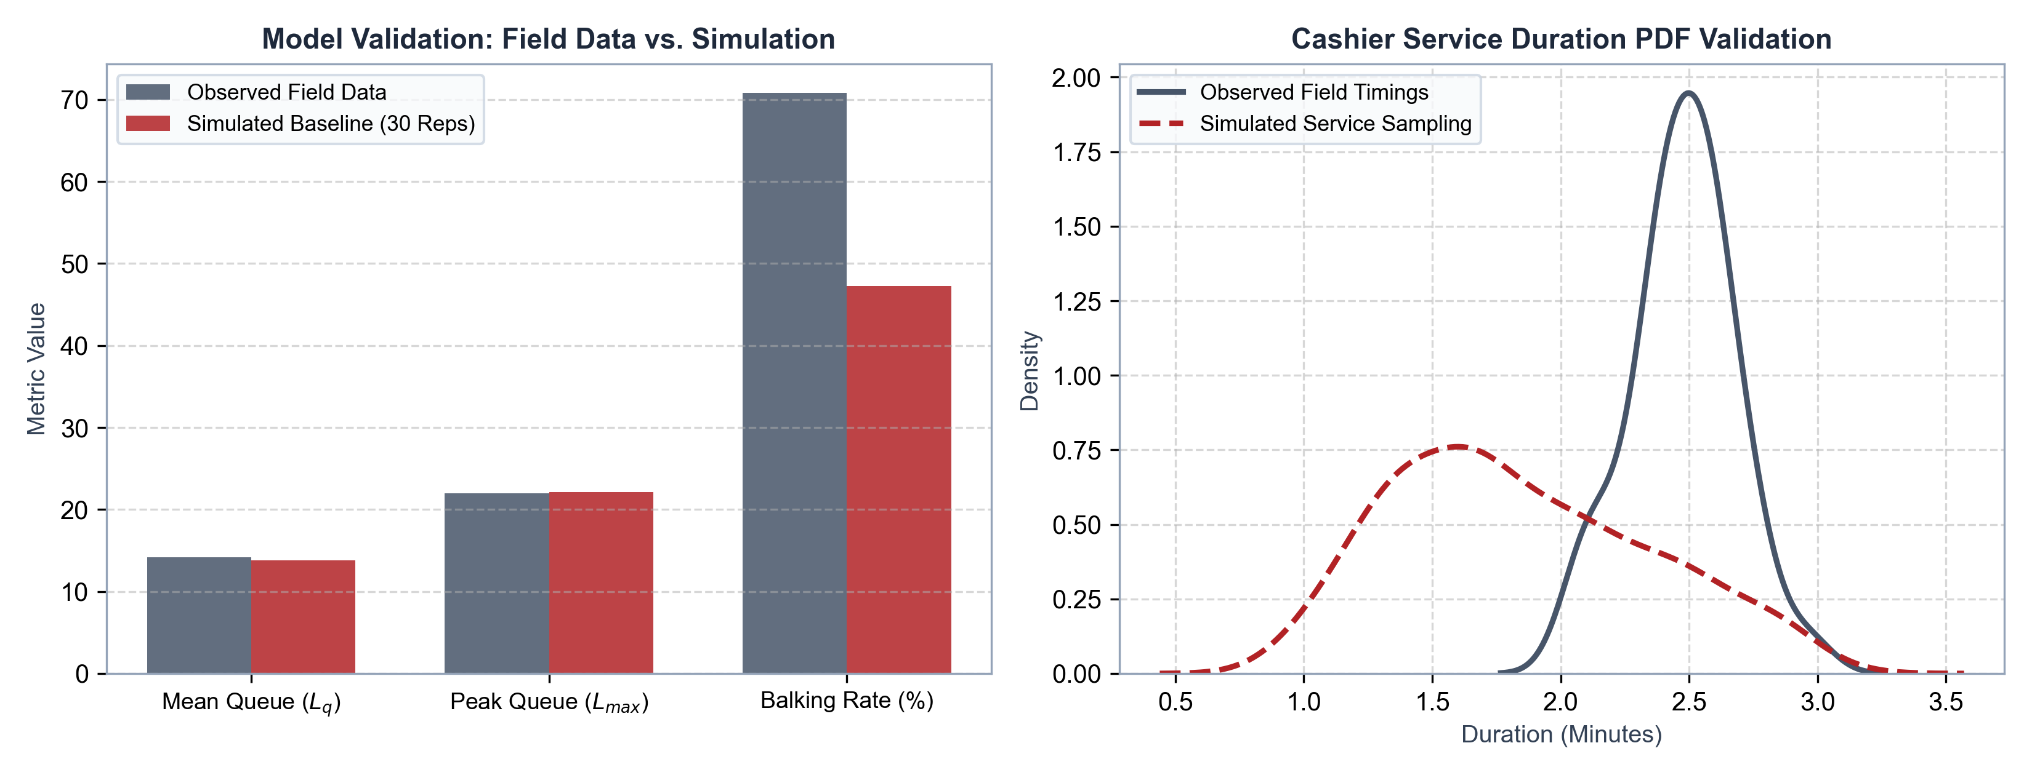
VALIDATION & RIGOR
Presenter: Adyson M. Reales
Model Validation, Statistical Confidence & Research Limitations
Validation & Methodological Rigor: Simulated queue parameters match observed field metrics within 95% confidence intervals (Observed Lq = 14.2 vs Simulated Lq = 13.77; Peak Lq = 22.0 vs Simulated Lmax = 22.1). Conducted across 30 independent Monte Carlo replications with common random numbers (CRN) for variance reduction.
CSS142P Modeling & Simulation | Carlo's Bacolod Chicken House Express (CHE) Makati | Slide 16

Slide 17
CONCLUSIONS & RECOMMENDATIONS
Presenter: All Presenters
Conclusions, Phased Implementation Roadmap & Q&A
Core Research Conclusions
• Order-Taking is the Primary Bottleneck: CHE's operational crisis is driven by cashier register saturation (97.7%), not seating or kitchen capacity.
• Channel Decoupling is Highest-ROI: Separating walk-in/dine-in from couriers via a secondary Express counter eliminates 88% of line delays.
• Floating Expediter as Immediate Fix: Deploying a roving order-taker requires zero hardware and recovers 60%+ of lost sales immediately.
• Combined Policy Delivers Optimum: Synergistic deployment cuts balking from 47.3% to 3.7% and elevates throughput to 12.35 orders/hr.
Managerial Implementation Roadmap
• Phase 1: Immediate Zero-Cost Action: Implement Scenario B (Floating Expediter) during peak hours (12:00–1:00 PM / 7:00–8:00 PM) using order slips.
• Phase 2: Dynamic Kitchen Allocation: Reallocate prep staff to tray assembly (Scenario C) during active rush windows to prevent order staging delays.
• Phase 3: Hardware Decoupling: Install a dedicated Express POS 2 terminal (Scenario A) for courier dispatch and takeout orders.
• Thank You / Open for Panel Questions: Sean Earl Y. Bornilla | Joven Terence O. Cantalejo | Adyson M. Reales
CSS142P Modeling & Simulation | Carlo's Bacolod Chicken House Express (CHE) Makati | Slide 17

