Slide 1
Structure and organization of folders and data
Nansen Legacy workshop
Reproducible data wrangling, visualization and collaboration with R and GitHub
Notes:
«personal data management»
Should result in openly readable/usable data management and analysis
Not only papers are part of your work, but also data collection and analysis
Sharing all this and making it reusable should be
Being selfish about how you organize your data (in a way that your future you can get into your analysis) is also good for this purpose

Slide 2
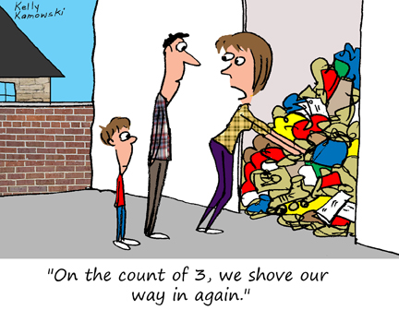
Why we need to organize
Reduce errors
Be more efficient
paper writing/review process less painful
easy re-use of functions/code
easier sharing later
Make your data and analysis readable and reusable for
Your future self
Your collaborators
Other researchers, journalists, the public
Notes:
Not only your paper, but also the raw data and the data analysis are part of your research and should therefore be published
Aim of this workshop: no «perfect recipe», but discussion
Find out what works for you best, but
It needs to be reproducible
It needs to be somewhat self-explanatory to someone who wants to work with that data and sees it for the first time
You need to be able to get back to it after a long time without spending too much time about understanding what you did We get data not all at once, but little by little (especialy if seasonal)
It should be in a shape so you can publish it directly, since if you want to publish your data you don’t need to fiddle around and what you did in the beginning doesnt match what came out in the end

Slide 3
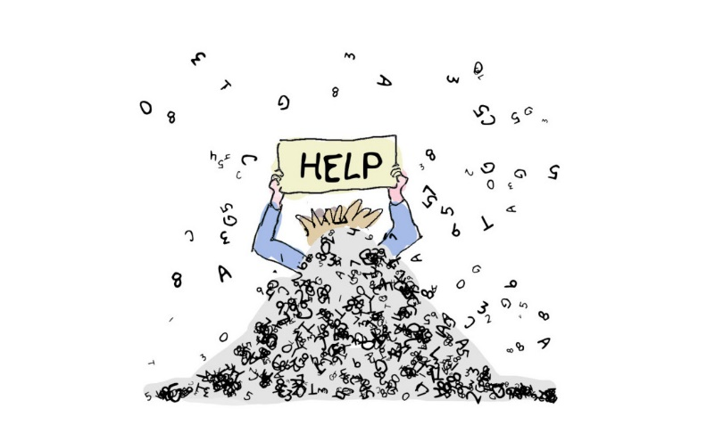
My master thesis started off as a mess…
Notes:
Master thesis
I realized I would get a lot of data, also of different types (community data of macrofauna, meiofauna, where some groups were identified to species level others not, a bunch of environmental data (sediments, different sectioning 0-1, 0-0.5, 0-10cm etc), data that I found open source (water column data/ CTD, sea ice) AND data from 1990s that I needed to type in manually from hard copies that I got sent
I realized I would lose my overview if I dont organize this all in a clever way
I started with just using a organized folder and naming structure and it already changed a lot
However, one year later when I got back to the data to get a paper of it published, I had to rewrite the whole code because I didnt understand what I was doing
So working on the paper also meant spending a lot of time getting into it again, so I also started to invest more time into working on my way of organization as well
Today my folder structure and my coding looks a lot better, but there is still a lot to improve
My code is over 5000 lines long

Slide 4
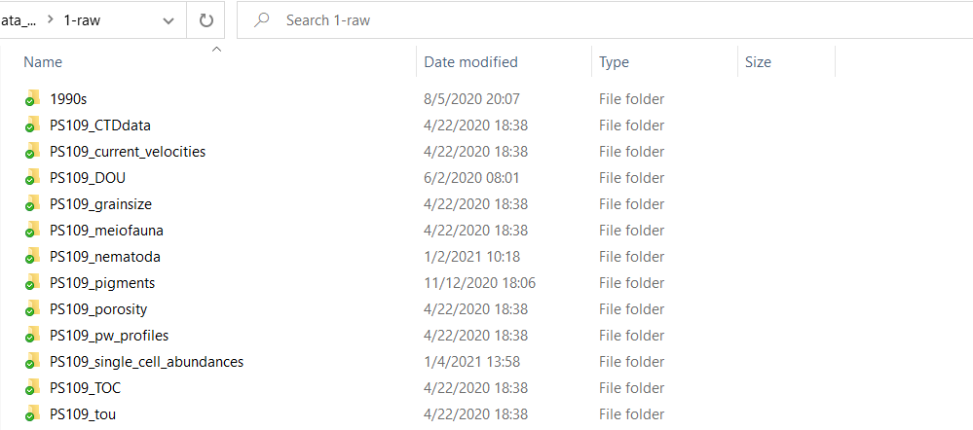
Notes:
Many people are surely doing this already

Slide 5
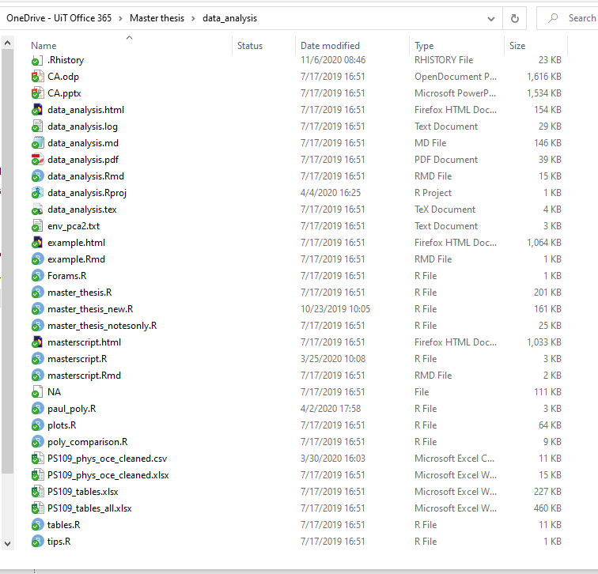
Notes:
Several formats of same file (txt, odp, ppt,
Master_thesis, master_thesis_new, master_thesis_notesonly
Tables, tables_all
Data, scripts, outputs all in the same file
Different ways to name files (paul_poly, poly_comparison)

Slide 6
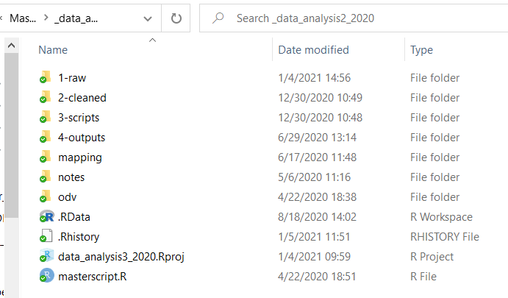
vs
Notes:
Several formats of same file (txt, odp, ppt,
Master_thesis, master_thesis_new, master_thesis_notesonly
Tables, tables_all
Data, scripts, outputs all in the same file
Different ways to name files (paul_poly, poly_comparison)

Slide 7
Group exercise (15min)
1. Split into break-out rooms
2. Take your own example (e.g. a project folder, your thesis etc.) and think about following questions:
Is the way you organized your folders and data reproducible for other people, and above all for your future self?
If not, what makes it difficult for you to have your folders and data organized?
At what point do you start to lose the overview?
What are common habits that you would like to change/improve regarding
File naming
folder architecture
Data input/process/output structure
Collaboration/Sharing
Other
3. Go to https://audience.ahaslides.com/AEN
Notes:
Not just give tips & recipe, but find out together what is actually difficult. Because it is always said that it saves you time to be organized or thats its actually not that difficult, but why is it then not really happening?
Data don’t come at the same time
Data are from different people, that have a different style to name things
Time
(time restriction, size of the project, coming back to it later etc.)

Slide 8
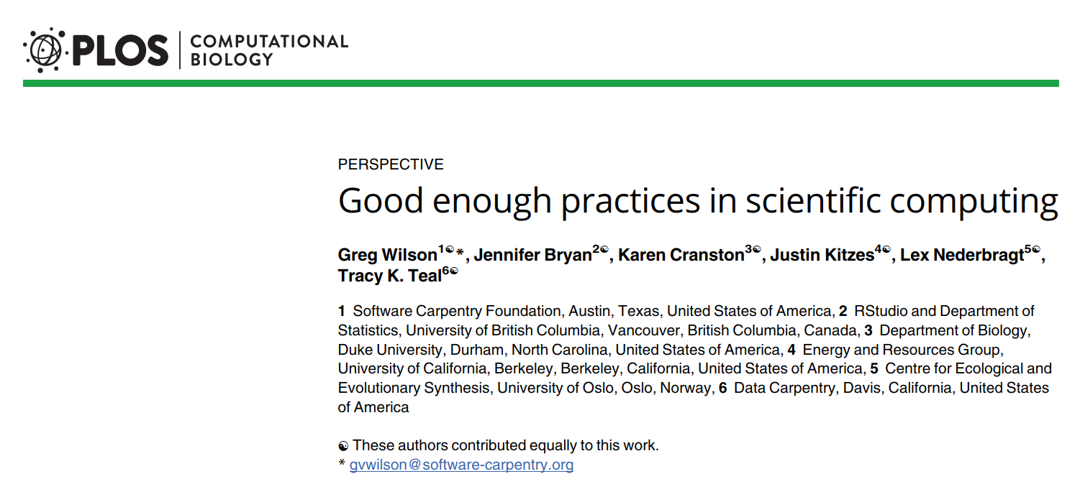

Slide 9
Good enough practices
Data management
Software
Collaboration
Project organization
Tracking changes
Manuscripts
Data management
Software
Collaboration
Project organization
Tracking changes
Manuscripts
Notes:
Set of recommendations by the paper
saving both raw and intermediate forms, documenting all steps, creating tidy data amenable to analysis.
Writing, organizing, and sharing scripts and programs used in an analysis.
making it easy for existing and new collaborators to understand and contribute to a project.
organizing the digital artifacts of a project to ease discovery and understanding.
recording how various components of your project change over time.
writing manuscripts in a way that leaves an audit trail and minimizes manual merging of conflicts.

Slide 10
FAIR data management principles
Findable
Accessible
Interoperable
Reusable
Data management
Software
Collaboration
Project organization
Tracking changes
Manuscripts

Slide 11
Save the raw data and keep it
Save data as originally generated
Change file permissions to read-only
Data management
Software
Collaboration
Project organization
Tracking changes
Manuscripts
Notes:
(e.g. by instrument or from survey)
Do not overwrite raw data files with cleaned versions
Essential for rerunning analyses from start to finish
Recovery from analytical mishaps
Experimenting
make it harder to damage raw data by accident

Slide 12
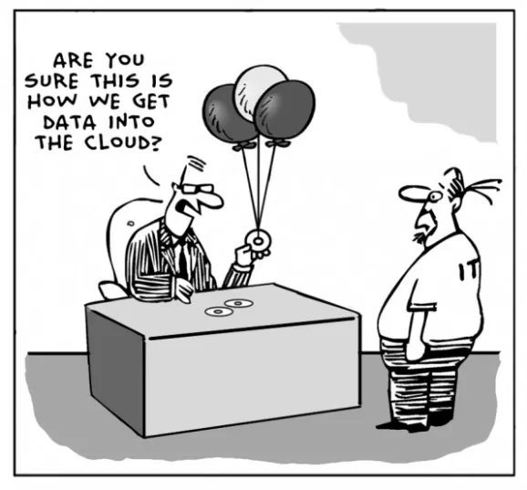
Ensure that raw data are backed up in more than one location
Careful with flash drives
Use institution-intern storage solutions
Rule of 3: Keep 2 copies onsite, 1 offsite.
NIRD internal work area:
/projects/NS9530K/nansen_legacy/work
Data management
Software
Collaboration
Project organization
Tracking changes
Manuscripts

Slide 13
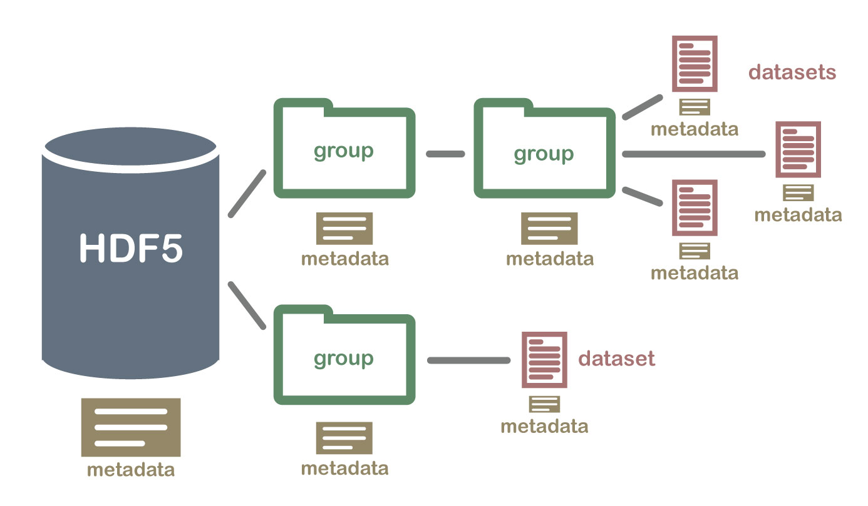
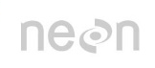
Create the data you wish to see in the world
Personal use (or in NIRD interal work area):
CSV, XLSX, JSON etc. all fine
When publishing:
NetCDF-CF (physical data)
Darwin Core Archive (biological data)
But keep original files!
Data management
Software
Collaboration
Project organization
Tracking changes
Manuscripts
Notes:
Save data as originally generated (e.g. by instrument or from survey)
Do not overwrite raw data files with cleane

Slide 14
Create the data you wish to see in the world
Variable names from common vocabulary:
CF Conventions (https://cfconventions.org/standard-names.html)
Darwin Core (https://dwc.tdwg.org/list/)
List the convention used in the file. The variable names are then searchable
AeN sample logging template generator
https://www.sios-svalbard.org/cgi-bin/darwinsheet/?setup=aen
Data management
Software
Collaboration
Project organization
Tracking changes
Manuscripts
Notes:
Save data as originally generated (e.g. by instrument or from survey)
Do not overwrite raw data files with cleane

Slide 15
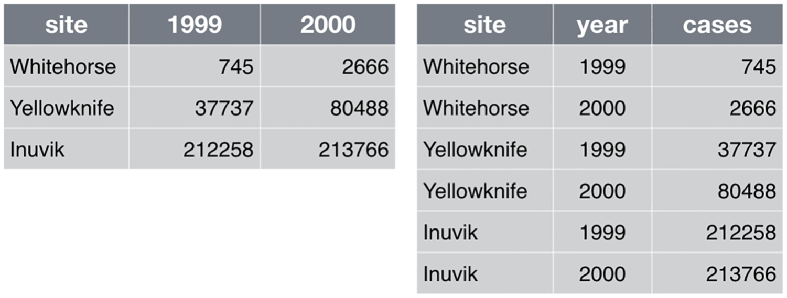
Create analysis-friendly data
each column a variable
each row an observation
Think about this already before going in the field → create templates using AeN template generator on SIOS
https://www.sios-svalbard.org/cgi-bin/darwinsheet/?setup=aen
Data management
Software
Collaboration
Project organization
Tracking changes
Manuscripts
Notes:
Save data as originally generated (e.g. by instrument or from survey)
Do not overwrite raw data files with cleane

Slide 16
Create the data you wish to see in the world
File names: Use self-explaining names
Use consistent file names and formats within a project, and if possible, from project to project.
No spaces but underscores
Use surname first, followed by first name or initials
Use the date format: YYYY-MM-DD, YYYY_MM_DD, or YYYYMMDD.
Keep track of different file versions with a suffix representing date (e.g., "filename_20140620") or version number (e.g., "filename_v001"). Document changes where possible.
Don't rely on directory structure to provide critical information about file contents
Project001/SiteB/SiteB_2010_rawdata.txt better than Project001/SiteB/2010/rawdata.txt
Data management
Software
Collaboration
Project organization
Tracking changes
Manuscripts
Notes:
Save data as originally generated (e.g. by instrument or from survey)
Do not overwrite raw data files with cleane

Slide 17
Record all the steps used to process data
Best way: write scripts for EVERY stage of data processing
It is also easier if you’re generating data constantly
If not possible
document every manual action
Record processing history in metadata of published file
Publish data papers
Data management
Software
Collaboration
Project organization
Tracking changes
Manuscripts
Notes:
Data manipulation is as important for your analysis as statistics and interpretation
You have to document this step throughoughly so you can reproduce
Write in a file what menu was used, what column was copied and pasted etc
At least you know what has been done, if not why

Slide 18
Submit data to a data repository that contributes to SIOS
Data file or data collection
NMDC, NPI, NorDataNet, MET, and NIRD
Data repository issues DOI (Digital object identifier)
Data management
Software
Collaboration
Project organization
Tracking changes
Manuscripts
Notes:
Provide metadata
Write README files

Slide 19
data.nleg@unis.no
Data management
Software
Collaboration
Project organization
Tracking changes
Manuscripts
Notes:
Provide metadata
Write README files

Slide 20
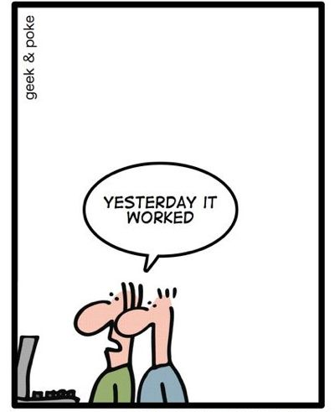
Software
«code-writing»
Be readable, reusable, testable
Data management
Software
Collaboration
Project organization
Tracking changes
Manuscripts
Notes:
We’re not doing software engineering and what we do probably doesnt og much beyond statistics
But we should apply some best practices of software engineers to make the code readbale, reusable, testable

Slide 21
Place a brief explanatory comment at the start of every script
What kind of data are you using in your script?
What will you achieve with the script?
Code snippets
In R:
Tools > Global Options > Code > Edit Snippets
See also: https://timfarewell.co.uk/my-r-script-header-template/
Data management
Software
Collaboration
Project organization
Tracking changes
Manuscripts
Notes:
Especially important when you’re publishing your code/data analysis

Slide 22
Decompose programs into functions
Don’t write one long script, but split your analyses into meaningful pieces
Sectioning
Data management
Software
Collaboration
Project organization
Tracking changes
Manuscripts
Notes:
no more than 1 page (about 60 lines) long
Mine: 50-150 lines long

Slide 23
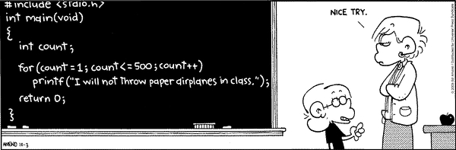
Be ruthless about eliminating duplication
Instead of copy-pasting
Write & reuse functions
Make lists
Use iterations (loops) or mapping (lapply, purrr)
Data management
Software
Collaboration
Project organization
Tracking changes
Manuscripts
Notes:
instead of multiple objects if you are going to do the same analysis on each object of the same structure

Slide 24

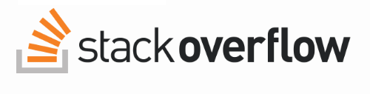
Always search for well-maintained software libraries that do what you need.
Check if others have done what you are trying to do instead of doing things from scratch, but
Test libraries before relying on them.
Data management
Software
Collaboration
Project organization
Tracking changes
Manuscripts

Slide 25
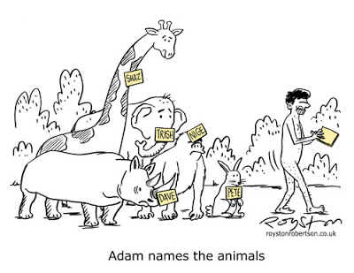
Give functions and variables meaningful names
«the greater the scope of a variable, the more informative its name should be»
Be consistent
Don’t use names that mean sth (e.g F, sum, plot)
Use tab completion
Instead of giving a relative path, use file.path()
Data management
Software
Collaboration
Project organization
Tracking changes
Manuscripts
Notes:
For documenting their purpose
Make the program easier to read

Slide 26
Do not comment and uncomment sections of code to control program’s behavior
This doesn’t make it reproducible
Rather use if/else statements in the program
Data management
Software
Collaboration
Project organization
Tracking changes
Manuscripts

Slide 27
Provide a simple example or test data set
Check whether your scripts give a known correct output for a simple known input (e.g. mock dataset of your generated data, or an older dataset)
Data management
Software
Collaboration
Project organization
Tracking changes
Manuscripts

Slide 28

Submit code to a reputable DOI-issuing repository
Just as your data, publish your code
Data management
Software
Collaboration
Project organization
Tracking changes
Manuscripts

Slide 29
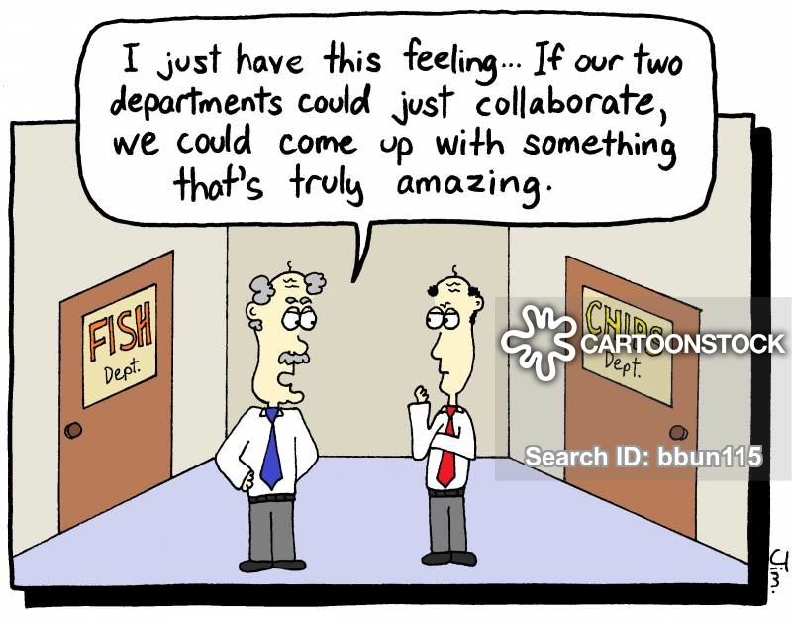
Collaboration
Notes:
You may know your collaborators, but you should make it easy for them to work/ proof the data for new collaborators to join
That collaborator could also be you returning to a project

Slide 30
Create an overview of your project
README.txt file at project level
Projects title
Brief description
Contact information
Collaborators/contributors (specify), sponsors/funding sources
Methods/techniques/protocols/standards, instrumentation, software (incl. Versions)
Citation info, ditribution restrictions, copyright
Examples of how to run various cleaning or analysis tasks
List of datasets you are going to use
dataset name, source, date created or downloaded, resolution and extent, CRS, licence, citation, any comments
Update regularly!
Data management
Software
Collaboration
Project organization
Tracking changes
Manuscripts
Notes:
Contributing -> more for software development? But certainly also good for us to specify what comes from whom in order to be on the paper
Might also be a «Absicherung» and documentation for us PhDs which you can use if it becomes clear that one of your initial co-authors dont deserve to be on the paper
all of the background information about a project that seems so obvious now but which you may very well forget in 5 years.

Slide 31
Create an overview of your project
README.txt file at file level for every dataset
complete list of the parameter names used in the dataset
Description of each parameter
Data format
Dates: YYYY-MM-DD or YYYYMMDD
Time: HH:MM:SS or HHMMSS +local time zone
Coordinates: decimal degrees (DD)
Units of measurement
An attribute/variable that describes data quality or certainty
Template:
https://cornell.app.box.com/v/ReadmeTemplate
Data management
Software
Collaboration
Project organization
Tracking changes
Manuscripts
Notes:
Contributing -> more for software development? But certainly also good for us to specify what comes from whom in order to be on the paper
Might also be a «Absicherung» and documentation for us PhDs which you can use if it becomes clear that one of your initial co-authors dont deserve to be on the paper
all of the background information about a project that seems so obvious now but which you may very well forget in 5 years.

Slide 32
Create a shared "to-do" list for the project
NOTES.txt or TODO.txt
Update regularly
Data management
Software
Collaboration
Project organization
Tracking changes
Manuscripts

Slide 33
Decide on communication strategies
Make clear how members of the project will communicate and which platforms will be used
E-mail, Microsoft Teams, Google docs, Zoom , GitHub….
Data management
Software
Collaboration
Project organization
Tracking changes
Manuscripts

Slide 34
Make the license & citation explicit
LICENSE.txt file in the projects home directory that states what licenses apply to the data and manuscripts
Do not use «no commercial use»
Rather use permissive software licenses rather then GNU General Pulic License (GPL)
CITATION.txt
Examples:
DataCite.org
Data management
Software
Collaboration
Project organization
Tracking changes
Manuscripts
Notes:
For example, if a researcher in a
developing country is being paid by her government to compile a public health report, she
will be unable to include your data if the license says "noncommercial".

Slide 35
Project organization
Data management
Software
Collaboration
Project organization
Tracking changes
Manuscripts

Slide 36
Put each project in its own directory, which is named after the project
Divide your research into projects
If 2 research efforts share more than half of their data or code, they should probably be put into one directory
If several projects require same code, that code/script should be a project of its own
Data management
Software
Collaboration
Project organization
Tracking changes
Manuscripts
Notes:
E.g. separate project for each paper you’re planning/working on
Main aim: consistenct helps you effectively find and use things later

Slide 37
Put text documents associated with the project in the doc directory
Files for manuscripts, documentation for source code, electronic lab notebook,
Data management
Software
Collaboration
Project organization
Tracking changes
Manuscripts

Slide 38
Put raw data and metadata in a data directory and files generated during cleanup and analysis in a results directory.
Results
Will require additional subdirectores
Cleaned data, statistical tables, final figures/tables
Data
Subdirectories to organize raw data based on time, method of collection, or other metadata
Data management
Software
Collaboration
Project organization
Tracking changes
Manuscripts

Slide 39
Put project source code in the src directory.
Scripts for data cleaning, making plots, statistical analysis
controller script (masterscript.R or runall.R) that contains all analysis steps for the enture project from start to finish
Data management
Software
Collaboration
Project organization
Tracking changes
Manuscripts

Slide 40
Name all files to reflect their content or function
E.g. bird_count_table.csv, manuscript.md, sightings_analysis.R
Don’t use sequential numbers (e.g. result1.csv, result2.csv or fig_3_a.png)
They will change as project evolves
Data management
Software
Collaboration
Project organization
Tracking changes
Manuscripts

Slide 41
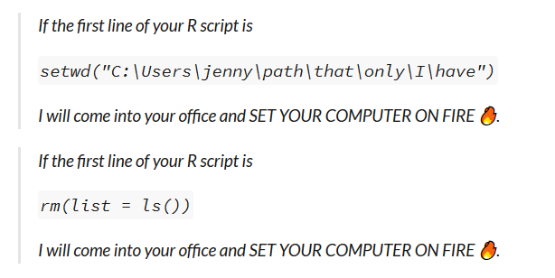
Rprojects and the here package
from Jenny Brian https://www.tidyverse.org/blog/2017/12/workflow-vs-script/
Also: never save or load your workspace
Notes:
Rprojects are automatically setting your project folder as working directory
You can have several Rprojects open
An Rproject is «closed» in itself, as long as the whole folder is removed, everything will work just as you set on each computer
setwd(), meanwhile, is completely dependent on the way you organize your files. Everyone who gets your script has to change the file path
rm() doesn’t give you a clean R session; it won’t, for instance, detach packages
Use here() from the here package to write file paths

Slide 42
Create an Rproject
Notes:
the default directory will be wherever the project is located

Slide 43
here::here()
Notes:
here::here() figures out the top-level of your current project using some sane heuristics. It looks at working directory, checks a criterion and, if not satisfied, moves up to parent directory and checks again. Lather, rinse, repeat.
If you have a long file path, instead of figuring out the backslashes, you put everything into comma and it creates the filepath for you
Works the same way, but not if you e.g. want to use Rmarkdown.

Slide 44
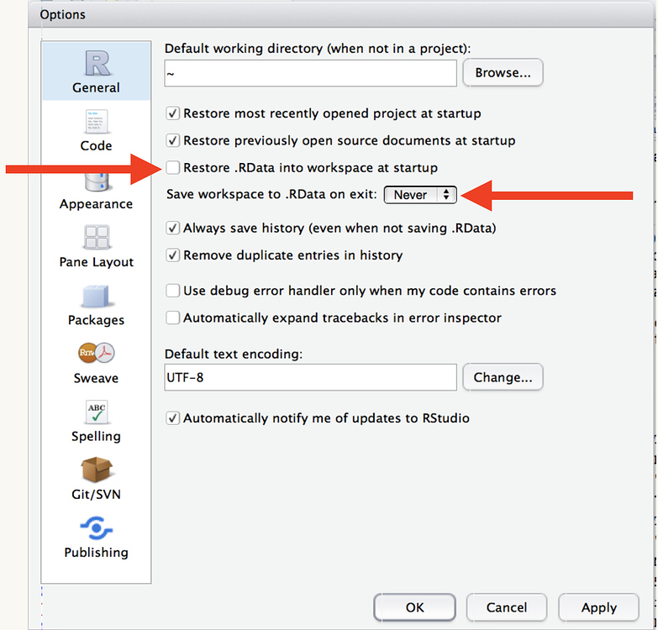
never save or load your workspace
Notes:
set up a local working directory in a fresh R session, which makes it much easier for someone else to open and run your code.
never save or load your workspace:
That ensures you always get a clean slate when you restart RStudio, and forces you to record all important steps in code.

Slide 45
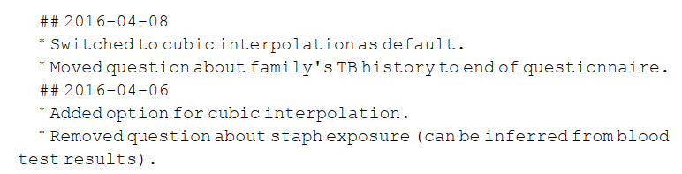
Add a file called CHANGELOG.txt to the project’s docs subfolder.
Data management
Software
Collaboration
Project organization
Tracking changes
Manuscripts
Notes:
Consider creating 1 change log file per contributor and merge those files whenever a backup copy is made

Slide 46
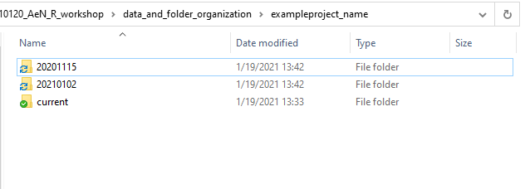
Copy the entire project whenever a significant change has been made
i.e., one that
materially affects the results, and store that copy in a subfolder whose name reflects the date in the area that’s being synchronized
Data management
Software
Collaboration
Project organization
Tracking changes
Manuscripts

Slide 47
Use a version control system.
To manage changes to a project
Data management
Software
Collaboration
Project organization
Tracking changes
Manuscripts
Notes:
Remember Luke’s webinar about GitHub!
Works with plain text files such as source code
You can store docx or pdf in a version control system, but its not possible to trach changes
Tabular data: possible to do version control but changing order of roes or columns will create a big change for the system
Raw data should not be changed

Slide 48
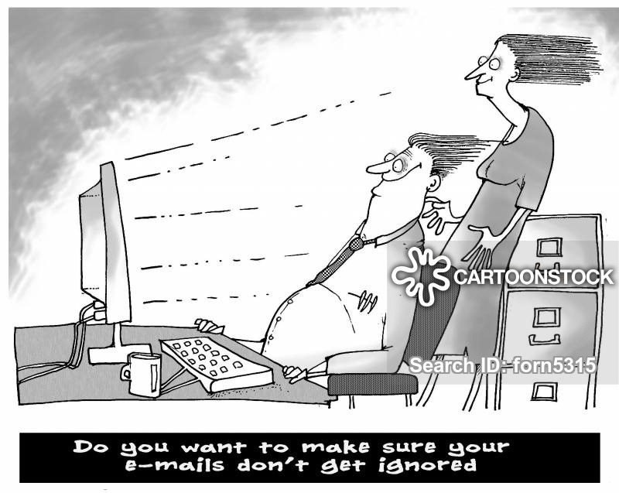
Manuscripts
Data management
Software
Collaboration
Project organization
Tracking changes
Manuscripts
Notes:
Instead of an e-mail based workflow,
Reduce the chances of work being lost or people overwriting each other’s work.
Make it easy to track and combine contributions from multiple collaborators.
Avoid duplication and manual entry of information, particularly in constructing bibliogra-phies, tables of contents, and lists.
Make it easy to regenerate the final published form (e.g., a PDF) and to tell if it is up to date.
Make it easy to share that final version with collaborators and to submit it to a journal.

Slide 49
Write manuscripts using online tools with rich formatting, change tracking, and reference management.
E.g. GoogleDocs
Data management
Software
Collaboration
Project organization
Tracking changes
Manuscripts

Slide 50
Write the manuscript in a plain text format that permits version control.
E.g. LaTeX or Markdown, GitHub
However, it requires all contributors to understand all these programs
Data management
Software
Collaboration
Project organization
Tracking changes
Manuscripts

Slide 51
Supplementary materials
Dont use pdf but csv, json, yaml, xml, hdf5
Rmarkdown html
→ For annotated code
→ reviewers see the stats, plus they can recreate them if they really want to.
Data management
Software
Collaboration
Project organization
Tracking changes
Manuscripts

Slide 52




Use a bibliography manager
Data management
Software
Collaboration
Project organization
Tracking changes
Manuscripts
Notes:
Perefer zotero since web-based and open source

Slide 53
Group work 2 (20min)
Apply these guidelines to your own project OR
Make a «template» folder for your future project (15min)
Discussion
Improvement?
What was the improvement?
What was still difficult?
Which tips were especially helpful?
What needs too much time, or seems unnecessary?
What were you already applying naturally?
Notes:
Of course a problem if PI’s do not value these things
«Can you please just send me a word document with track changes»
But maybe we can change the system, e.g. if we (co-)supervise and require the students, to at least keep their data organized in this way even if we’re not experienced in GitHub and Rmarkdown etc ourselves

Slide 54
References & further reading
Data structure and folder organization
https://www.youtube.com/watch?v=nabtt660-xg&list=PLgDT5hypdTySm2mh-hQA7knReBJY7ia_x&ab_channel=UWSchoolofAquaticandFisherySciences
Wilson, Greg, Jennifer Bryan, Karen Cranston, Justin Kitzes, Lex Nederbragt, and Tracy K. Teal. “Good Enough Practices in Scientific Computing.” PLOS Computational Biology 13, no. 6 (June 22, 2017): e1005510. https://doi.org/10.1371/journal.pcbi.1005510.
https://www.tidyverse.org/blog/2017/12/workflow-vs-script/
https://library.ucsd.edu/research-and-collections/data-curation/best-practices.html
Here::here() :
https://github.com/jennybc/here_here
https://malco.io/2018/11/05/why-should-i-use-the-here-package-when-i-m-already-using-projects/

Slide 55
Figure references
https://www.r-bloggers.com/2016/03/are-you-doing-parallel-computations-in-r-then-use-biocparallel-2/

Slide 56
More literature
Data wrangling
Wickham & Grolemund, R for Data Science https://r4ds.had.co.nz/
Advanced R
https://adv-r.hadley.nz/index.html

