Slide 1
PROJECT
SENSIFAKE
Sara Basco
Lorenzo Berretta
Giovanni Di Nola
1

Slide 2
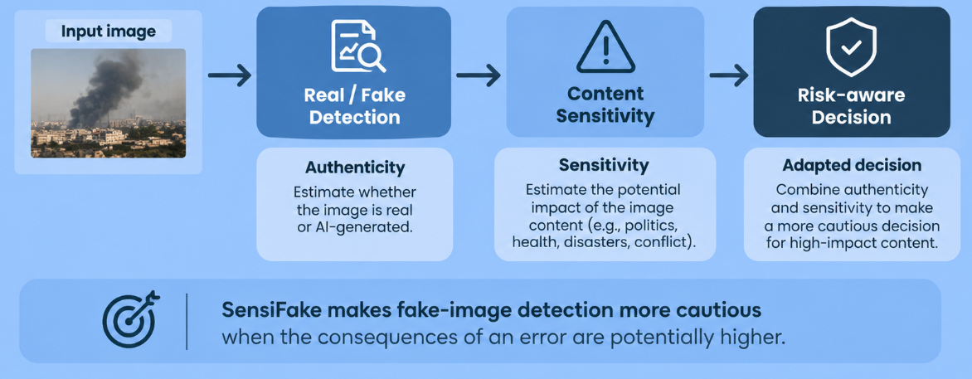
Project Goals
Not all classification errors have the same impact.
SensiFake aims to protect any individual from false acusations and to avoid the spreading of fabricated news by recognising the sensibility of the content of the image and consequently adapting its evaluation parameters.
2

Slide 3
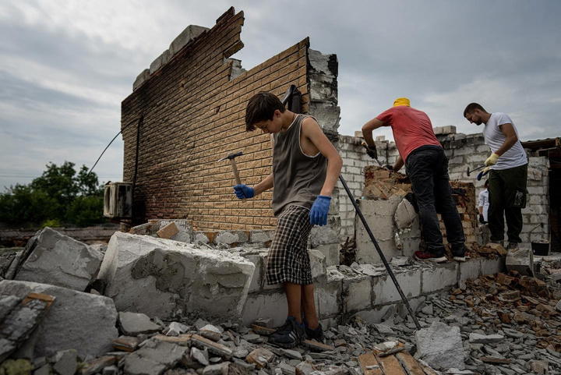
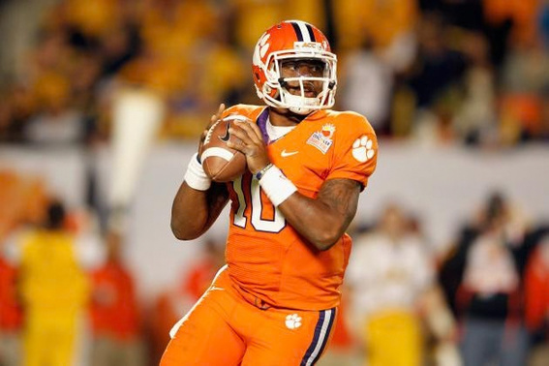

Dataset
ICCV 2025 RRDataset
A Research on the analysis of real life scenarios
OpenFake
Dataset with a focus on politically and socially salient content
SID-Set
Social media Image Detection dataSet
2

Slide 4
Dataset Construction
3

Slide 5
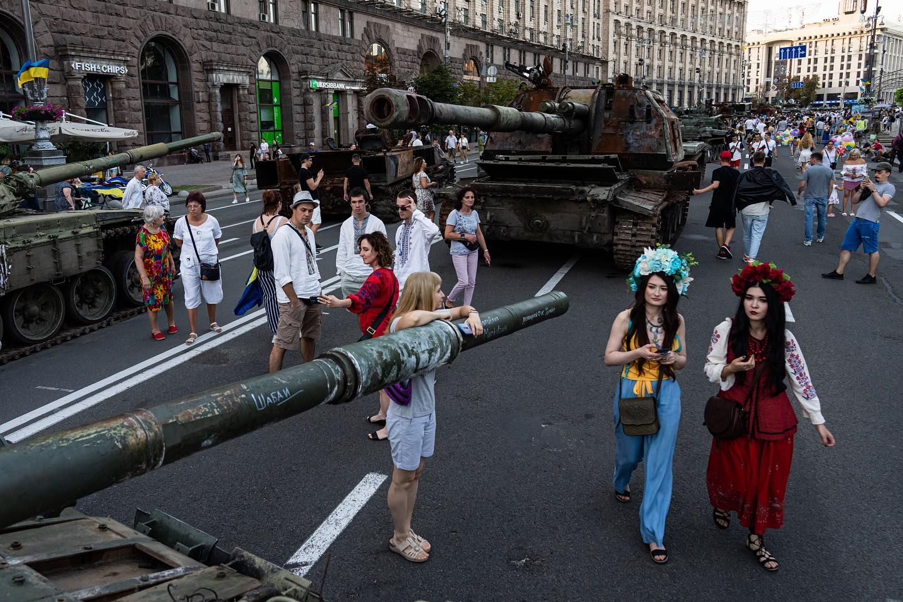
Sensitivity Parameters
To assess how sensitive the content of an image is, and how harmful could its diffusion be, we decided to evaluate each image based on three parameters: public relevance, harm and vulnerability.
4

Slide 6

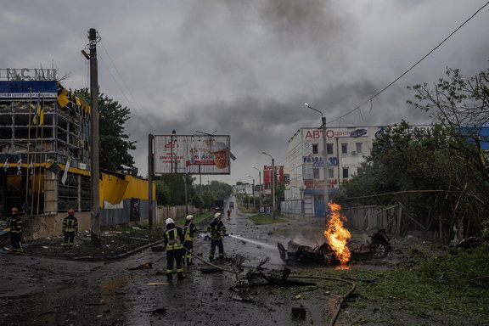
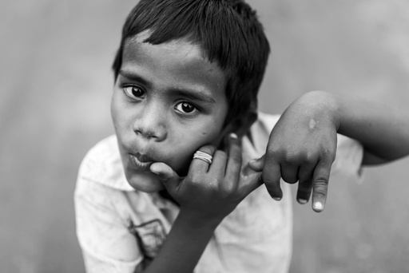
Sensitivity Rating
Public Relevance
Entity of the impact of an eventual false negative
Harm
Gravity of the depicted situation
Vulnerability
Presence of a subject deserving of increased severity
6

Slide 7

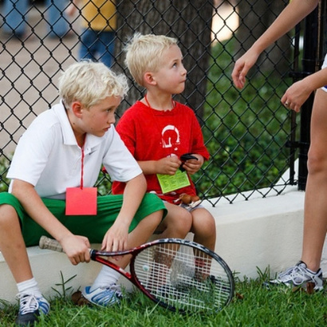
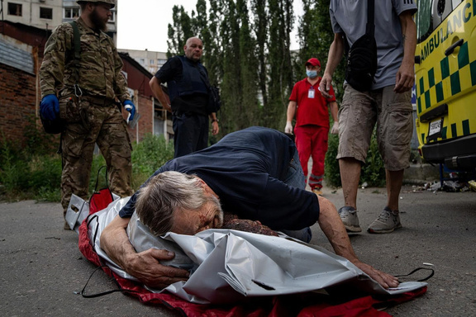
Sensitivity Rating
Low
No observable sensitivity
Medium
Moderate public relevance or harm concern.
High
High public relevance, urgent harm, or vulnerability.
5

Slide 8
Manual Annotator
Building the gold standard: human judgment on every sensitive image.
6
Notes:
Sensitivity is subjective, so we built a human-labeled core. The three parameters make each judgment explicit instead of relying on gut feeling.

Slide 9
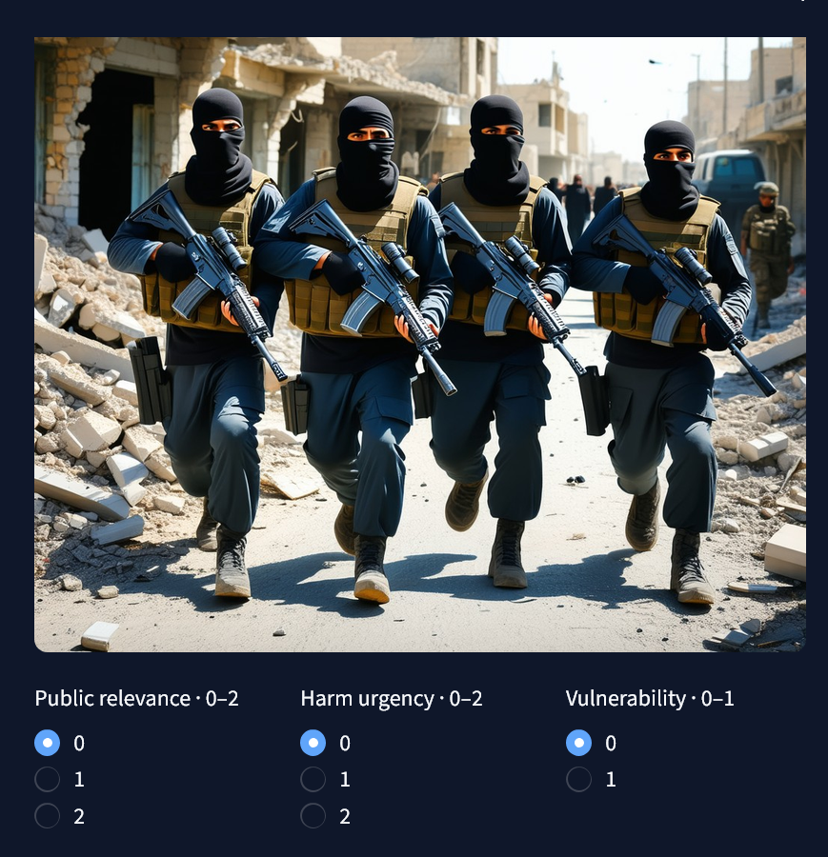
Manual Annotator Dashboard
Review: one image at a time, with its source and real/fake label.
Score: public relevance, harm and vulnerability on a short scale.
Rate: the scores combine into Low, Medium or High, following the rubric.
Record: each decision is saved as structured JSON, so it can be audited.
7

Slide 10

Gold Standard
Gold: 1,101 manually rated images (354 Low, 595 Medium, 152 High).
Silver: 3,398 images rated automatically, each with a confidence score.
Use: gold labels are the reference to check the auto-annotator and drive the oracle variant of the ablation.
Output: the dashboard exports the labels and their provenance as JSON.
8

Slide 11
Automatic
Annotator
We use an automatic ResNet-50 annotator to classify semantic sensitivity, independently from image authenticity. It outputs low/medium/high probabilities, a confidence score, and provenance for every image.
9

Slide 12
AutoAnnotator
ResNet-50 annotator
Structured output
Input collection
Quality
Validated images from multiple sources
Image feature extraction + sensitivity classifie
Predicted level low / medium / high Confidence score
Review queue for uncertain or ambiguous cases
10

Slide 13
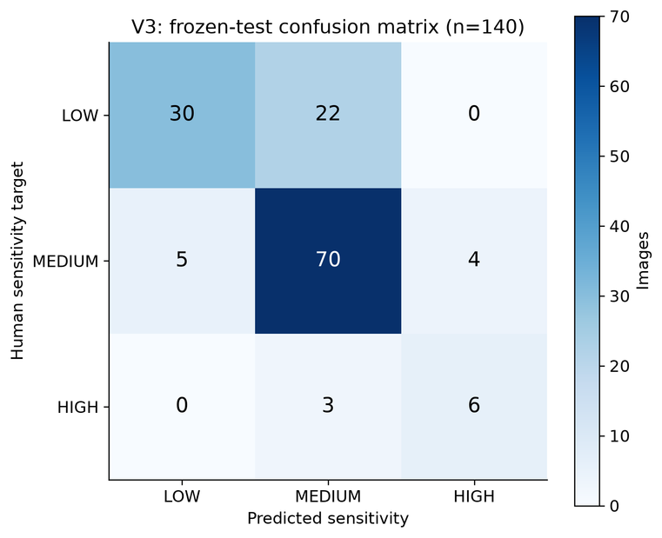
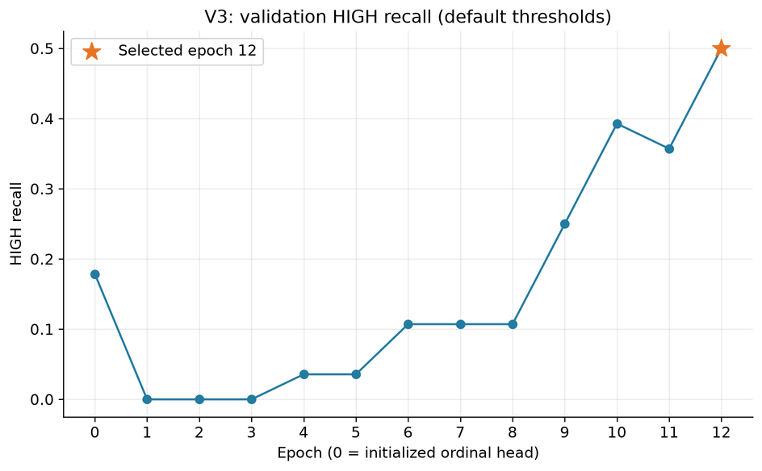
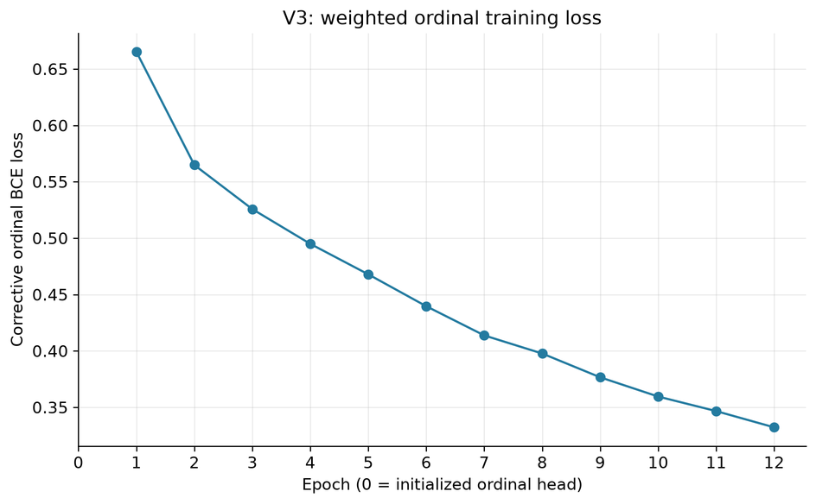
Performance Analysis
An increase in recall and a descending loss proves the improvement of the model
Most mistake happen between adjacent classes.
13

Slide 14
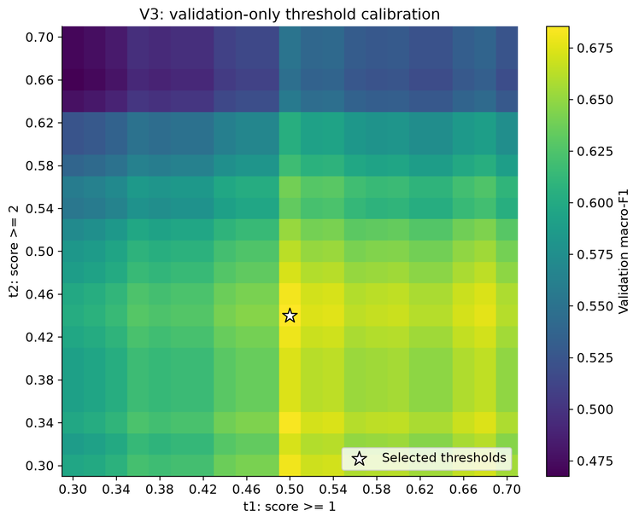
Performance Analysis
Threshold calibration reveals a trade-off between overall performance and detecting high-sensitivity images. Using thresholds of t1=0.30 and t2=0.30 increases high-class recall to 71.4%, but reduces accuracy to 65.6% and macro-F1 to 0.596. The selected thresholds, t1=0.50 and t2=0.44, achieve a better overall balance, with 71.4% accuracy and 0.685 macro-F1, while high-class recall is 64.3%. These results were measured on the 192-image validation set; the thresholds were selected to maximize macro-F1.
14

Slide 15
AutoAnnotator
Output
Gold
Standard
Silver
Standard
Confidence
Low
354
913
0.6863
No observable sensitivity
Medium
595
2413
0.7688
Moderate public relevance or harm concern.
152
72
High
0.6743
High public relevance, urgent harm, or vulnerability.
11

Slide 16
Effort Benchmark
17

Slide 17
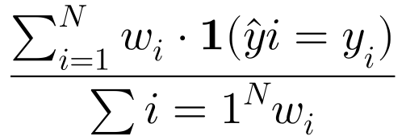
Benchmark
Sensitivity Threshold
Additionally, the evaluator was told to change its evaluation metric based on the sensitivity of the image.
To perform the benchmark the model used was Effort, a method integrated into DeepfakeBench for generalizable AI-generated image (AIGI) and deepfake detection.
Sensitivity Rating
Threshold
The sensitivity metric was introduced following this formula
Low
0.5
Medium
0.4
High
0.3
Where w is the weight given by the sensitivity score of i, that gets multiplied by 1 if the prediction is correct. This way an error on a higher sensitivity image is worth more
12

Slide 18
Benchmark pipeline
Validated manifest
Effort detector
Predictions
Analysis
4,499 images
real / fake labels
low / medium / high
Effort backbone
224 × 224 preprocessing
Severity-adaptive threshold: 0.5 (low), 0.4 (medium), 0.3 (high)
Accuracy ROC-AUC Recall / F1
The benchmark pipeline processes a validated dataset through the Effort detector, generates predictions, and evaluates performance using standard classification metrics.
13

Slide 19
Benchmark
Results
Accuracy
Recall
F1
Low
0.711
0.91
0.76
No observable sensitivity
Medium
0.75
0.92
0.78
Moderate public relevance or harm concern.
0.88
0.97
0.92
High
High public relevance, urgent harm, or vulnerability.
14

Slide 20
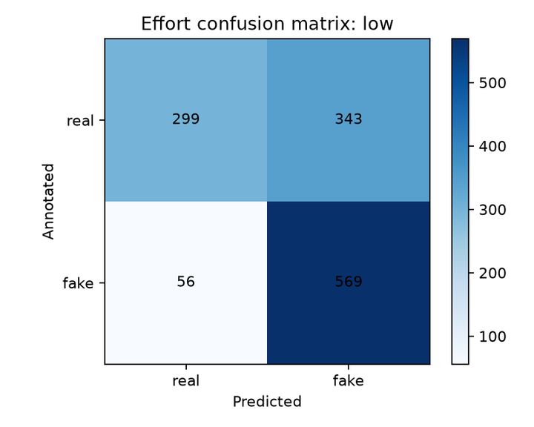
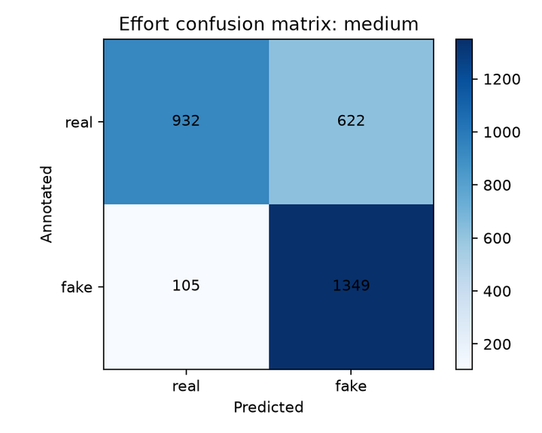
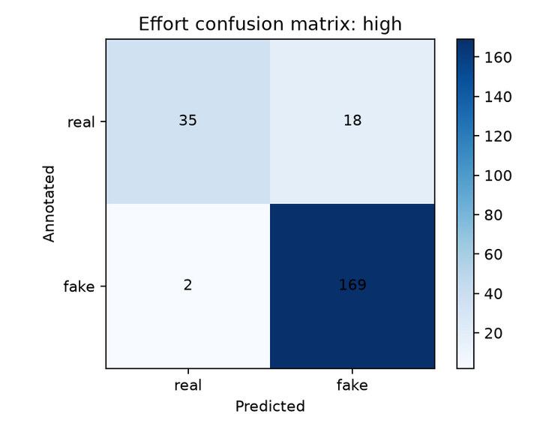
Benchmark
Evaluation on Sensitivity
The low presence of false negatives satisfies the policies of the project. The higher severity of the evaluation toward more sensitive images led to a much higher recall and a higher F1.
15

Slide 21
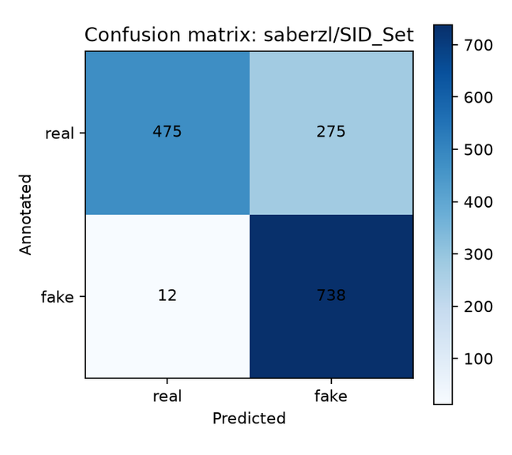
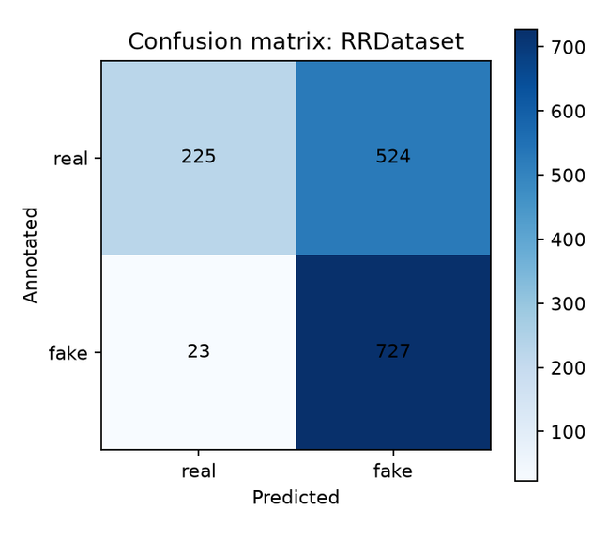
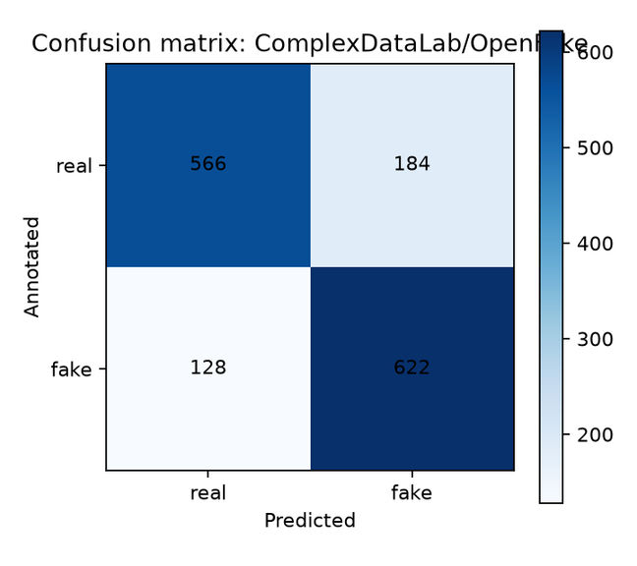
Benchmark
Evaluation on Origin
General social-media images
Politically/socially salient images
Human-centric news
A higher than normal percentage of false positives satisfies the policies of the project.
A higher percentage of images representing humans led to an exceedingly severe evaluation
Even with more modern image generator, the readable sensitivity of the images made the results more consistent
16

Slide 22
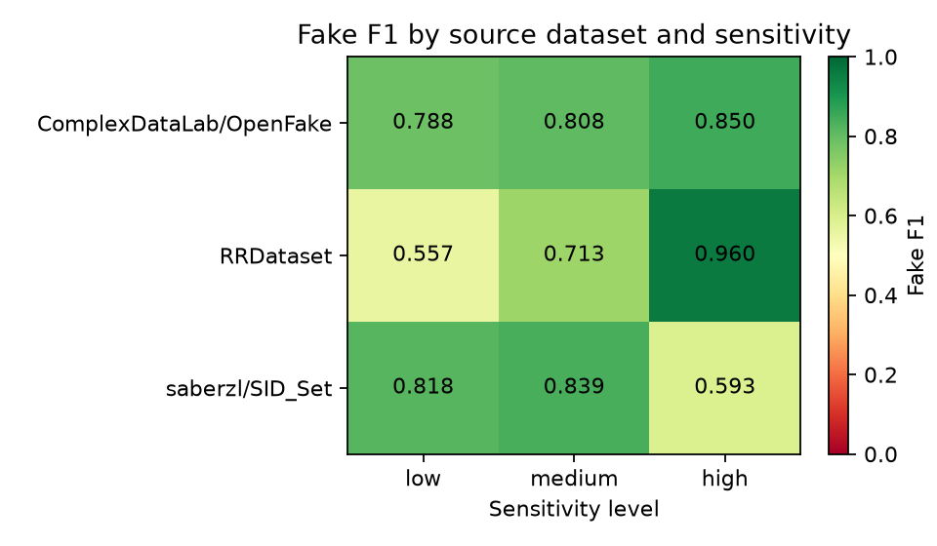
Benchmark
Heatmap Analysis
Fake-detection performance varies across both source datasets and sensitivity levels. RRDataset shows its strongest F1 on high-sensitivity images, while SID_Set shows a substantial decline for that group. OpenFake is comparatively consistent across sensitivity levels.
21

Slide 23
Sensitivity-Aware
Detection
17

Slide 24
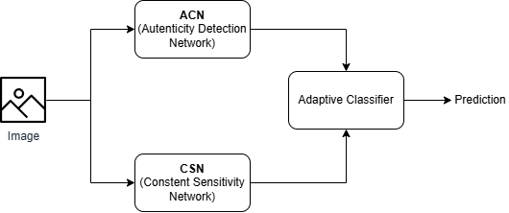
Authenticity Detection Network
A neural network that is trained for classify an image as real or fake.
Content Sensitivity network
A neural network trained to classify the content sensitivity of an image into three levels: low, medium, or high.
Adaptive Classifier
The outputs of both networks are combined by the Adaptive Classifier.
The CSN probabilities are used to compute a prudence score, which dynamically adjusts the classification threshold applied to the ADN output. Based on the adjusted threshold and the probability of the image being real, the classifier produces the final Real / Fake prediction.
The key idea is that the decision threshold is dynamically adjusted according to the model’s estimated prudence, resulting in a more adaptive and conservative classification.
18

Slide 25
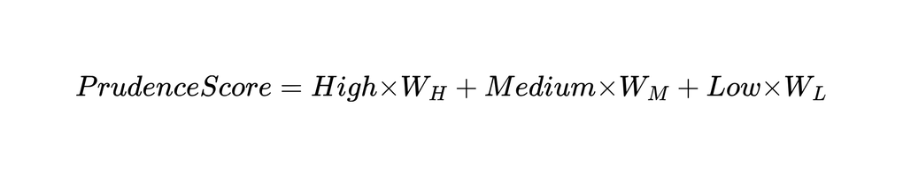
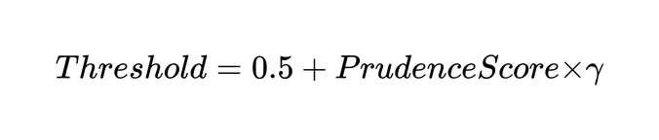
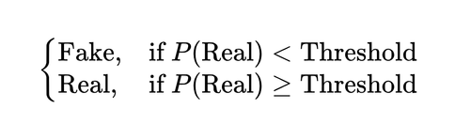
Adaptive Classification
After obtaining the outputs of ADN and CSN, the predicted probabilities are combined to generate the model’s final prediction.
1. Prudence Score
where W_H, W_M, and W_L are the weights assigned to the High, Medium, and Low probability levels.
2. Adaptive Threshold
where γ controls the influence of the prudence score on the decision threshold.
3. Final Prediction
The dynamic threshold increases with the prudence score (content sensitivity adjusted with weights). Therefore, for highly sensitive images, the system requires stronger evidence from the ADN before classifying the image as real. This reduces the risk of false positives (fake images incorrectly classified as real) that is one of our main concern of the project. So lower sensitivity means lower threshold so the system relies more on the pure output of the ADN, instead for higher sensitivity, the threshold should be higher to be considered real.
19

Slide 26
Ablation &
Discussion
20

Slide 27
Design
Does the sensitivity component really help, or are we just being stricter?
V0 · Baseline
ADN only, fixed threshold 0.5. No sensitivity information.
V1 · Oracle
Adaptive threshold driven by gold sensitivity labels: the upper bound.
V2 · SensiFake
Adaptive threshold driven by CSN predictions: the full pipeline.
V3 · Control
Sensitivity labels shuffled, same threshold distribution as V2.
Sweeps and metrics
γ and (W_L, W_M, W_H) · fake→real error, real→fake error, Recall, F1, sensitivity-weighted accuracy · per stratum
21

Slide 28
What the Results Already Show
0.71 → 0.88
Accuracy, low → high sensitivity
0.91 → 0.97
Recall, low → high sensitivity
224 / 4,499
High-sensitivity images (5%)
Insight
Gains grow with sensitivity, exactly where the threshold is strictest (0.3).
Part of this may be a pure threshold effect: V3 is needed to separate it.
Caution
With n = 224, the High accuracy of 0.88 has a 95% interval of about ±4 points.
High-sensitivity images come from different sources, so content and origin are confounded.
22

Slide 29
Ethical Implications
Unequal error costs
Calling a real image fake can discredit genuine war or health evidence. Calling a fake real spreads disinformation. We favour the second concern, so we must disclose the cost.
Who defines "sensitive"?
Public relevance, harm and vulnerability are value-laden. Annotators and taxonomy can encode cultural and political bias.
Moderation power
Stricter checks on sensitive topics can chill legitimate speech. Needs human review, transparency and an appeal path.
23

Slide 30

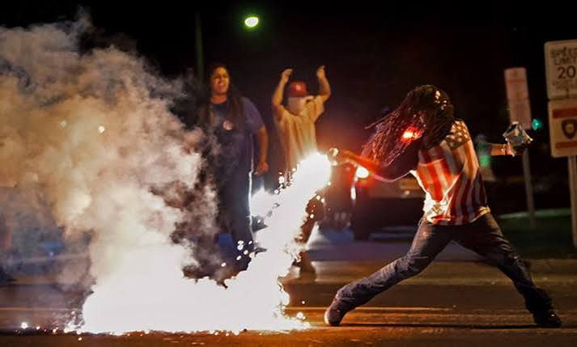
Project Goals
Not all classification errors have the same impact.
Artificial intelligence has made it increasingly difficult to distinguish between real images and images generated by AI models. While false classification involving an everyday object may have limited consequences, an image related to politics, health, disasters, conflict, or vulnerable people can have a much greater social impact.
SensiFake aims to protect any individual from false accusations and to avoid the spreading of fabricated news by recognising the sensitivity of the content of the image and consequently adapting its evaluation parameters.
25

