Slide 1
STARS 2024 Team 4: RISC-V CPU

Slide 2
Outline:
Introduction
Goals
Architecture Overview
Top Level RTL & Example Executions
Individual Components & Verification Plan
Individual Test Cases
Implementation Plan
End/Questions

Slide 3
Introduction

Slide 4

Goals
Design and prototype a CPU with the follow components:
Instruction Decoder/Control Unit
ALU
Program and Data Memory
Registers
Program Counter
Peripherals:
VGA Display
UART controller

Slide 5

Goals
Example CPU functions
Add/subtract
NOT, XOR, OR, AND
Shift left/right
Load to register/memory
Branch/Jump
More ☺

Slide 6

Goals
Possible apps/games to implement
Pong
Snake
Tetris

Slide 7

ISA: RISC-V 32I
“Reduced Instruction Set Computer”
Open source
32 internal registers
40 different instructions
6 instruction types
Single clock cycle
Relatively simple to make ☺

Slide 8
Team Roles
Michael – Top Level Design, Program Counter
Andy – Control Unit, Decoder, ImmGen
Mary – Arithmetic Logic Unit
Duc – Registers/Memory
Travis – Peripherals (Display and keyboard)
Dhruv – moral support ☺

Slide 9
General Architecture
Top Level Design and Example Executions

Slide 10
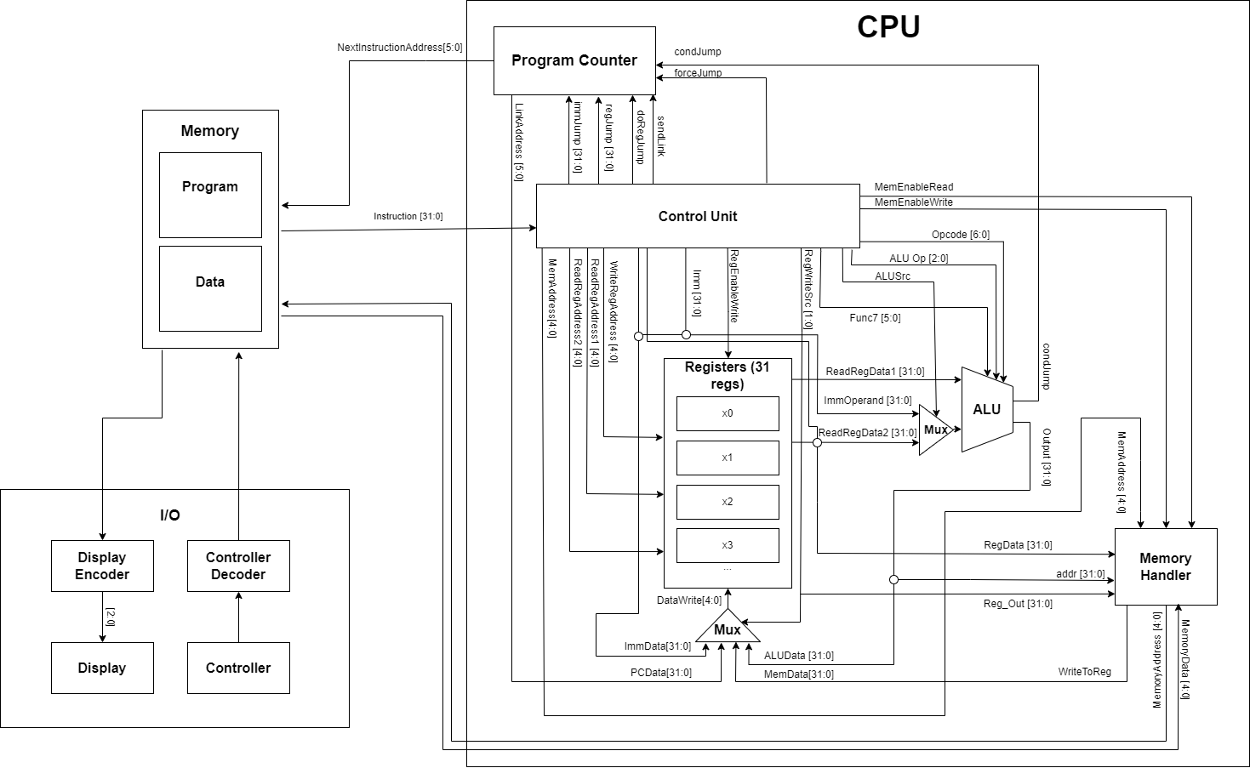
Top Level Design
Number of flip-flops:~1120

Slide 11
Fetch/Execute Cycle
1) Retrieve instructions from memory.

Slide 12
Fetch/Execute Cycle
2) Decode instructions and send signals to relevant components.

Slide 13
Fetch/Execute Cycle
3) Get data from registers and/or memory.

Slide 14
Fetch/Execute Cycle
4) Use ALU to perform calculations.

Slide 15
Fetch/Execute Cycle
5) Store ALU output.

Slide 16
Fetch/Execute Cycle
6) Determine the next instruction using program counter.

Slide 17
Fetch/Execute Cycle
7) Signal address of next instruction for the next cycle.

Slide 18
Example Fetch/Execute Dataflow: add
Addition
Instruction: add x8, x26, 14

Slide 19
Example Fetch/Execute Dataflow: add
Addition
Instruction: add x8, x26, 14
ALUOp: 000
ALUSrc: 0
x8
x26: 95
X14:742

Slide 20
Example Fetch/Execute Dataflow: add
Addition
ALUOp: 000
ALUSrc: 0
95
x8
742
x26: 95
X14:742

Slide 21
Example Fetch/Execute Dataflow: add
Addition
ALUOp: 000
ALUSrc: 0
95
x8
742
x26: 95
X14:742
837

Slide 22
Example Fetch/Execute Dataflow: add
Addition
x8:837
837
837

Slide 23
Example Fetch/Execute Dataflow: add
Addition
Next Instruction
x8:837

Slide 24
Example Fetch/Execute Dataflow: store
Storing
Instruction: store x26, 485(x0)

Slide 25
Example Fetch/Execute Dataflow: store
Storing
Instruction: store x26, 485(x0)
ALUOp: 010
ALUSrc: 1
Immediate: 485
x26
x0

Slide 26
Example Fetch/Execute Dataflow: store
Storing
ALUOp: 010
ALUSrc: 1
Immediate: 485
x26: 95
0
485
x0:0
95

Slide 27
Example Fetch/Execute Dataflow: store
Storing
Address: 485, Value: 95

Slide 28
Example Fetch/Execute Dataflow: store
Storing
Next Instruction
Address: 485, Value: 95

Slide 29
Components

Slide 30
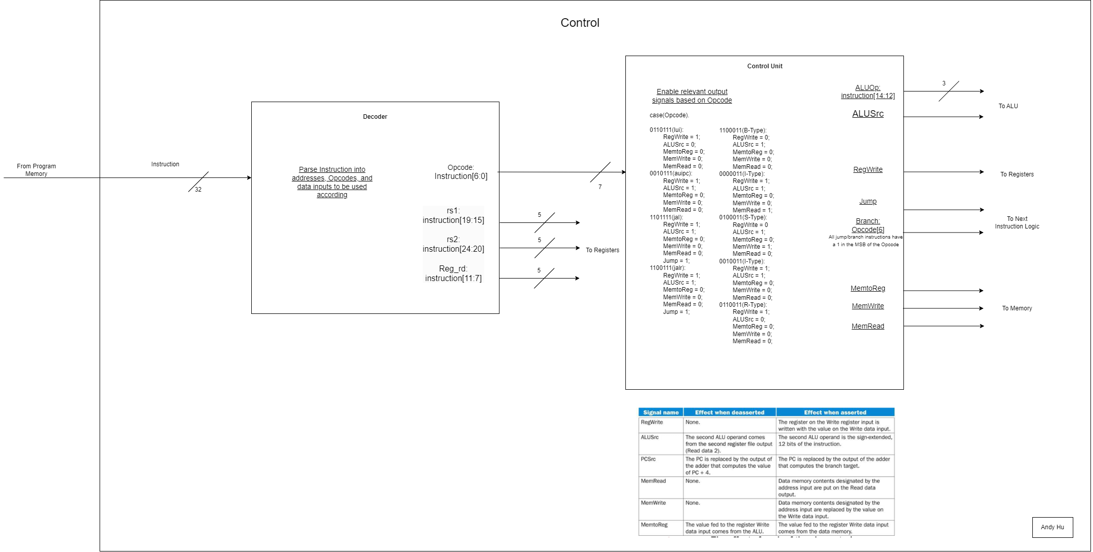
Control Unit & Decoder
Decoder:
Parse Instruction in to addresses, Opcodes, and data inputs to be used accordingly
Control Unit:
Enable relevant control signals based on Opcode

Slide 31
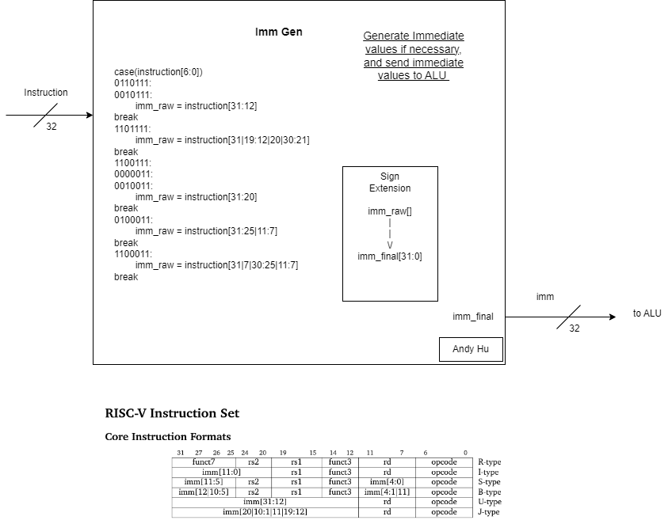
Immediate Generator
Imm Gen:
Generate Immediate values if necessary and send immediate values to ALU

Slide 32
Control Unit & Decoder Test Cases
Control Unit Test Cases
Input all valid Opcodes, validate control signal outputs
Input invalid Opcode, check for error
Decoder Test Cases
Input all instruction types with register addressees, validate correct addresses
Input instruction without register address, check for garbage output

Slide 33
Immediate Generator Test Case
ImmGen Test Cases
Input all instruction types with an immediate value, validate correct immediate
Ensure no immediate is generated if instruction doesn’t include an immediate

Slide 34
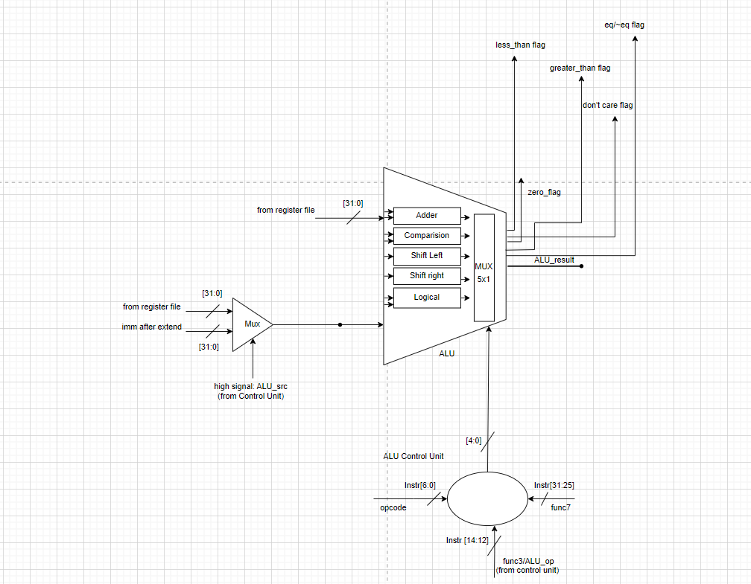
ALU
RTL:
Input:
(operands)
-opA [31:0]
-opB [31:0]
(select signals)
-opcode[6:0]
-func3[2:0]
-func7[6:0]
Output:
-ALU result [31:0]
-0 flag
-don't care flags
-less than flags
-greater than flags
-equal/not equal flags

Slide 35
ALU
Pseudo Code:
ALU:
case(ALU control input)
ADD: ALU result = rs1+ rs2 ( opA + opB )
flag 0 =0
flag less than = 0
flag greater than = 0
flag don’t care = 0
flag equal to /~ not equal to =0
ADDI: ALU result = rs1+imm (opA + opB)
flag 0 =0
flag less than = 0
flag greater than = 0
flag don’t care = 0
flag equal to /~ not equal to =0
(....all operations are executed
based on the ALU control input)
ALU Control Unit:
if(opcode=1100011)
if(func3=000)
ALU control input = BEQ
if(func3=001)
ALU control input=BNE
if(opcode=0110011)
if(func3=000)
if(func7=0000000)
ALU control input=ADD
(....define the ALU control input for each
of the operations based on the value
of the opcode, func3 and func7…)

Slide 36
ALU
Test Cases:
all possible combination of opcode, func3 and func7 ( 26 combinations)
(make tasks for the operations)
different corner cases for operands (add, and, xor, etc.)
(assign variable value to each operand)
all 0s
all 1s
all 5s
all As
pattern 0000 FFFF
pattern FFFF 0000
pattern AAAA 5555
pattern 5555 AAAA
error checking for undefined combinations of opcode, func3 &func7 -> assign value
check generation of correct flags

Slide 37
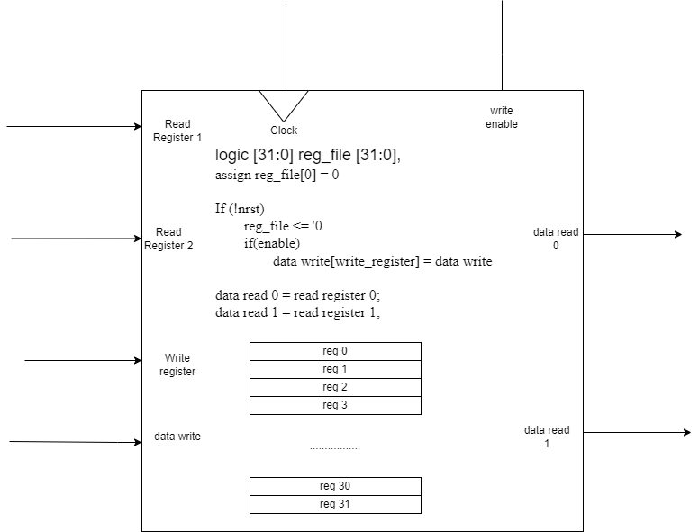
Registers
Register RTL and Psuedocode

Slide 38
Registers
Test Cases
Reset: check all registers are set to 0
With write_enable off, try writing register: should be no change
With write_enable on, try writing to a register: check for correct value
Write random values to all registers, try reading all registers: check data_read is correct
Do twice
Reset check again

Slide 39
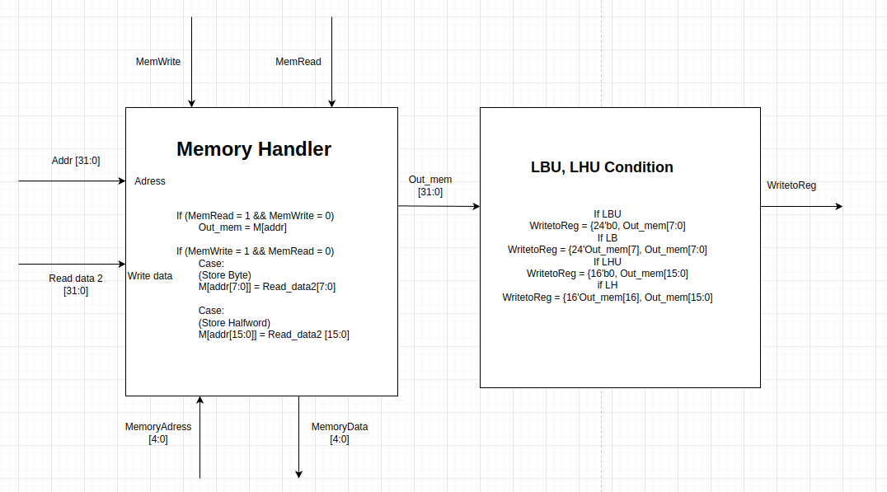
Memory
Memory Handle RTL and Psuedocode
Test Case
- Reset: All set are set to 0
- Load Byte Unsigned: 24 bits = 0
- Load Byte: assigned 24 bits to bit 7
- Load Halfword Unsigned: 16 bits =0
- Load Halfword: assigned 16 bits to bit 16
- Normal Loading
- Storing
- MemRead = 1
- MemWrite = 1
39

Slide 40
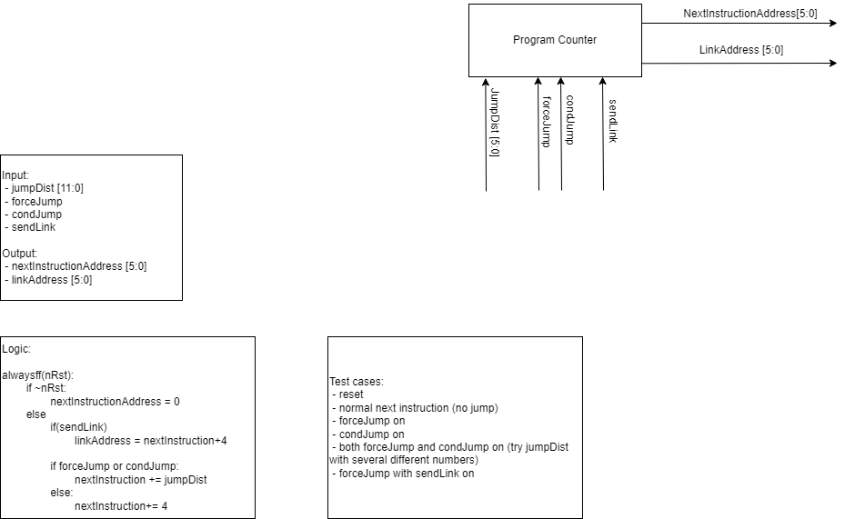
Program Counter (Next Instruction Logic)
RTL Diagram and Input/Output

Slide 41
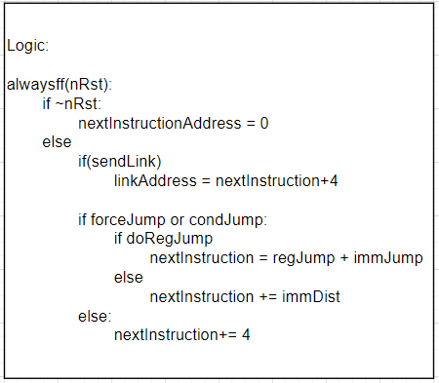
Program Counter
Logic and Test Cases

Slide 42
Peripherals
☺

Slide 43
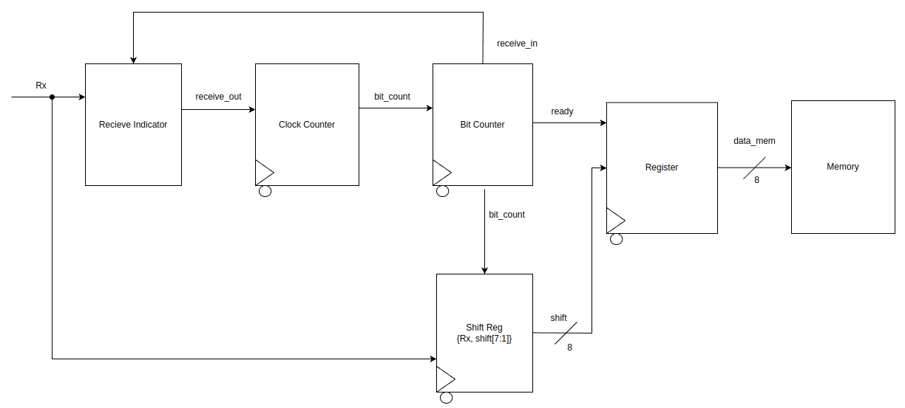
I/O UART Rx Input
43

Slide 44
I/O UART Output Components
Recieve Indicator: When Rx is low, receive_out becomes high. When recieve_in is high, receive_out is low until Rx becomes low again
Clock Counter: When given a high input signal, starts counting the clock cycles until counting to the BAUD rate and starting over
Output: When the BAUD rate is hit, sends an output bit_count signal
Bit Counter: When given a high bit_count input, adds to the counter until reaching 8 and starting over
Output: On each count, enables the shift register to shift in the Rx bit
When 8 is reached, sends a high ready signal and a low receiving signal to indicate bits have stopped sending
44

Slide 45
I/O UART Rx Input Test Case
- Test that reset sets everything to 0
- Test that if you arent receiving and, and the Rx signal is low, then receive flag should now be high
- Test that the bit count increases after ‘BAUD rate’ clock cycles
- Test that we shift in a new bit after each BAUD Cycle.
- Test that after 8 bits get cycled in, receiving flag is low, shift contains all our input bits, and the ready flag turns on
- Test that on the next clock cycle (with ready = 1) , the data gets sent to memory, and the ready flag turns off.
- Test 3 or 4 different serial inputs and make sure they all are all sent to memory accurately

Slide 46
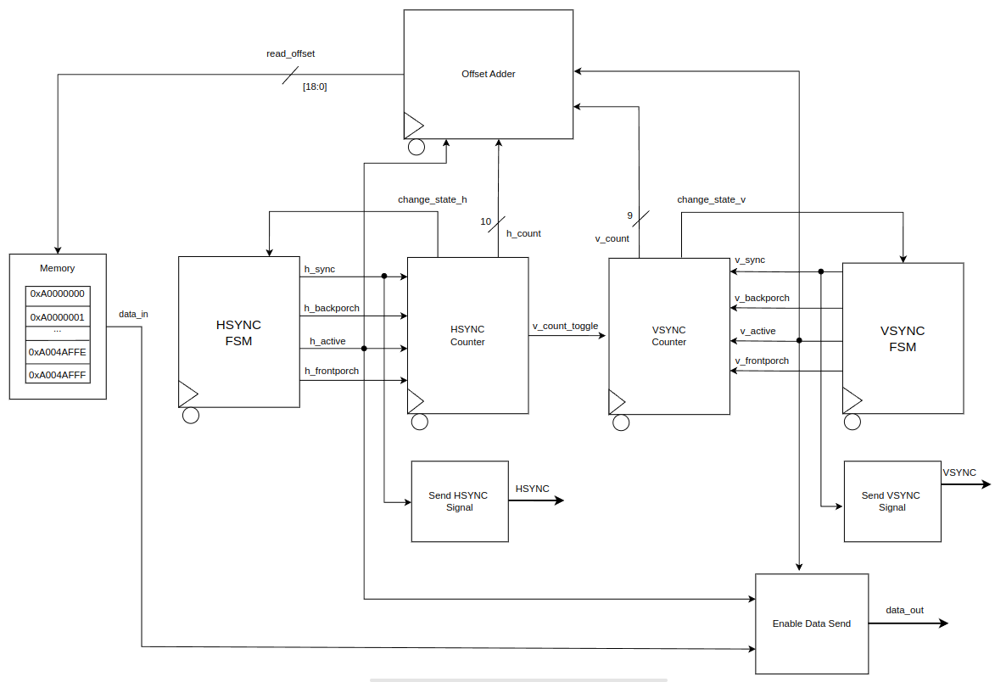
I/O VGA Output
46

Slide 47
I/O VGA Output Components
FSM(H and V): 4 states: SYNC, BACKPORCH, ACTIVE, and FRONTPORCH
State sequence: each change_state high input triggers next state.
Output logic: high signal output for the current state
HSYNC Counter: Depending on input state signal, the max count changes. Counts on clock cycle
Output: When max count is reached, change_state_h signal is high
When FRONTPORCH state and max count are high, v_count_toggle signal is high
VSYNC Counter: Depending on input state signal, the max count changes. Counts on v_count_toggle input
Output: When max count is reached, change_state_v signal is high
Offset Adder: If both FSMs are in ACTIVE, reads h_count and v_count and does operations on them.
Output: read_offset = (640 * v_count) + h_count
47

Slide 48
I/O VGA Output Test Case
- Test that starting state is SYNC for both H and V upon reset, and HSYNC and VSYNC are low
- Test that after *sync clk cycles, we change hsync state into BACKPORCH and turn HSYNC output to 1
- Test that after *backporch clk cycles, we change hsync state into ACTIVE
- Test that while active, data is sent out only if h_active and v_active are both high
- Test that after *active clk cycles, we change state to FRONTPORCH, and once *frontporch clk cycles have passed, v_count_toggle becomes high, and the state goes to SYNC
- Test that after 2 HSYNC cycles, vsync state enters FRONTPORCH and VSYNC is high
- Test that when VSTATE is ACTIVE, data is being sent out of the system
- Test that after final frontporch clock cycle in both V and H, offset resets and both enter SYNC state
- Test with various memory register information to ensure proper functionality
48

Slide 49
Implementation Timeline
Finish Verilog of individual components by Saturday (6/22)
Finish testbenches and integration of all components by next Wednesday (6/26)
Finish any additional tasks and overall testbench by next Friday (6/28)

Slide 50
Expected Obstacles
Integrating Modules
Overlap with Fetch Execute Cycles
Integrating IO with CPU
Image generation
Testbenching (a lot of testbenching)

Slide 51
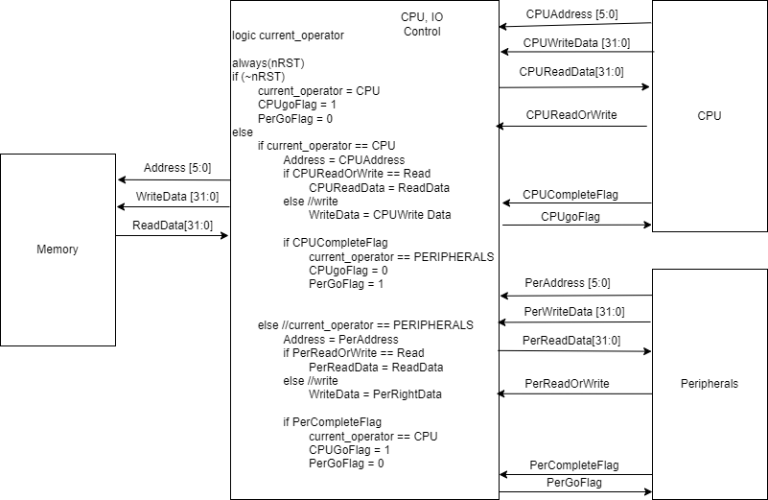
IO CPU Integration Potential Solution

Slide 52
Thank You!
Pleas ask Questions and voice and Concerns!

