Slide 1
STARS 2024 CPU Architecture

Slide 2
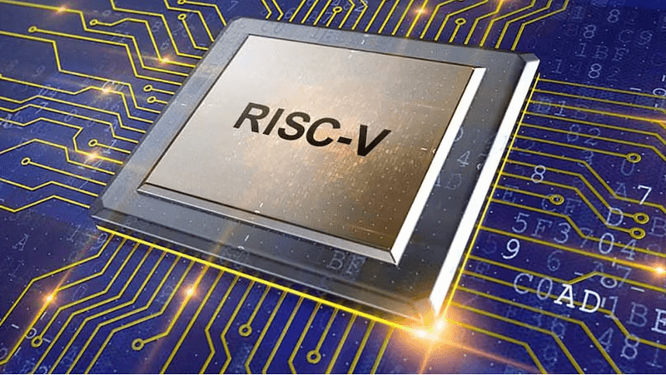
Goals
Design and prototype a CPU with the follow components:
Instruction Decoder/Control Unit
ALU
Program and Data Memory
Registers
Program Counter
Peripherals:
Display
Keyboard?

Slide 3

Goals
Implement the following commands in Assembly
Add/subtract
NOT, XOR, OR, AND
Shift left/right
Load to register/memory
Branch/Jump

Slide 4

Goals
Possible apps/games to implement
Pong
Snake
Tetris

Slide 5

Model: RISC-V
Open source
31 internal registers
Add more stuff later

Slide 6
Team Roles
Michael – Top Level Design, Program Counter
Andy – Control Unit (and decoder)
Mary – ALU
Dhruv – Registers/Memory
Travis – Peripherals (Display and keyboard)

Slide 7
Top Level Design

Slide 8
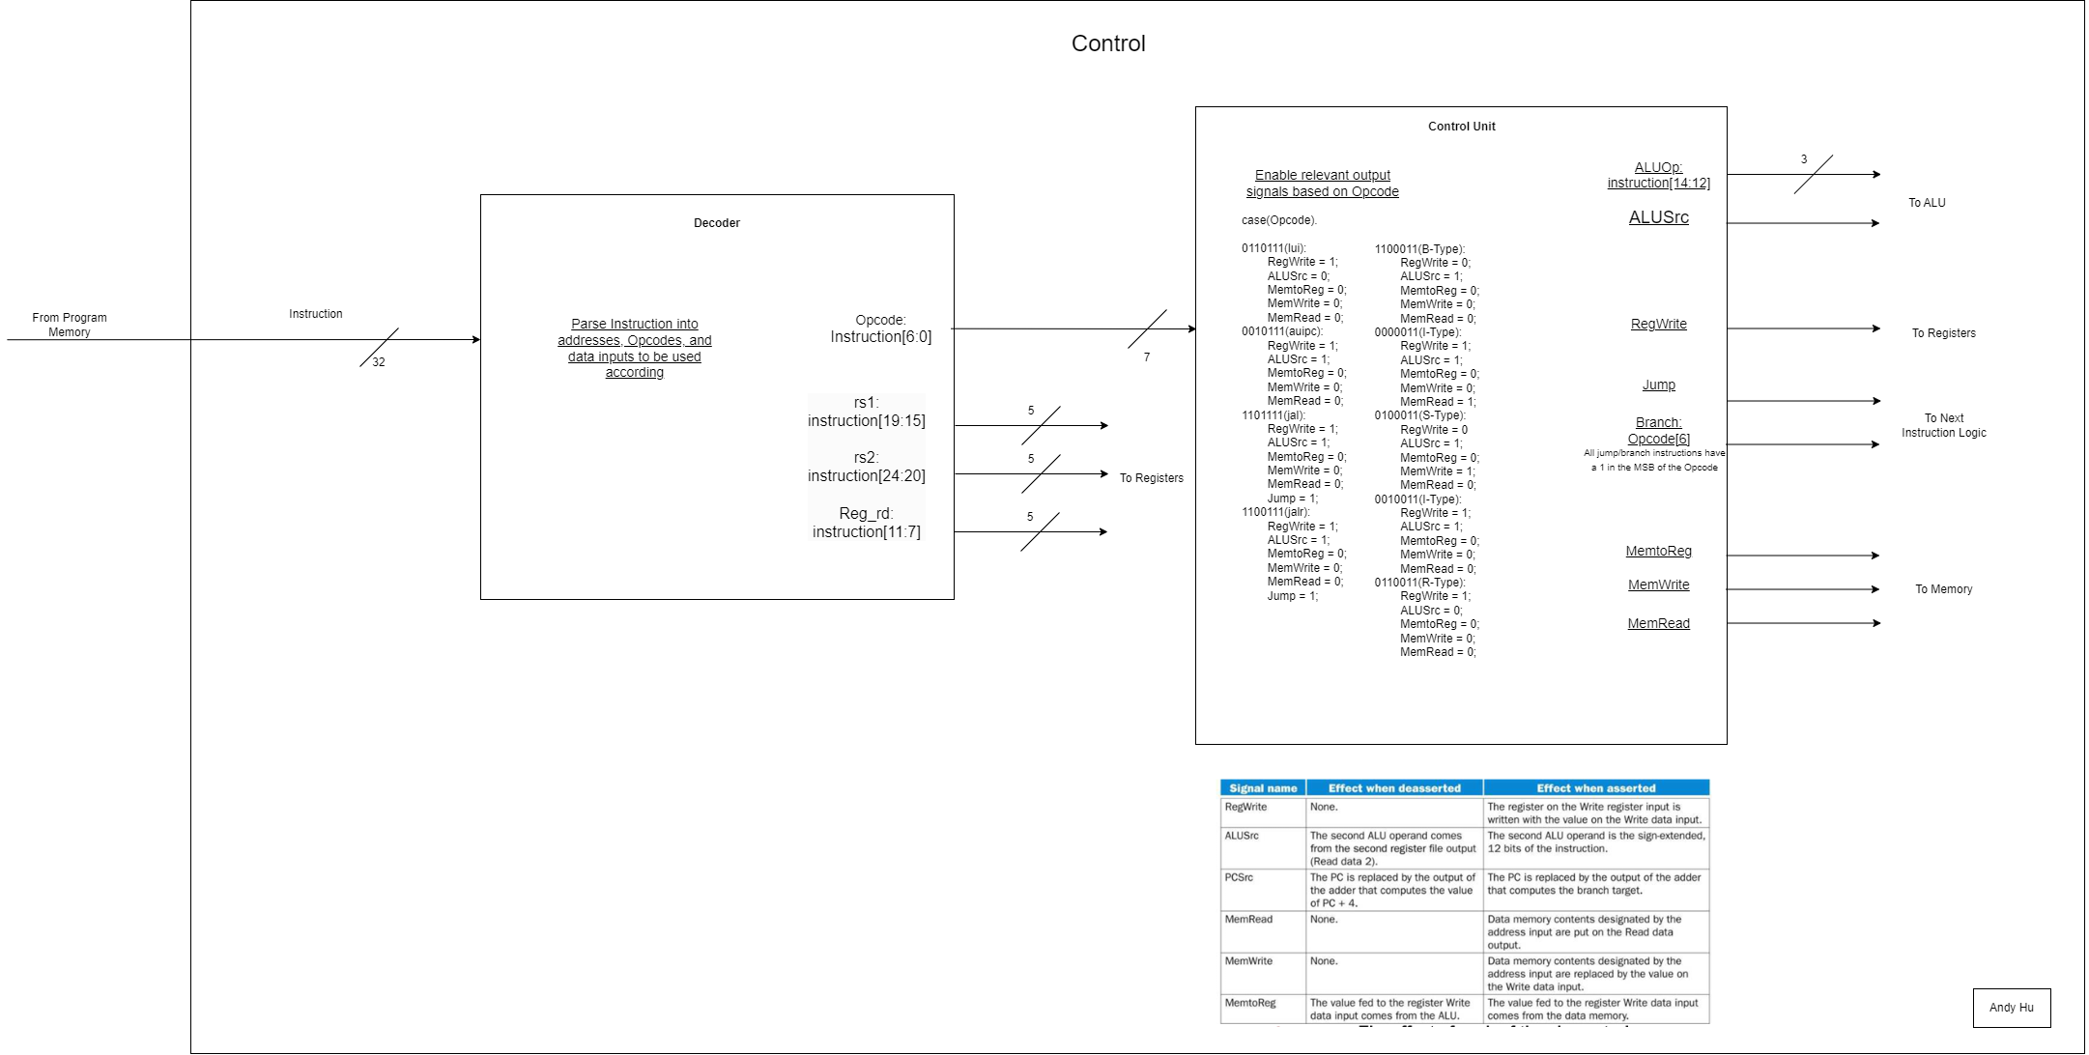
Control Unit & Decoder
Decoder:
Parse Instruction in to addresses, Opcodes, and data inputs to be used accordingly
Control Unit:
Enable relevant control signals based on Opcode

Slide 9
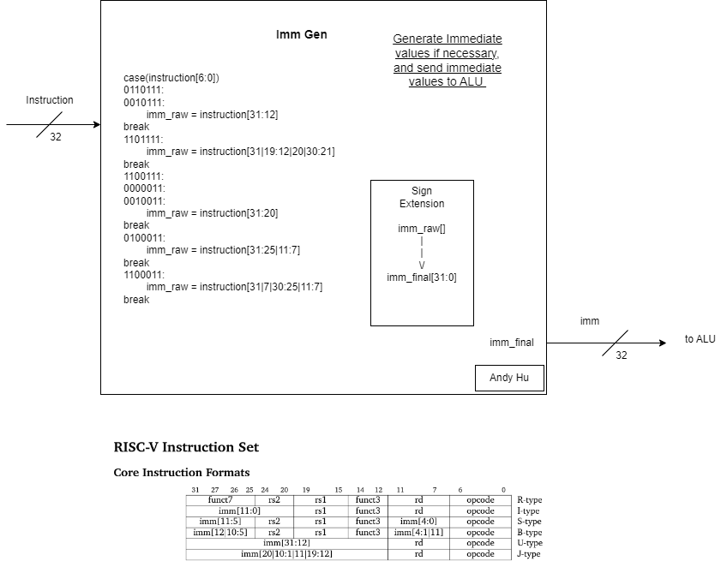
Immediate Generator
Imm Gen:
Generate Immediate values if necessary and send immediate values to ALU

Slide 10
ALU

Slide 11
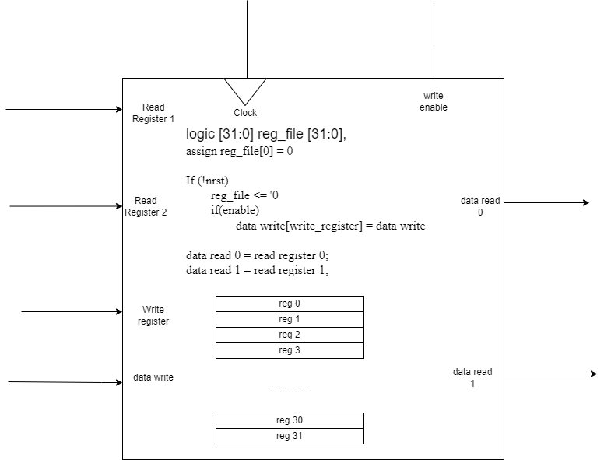
Registers
Register RTL and Psuedocode

Slide 12
Registers
Test Cases
Reset: check all registers are set to 0
With write_enable off, try writing register: should be no change
With write_enable on, try writing to a register: check for correct value
Write random values to all registers, try reading all registers: check data_read is correct
Do twice
Reset check again

Slide 13
Memory

Slide 14
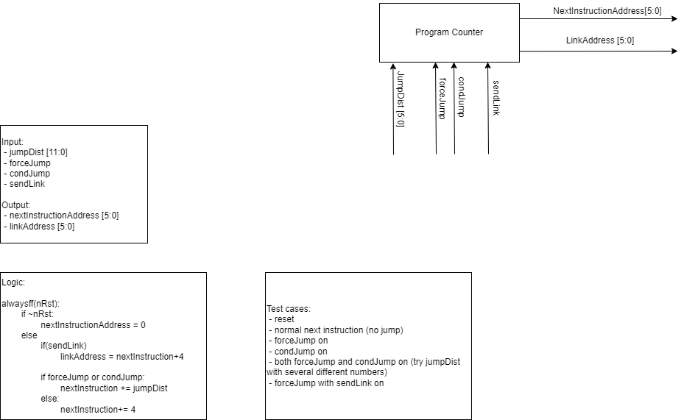
Program Counter
RTL Diagram and Input/Output

Slide 15
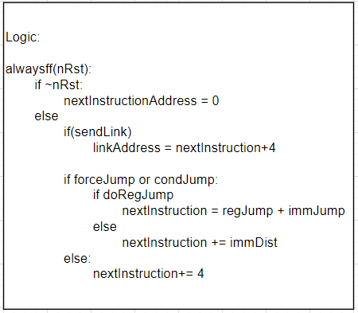
Program Counter
Logic and Test Cases

Slide 16
Peripherals

Slide 17
Expected Obstacles

Slide 18
Future Plans
Error correction?

