Slide 1
STARS 2024 CPU Architecture

Slide 2

Goals
Design and prototype a CPU with the follow components:
Instruction Decoder/Control Unit
ALU
Program and Data Memory
Registers
Program Counter
Peripherals:
Display
Keyboard?

Slide 3

Goals
Implement the following commands in Assembly
Add/subtract
NOT, XOR, OR, AND
Shift left/right
Load to register/memory
Branch/Jump

Slide 4

Goals
Possible apps/games to implement
Pong
Snake
Tetris

Slide 5

Model: RISC-V
Open source
31 internal registers
Add more stuff later

Slide 6
Team Roles
Michael – Top Level Design, Program Counter
Andy – Control Unit (and decoder)
Mary – ALU
Dhruv – Registers/Memory
Travis – Peripherals (Display and keyboard)

Slide 7
Top Level Design

Slide 8
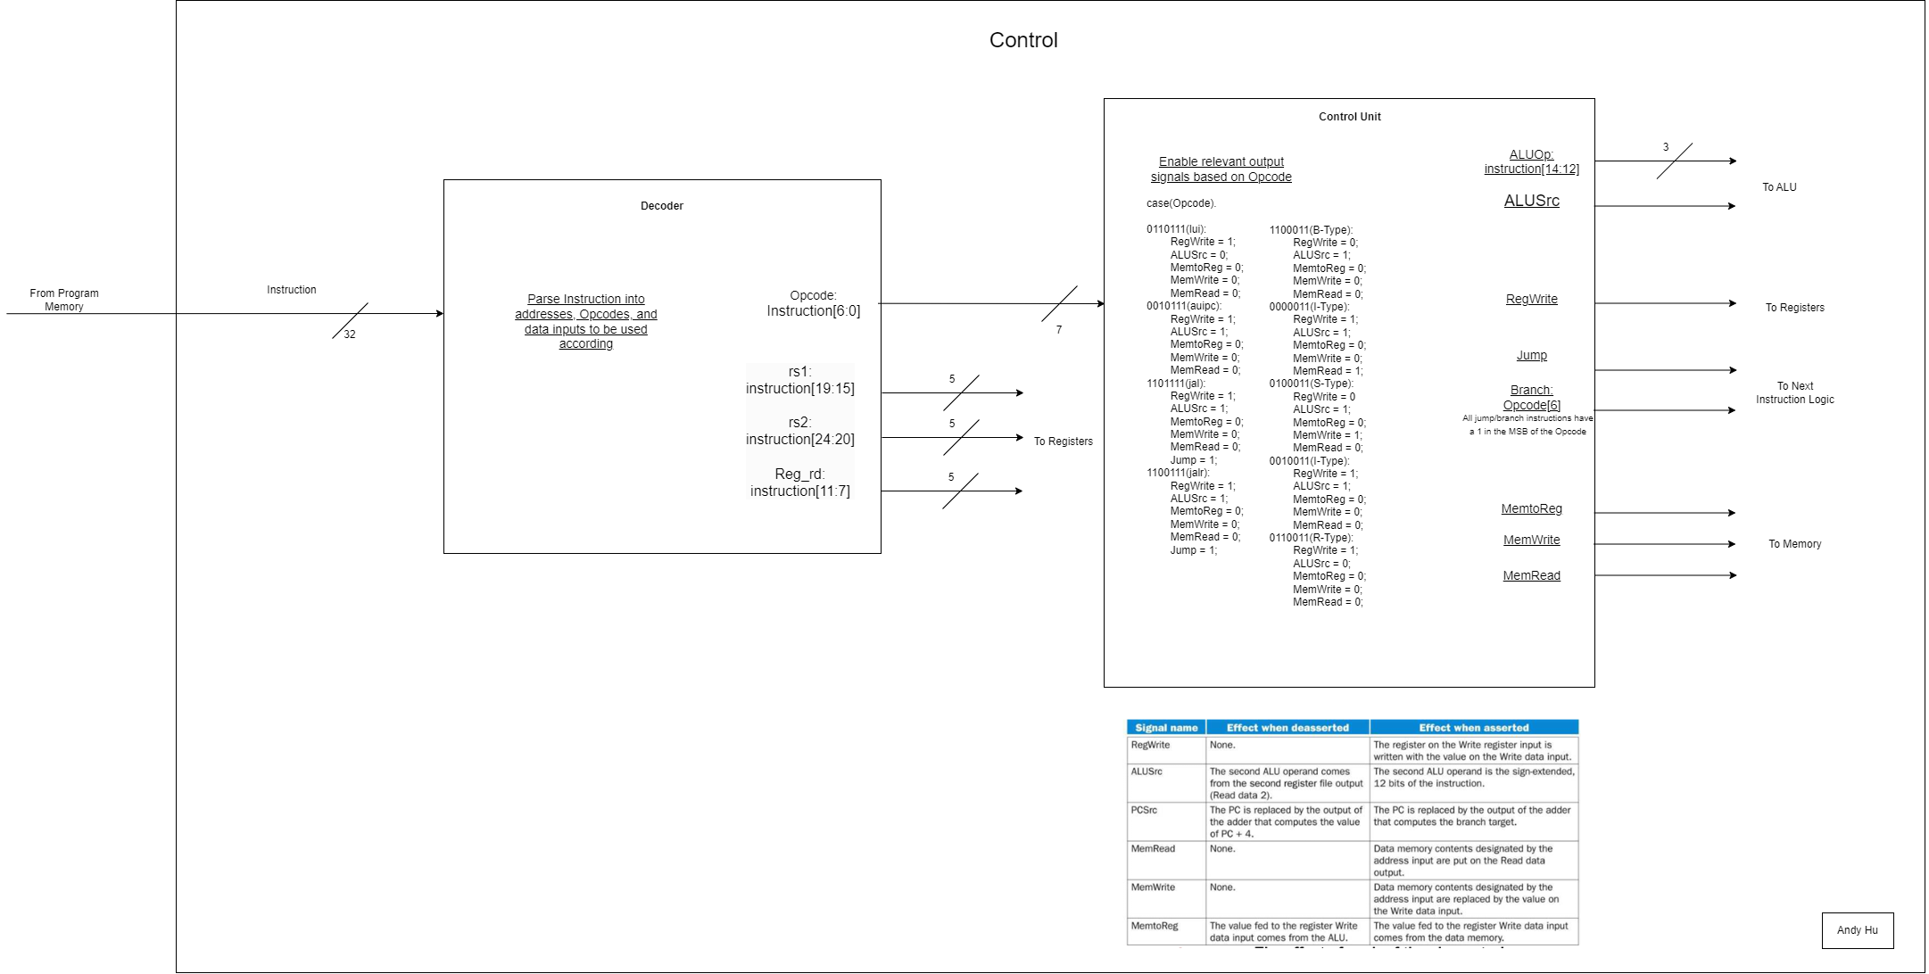
Control Unit & Decoder
Decoder:
Parse Instruction in to addresses, Opcodes, and data inputs to be used accordingly
Control Unit:
Enable relevant control signals based on Opcode

Slide 9
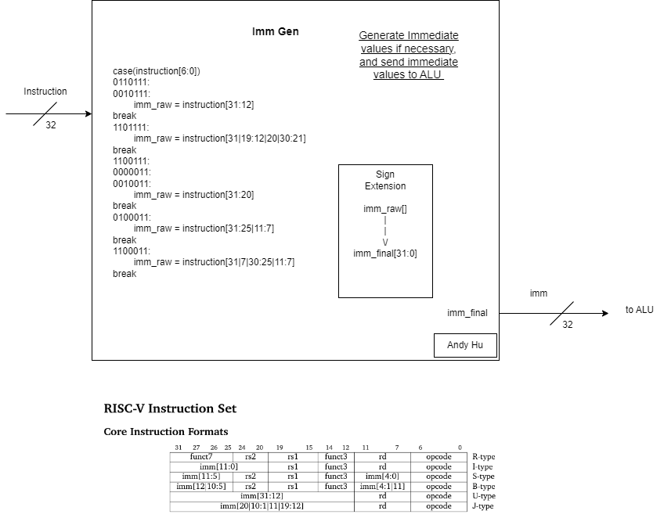
Immediate Generator
Imm Gen:
Generate Immediate values if necessary and send immediate values to ALU

Slide 10
Control Unit & Decoder Test Cases
Control Unit Test Cases
Input all valid Opcodes, validate control signal outputs
Input invalid Opcode, check for error
Decoder Test Cases
Input all instruction types with register addressees, validate correct addresses
Input instruction without register address, check for garbage output

Slide 11
Immediate Generator Test Case
ImmGen Test Cases
Input all instruction types with an immediate value, validate correct immediate
Ensure no immediate is generated if instruction doesn’t include an immediate

Slide 12
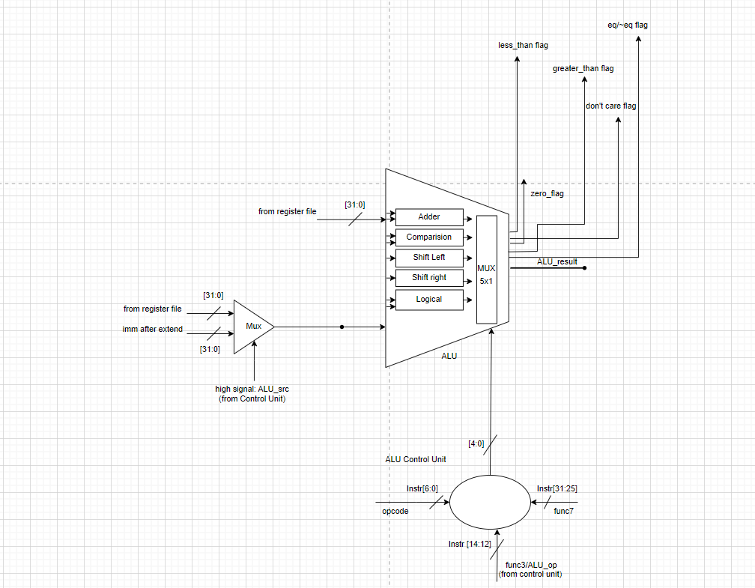
ALU
RTL:
Input:
(operands)
-opA [31:0]
-opB [31:0]
(select signals)
-opcode[6:0]
-func3[2:0]
-func7[6:0]
Output:
-ALU result [31:0]
-0 flag
-don't care flags
-less than flags
-greater than flags
-equal/not equal flags

Slide 13
ALU
Pseudo Code:
ALU:
case(ALU control input)
ADD: ALU result = rs1+ rs2 ( opA + opB )
flag 0 =0
flag less than = 0
flag greater than = 0
flag don’t care = 0
flag equal to /~ not equal to =0
ADDI: ALU result = rs1+imm (opA + opB)
flag 0 =0
flag less than = 0
flag greater than = 0
flag don’t care = 0
flag equal to /~ not equal to =0
(....all operations are executed
based on the ALU control input)
ALU Control Unit:
if(opcode=1100011)
if(func3=000)
ALU control input = BEQ
if(func3=001)
ALU control input=BNE
if(opcode=0110011)
if(func3=000)
if(func7=0000000)
ALU control input=ADD
(....define the ALU control input for each
of the operations based on the value
of the opcode, func3 and func7…)

Slide 14
ALU
Test Cases:
-all possible combination of opcode, func3 and func7 ( 26 combinations)
(make tasks for the operations)
-different corner cases for operands (add, and, xor, etc.)
(assign variable value to each operand)
all 0s
all 1s
all 5s
all As
pattern 0000 FFFF
pattern FFFF 0000
pattern AAAA 5555
pattern 5555 AAAA
-error checking for undefined combinations of opcode, func3 &func7 -> assign value
-check generation of correct flags

Slide 15
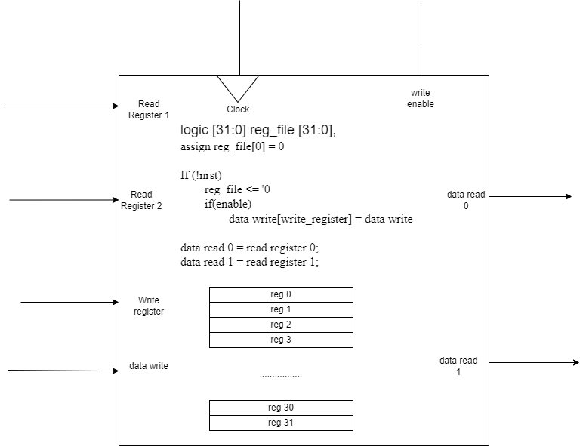
Registers
Register RTL and Psuedocode

Slide 16
Registers
Test Cases
Reset: check all registers are set to 0
With write_enable off, try writing register: should be no change
With write_enable on, try writing to a register: check for correct value
Write random values to all registers, try reading all registers: check data_read is correct
Do twice
Reset check again

Slide 17
Memory

Slide 18
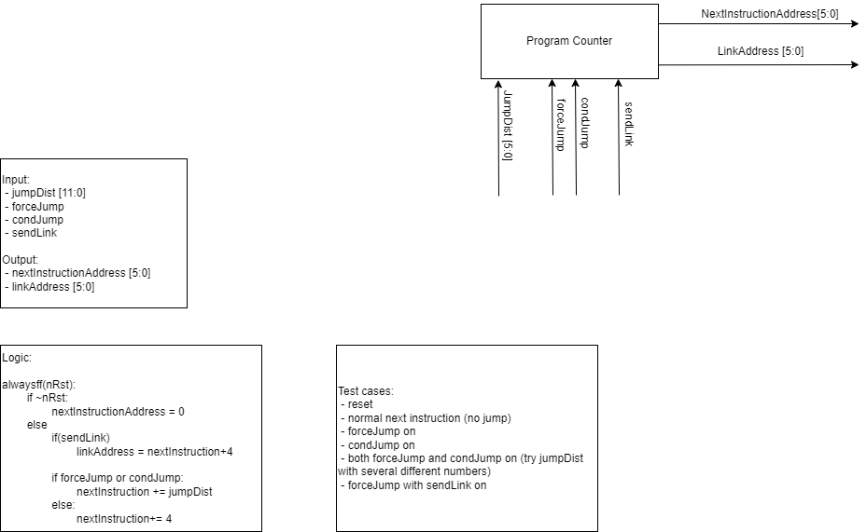
Program Counter
RTL Diagram and Input/Output

Slide 19
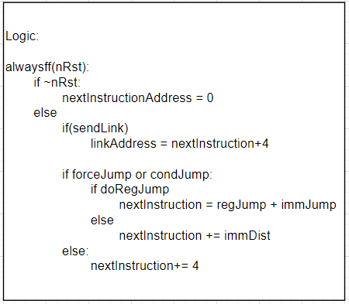
Program Counter
Logic and Test Cases

Slide 20
Peripherals

Slide 21
Expected Obstacles

Slide 22
Future Plans
Error correction?

