Slide 1

Battle of Neighborhood's
Discovering USA’s Best City for opening a Casino/Shopping Mall using Data Science.

Slide 2
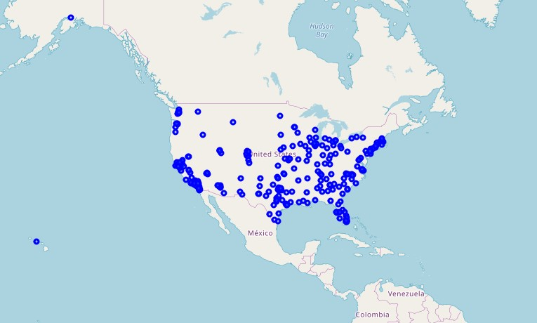
Business Problem
A Successful Asian Entrepreneur wants to expand his Business to USA. He wants to open a Casino/Shopping Mall in USA but not sure in which City and Locality he should open the Mall and be Successful.
Cities of USA

Slide 3
DATA
REQUIREMENT
Data that will be required for solving the problem -
List of all the cities in United States with population density and coordinates
List of all the cities in United States with Per Capita Income
List of all venues in each city
List of all venues in each locality in the selected city
SOURCE
Wikipedia
https://en.wikipedia.org/wiki/List_of_United_States_cities_by_population
https://en.wikipedia.org/wiki/List_of_United_States_counties_by_per_capita_income
Foursquare API
For Venues in City and in Each locality in selected city.

Slide 4
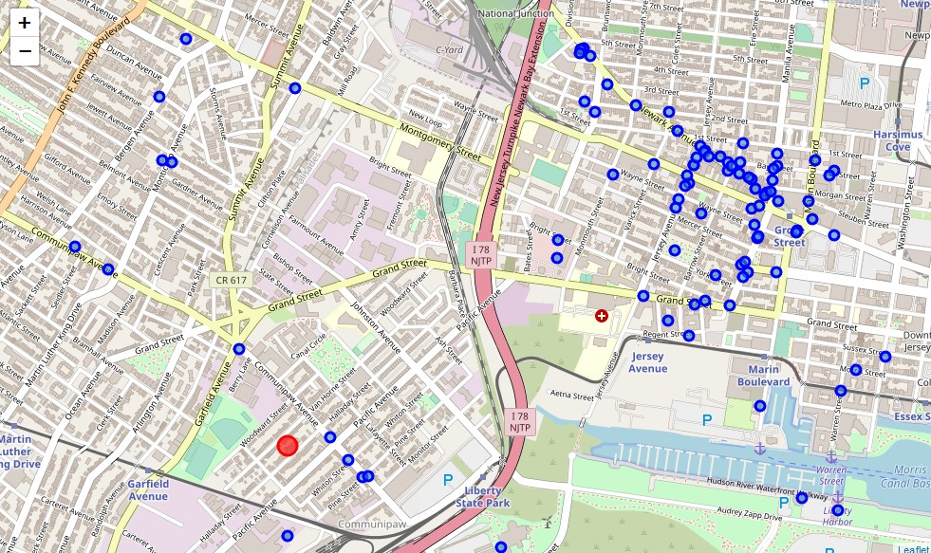
METHODOLOGY
To suggest the best Location ,steps followed are -
Using Beautiful Soup Library Wikipedia pages containing information about Cities of USA by Population and Per Capita income are scraped into Pandas Dataframe.
Dataframe contained data about Cities, Coordinates, Area, Per capita Income and Population Density. Than Dataframe was Cleaned and Processed according to requirement of the problem to be solved. Proper benchmarks were set to obtain the best results.
The List of Venues in a City were obtained using Foursquare API and the city with maximum weight according to the Model is selected.
With the help of Unsupervised Machine Learning Algorithm (K Means Algorithm) Locality in the city is obtained where opening a Shopping Mall/Casino will be most benefitted.
1
2
3
4

Slide 5
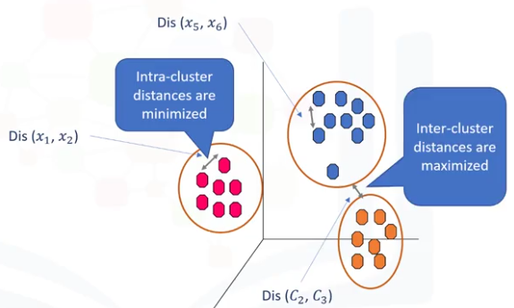
K- Means Clustering (Unsupervised Machine Learning Algorithm)
Unsupervised Learning
Supervise, means to observe, and direct the execution of a task, project, or activity. We do not supervise the model, but we let the model work on its own to discover information that may not be visible to the human eye. It means, the unsupervised algorithm trains on the dataset, and draws conclusions on unlabeled data.
What is a Cluster?
K-Means Clustering
1
A cluster is a group of data points or objects in a dataset that are similar to other objects in the group, and dissimilar to datapoints in other clusters.
2
K-Means is a type of partitioning clustering, that is, it divides the data into K non-overlapping subsets or clusters without any cluster internal structure or labels. This means, it's an unsupervised algorithm.

Slide 6

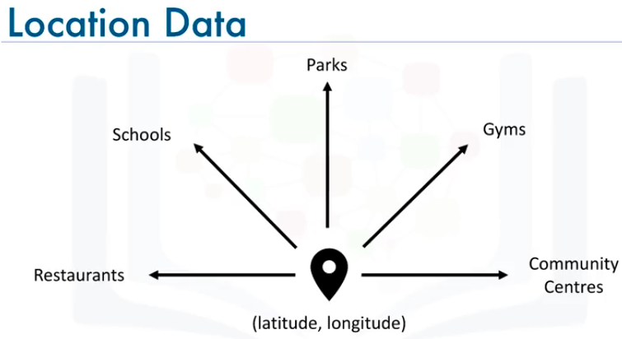
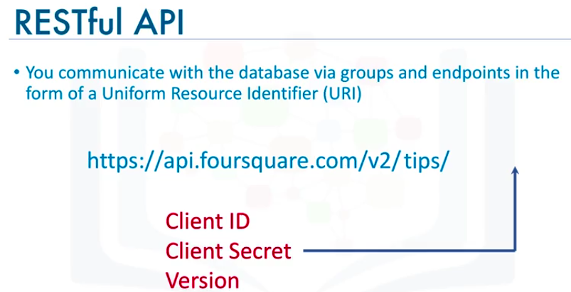
Location Data Provider – Foursquare
1
Location Data
Location data is data describing places and venues, such as their geographical location, their category, working hours, full address, and so on, such that for a given location given in the form of its geographical coordinates (or latitude and longitude values) one is able to determine what types of venues exist within a defined radius from that location.
2
Foursquare
Foursquare is a technologic company that built a massive dataset of accurate location data.
Foursquare powers location data for Apple, Uber, Snapchat, Twitter and many more.
Their API and location data is currently being used by over 100,000 developers.

Slide 7
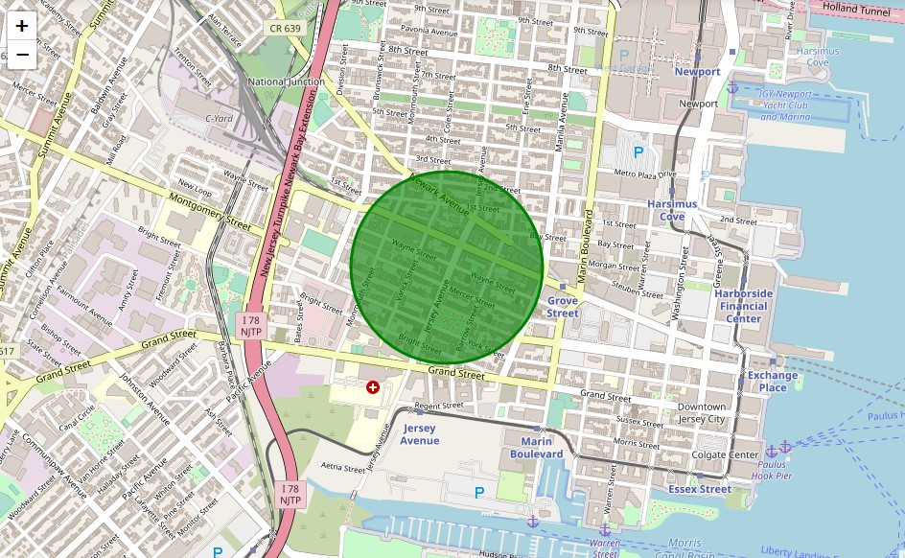
Results
Best City in USA for opening a Shopping Mall/Casino-
NEW JEARSEY
Best Locality in New Jersey –
Near Jersey Avenue

Slide 8
Discussions and Recommendations
1
In the Foursquare API, we have queried the Venues of a locality by specifying the LIMIT and Radius of our choice. We have chosen less LIMIT as the number of API calls that can be done using a free account in Four Square are less.
○ We can increase the limit for more accurate results.
○ We can increase the Radius for more venue results from each city
2
In the venue categories we are choosing only few out of 2000 that are available to give weights and identify the best cluster. Hence, assigning weights must be done relatively for each category and then considering more number of venue categories would actually yield a better output.

