Slide 1






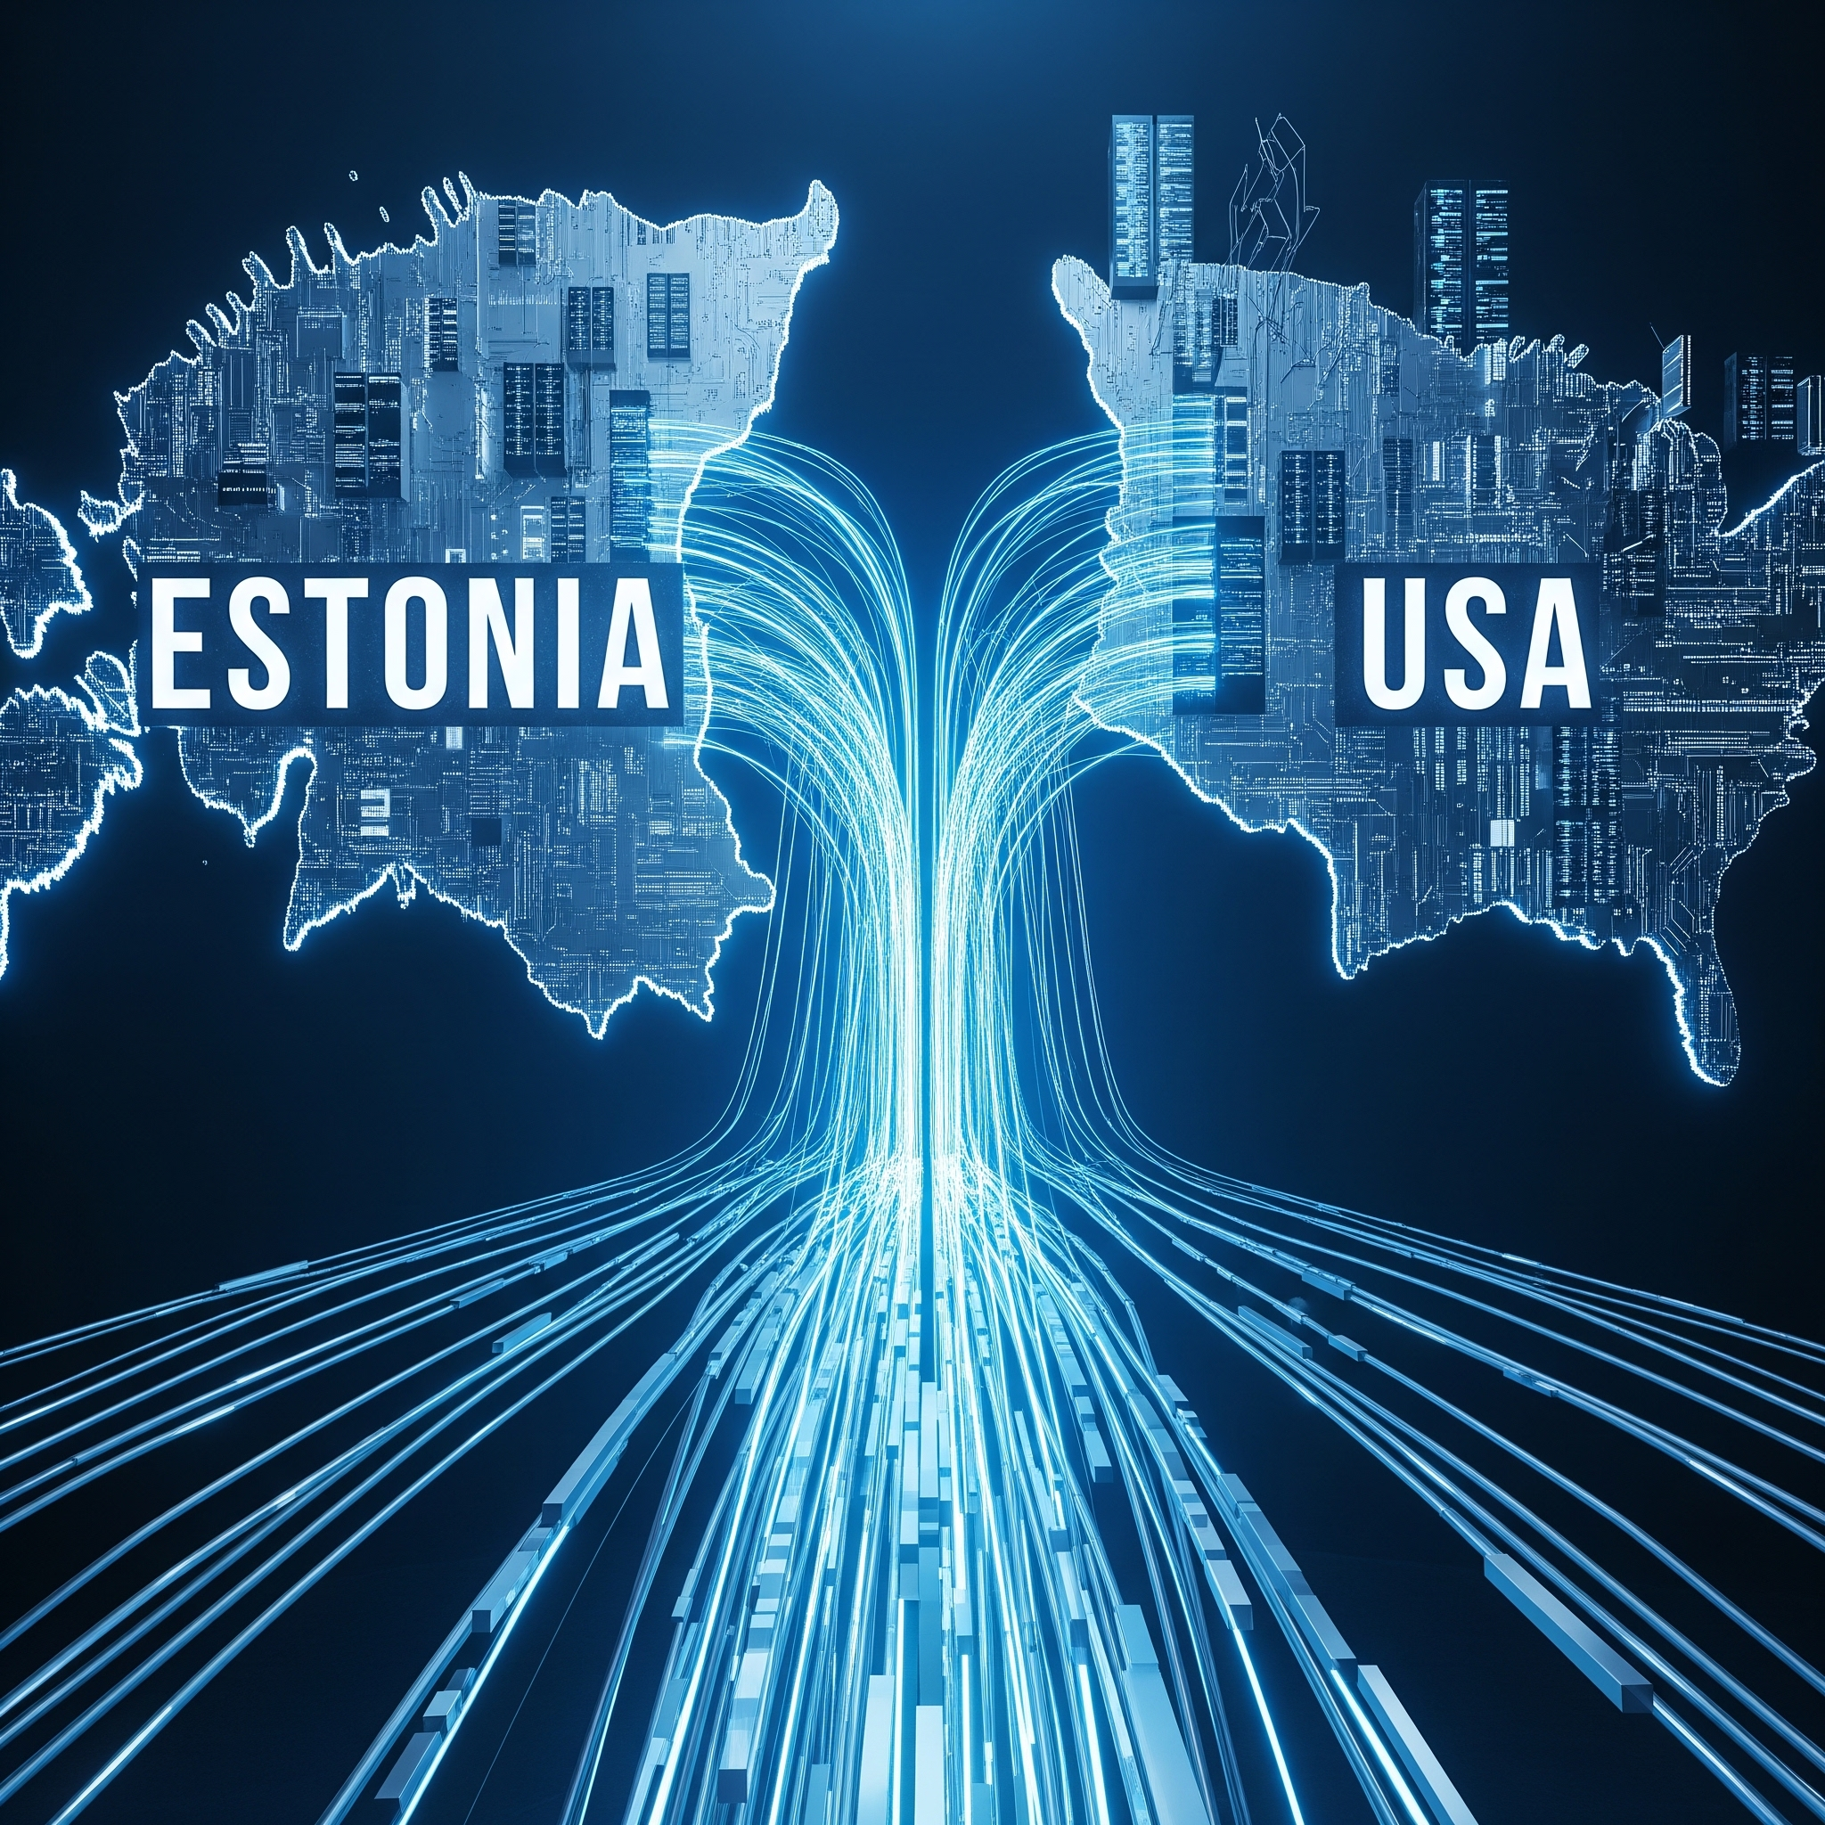
Fenix Capital & Invest Estonia:
The Transatlantic Defense Bridge
Connecting Estonia’s defense and DeepTech ecosystem to US capital, procurement pathways, and prime contractor networks

Slide 2
Our Investment Thesis
Fenix Capital is a $5M pre-seed and seed fund headquartered in Washington, DC, backing US and allied-nation defense and supply chain software companies.
We invest in companies building mission-critical software for supply chain visibility, compliance, and resilience, across the US and allied defense industrial bases.
Our Strategic Edge
15+ years building critical mineral supply chains for the Defense Industrial Base across 40+ sector companies.
This gives us pattern recognition most investors lack — spotting founders building mission-critical software before it becomes obvious.
Investment Focus
Concentrated $5M fund — selective pre-seed and seed investments.
Reserve capital for follow-on in top performers.
LP base: family offices, HNWIs, impact investors, and defense-aligned CVCs.

Slide 3
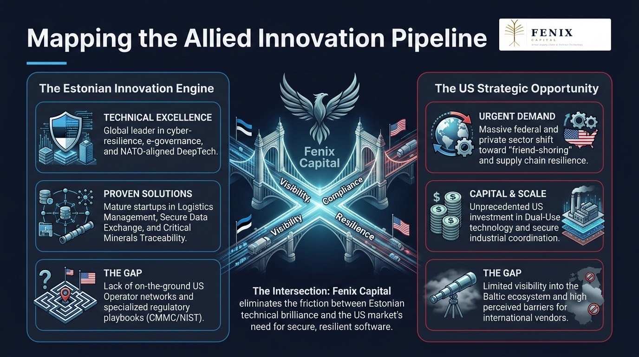

Slide 4
Fenix Capital: A Bridge for Allied Cooperation
The Edge
15 years of hands-on experience in government contracting, DoD acquisitions and procurement, and building critical mineral supply chains for the US Defense Industrial Base.
The Execution
As a former Army Officer, DoD Project Manager, and defense startup founder, Fenix’s Managing Director brings the operational discipline and insider network required to derisk US market entry for allied founders.
Fenix provides the playbook for:
Federal procurement navigation
US prime contractor introductions
Supply chain resilience certification

Slide 5

Our Mutual Value Proposition
For Startup Estonia
A US capital partner with federal access
Fenix actively seeks pre-seed and seed defense and DeepTech founders — and provides them direct access to US capital, federal procurement pathways, and Tier-1 prime contractor introductions.
Startup Estonia’s network becomes the front door to Fenix’s Washington-based deal pipeline.
For Invest Estonia
A curated on-ramp for your US LP network
Fenix Capital gives Invest Estonia’s US-based LP network a Washington-anchored, defense-focused fund vehicle to back Baltic innovation — without the complexity of direct cross-border investment.
Baltic Deployment Target: Up to $1M committed to Estonian and Baltic portfolio companies over 12–18 months. Check sizes: $100K–$250K at pre-seed; follow-on reserved for top performers.

Slide 6








Deal Flow Alignment: Baltic Defense & DeepTech
center_focus_strong
The Focus
Fenix tracks founders at the intersection of allied defense technology, maritime security, and supply chain resilience — precisely where Estonia’s DeepTech ecosystem has built durable advantages.
hub
Estonian Portfolio CandidatesProven operators ready to scale into the US market:
Frankenburg Technologies: Defense Tech & Automated Systems
TELETACTICA: Secure, Mission-Critical Communications
GScan: DeepTech Maritime Cargo Scanning & Material Verification
Waybiller: Logistics Software for Heavy Logistics
rocket_launch
The Execution
Fenix navigates vendor credentialing, federal contracting vehicles, and Tier-1 prime contractor relationships — directly accelerating time-to-contract for Estonian founders.

Slide 7
Strategic Initiative: Allied Defense Tech Roundtable
event
The Proposal
Fenix Capital, Invest Estonia, and Startup Estonia co-host a closed-door roundtable at the Estonian Embassy in Washington, D.C.
groups
The Room
Fenix Capital’s network of military leaders, defense executives, and supply chain operators — alongside Invest Estonia’s US-based LP network and Startup Estonia’s top defense tech and DeepTech founders.
track_changes
The Goal
To open direct procurement conversations, catalyze cross-border investment, and establish Estonia as the premier allied defense tech supplier to the US market.

