Slide 1
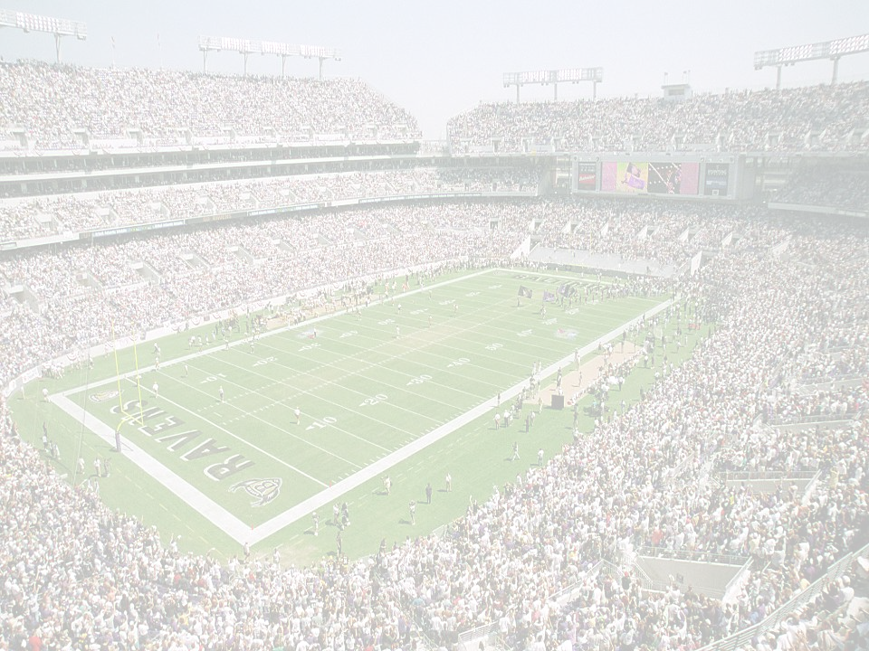




3-4
DEFENSE
3-4
DEFENSE
PRESENTED BY
MIKE PETTINE
BALTIMORE RAVENS
OUTSIDE LINEBACKERS COACH
FRANK GLAZIER CLINIC
MARCH 2005

Slide 2
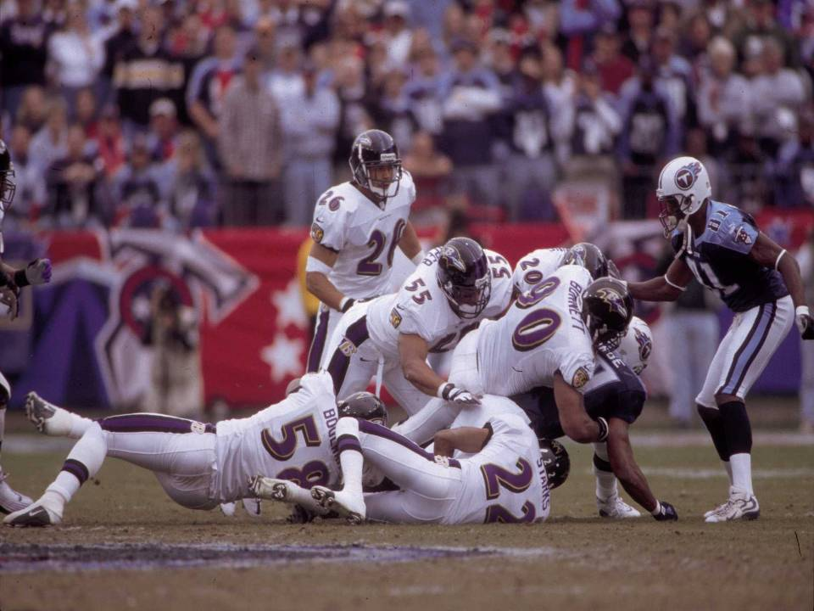
DEFENSIVE OBJECTIVES
DEFENSIVE OBJECTIVES
#1 – PREVENT POINTS ! ! !
#2 – SCORE
#3 – FORCE TURNOVERS
#4 – FORCE BALL BACK TO OFFENSE IN GREAT FIELD POSITION
HOW TO GET IT DONE:
PLAY YOUR BEST PLAYERS!
SIMPLE (YET MULTIPLE) SCHEME -- MAJORITY OF LEARNING IN HANDS OF FEW
CREATE CONFUSION THRU MOVEMENT / DISGUISE
USE GREAT FUNDAMENTALS / TECHNIQUE
PRESSURE THE OFFENSE (CALCULATED, NOT RECKLESS) -- MAKE THEM REACT TO US!
CREATE MISMATCHES – EXPLOIT THEIR WEAKER PLAYERS / PROTECT YOURS
DEFEND FORMATIONS -- STOP WHAT THEY DO BEST!
DEFEND BEST PLAYERS – SCHEME TO MINIMIZE EFFECT OF BEST WEAPONS!
EFFICIENT PREPARATION – ATTENTION TO DETAIL -- WORK SMARTER THAN YOUR OPPONENT!

Slide 3
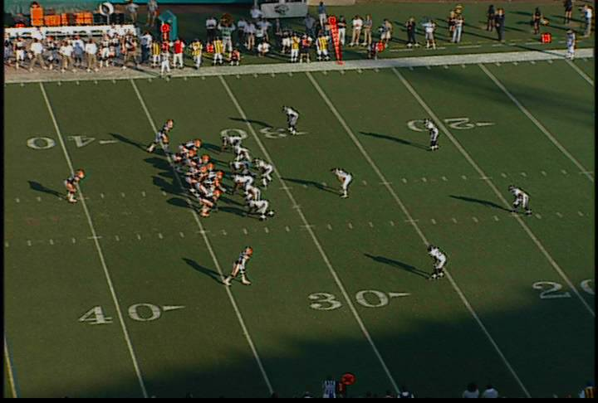
WHY THE 3-4?
WHY THE 3-4?
‘3-4’
as a
PERSONNEL
GROUP
NEARLY 100%
on BASE DOWNS
vs. BASE OFF. PERSONNEL
‘3-4’
as an
ALIGNMENT
(ODD FRONT)
APPOX. 10-15%
on BASE DOWNS
vs. BASE OFF. PERSONNEL
B
E
N
E
B
B
B
Opportunity to put your best players on the field (DL vs. LB)
Flexibility / Disguise – slant to / stem to other fronts
Dominant Nose can control a game – increased pressure on Center
OL must face DL that will 2 gap, Shade, or Slant
Unfamiliarity with the scheme can lead to offensive confusion
Increase offensive preparation time
Create pass rush mismatches (OLB’s on Backs, Guards, or Tackles)
Offense has to account for 7 potential immediate rushers (5 on LOS)
Easier to blitz defensive backs - drops replaced by LB instead of DL
Easier to make coverage adjustments vs. EMPTY

Slide 4
BASE ALIGNMENT
ODD
BASE COVERAGES:
2,3,4,6
W
E
N
E
S
WILL
END
NOSE
END
SAM
C
M
T
C
MIKE
TED
CORNER
CORNER
WS
SS
WEAK SAFETY
STRONG SAFETY

Slide 5
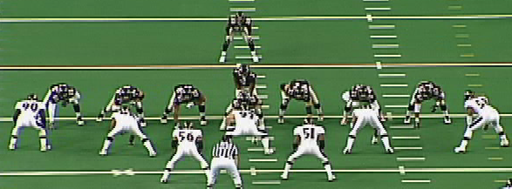
FRONT: ODD
ALIGNMENT
LE – 4 TECH
N – 0 TECH
RE – 4 TECH
BASE TECHNIQUE: 2 GAP (align slightly off the ball)
Beat the offensive lineman to the punch!
Explode with hands and elbows underneath you (thumbs up)
    Try to get “knock em back”
    Don’t cross your feet – step, shuffle, shuffle
    Be in a position to play both gaps
Fight the double team front-side
    Attack the post man (the man in front of you)
    Press your hips into the drive man -- Do not let go of the post man!!!
    Anchor, separate off the block
Recognize Back-Back, Wham (Nose)
Recognize Blocking patterns – TAG, FAN (Ends)
“Elephants on parade” = boot / reverse
Do not allow jump thru (scoop block)

Slide 6
MULTIPLE FRONTS
ODD to OVER ED
BASE COVERAGES:
2,4,6
W
E
N
E
S
C
M
T
C
WS
SS

Slide 7
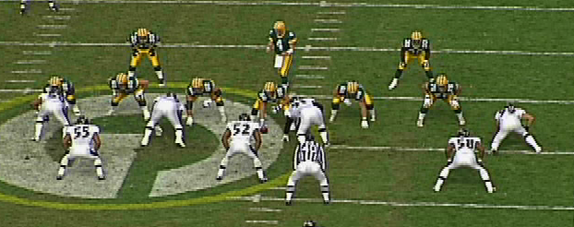
FRONT: OVER ED
ALIGNMENT
CLOSED END – 3 TECH
N – SHADE (OPEN)
OPEN END – ‘ED’ (5 TECH)
BASE TECHNIQUE: SHADE
You can not get reached!
Do not allow jump thru (scoop block)
If the blocker gets off on LB - you have to make play using “BIG BALL” technique
    Play the double team the same as the Reach block
    All other blocking patterns are REACTIONARY BLOCKS
      TAG block = OT down, OG pull out, Down block, “Elephants on Parade,”
      Counters and Jokers, High Hats
BASE TECHNIQUE: ED
You are a C gap defender
Vs. Turnout – Squeeze blocker to reduce B gap
Vs. Down Block = SPILL (don’t trade 1 for 1) – pry upfield through puller – force bounceout
Vs. Bim (Draw set) = Bim the Bimmer
Vs. Flow Away = Windback run, QB, Reverse
Vs. Pull or “Elephants on Parade” – Get Upfield for Boot / Reverse

Slide 8
MULTIPLE FRONTS
ODD to OVER
BASE COVERAGES:
3,6
W
E
N
E
S
C
M
T
C
WS
SS

Slide 9
MULTIPLE FRONTS
ODD to UNDER
BASE COVERAGES:
6,3
W
E
N
E
S
C
M
T
C
WS
SS

Slide 10
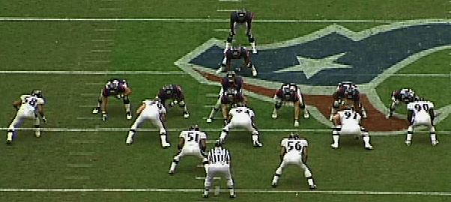
FRONT: UNDER
ALIGNMENT
CLOSED END – 4 TECH
N – SHADE (CLOSED)
OPEN END – 3 TECH
BASE TECHNIQUE FOR NOSE & OPEN END: SHADE
SAME FUNDAMENTALS AS OVER ED
BASE TECHNIQUE FOR CLOSED END: 2 GAP
SAME FUNDAMENTALS AS ODD

Slide 11
MULTIPLE FRONTS
ODD to REDUCE
BASE COVERAGES:
3 WEAK
W
E
N
E
S
C
M
T
C
WS
SS

Slide 12
MULTIPLE FRONTS
ODD to SINK (46)
BASE COVERAGES:
3
W
E
N
E
S
C
M
T
C
WS
SS

Slide 13
ODD COVERAGES
COVER 2
W
E
N
E
S
M
T
C
C
SQUAT
CURL
CURL
SQUAT
HOOK
WS
SS
1/2
1/2

Slide 14
ODD COVERAGES
COVER 3
W
E
N
E
S
M
T
CURL-FLAT
C
C
CURL-FLAT
HOOK
HOOK
WS
SS
1/3
1/3
1/3

Slide 15
ODD COVERAGES
COVER 3 WEAK
W
E
N
E
S
M
T
C
C
CURL-FLAT
CURL-FLAT
HOOK
HOOK
WS
SS
1/3
1/3
1/3

Slide 16
ODD COVERAGES
COVER 4
W
E
N
E
S
M
T
CURL-FLAT
C
C
CURL-FLAT
HOOK
WS
SS
1/4
1/4
1/4
1/4

Slide 17
ODD COVERAGES
COVER 6
W
E
N
E
S
M
T
C
C
SQUAT
CURL
CURL-FLAT
HOOK
WS
SS
1/4
1/2
1/4

Slide 18
OVER COVERAGES
ODD to OVER
COVER 36
COVER 3 vs. PRO
W
E
N
E
S
M
T
CURL-FLAT
C
C
CURL-FLAT
HOOK
HOOK
WS
SS
1/3
1/3
1/3

Slide 19
OVER COVERAGES
ODD to OVER
COVER 36
COVER 6 vs. SLOT
E
N
E
S
W
M
T
C
CURL-FLAT
C
SQUAT
HOOK
CURL
SS
WS
1/4
1/4
1/2

Slide 20
OVER ED COVERAGES
ODD to OVER ED
COVER 2
E
N
E
S
W
M
T
C
C
SQUAT
SQUAT
CURL
CURL
HOOK
WS
SS
1/2
1/2

Slide 21
OVER ED COVERAGES
ODD to OVER ED
COVER 4
E
N
E
S
W
M
T
C
C
CURL - FLAT
CURL-FLAT
HOOK
WS
SS
1/4
1/4
1/4
1/4

Slide 22
OVER ED COVERAGES
ODD to OVER ED
COVER 6
E
N
E
S
W
M
T
C
C
CURL-FLAT
SQUAT
CURL
HOOK
WS
SS
1/4
1/2
1/4

Slide 23
REDUCE COVERAGES
ODD to REDUCE
COVER 3 WEAK
E
N
E
S
T
W
M
C
C
CURL-FLAT
CURL-FLAT
HOOK
HOOK
WS
SS
1/3
1/3
1/3

Slide 24
UNDER COVERAGES
ODD to UNDER
COVER 63
COVER 6 vs. PRO
W
E
N
E
S
M
T
C
C
SQUAT
CURL
CURL-FLAT
HOOK
WS
SS
1/4
1/2
1/4

Slide 25
UNDER COVERAGES
ODD to UNDER
COVER 63
COVER 3 vs. SLOT
W
E
N
E
S
M
T
C
CURL-FLAT
C
CURL
HOOK
HOOK
SS
WS
1/3
1/3
1/3

Slide 26
SINK COVERAGES
ODD to SINK (46)
COVER 3
W
E
N
E
T
S
C
M
SS
C
CURL-FLAT
CURL-FLAT
HOOK
HOOK
1/3
WS
1/3
1/3

Slide 27
3-4 PRESSURE PACKAGE
3-4 PRESSURE PACKAGE
PRESSURE: 5 or more Rushers, or involving a DB in a 4 man rush
Be CREATIVE: Have flexible system to designate rushers
Be ADAPTABLE: Match pressures with opponent tendencies
Match coverages with your personnel (Off Man, Bump, Zone, etc.)
Send your best rushers – but not 100% - Changeups
BLUFF – show pressure & back out – Droppers must be good actors
Take calculated risks – don’t be reckless!
COVERAGES
COVER 0 – Straight Man to Man, No Help
COVER 1 – Man to Man, Centerfield Help
COVER 2 – 4 Under, 2 Deep Zone
FIRE ZONE – 3 Deep, 3 Under Zone
Other: Brackets, Combinations -- tailored to fit particular opponent

Slide 28
COVER 0 PRESSURES
ODD LIGHTNING 0
ODD MAX 0
S
E
N
E
W
S
E
N
E
W
T
M
T
M
C
C
C
C
S
WS
WS
S
S
S
COACHING POINTS
Have sound Match Up rules -- Corners Over, 1’s - 2 Strong – 3 Strong/2 Weak, Jersey #
Don’t show too early – but be in a position to do your work
Have the ability to “Hands Out” versus obvious audible
Coverage defenders can not get beat inside!
Anticipate the “Hot” or quick throw (Catch Technique / Flat Foot)

Slide 29
COVER 1 PRESSURES
ODD SAW 1 (UNDER)
OVER SWILL 1
S
E
N
E
W
S
E
N
E
W
T
M
T
M
C
C
S
C
C
S
S
S
WS
WS
FREE
FREE
COACHING POINTS
Have sound Match Up rules -- Corners Over, 1’s - 2 Strong – 3 Strong/2 Weak, Jersey #
Don’t show too early – but be in a position to do your work
Have the ability to “Hands Out” versus obvious audible
Anticipate the “Hot” or quick throw
Coverage defenders know where your help is!
With Centerfield help, can overplay outside routes
Can use WS to double / bracket dominant receiver – 1X, 1Z, 1Y, 1H

Slide 30
COVER 2 PRESSURES
ODD STING 2
ODD EAGLE 2
S
E
N
E
W
S
E
N
E
W
SQUAT
T
M
SQUAT
SQUAT
T
M
BUZZ
C
#3
C
C
C
HOOK
HOOK
HOOK
HOOK
S
WS
S
S
S
WS
1/2
1/2
1/2
1/2
COACHING POINTS
Don’t show too early – but be in a position to do your work
Anticipate the “Hot” or quick throw
Eagle 2 is designated to passing strength – can also go to Wide Field (FALCON 2)

Slide 31
FIRE ZONE CONCEPT
5 MAN RUSH -- ZONE COVERAGE
3 UNDERNEATH ZONE DEFENDERS, 3 DEEP ZONE DEFENDERS
5 RUSHERS
6 DROPPERS
W
E
N
E
S
ANY COMBINATION OF 5 RUSHERS
T
C
M
C
WS
SS

Slide 32
FIRE ZONE CONCEPT
5 MAN RUSH -- ZONE COVERAGE
3 UNDERNEATH ZONE DEFENDERS, 3 DEEP ZONE DEFENDERS
6 DROPPERS
W
S
CURL/FLAT
CURL/FLAT
HOOK (#3)
C
C
WS
SS
DEEP 1/3
DEEP 1/3
DEEP 1/3

Slide 33
EXAMPLE
ODD BEAR FIRE ZONE
5 RUSHERS
6 DROPPERS
S
E
N
E
W
T
M
C
1st
2nd
C
S
S
WS

Slide 34
FIRE ZONE PRESSURES
ODD FIELD FZ
ODD BACKS FZ
WIDE FIELD
“LIZ”
“RIP”
“BANG”
“BANG”
S
E
N
E
W
S
E
N
E
W
C
CURL
FLAT
T
M
C
T
M
C
CURL
FLAT
C
CURL
FLAT
HOOK
CURL
FLAT
S
WS
HOOK
WS
S
S
1/3
1/3
S
1/3
1/3
1/3
1/3
COACHING POINTS
Don’t show too early – but be in a position to do your work
Anticipate the “Hot” or quick throw (“HOT” side vs. “COLD” side)
Designate to FIELD, BACKS, PASS STRENGTH, TIGHT END, INDIVIDUAL, R/L etc.
Set up based on scouting report -- tendencies
Vs. Slot – OLB blitzes outside / ILB blitzes inside (“SCRAPE”)
Blitzing LB can “read out” vs. full flow away or near G pull
E
B
B
“SCRAPE”

Slide 35
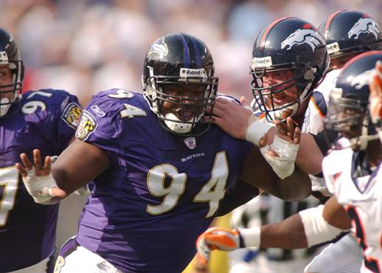
ADDITIONAL NOTES on DEFENSE
1. DO NOT LOSE SIGHT OF THE FUNDAMENTALS! – If your players can not RUN, are not TRAINED TO DEFEAT BLOCKS and TACKLE, the best schemes in the world are worthless!!
2. Use 2-a-days to master physical techniques – majority of the playbook should already be installed before you put on the pads
3. Create a fast practice tempo – No wasted time!
Shortens practices, increases functional conditioning, maximize reps
4. Conduct more “walk-thru” type meetings versus on the board
Review tougher looks – Empty, Unbalanced, Bunches, etc.
5. Quiz your players on alignment / assignment – oral & written -- see how good a teacher you are!
6. Use a Coach as the Scout Team Quarterback – critical position on the staff!
7. Coach effort! Never accept anything less than great effort! Reward hustle / Punish loafing!
8. Emphasize importance of individual roles within framework of defense
DO YOUR JOB AND GOOD THINGS WILL HAPPEN!
STRESS TEMPO – PLAYING FAST
PLAY ON OUR TERMS!

Slide 36
DEFENDING the SPREAD ATTACK
QUESTIONS to ask about the OPPONENT:
What is the opponent trying to accomplish with the Spread?
    Is it their way of life?
    No Huddle – Fast Break
    3rd Down Package only?
    Run philosophy – Checked? Interior vs. Perimeter
    Pass philosophy – Concepts – Vertical, Mismatches, Sticks
2. What are their reads?
Is the QB reading the middle of the field?
Are they counting defenders in the box?
3. What defenses have hurt them? How are they successful?
Do they have a solid blitz pick-up system? Audible or sight-adjust?
Are their routes geared more for man or zone?
4. Who is their best weapon?
Who do they try to isolate?
Is the QB a running threat?
Do they run any form of option?
  Identify types and give option assignments in all defenses

Slide 37
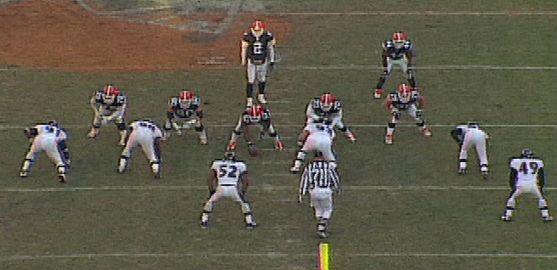
SUB FRONT: FLEX
ALIGNMENT
CLOSED END – 7 TECH
CLOSED DT – 3 TECH
OPEN DT – 1 (G) TECH
OPEN END – 5 TECH
FOR POTENTIAL RUN SITUATIONS
PRIMARILY USED TO: STRONG AGAINST RUN
CONVERT TO PASS RUSH

Slide 38
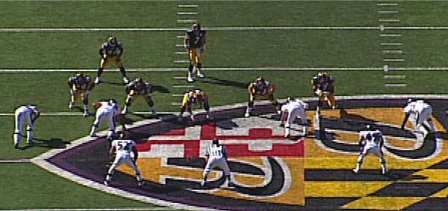
SUB FRONT: RUSH
ALIGNMENT
CLOSED END – 9 TECH
LT – 3 or 4i TECH
RT – 3 OR 4i TECH
OPEN END – WIDE 5 TECH
FOR OBVIOUS PASS SITUATIONS
PRIMARILY USED TO: 4 MAN PASS RUSH
EXECUTE PASS RUSH GAMES

Slide 39
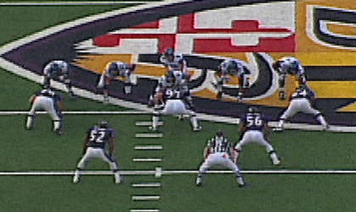
SUB FRONT: 3-2
ALIGNMENT
LEFT END – 5 TECH
N – 0 TECH
RIGHT END – 5 TECH
FOR RUN or PASS SITUATIONS
PRIMARILY USED TO: DISGUISE BLITZ
CAUSE PROTECTION ISSUES
RUSH 3
PUT PRESSURE ON SNAP

Slide 40
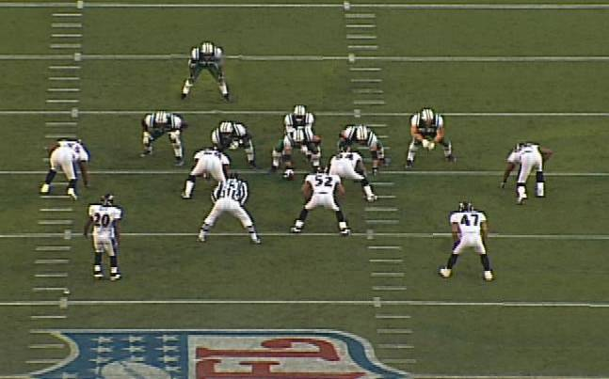

BASE INVERT ALIGNMENT
(vs. BACK OFFSET)
SET FRONT TO BACK
E
T
T
E
C
B
C
N
D
3-4 YDS DEEP
3-4 YDS DEEP
3-4 YDS DEEP
5-6 YDS DEEP
5-6 YDS DEEP
WS
SS
7-8 YDS DEEP
7-8 YDS DEEP

Slide 41
BASE INVERT ALIGNMENT
(vs. BACK at HOME)
TACKLES IN “20’s”
E
T
T
E
C
B
C
N
D
3-4 YDS DEEP
3-4 YDS DEEP
3-4 YDS DEEP
5-6 YDS DEEP
5-6 YDS DEEP
WS
SS
7-8 YDS DEEP
7-8 YDS DEEP

Slide 42
INVERT 2
E
T
T
E
B
C
C
N
D
CURL
SQUAT
CURL
SQUAT
WS
SS
3 REC
HOOK
1/2
1/2

Slide 43
INVERT 3
E
T
T
E
B
C
C
N
D
CURL-FLAT
CURL-FLAT
WS
SS
HOOK-CURL
HOOK-CURL
1/3
1/3
1/3

Slide 44
INVERT 4
E
T
T
E
B
C
C
N
D
CURL-FLAT
CURL-FLAT
WS
SS
3 REC
HOOK
1/4
1/4
1/4
1/4

Slide 45
INVERT MIX
E
T
T
E
B
C
3 OVER 2
MIX
3 OVER 2
MIX
C
N
D
MAN ON
BACK
WS
SS

Slide 46
RUN STUNTS
RUN STUNTS
Must have ways to force bounce-out to perimeter defenders vs. SPREAD run game
E
T
T
E
E
T
T
E
B
D
B
D
    STIR
    Both Ends – JAM technique
    Both Tackles – squeeze A, read out vs. Flow To
    Tackles use Ends as natural pick
    LB’s anticipate ball spilling out
    KNIFE
    Closed End & DT – JAM technique
    Open DT – squeeze A, read out closed side
    Open DE – ED (Base 5) technique
    LB’s anticipate ball spilling out closed

Slide 47
PASS RUSH GAMES
PASS RUSH GAMES
E-T
T-E
E
T
T
E
E
T
T
E
1st
2nd
1st
2nd
B
D
B
D
    T-E or E-T
    E-T = End 1st, DT 2nd
    T-E = DT 1st, End 2nd
        vs. GUN, E can sell upfield
        vs. QB under C – go right now
    TOM
    Both DT’s read the C
    DT away from sliding C will pick,
    then work upfield
    DT to the sliding C will wrap around
    If C straight back, furthest DT up the field penetrates and the DT wraps around

Slide 48
SUB COVER 0 PRESSURES
SCHOOLYARD 0
ALL OUT 0
N
E
T
T
E
D
E
T
T
E
D
N
B
B
C
C
S
WS
C
C
S
S
WS
S
COACHING POINTS
Have sound Match Up rules (Corners Over)
Don’t show too early – but be in a position to do your work
Anticipate the “Hot” or quick throw
Play off in Cover 0 (Flat foot technique) – ball is coming out quick!

Slide 49
SUB COVER 1 PRESSURES
3-2 KINGS 1
3-2 KINGS OPEN 1
N
E
T
E
X
N
X
E
T
E
B
D
B
D
C
C
C
C
S
S
S
S
WS
WS
FREE
FREE
COACHING POINTS
Have sound Match Up rules (Corners Over)
Don’t show too early – but be in a position to do your work
Anticipate the “Hot” or quick throw
Coverage defenders know where your help is!
With Centerfield help, can overplay outside routes
Can use WS to double / bracket dominant receiver – 1X, 1Z, 1Y, 1H

Slide 50
SUB FIRE ZONE PRESSURES
FOX FZ (FIELD)
BULL FZ (BACKS)
WIDE FIELD
“LIZ”
“RIP”
CHECK “MABLE” vs.
2 DETACHED WEAK
N
E
T
T
E
E
T
T
E
N
C
B
D
D
B
C
SEAM
FLAT
C
C
SEAM
FLAT
3 REC
HOOK
SEAM
FLAT
3 REC
HOOK
SEAM
FLAT
S
WS
WS
S
S
TIGHT
1/3
S
TIGHT
1/3
TIGHT
1/3
TIGHT
1/3
1/3
1/3
COACHING POINTS
Don’t show too early – but be in a position to do your work
Anticipate the “Hot” or quick throw
Designate to FIELD, BACKS (TO & AWAY), PASS STRENGTH, INDIVIDUAL, R/L, etc.
Set up based on scouting report -- tendencies

