Slide 1


IASciD S6
A.U 2023
Emotion Detection
Using NLP
Presented by:
Adil Alami
Akram el Basri
Abdessamad Berahhou
Supervised by:
Prof. Nabil MRANI

Slide 2

Outline :
Introduction
The Objectif
How we tried to solve it
Code Overview
Data Preprocessing
Model Architecture
Testing & Validation
Conclusion

Slide 3
Introduction

Slide 4

The Objectif

Slide 5

The Objectif
I am feeling so happy
Happiness ?

Slide 6
The Objectif
I am feeling so happy
Extract key words
Classify emotion
90% sarcasm, 10% pretending, 0% happiness

Slide 7
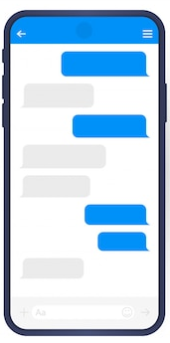
The Objectif

Slide 8

The Objectif
I am feeling so happy
je me sens si heureux
أشعر بسعادة كبيرة
Ich fühle mich so glücklich
???

Slide 9
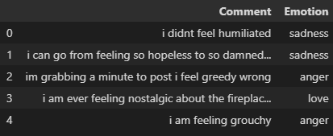
How we tried to solve it

Slide 10
How we tried to solve it
My friend was the happiest man when Lionel Messi won The Best FIFA Men's Player Award 2022
My friend was the happiest man when Lionel Messi won The Best FIFA Men's Player Award 2022

Slide 11
How we tried to solve it
My friend was the happiest man when Lionel Messi won The Best FIFA Men's Player Award 2022
My friend was the happy man when lionel messi win The best fifa mens player award 2022

Slide 12
How we tried to solve it
friend happy man lionel messi win best fifa men player award
Happiness

Slide 13
How we tried to solve it
My friend was not happy when Lionel Messi won The Best FIFA Men's Player Award
friend happy man lionel messi win best fifa men player award
Happiness ???

Slide 14
Code Overview

Slide 15
Data Preprocessing

Slide 16
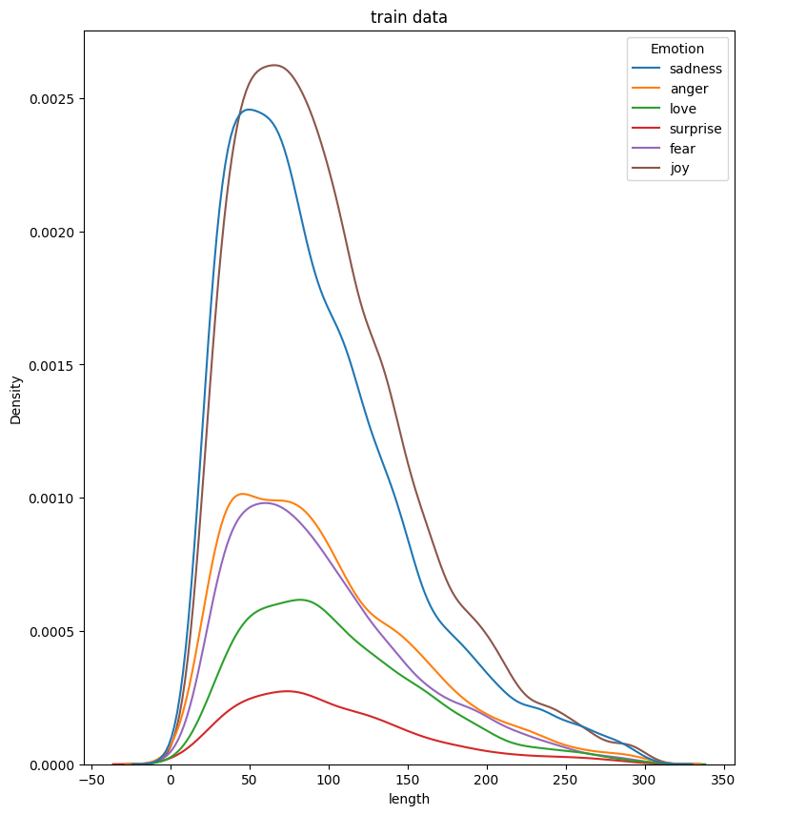
Data Preprocessing

Slide 17
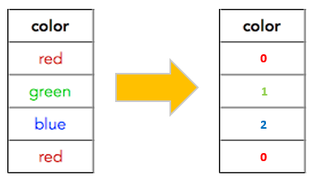
Data Preprocessing

Slide 18
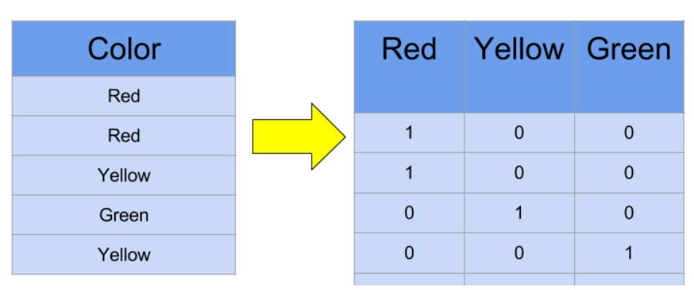
Data Preprocessing

Slide 19
Model Architecture
Data Processing
Phrase
Corpus
I love you so much
love much

Slide 20
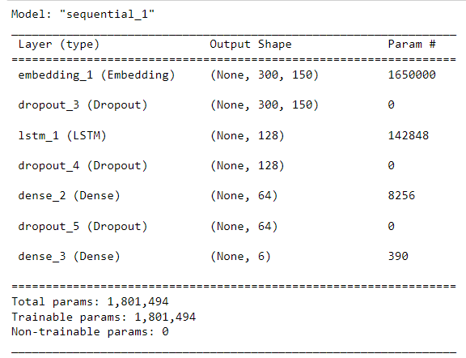
Model Architecture
Description :
Ce modèle est utilisé pour
la classification de texte en utilisant des réseaux de neurones récurrents et des techniques de régularisation pour réduire l'overfitting.

Slide 21
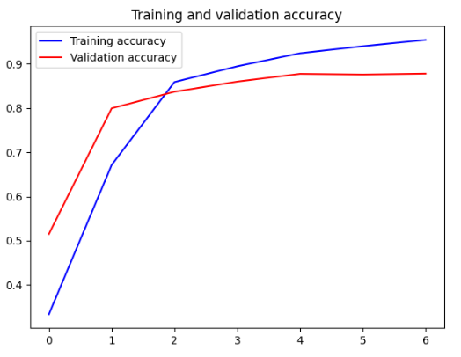
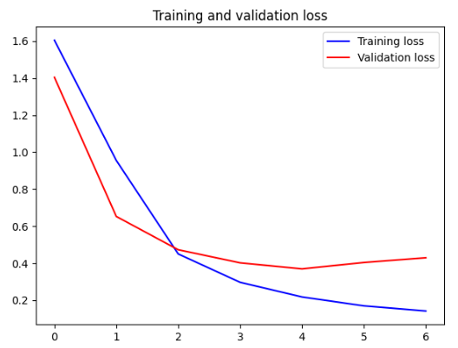
Testing & Validation
Training && Validation
Accuracy
Training && Validation
loss

Slide 22
Testing & Validation

Slide 23
Conclusion

Slide 24
IASciD S6
A.U 2023
Emotion Detection
Using NLP
Presented by:
Adil Alami
Akram el Basri
Abdessamad Berahhou
Supervised by:
Prof. Nabil MRANI

