Slide 1
Universal Speech Enhancement
Policy learning · multi-expert routing · DNSMOS-driven selection Frozen WavLM + dynamic speculate-and-measure · FastAPI + React
github.com/Aejazzz/universal_speech_enhancement

Slide 2
Problem & approach
Real-world noisy speech: one fixed denoiser rarely fits all distortions.
Mixture-of-experts: neural models (DeepFilterNet3, optional MossFormer2 / Resemble) plus classical FFT baselines.
Trained router (WavLM + MLP) suggests expert and strength; dynamic router scores every active candidate with DNSMOS P.835 (+ UTMOS when reliable).
"Do no harm" margin keeps BYPASS when improvement is marginal.

Slide 3
End-to-end pipeline
Load & resample → 16 kHz mono
Preprocess: DC removal, 60 Hz HPF, ITU-R BS.1770 loudness (−23 LUFS)
Distortion analyzer (CRNN on log-mel) → 6-D features for policy
Policy: frozen WavLM-base-plus, multi-layer pool → expert, strength, refine
Dynamic routing (optional): sweep strengths per expert → rank by DNSMOS blend
Brick-wall limiter −1 dBFS → metrics (DNSMOS, PESQ, STOI, SI-SDR) + plots

Slide 4
Architecture snapshot
Stack
Artifacts per run
Frontend: React, Tailwind, Vite
Backend: FastAPI, uvicorn
Core: PyTorch, speechmos (DNSMOS), transformers (WavLM)
enhanced.wav, metrics.json, routing.json
Waveform / spectrogram / policy probability PNGs
Full dynamic candidate leaderboard in API

Slide 5
Blind evaluation — 100 clips (URGENT validation noisy set)
Metric | Value
Files processed | 100
Mean ΔDNSMOS (OVRL) | +0.72
Mean ΔSIG | +0.56
Mean ΔBAK | +1.54
Chosen = top rank | 100%
Pareto-dominated picks | 0

Slide 6
Routing distribution (mean ΔDNSMOS by chosen expert)
Expert | Clips | Mean ΔOVRL | Mean ΔSIG | Mean ΔBAK
DeepFilterNet3 | 57 | +0.74 | +0.47 | +1.60
NoiseReduce | 26 | +0.58 | +0.27 | +1.40
WienerFilter | 11 | +1.01 | +1.51 | +1.64
SpectralSubtraction | 4 | +0.55 | +0.84 | +1.38
SpectralGate | 2 | +0.89 | +1.14 | +1.49

Slide 7
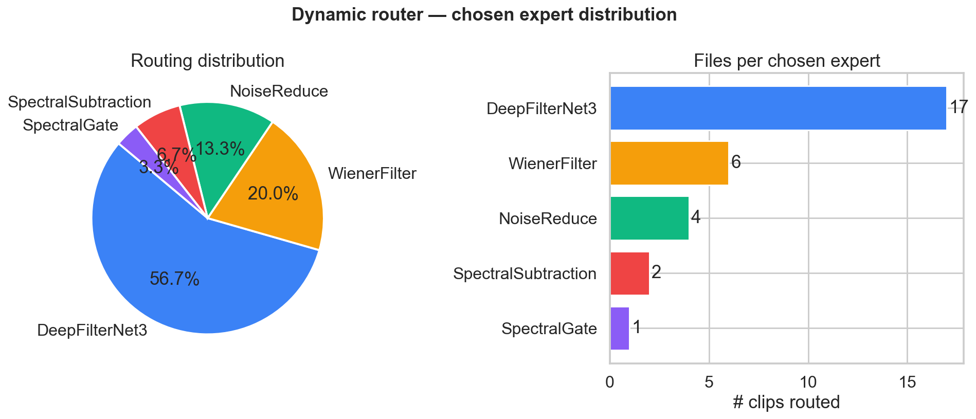
Results: routing distribution

Slide 8
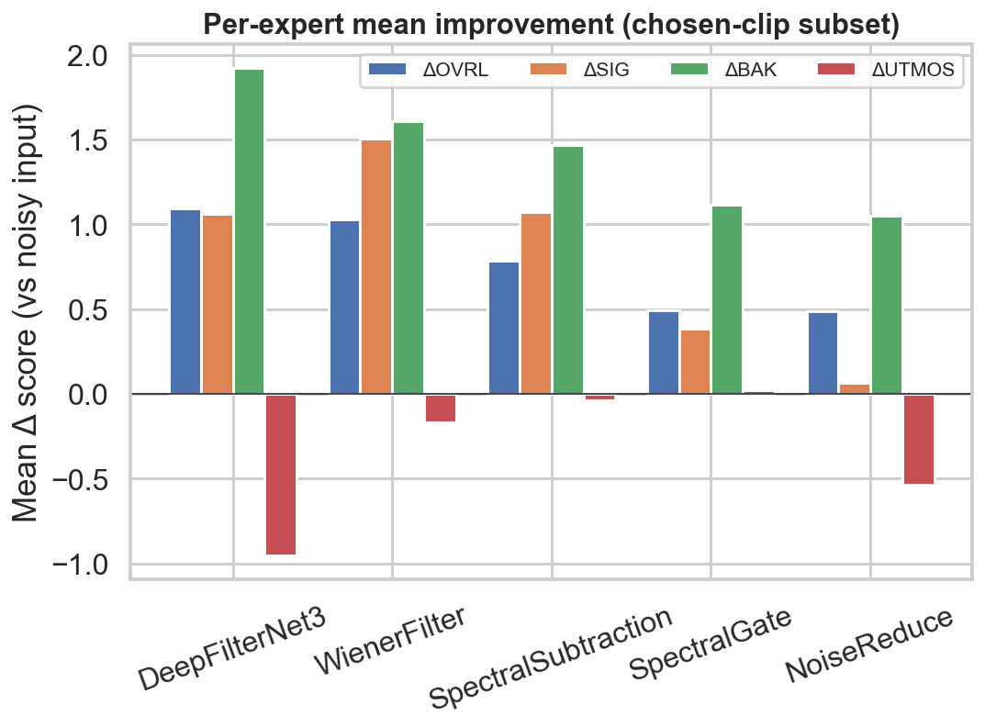
Results: expert leaderboard (mean deltas)

Slide 9
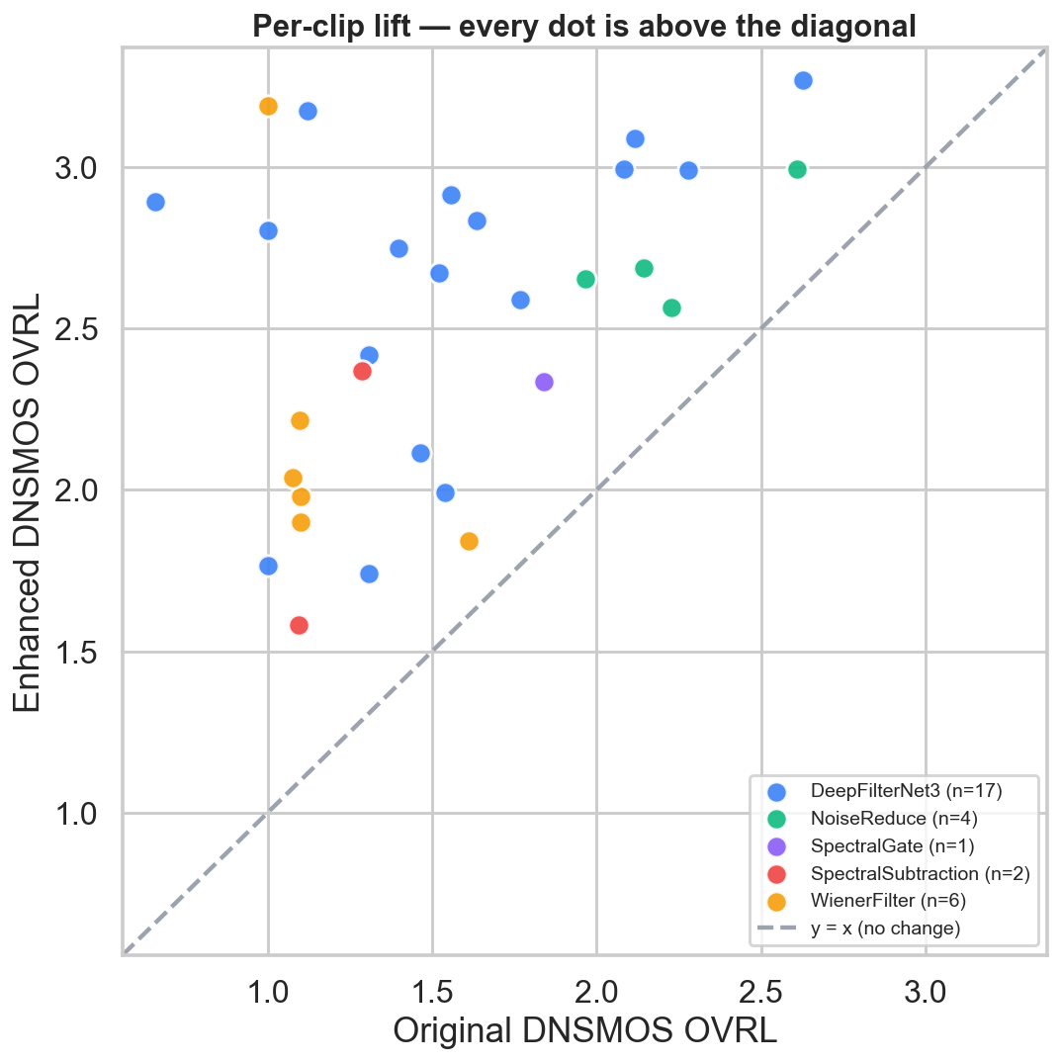
Results: noisy vs enhanced DNSMOS (OVRL)

Slide 10
Live demo
Windows: pwsh -File scripts/start_demo.ps1
Backend http://127.0.0.1:8001/health · Frontend http://127.0.0.1:5173
Upload .wav / .flac / .mp3 → Enhance Audio → scorecard, leaderboard, A/B audio
Batch eval: python scripts/eval_blind_batch.py --input-dir <noisy_folder> --resume

Slide 11
Notes for Q&A
UTMOS22 may fall back to heuristic if torch.hub conflicts with speechmos; router then uses DNSMOS-only blend (utmos_reliable=False).
SOTA comparison bars in plots are illustrative — cite papers/leaderboards for publication.
See README.md and DEMO.md for full architecture, API schema, and training pipeline.

