Slide 1

HOW TO INCREASE
Vending Machine
Revenue
Revenue
Growth
Analysis
Focused on Lever 1 & 3 — Activating Underperforming
Machines & Fixing Digital Payment Bottlenecks
Data Period: March – May 2020 | TP.HCM Operations | 177 Machines

Slide 2



Where We Are Today
1,137M VND
115,68K
9,829 VND
36.8%
Total Revenue
Total Transactions
Avg Revenue / Txn
Digital Rate
+44.4% May MoM
Avg 1,285/day
Revenue Logic Tree
# Machines
177
Location type
& geography
# Transactions
115,679
Total Revenue
1,137M VND
LEVER 1
LEVER 3
Txn / Machine
653 (3mo)
Payment
friction
Avg Rev / Txn
9829 VND
Product Mix
(SKU variety)
Price point
Medium/Big

Slide 3
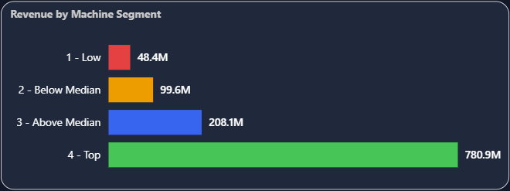

Lever 1 — Activate Underperforming Machines
58 machines running below 50% median → only 4.3% of revenue → potential +16% uplift
58
machines below 50% median
(< 198 txn / 3 months)
+186M
VND potential uplift
8.5 vs 52.1
avg unique SKUs
Low vs Top performers
Root Cause: Low performers average only 8.5 unique SKUs vs 52.1 for top machines. Fewer product options = fewer reasons to buy = lower transaction volume. The fix is operational, not locational: replenish and diversify SKUs before considering machine relocation.

Slide 4

Three Groups — Three Different Fixes
Diagnosis by location type reveals distinct root causes for each group
Group 1 — Schools (18 machines)
Group 2 — Familymart (15 machines)
Group 3 — Go Vap (4 machines)
Avg txn: 51/3 months
Avg txn: 58/3 months
Avg txn: 17/3 months ← critically low
Avg SKUs: 10.4
Avg SKUs: 8.7
Some machines: 4 unique SKU only
Avg price/txn: 9,513 VND (-4% vs avg)
Located in Quan 1 (highest competition)
Revenue: 700K VND / 3 months
Root Cause
Root Cause
Root Cause
Low transaction volume AND below-average ticket size. Product mix not suited to student needs — students prefer affordable snacks and drinks under 8,000 VND
Familymart already sells beverages — direct overlap. These machines face structural competition, not a product gap.
Only 4 SKU stocked = machine effectively empty. This is a stock-out / misconfiguration issue, not a location problem.
Actions
Actions
Actions
1. Add 5–10 low-price snack SKUs (< 8,000 VND) to all 18 machines
1. Traffic audit: measure foot traffic at each machine for 2 weeks
1. Immediate physical inspection within 48 hours
2. Prioritize afternoon restock (peak: 13h–16h for schools)
2. If traffic < 30 people/day → prepare relocation plan to KCN
2. Restock and configure with minimum 15 SKUs
3. Target: raise school low segment machines to median (397 txn)
3. If traffic adequate → differentiate with exclusive SKUs (not sold in Familymart)
3. If stock normal → investigate machine malfunction / QR display

Slide 5
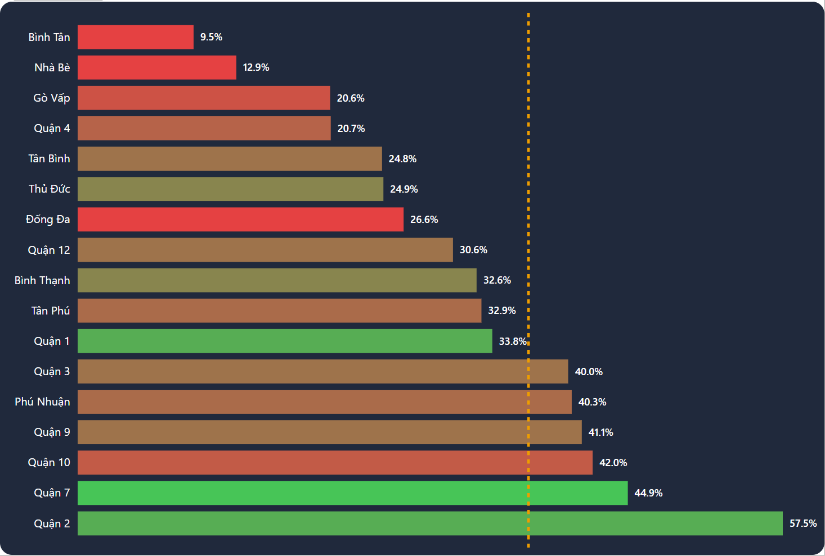
Lever 3 — Fix the Digital Payment Bottleneck
Digital transactions average 5.5% higher ticket value — but 63% of sales are still cash
Binh Tan digital rate
9.5 %
Lowest — yet highest rev/machine
Digital ticket premium
+5.5%
10,261 vs 9,701 VND avg
Potential uplift (Binh Tan)
~832K
Key Insight: Binh Tan has the highest revenue/machine (20.2M VND/month) but the lowest digital rate (9.5%). This is an infrastructure problem — not a customer preference. A QR/POS audit of the 3 Binh Tan machines is the single fastest action to unlock higher ticket values.
VND if raised to 40%+

Slide 6
Action Plan & Expected Impact
Prioritized by effort vs revenue uplift — Lever 1 and 3 only
NOW
Lever 1
Week 1–2
NOW
Lever 3
Week 1–2
Inspect & restock 4 Go Vap machines
QR/POS audit — 3 Binh Tan machines
Physical audit within 48h. Minimum 15 SKUs per machine. Resolve stock-out / misconfiguration.
Test all payment methods. Replace/repair broken terminals. Target digital rate: 40%+.
Expected uplift: From ~700K → ~15.7M VND (+15M uplift)
Expected uplift: +832K VND ticket premium
Q2
Lever 1
Month 2
Q2
Lever 1
Month 2
Add snack SKUs to 18 school machines
Traffic audit — 15 Familymart Q1 machines
5–10 affordable snack/drink SKUs (< 8,000 VND). Afternoon restock schedule. Measure txn lift after 4 weeks.
2-week foot traffic count. If < 30 people/day → prepare relocation proposal to KCN/Ben Tau sites.
Expected uplift: From ~8.7M → ~67.9M VND (+59M uplift)
Expected uplift: Potential: up to +17x rev/machine if relocated to KCN (pending traffic audit)

Slide 7
Impact Summary
Combined Lever 1 + 3 potential vs current baseline
Total current revenue
1,137M VND
Lever 1 — machine fix
+186M VND
Lever 3 — digital fix
+832K VND
Total potential
1,324M VND
Uplift %
+16%
Note: L1 uplift assumes all 58 low machines reach system median (397 txn). L3 uplift based on Binh Tan reaching average district digital rate (36.8%). Estimates based on 3-month data — validate after 4-week pilot.

