Slide 1
Photography Portfolio 2025

Slide 2




Nature Collection

Slide 3


Slide 4

Urban Architecture
Downtown skyline at golden hour

Slide 5
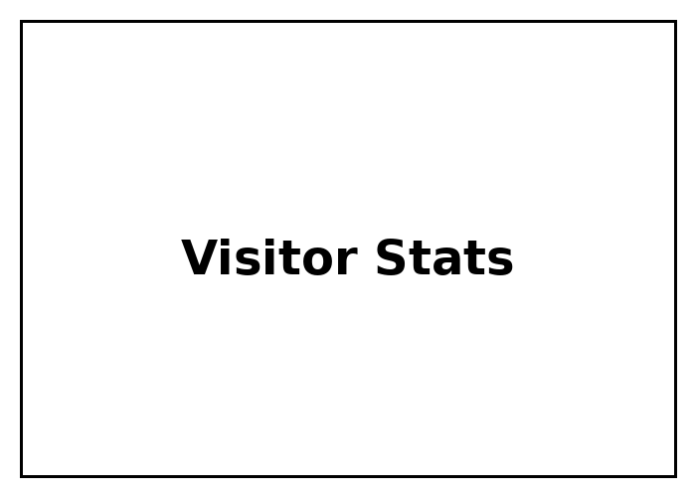
Exhibition Statistics

