Slide 1
Introduction to Machine Learning
CS 450 - Lecture 1

Slide 2
Learning Objectives
• Understand supervised vs unsupervised learning
• Implement linear regression
• Evaluate model performance
• Apply cross-validation techniques

Slide 3
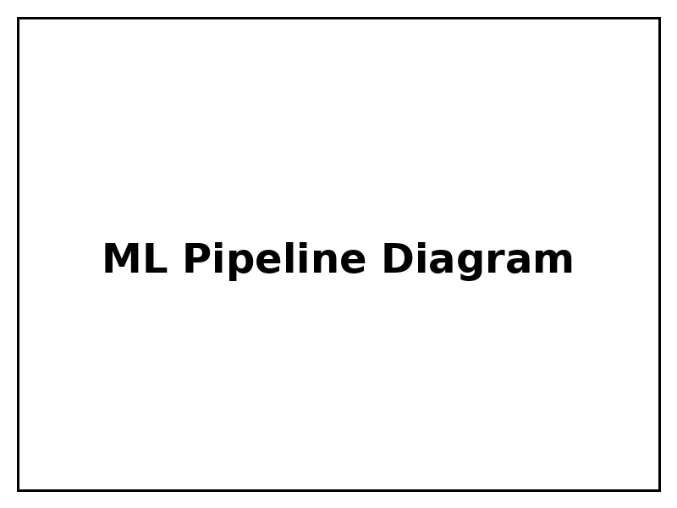
Supervised Learning Pipeline

Slide 4
Linear Regression Example
from sklearn.linear_model import LinearRegression
# Create and train model
model = LinearRegression()
model.fit(X_train, y_train)
# Make predictions
predictions = model.predict(X_test)

Slide 5
Key Takeaways
1. ML requires clean, labeled data
2. Always split data into train/test sets
3. Evaluate using appropriate metrics
4. Iterate and improve

