Slide 1

Slide with Decorative Background

Slide 2

Dashboard Analytics

Slide 3
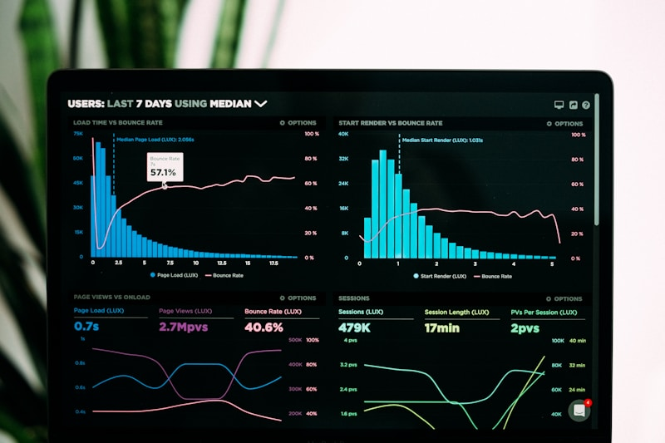
Performance Metrics

