Slide 1
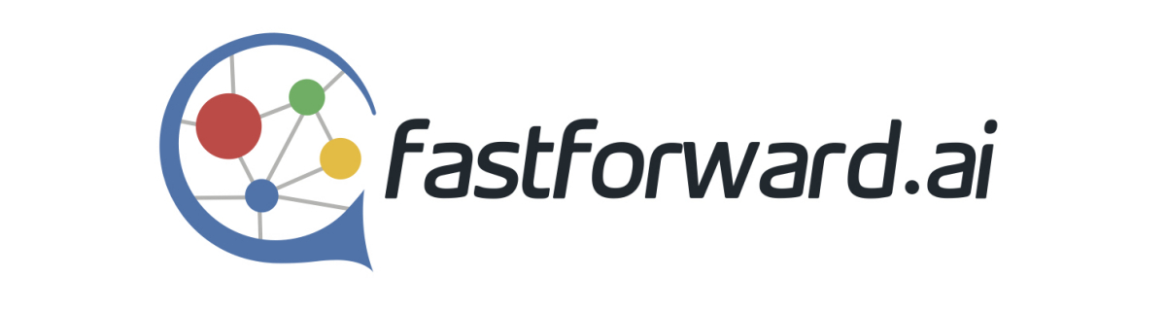
Alerts Handling Protocol

Slide 2
Introduction
We would like to have a clear boarder line for roles and responsibilities for Alerts handling
Teams involved are Cloud-OPS, Service Desk and Development team.
We have three different possibilities for alerts:
Physical VPN or Customer integration layer Alerts
FF service instances Alerts
Cloud Alerts

Slide 3
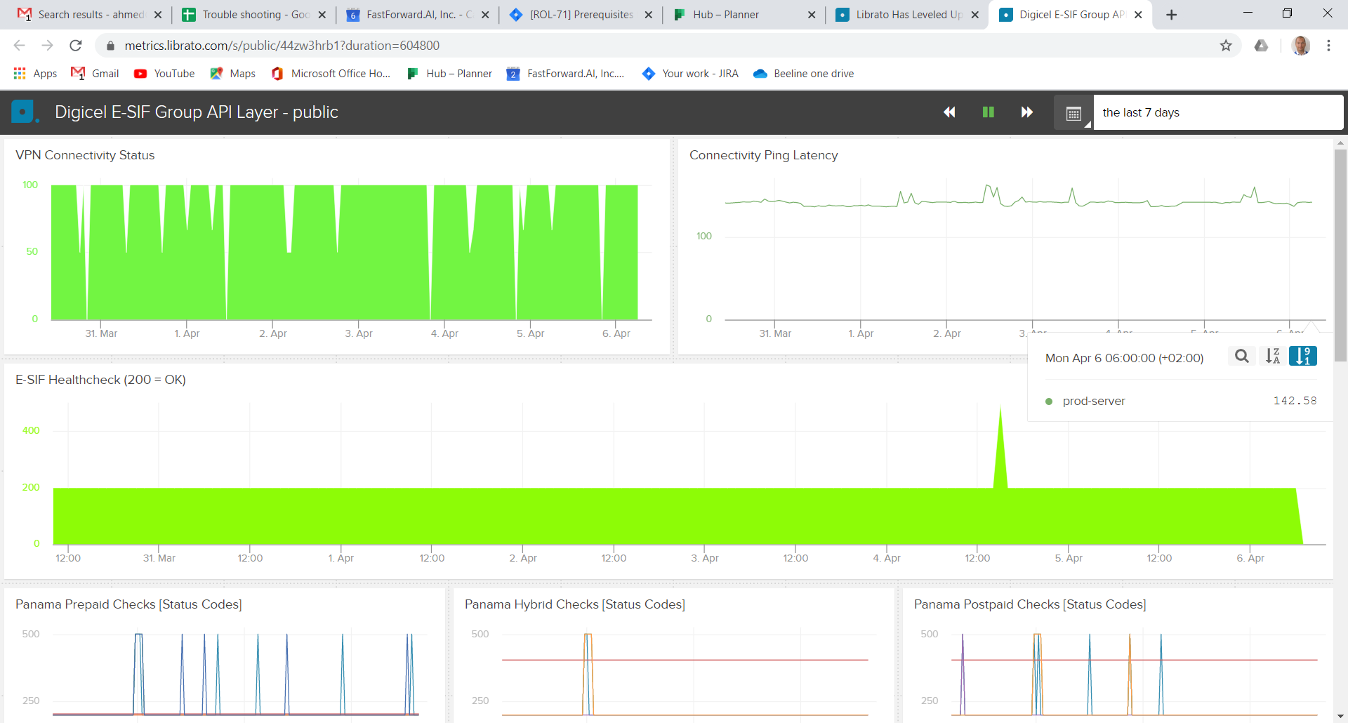

Part 1: Physical VPN and Customer integration layer Alerts
VPN : represents connectivity
CIL: represents the service
Alarms are generated by Librato

Slide 4
Responsibility Matrix and SLA
During work hours | 9AM - 5PM CET
Alert Type | Customer VPN is down
 | Customer API is down
System Action | Email sent automatic from Liberato to Cloud-Ops, Service Desk, Customer Contact
Trigger 1st Email | 5 min persistent outage
Frequency period | Every 45 minutes
Tier 1
who | DevOps
Action | investigate FF.ai infrastructure
time: | 30min from 1st alert
Tier 2
who | TAM
what action | follow-up with customer
time: | After 1st Feedback of Cloud-OPS
 | After problem solving To send report to customer (1 working day)
Post-incident | If incident stopped at Tier 1, Cloud-Ops logs reason
 | If incident stopped at Tier 2, Cloud-Ops logs reason
Outside work hours | 5PM - 9AM CET + Holidays
Alert Type | Customer VPN is down
 | Customer API is down
System Action | automatic to Cloud-Ops, Service Desk, Customer Contact
Trigger 1st Email | 5 min persistent outage
Frequency period | Every 3 Hours

Slide 5
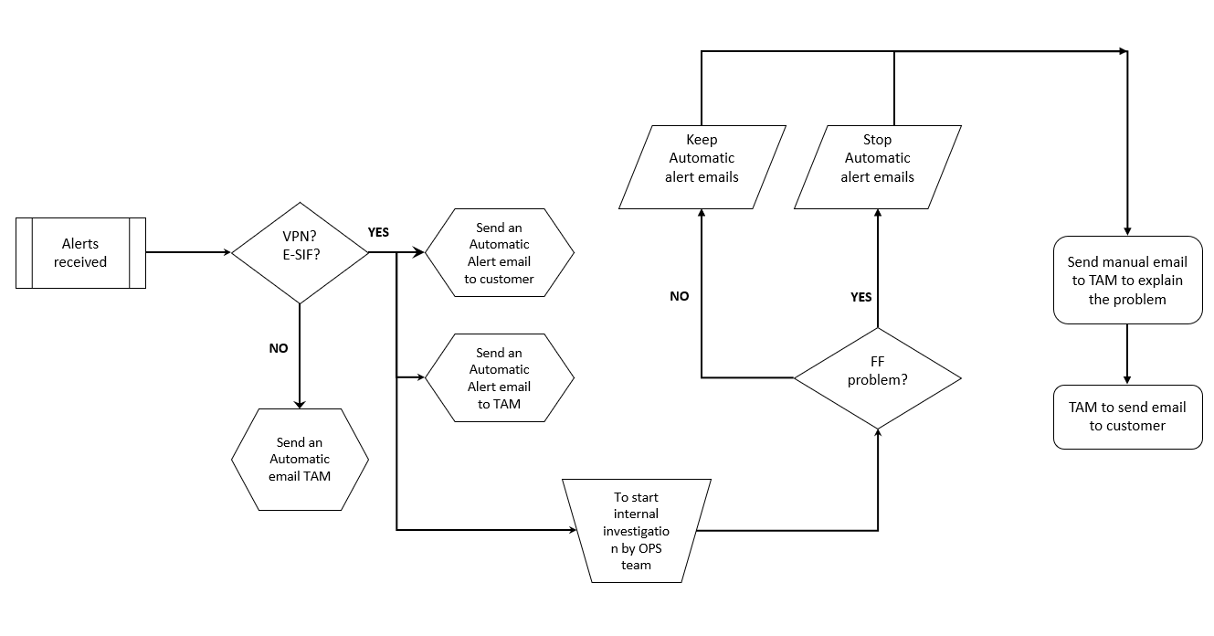
Process work-flow

Slide 6
Part 2: FF.ai Service Instances Alerts

Slide 7
Part 3: Cloud Alerts

Slide 8
Backup

Slide 9
Keep Automatic alert emails
Stop Automatic alert emails
VPN?
E-SIF?
Send an Automatic Alert email to customer
Alerts received
YES
Send manual email to TAM to explain the problem
NO
YES
NO
Send an Automatic Alert email to TAM
FF problem?
TAM to send email to customer
Send an Automatic email TAM
To start internal investigation by OPS team

