Slide 1
POLARIS-X / POLARIMETRIC STRESS IMAGING
From mechanical stress to polarized-light images
Objective
Predict the optical response around a circular hole and explore where stress differences can be recovered from synthetic images.
Mechanical loading
→
Stress field
→
Optical retardation
→
Synthetic images
→
Constrained inverse
• Mechanics: analytical and finite-element models provide stress differences and principal-axis orientations.
• Optics: the stress-optic law and Jones model predict wavelength- and analyzer-dependent intensity.
• Inverse: recover stress differences only where measurements are informative, with explicit uncertainty.
Synthetic simulation • Illustrative material parameters • Experimental calibration required
01
Notes:
Introduce the complete workflow before showing Figures 1–4. These are synthetic, numerically checked simulations with illustrative material parameters. They are not experimental measurements. Figure 1 isolates analyzer rotation, Figure 2 shows mechanics, Figure 3 connects mechanics to optics, and Figure 4 illustrates constrained reconstruction.

Slide 2
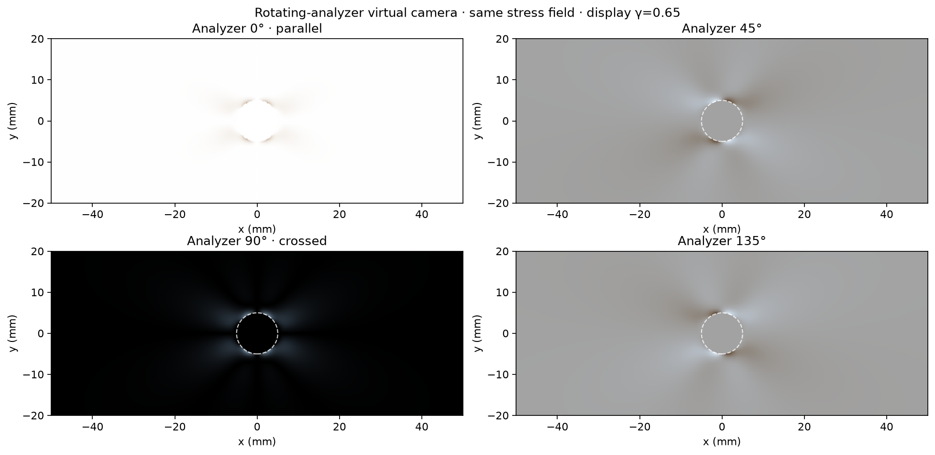
POLARIS-X / POLARIMETRIC STRESS IMAGING
Image 1 — Effect of analyzer rotation
• Same Kirsch field at nominal 1000 N, viewed at analyzer angles of 0°, 45°, 90° and 135°.
• Parallel polarizers give a bright background; crossed polarizers reveal localized optical contrast.
• Image brightness depends on optical orientation and retardation, as well as the display gamma.
Synthetic simulation • Illustrative material parameters • Experimental calibration required
02
Notes:
The load is unchanged across these panels. The analyzer selects different components of the emerging polarized light. The ideal clear hole is bright at 0 degrees and dark at 90 degrees. Brightness is not a direct stress scale.

Slide 3
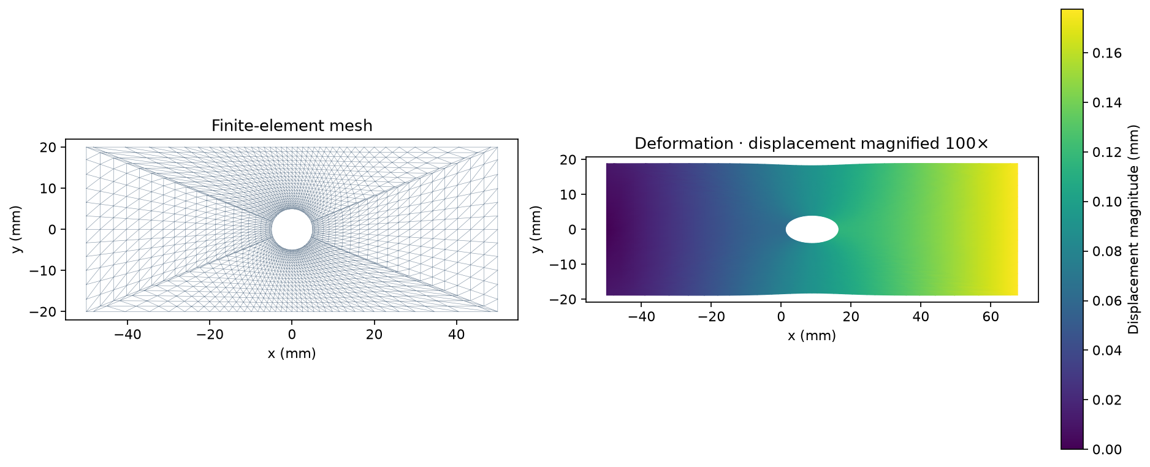
POLARIS-X / POLARIMETRIC STRESS IMAGING
Image 2 — Finite-element mesh and deformation
• Finite plate at 1000 N: triangular elements are refined near the hole.
• The deformed shape is magnified 100× to make small displacements visible.
• The color scale gives actual displacement magnitude in mm; its values are not magnified.
Synthetic simulation • Illustrative material parameters • Experimental calibration required
03
Notes:
This example has a left roller grip and uniform tensile loading on the right edge. The solver assumes linear elasticity and plane stress. Displacement and stress are different quantities. The displayed shape is exaggerated.

Slide 4
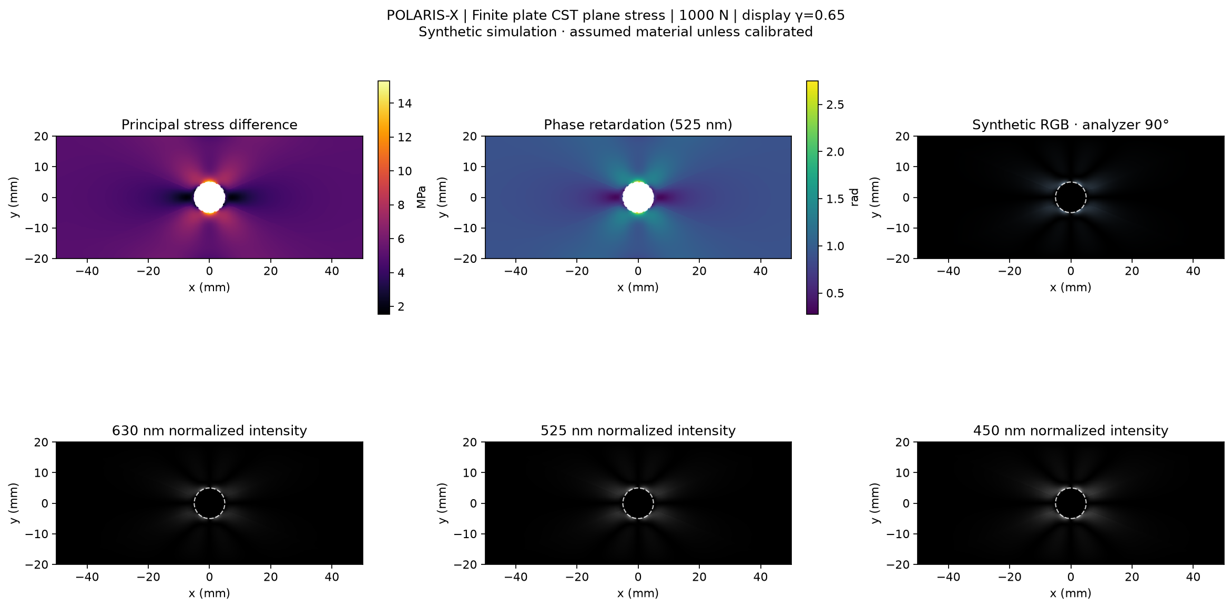
POLARIS-X / POLARIMETRIC STRESS IMAGING
Image 3 — Finite-plate stress-to-light simulation
• Finite plate at 1000 N: principal stress difference is elevated near the hole boundary.
• The stress-optic law converts stress difference to retardation; Jones optics predicts the intensity.
• Synthetic RGB combines 630, 525 and 450 nm channels, shown separately below.
Synthetic simulation • Illustrative material parameters • Experimental calibration required
04
Notes:
The top-left map is principal stress difference in MPa, not an individual stress component. The top-middle map shows phase retardation at 525 nm. The analyzer is crossed at 90 degrees. Intensity also depends on the principal-axis orientation, so the brightest pixels need not have the largest stress. The coefficient is assumed unless measured.

Slide 5
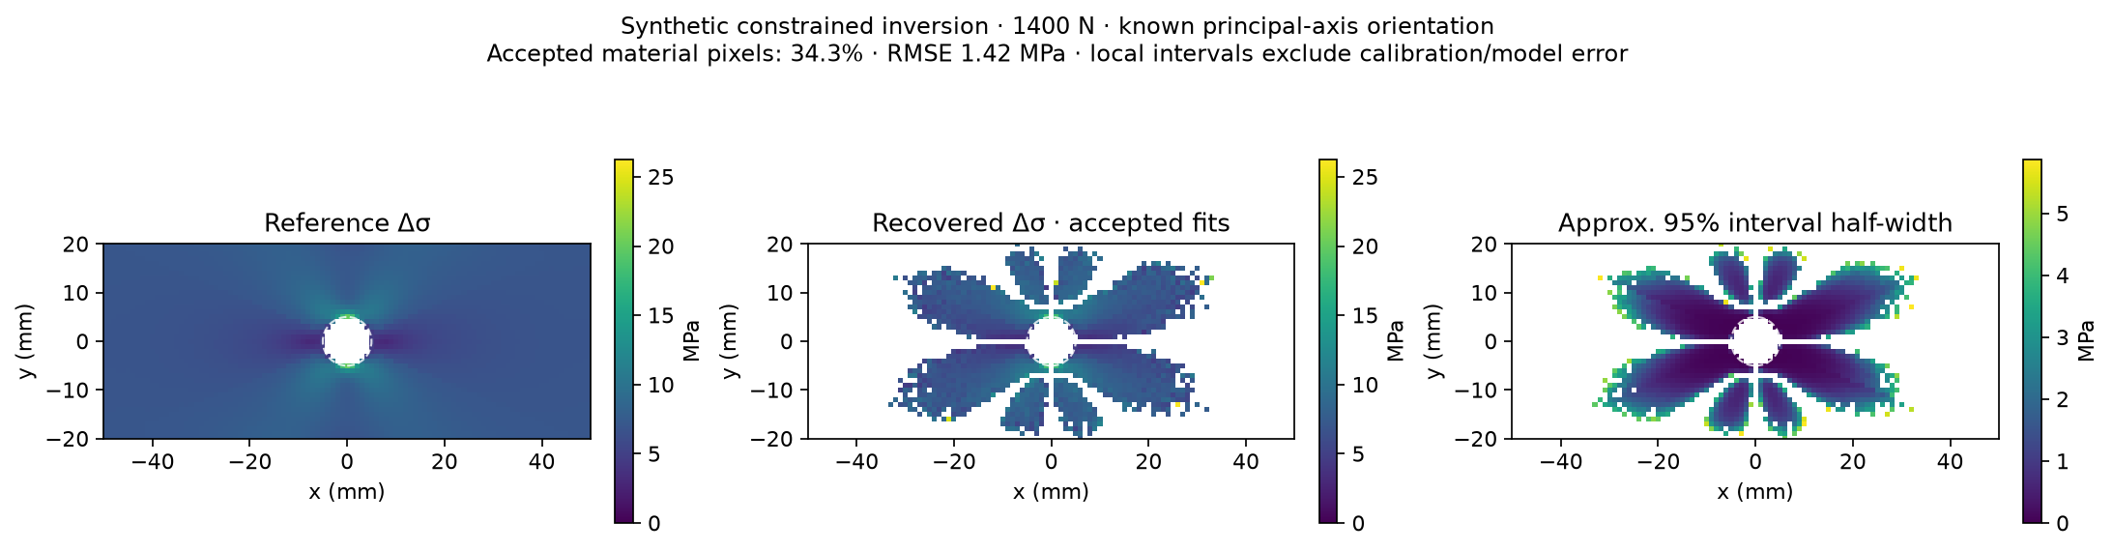
POLARIS-X / POLARIMETRIC STRESS IMAGING
Image 4 — Constrained reconstruction at 1400 N
• Known orientation is supplied; 34.3% of material pixels pass the acceptance checks.
• RMSE: 1.42 MPa; maximum error: 19.31 MPa. Acceptance does not guarantee correctness.
• Blank regions are unresolved or outside material. Local intervals exclude model/calibration error.
Synthetic simulation • Illustrative material parameters • Experimental calibration required
05
Notes:
Reconstruction is conditional on known principal-axis orientation, thickness and optical coefficient. This separate 1400 N case is not the same load as Figures 1–3. It estimates stress difference, not the full tensor. 1395 of 4072 material pixels are accepted. Median absolute error is 0.294 MPa, RMSE 1.421 MPa, and six accepted pixels exceed 5 MPa error; the largest error is 19.309 MPa due to an incorrect fringe branch. The shared map color scale now includes these outliers. Local approximate 95% interval coverage is 95.84% in this one synthetic realization; this does not establish experimental calibration. Full details: docs/FIGURE_AUDIT.md.

