Slide 1
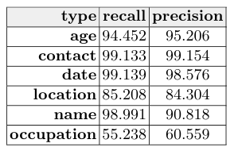




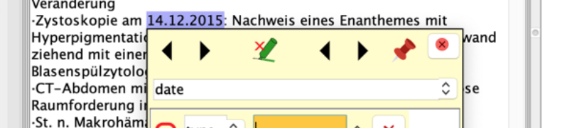
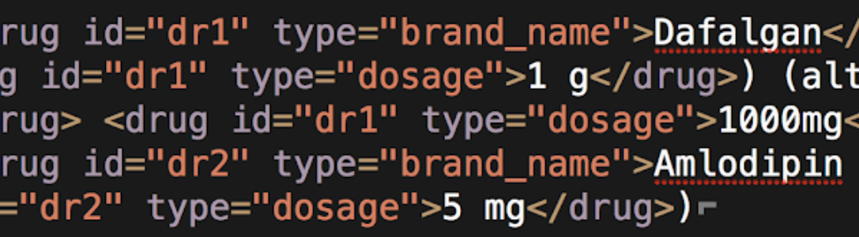


Automated ADE detection from electronic medical records using NLP
Data Extraction
Anonymization (per category)
SwissMADE is the first Swiss project to use electronic patient records. We employed the dictionary-based entity recognizer OGER to extract drug and diagnose mentions.
Reports from patients who received antithrombotic drugs during hospital stay in one of the four hospitals below longer than 24 hours, aged 65 and older, between 2015 and 2016.
The paper describes the processing of 18 000 reports extracted from the University Hospital of Zurich (USZ).
Automatic Annotation
Manual Annotation
From structured patient data, dictionaries are generated of of drug and diagnose variations. These dictionaries are used by OGER to automatically annotate free text data.
400 reports are automatically annotated by the Kantonsspital Baden (KSB) using the GATE annotation tool and a schema developed by all four hospitals together.
This data set will serve as an evaluation for our pipeline.
nicola.colic@uzh.ch, Beeler, Csajka, Foufi, Gaspar, Le Pogam, Lisibach, Lovis, Lutters, Rinaldi
check the QR code for the full paper and full list of associations

