Slide 1
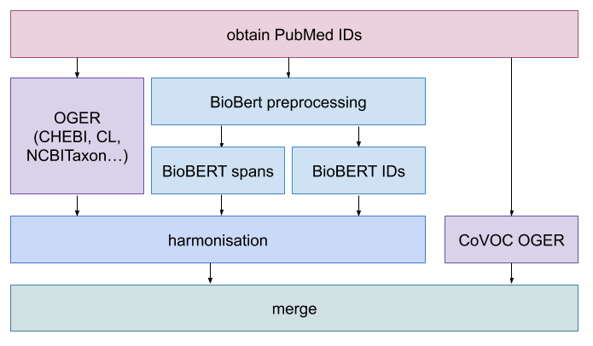
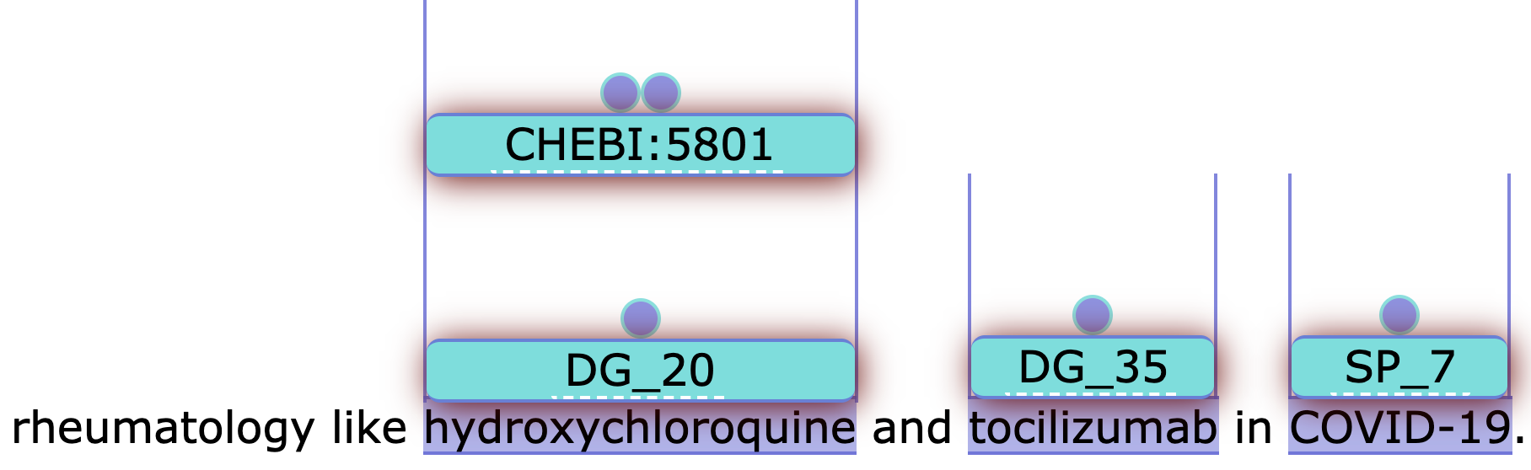
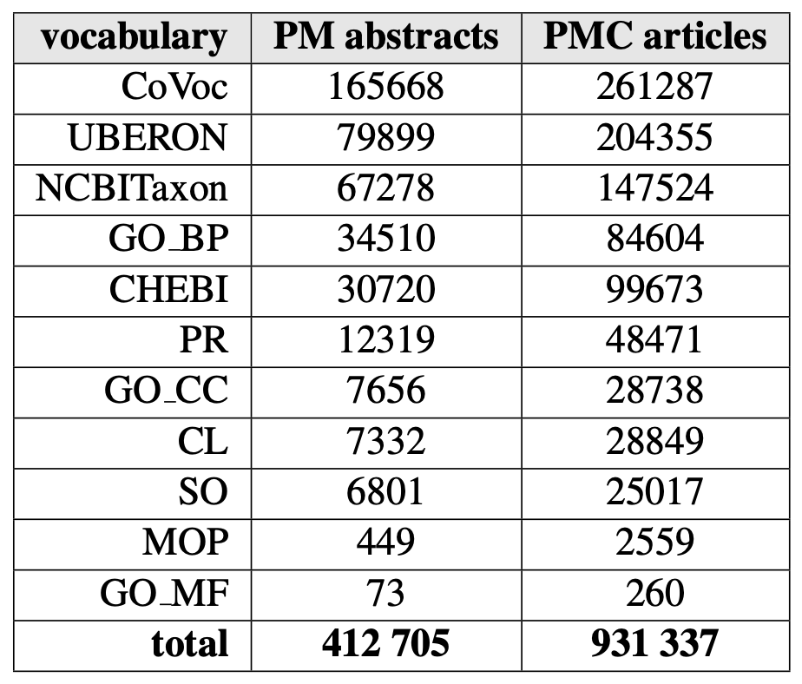

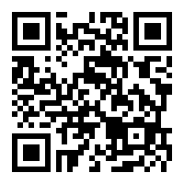
Annotating the Pandemic: NER and NEN of LitCovid
Entity recognition and normalization on COVID-19 literature using a CRAFT-trained BioBERT model for its precision and our dictionary-based tool for its recall.
Pipeline output is uploaded to PubAnnotation, for example, where it is visualized via TextAE. We're also uploading our results to EuroPMC, our own webserver using BRAT, and allowing downloads in JSON and CoNLL TSV for downstream tasks.
Annotations
per entity type
for PubMed
(abstracts) and
PubMed Central
(full articles)
LitCovid is a dataset of 20 000 PubMed articles related to COVID-19. We are using our pipeline, which performed with F1-score of 0.74 and 0.92 on the CRAFT corpus, depending on entity type (chemical, disease...). Output of models (BioBERT and OGER, our dictionary-based tool) was merged according to different strategies determined most effective in previous work depending on the entity type. The BioBert models produce either ID or span annotations. In the latter case, the ID of the entity was supplied by OGER. This approach helps to optimize both recall and precision. Then, another run of OGER with a hand-crafted dictionary for terms specific to COVID-19, allowing us to make quick changes without retraining models.
All the data can be found online at pub.cl.uzh.ch/projects/COVID19/
BioMeXT
www.biomext.org
paper on OpenReview:

