Slide 1
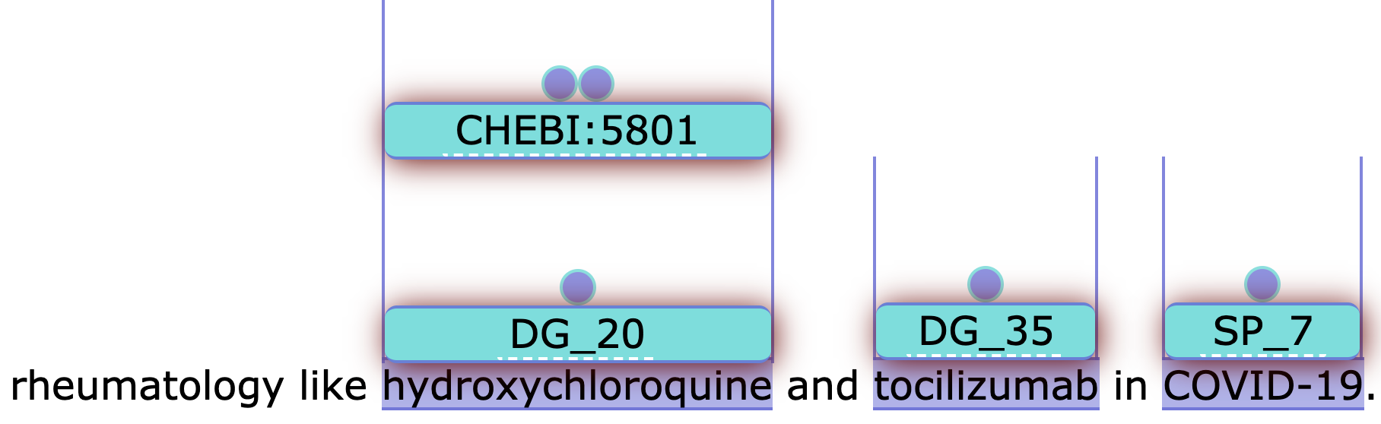
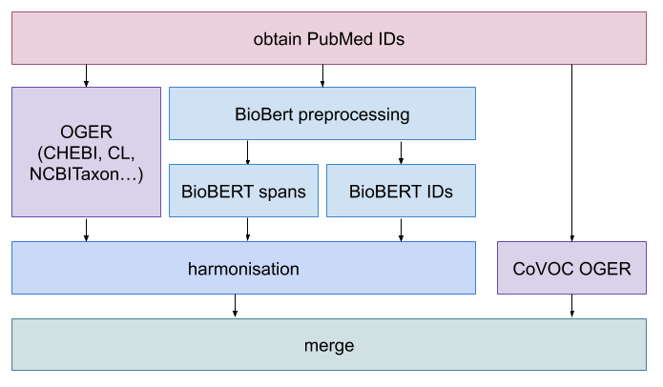
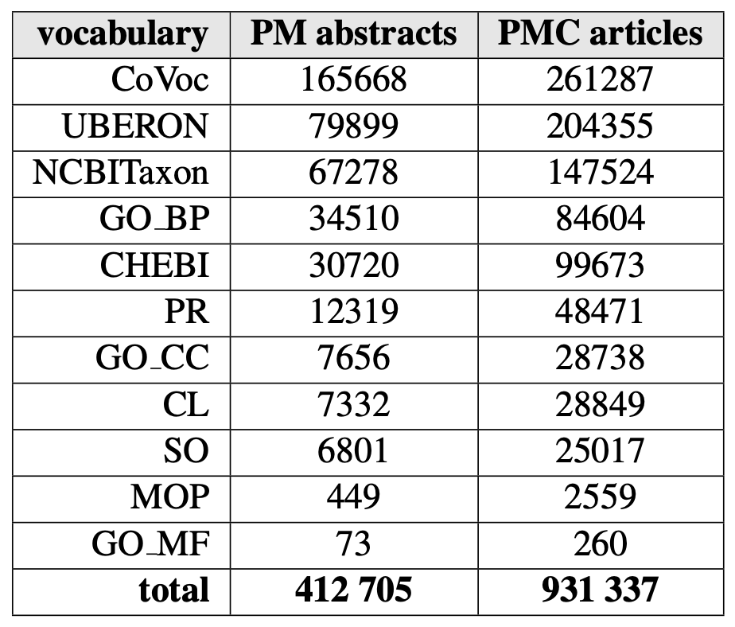
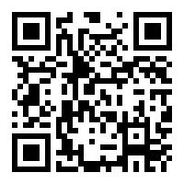




Annotating the Pandemic: NER and NEN of LitCovid
Entity recognition and normalization on COVID-19 literature using a CRAFT-trained BioBERT model for precision and our dictionary-based tool for recall and entity identifiers.
The output of our pipeline is uploaded to PubAnnotation, for example, where it is visualized via TextAE. We're also uploading our results to EuroPMC, our own webserver using BRAT, and allowing downloads in JSON and CoNLL TSV for downstream tasks.
LitCovid is a dataset of PubMed articles related to COVID-19. We use our pipeline, which performs with a F1-score of 0.74 - 0.92 on CRAFT, depending on entity type (chemical, disease...). Our pipeline merges the output of different models (BioBERT and OGER, our dictionary-based tool) according to the strategy determined most effective in previous work for the respective entity type. The BioBert models produce either ID or span annotations. In the latter case, the ID of the entity was supplied by OGER. This approach helps to optimize both recall and precision. Then, another run of OGER with a hand-crafted dictionary for terms specific to COVID-19, allowing us to make quick changes without retraining the models.
All the data can be found online at covid19.nlp.idsia.ch/lbd.html
Annotations per entity type for PubMed (20k abstracts) and PMC (5k full articles)
§§
BioMeXT
www.biomext.org
Furrer@cl.uzh.ch
Fabio.Rinaldi@idsia.ch
Colic@ifi.uzh.ch

