Slide 1
Risk Management
Anjal Thapa

Slide 2
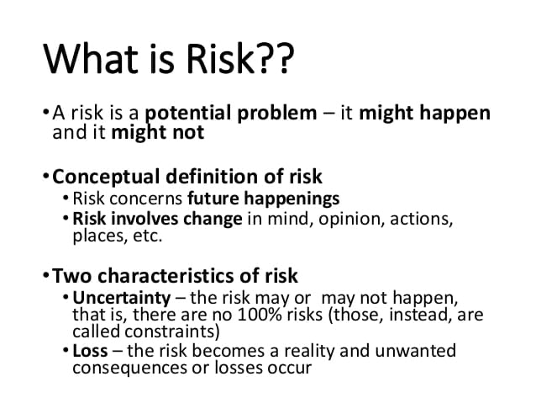

Software Project Management

Slide 3
Nature of Project Risks
Planning assumptions
Estimation errors
Eventualities
Software Project Management
Notes:
During the project evaluation (feasibility study), we have some estimations (e.g. size or time), which are based on some assumptions.
Based on these estimations and assumptions, we decide whether to continue the project or not.
Thus, anything that goes wrong with the estimations and assumptions are potential threats to the project.

Slide 4
Planning Assumptions
Common assumption:
  “Everything will go smoothly”
    Environment is reliable and fixed
    Design will be perfect first time
    Coding will be ‘nearly perfect’
Software Project Management

Slide 5
Planning Assumptions (cont’d)
Guidelines
  List all the assumptions
  Identify the effects of these assumptions on the project if they are no longer valid
Software Project Management

Slide 6
Estimation Errors
Difficult to have accurate size or time estimations
  Lack of experience of similar tasks
  Lack of historical data
  Nature of the task
Software Project Management
Notes:
These three factors (experience, history, nature) are interrelated.
For example, if we are to document the user manuals and we have done this for a similar system, the estimation will be accurate to some extent.
However, if we are to test and debug the system, it is then difficult to have a good estimate even if we have tested and debugged a similar system before.

Slide 7
Eventualities
Unexpected and unimaginable events
Common unexpected events
  Hardware cannot be delivered on time
  Requirements specification needs to be rewritten
  Staffing problem
Software Project Management
Notes:
Point out in real life that unexpected events always occur

Slide 8
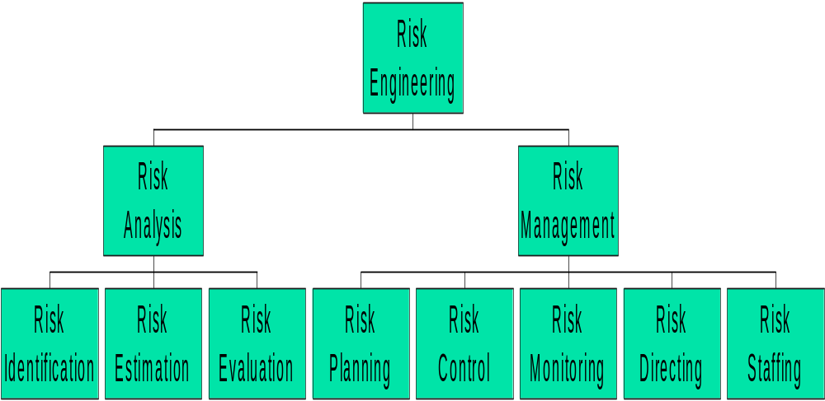
Boehm’s Risk Engineering
Software Project Management
Notes:
In Boehm’s Tutorial on Software Risk Management, IEEE Computer Society, 1989
There are many different models, but they are very similar.
A task breakdown structure for Boehm’s risk engineering is introduced here.

Slide 9
Risk Identification
Identify the hazards that might affect the duration or resource costs of the project
Hazard → Problem → Risk
A hazard is an event that might occur and will create a problem for the successful completion of the project, if it does occur
Software Project Management
Notes:
Examples of hazard: a team member is ill; late delivery of a hardware component; system down

Slide 10
Hazard, Problem, and Risk
Hazard: Mary’s baby may be born early
Problem: Modules P and Q will have no coder
Risk: Milestone 7 will be delayed, or extra budget will be needed to hire another coder
Software Project Management

Slide 11
Risk Identification (cont’d)
Type of risks
  Generic risk (common to all projects)
    Standard checklist can be modified based on the risk analysis of previous projects
  Specific risk (only applies to individual projects)
    More difficult to find
    Need to involve project team members
    Need an environment that encourages risk assessment
Software Project Management
Notes:
Generic risks are those risks relevant to all software projects.
Examples are misunderstanding of the requirements and key staff being ill.
Specific risks are those risks relevant to an individual project only.
Team members of the project are the frontline of identifying these potential risks.
Need to set up an encouraging risk-identification environment so that team members are willing to share their findings.
“Assuming that the problems will not occur does not prevent their occurrence.”

Slide 12
Common Risk Factors
Application factors
Staff factors
Project factors
Hardware and software factors
Changeover factors
Supplier factors
Environment factors
Health and safety factors
Software Project Management
Notes:
Boehm’s Top Ten Risk Items
Personnel shortfalls
Unrealistic schedules and budgets
Developing the wrong software functions
Developing the wrong user interface
Gold Plating
Continuing stream of requirements changes
Shortfalls in externally performed tasks
Shortfalls in externally furnished components
Real-time performance shortfalls
Straining computer science capabilities

Slide 13
Application Factors
Nature of the application
  A data processing application or a life-critical system (e.g. X-ray emission system)
Expected size of the application
  The larger is the size, the higher is the chance of errors, communication problems and management problems
Software Project Management
Notes:
Nature of the application:
It is a critical factor to the success of the project.
Expected size of application:
The larger is the size, the higher is the chance of errors, communication and management problems.

Slide 14
Staff Factors
Experience and skills
Appropriateness of experience
Staff satisfaction
Staff turn-over rates
Software Project Management
Notes:
Experience and skills:
Experienced programmers are less likely to make errors.
Appropriateness of Experience:
Experience in structural design (using JSD) may not be related to OOD in UML.
Experience in coding COBOL may not be related to coding in C++ or Java.
Staff satisfaction:
Dissatisfied or Unmotivated staff may cause a project to fail.
Staff turn-over rate:
Key personnel leaving unexpectedly would cause a project to fail.
High turn-over rate would cause much communication overhead and may delay a project.

Slide 15
Project Factors
Project objectives:
  Ill defined
  Unclear to every team member and user
Project methods:
  Ill specified methods
  Unstructured methods
Software Project Management

Slide 16
Hardware and Software Factors
New hardware
  Stability of the new hardware system
Cross platform development
  Development platform is not the operation platform
  Does the language used support cross platform development?
Software Project Management
Notes:
New hardware:
Usually, new hardware systems are not so stable at their early stage.
Cross platform development:
Platform Issue:
Normally, the development platform and the operation platform are not exactly the same.
Adjustment is needed to cater for the operation platform. This leads to extra time and effort.
Problems may only occur in the operation platform.
Language Issue:
Availability of languages in the development platform as well as the operation platform
High portability languages should be used such as C, C++, and Java.
This also relates to the skills of the staff.
Integration issues of different development off-the-shelf components such as VB, ODBC, Java, and JDBC.

Slide 17
Changeover Factors
‘All-in-one’ changeover
  The new system is put into operation
Incremental or gradual changeover
  Adding new components to the system by phases
Parallel changeover
  Both the existing system and the new system are used in parallel
Software Project Management
Notes:
All-in-one: Too risky. It minimizes operation costs if everything is OK.
Incremental: Minimizes the risk involved.
However, it is not always practical because it involves too many issues such as
the order of integration of the components,
the scheduling of the components,
the interface between the replaced components and the replacing components, and
training of operation personnel.
Parallel: A safety net, no risk at all during the parallel phases. Too costly. Sometimes, it is impossible.

Slide 18
Supplier Factors
Late delivery of hardware
Instability of hardware
Late completion of building sites
Software Project Management

Slide 19
Environment Factors
Changes in environment such as hardware platforms
Changes in government policies
Changes in business rules
Restructuring of organizations
Software Project Management

Slide 20
Health and Safety Factors
Health and safety of staff and environment
  Staff sickness, death, pregnancy etc.
  Any tragic accident to staff
Software Project Management

Slide 21
Risk Estimation
Recall that
Hazard → Problem → Risk
Risk estimation is to assess the likelihood and impact of each hazard
Risk exposure (risk value)
  It is the importance of the risk
Risk exposure = risk likelihood × risk impact
Software Project Management

Slide 22
Risk Estimation (cont’d)
Advantages
  The only way to compare or rank the risks
  To have a good quantitative estimate, the extra effort can provide a better understanding of the problem
Disadvantages
  Estimation is difficult, subjective, time-consuming and costly
Software Project Management

Slide 23
Risk Evaluation
Ranking the risks
Determining the corresponding risk reduction strategies
Software Project Management
Notes:
Ranking only shows the order of importance of the risks not their relative sizes.

Slide 24
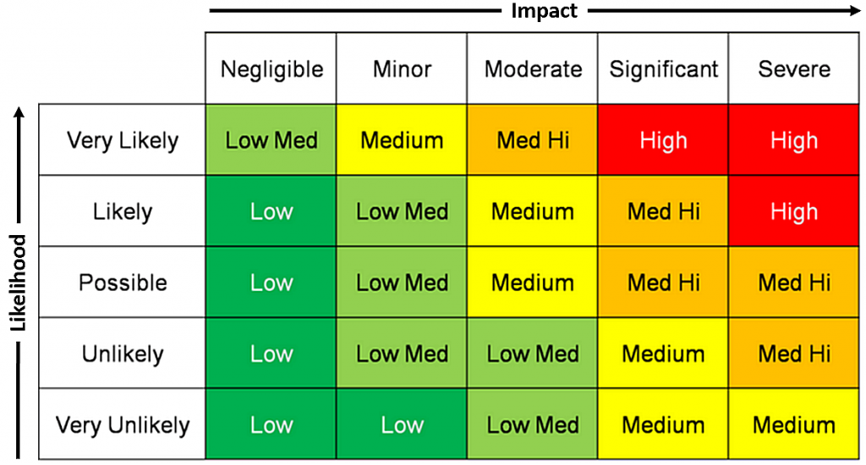
Metrix
Software Project Management

Slide 25
Ranking Risks
Ranking the risks based on their risk exposures
Ranking shows the order of importance
In practice, also consider factors like
  Confidence of the risk assessment
  Compound risk
  The number of risks
  Cost of action
Software Project Management
Notes:
Other factors:
Confidence: need to re-assess those risks that we have low confident in more detail
Compound: combine risks that depend on each other to form a single risk
Number: limit the size of the priority list
Cost:
Risk with low fixing costs can be incorporated into the project.
Risk with high fixing costs should be considered whether the cost of action will outweigh the benefits of reducing the risk.

Slide 26
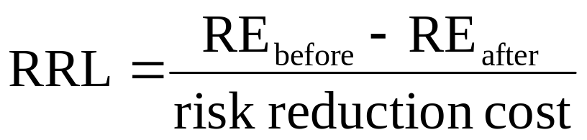
Risk Reduction Leverage (RRL)
RRL is used to determine whether it is worthwhile to carry out the risk reduction plan.
The higher is the RRL value, the more worthwhile is to carry out the risk reduction plan.
Software Project Management
Notes:
RE stands for Risk Exposure.
Guidelines:
If RRL > 1, there is a gain from enacting the plan. Go ahead.

Slide 27
Risk Management
Risk planning
Risk control
Risk monitoring
Risk directing
Risk staffing
Software Project Management

Slide 28
Risk Planning
Making contingency plans
Where appropriate, adding these plans into the project’s overall task structure
Software Project Management

Slide 29
Risk Control
Minimizing and reacting to problems arising from risks throughout the project
Software Project Management

Slide 30
Risk Monitoring
It is an ongoing activity throughout the whole project to monitor
  the likelihood of a hazard; and
  the impact of the problem caused.
Software Project Management

Slide 31
Risk Directing and Staffing
These concerns with the day-to-day management of risk.
Risk aversion strategies and problem solving strategies frequently involve the use of additional staff and this must be planned for and should be considered.
Software Project Management

Slide 32
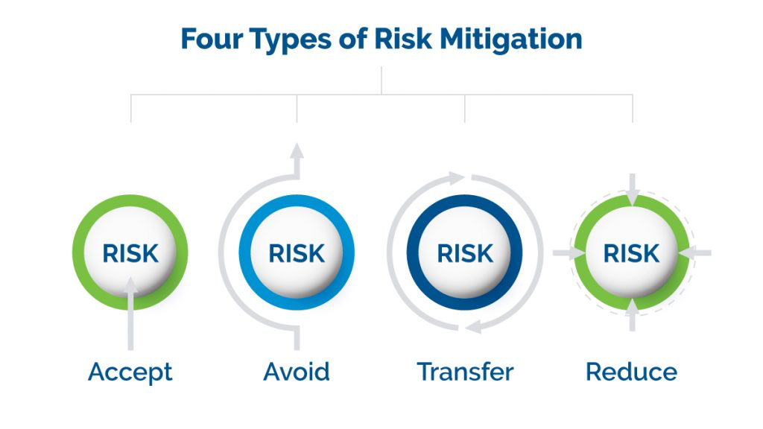
Risk Mitigation Strategies
Software Project Management

Slide 33
Risk Acceptance and Sharing
This technique involves accepting the risk and collaborating with others in order to share responsibility for risky activities.
Many organizations working on international projects will reduce the political, legal, and employment risks associated with international projects by developing a joint venture with a company based in a particular country,
Software Project Management

Slide 34
Risk Avoid
This technique usually involves developing an alternative strategy that is more likely to succeed, but is usually linked to a higher cost.
A very common risk elimination technique is to use proven and existing technologies rather than adopting new technologies, although they could lead to better performance or lower costs.
Software Project Management

Slide 35
Risk transfer
Risk transfer is a risk reduction method that shifts risk from the project to another party.
A classic example of risk transfer is the purchase of an insurance. The risk is transferred from the project to the insurance company.
Software Project Management

Slide 36
Risk Reduce and Mitigation
Risk mitigation represents an investment in order to reduce the risk on a project.
On international projects, for example, companies will often buy a guaranteed exchange rate in order to reduce the risk associated with exchange rate fluctuations.
Software Project Management

Slide 37
Contingency Plan
Contingency means something that could happen or come up depending on other occurrences. An example of a contingency is the unexpected need for a bandage on a hike. The definition of a contingency is something that depends on something else in order to happen.
Software Project Management

