Slide 1
Network Coding for
Multi-Resolution Multicast
March 17, 2010
MinJi Kim, Daniel Lucani, Xiaomeng (Shirley) Shi, Fang Zhao, Muriel Médard
Research Laboratory of Electronics
Massachusetts Institute of Technology

Slide 2
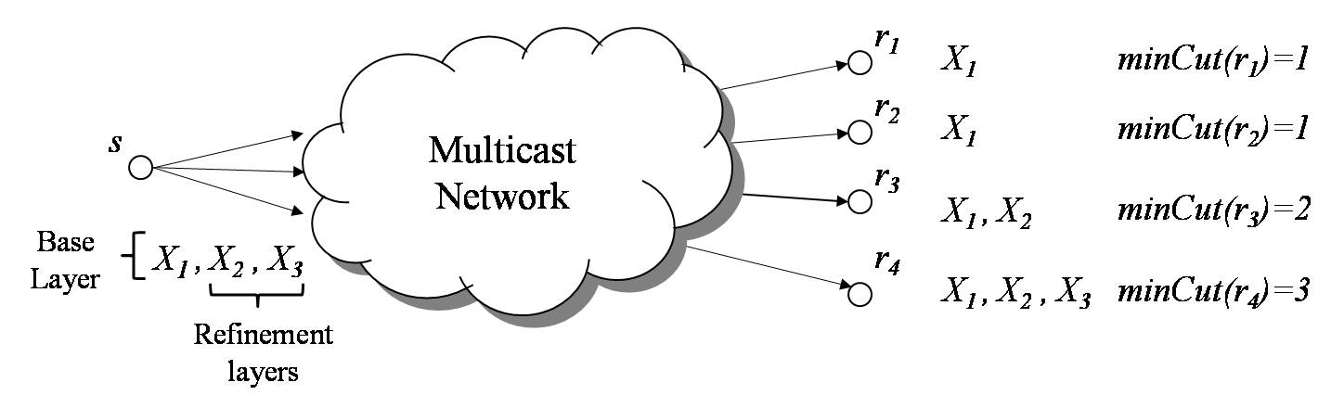
Multi-Resolution Multicast
Applications: teleconferencing, video-streaming
Challenges:
  Heterogeneous receivers, different rates
  Maximize rate & guarantee decodability
Directed acyclic graph, unit capacity links G=(V,E)
Max rate if no other receivers existed
Goal: design a distributed algorithm to maximize the total rate, with the reception of base layer guaranteed.

Slide 3
Background: Network Coding
Network coding: mixing of data at intermediate nodes
  Throughput gains [Ho et al. ‘03]
  Robust against erasures
    with knowledge [Lun et al. ’04]
    without knowledge [Dana et al. ’06]
  Achieves max-flow in multicast setting [Ahlswede et al. ’00]
  Intra-layer: only mix data from the same layer
  Inter-layer: mix data across layer as well as within
Routing solution: Requires multiple calls to Steiner Tree problem (NP-Hard)
s
p₁
X₃
p₂
X₂
p₁
p₂
p₁ + p₂
X₁
q₁
p₁ + q₁
p₁ + p₂+ q₁
r₁
r₂
r₃
1
3
1

Slide 4
Background: Multi-rate Multicast
Multi-rate multicast with network coding
  [Koetter et al. ’03] Two-level multicast
    Min-cut Max flow holds
  [Sundaram et al. ‘05][Zhao et al ‘06][Xu et al. ‘07][Silva et al. ‘07] [Walsh et al. ‘08][Wu et al. ‘08]
    Each layer treated as different flow (intra-layer)
    Centralized
  [Dumitrescu et al. ‘09] Inter-layer coding scheme but needs poly # calls to IP solver.
Multicast Network
s
Want all layers
Want a subset of layers

Slide 5
Overview of Pushback Algorithm
Use benefit of mixing data while ensuring decodability
Distributed, message passing approach
  Pushback stage: requests sent bottom up
  Code assignment stage: code distributed top down
Random linear network coding
  Distributed
  Both inter-layer and intra-layer coding
  May require decoding at intermediate nodes
  Field F_{q} (small field sizes, ~2¹⁰ sufficient)
Guarantees decodability of base layer
Outperforms routing as well as previous coding schemes (intra-layer)

Slide 6
Pushback: Request q(v)
Request q(v): “I want packets coded across layers 1 to at most q(v)”
Min-req Criterion
Min-cut Criterion
q(v)
q(v)
q(v)
3
q(v)
2
3
2
minCut(v) = 3
v
v
Receiver r:
q(r) = minCut(r)
q(u₃)
Receiver r:
q(r) = minCut(r)
q(u₃)
q(u₂)
q(u₂)
r
u₂
u₃
r
u₂
u₃
3
2
0
3
2
0
q(v) = min{q(u)≠0, u is a child of v}
If minCut(v) ≤ min{q(u)≠0},
q(v)= min{q(u)≠0}.
Otherwise, q(v)=minCut(v).

Slide 7
Code Assignment: Code c(e,m)
Code c(e,m): “On edge e, I am sending packets coded across layer 1 to layer m”
s
Source s matches the requests exactly!
a₁X₁+a₂X₂
b₁X₁
u₁
u₂
q(u₁)=2
q(u₂)=1

Slide 8
Code Assignment: Code c(e,m)
Code c(e,m): “On edge e, I am sending packets coded across layer 1 to layer m”
Once code received from all parents:
  Determine L: the number of layers it can decode
aX₁ + b X₂
cX₁ + d X₂
aX₁
bX₁ + cX₂ + d X₃
L = 2
For each child u:
  If q(u)≤ L, send c(e, q(u))
  Otherwise,
  m* = max{m_{i} ≤q(u)}, and sends c(e,m*)
v
Decode X_{1,}X₂!!
L = 1
eX₁
fX₁
u
q(u)=1
q(u)=2

Slide 9
Example: Pushback with min-cut
Pushback:
min-cut
s
code assignment
3
1
2
2
3
1
minCut=2
3
Decodes
L1 & L2
3
1
pushback
r₁
r₂
r₃
minCut(r₁)=1
minCut(r₂)=3
minCut(r₃)=1
1
3
1

Slide 10
Base Layer is Always Decodable
Lemma 1: Assume minCut(v) = n. In the pushback algorithm, if all the received codes at v are combinations of at most n layers, v can decode at least layer 1.
c₁
c₂
c₃
Proof by induction and contradiction
r₁
M₁
r₂
M₂
r₃
M₃
Lemma 2: In the pushback algorithm, for each edge (v,v’), assume node v’ sends to v a request q(v’) = q. Then the code on edge (v, v’) is across at most q layers.
Holds for both the min-req and min-cut criteria
Theorem 1: In the pushback algorithm, every receiver can decode at least the base layer.
Lemma 2 ensures that a rx with min cut n receives linear comb. of at most n layers.
Lemma 1 then ensures the receiver can decode at least layer 1.

Slide 11
Simulation Setup
Network model (3 layers)
  Random directed acyclic graph, unit capacity links
  Min cut ≤ 3 for all nodes
  indegree ≤ 3 for all nodes
Message Passing Schedule: sequential, flooding
Benchmark algorithms (layer by layer)
  Point to point routing
  Steiner tree routing (optimal min cost)
  Intra-layer network coding
Metrics
  % Happy nodes =
  % Rate achieved =
The best a node can hope for
100
# receivers that achieve min-cut
# of trials
Σ
all trials
total # receivers
Σ_{all trials}(total rate achieved)
Σ_{all trials} (total min cut)
Upper bound on
optimal achievable rate assuming no other receivers exists in the network
Lower bound on total rate achieved

Slide 12
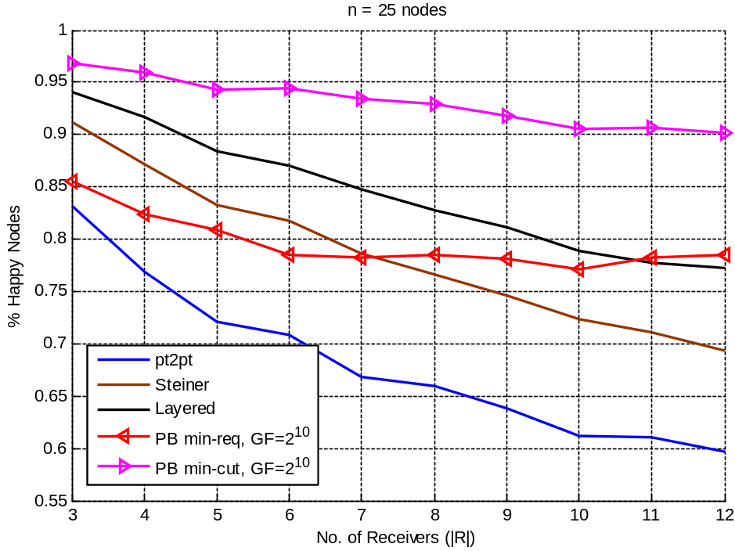
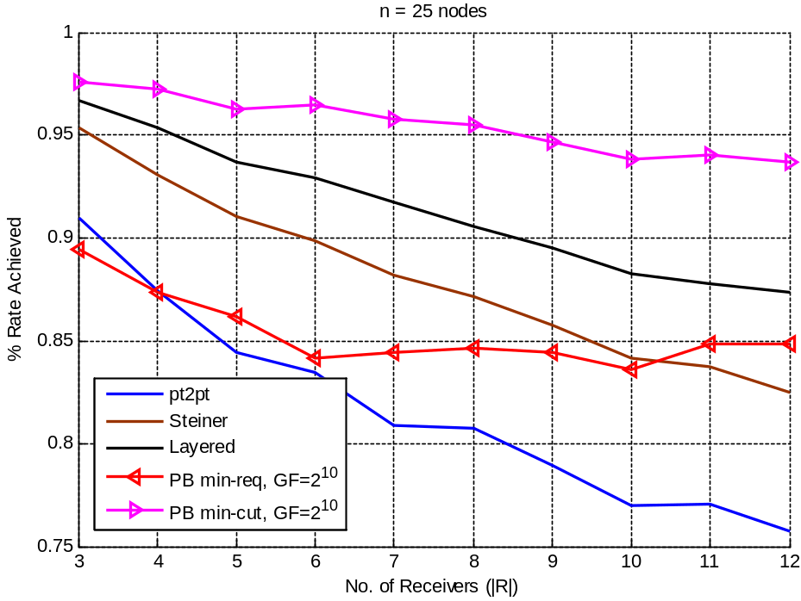
Simulation Results:
No. of Receivers, 3 Layers, GF = 2¹⁰
% Happy Nodes, 25 nodes
% Rate Achieved, 25 nodes
Smart coding always out performs
Intra-layer coding out performs routing schemes;
Pushback with min-cut shows consistent gains over intra-layer coding
Gap in performance grows in size as number of receivers increases.
Pushback with min-req performs worse than routing when #rx small:
  always need intelligent and careful code design.

Slide 13
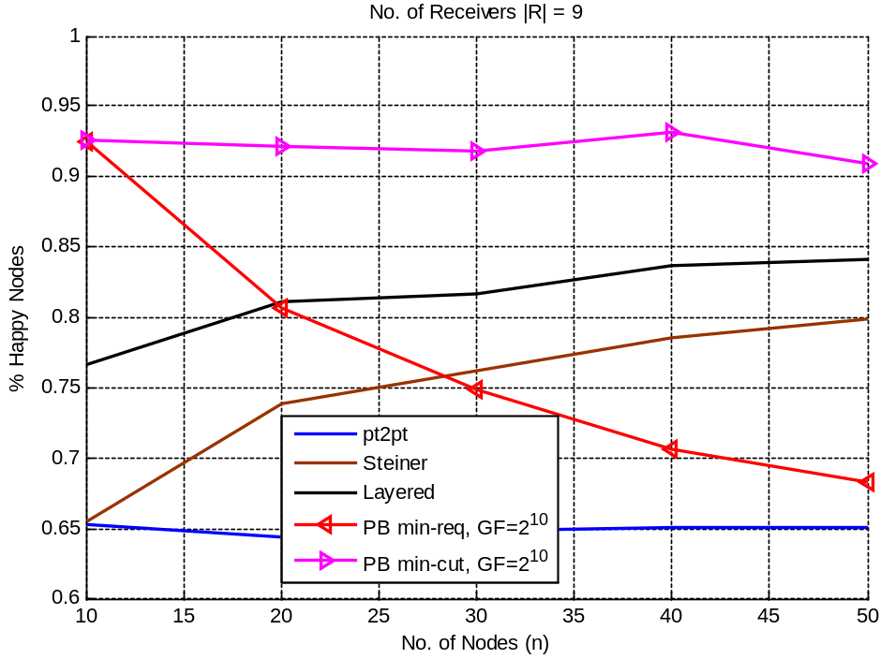
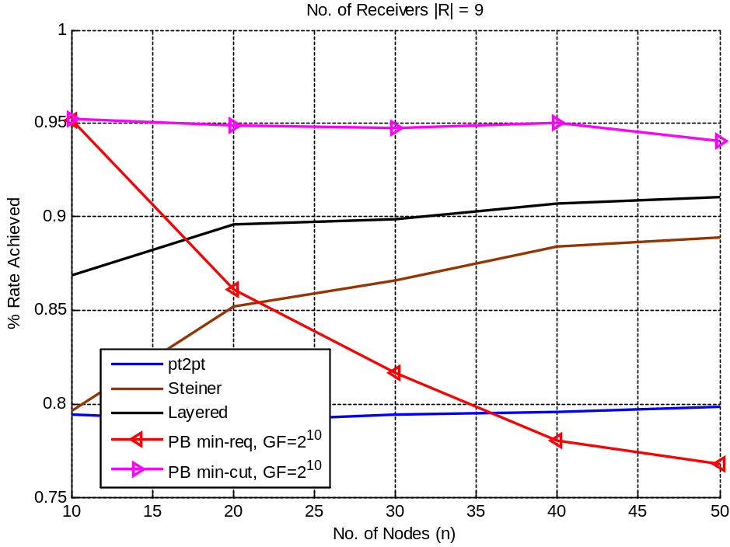
Simulation Results:
Network Size, 3 Layers, GF = 2¹⁰
% Happy Nodes, |R| = 9
% Rate Achieved,|R| = 9
Smart coding always out performs
Intra-layer coding out performs routing schemes;
Pushback with min-cut shows consistent gains over intra-layer coding
Pushback with min-req performs worse than routing when network grows in size:
  always need intelligent and careful code design.

Slide 14
Discussion and Conclusion
Distributed, simple message passing scheme
  Even with decoding and re-encoding at intermediate nodes, complexity of the algorithm scales approximately linearly with network size
  Delay in pushback/code assignment can be amortized over multiple tx
Guarantees decodability of base layer at all receivers
Outperforms routing & intra-layer coding schemes in terms of total rate achieved
Robustness: performance gain increases as network size and #receivers grow
Empirically, only a small field size is needed. Note sufficiency of field size depends on network topology and #layers to be transmitted

