Slide 1
ITU Workshop on “Quality of Service and Quality of Experience of Multimedia Services in Emerging Networks” (Istanbul, Turkey, 9-11 February 2015)
Standardization activities on optical access transport systems in ITU-T SG15
Hiroshi OTA
Advisor, ITU/TSB
hiroshi.ota@itu.int

Slide 2
Overview

Slide 3
ITU-T Study Groups (SGs)
SG2: Operational aspects of service provision and telecommunications management
SG3: Tariff and accounting principles including related telecommunication economic and policy issues
SG5: Environment and climate change
SG9: Television and sound transmission and integrated broadband cable networks
SG11: Signalling requirements, protocols and test specifications
SG12: Performance, QoS and QoE
SG13: Future networks including cloud computing, mobile and next-generation networks
SG15: Networks, technologies and infrastructures for transport, access and home
SG16: Multimedia coding, systems and applications
SG17: Security
TSAG: Telecommunication Standardization Advisory Group

Slide 4
SG15: Networks, Technologies and Infrastructures for Transport, Access and Home
Optical transport networks and access network infrastructures
Optical and other infrastructures, systems, equipment, fibres, control plane technologies
Customer premises, access, metropolitan and long haul
Lead SG for:
access network transport
optical technology
optical transport networks
smart grid
Details are at http://www.itu.int/en/ITU-T/studygroups/2013-2016/15

Slide 5
Questions under SG15
Q1:Coordination of access and Home Network Transport standards
Q2: Optical systems for fibre access networks
Q3: General characteristics of transport networks
Q4: Broadband access over metallic conductors
Q5: Characteristics and test methods of optical fibres and cables
Q6: Characteristics of optical systems for terrestrial transport networks
Q7: Characteristics of optical components and subsystems
Q8: Characteristics of optical fibre submarine cable systems
Q9: Transport network protection/restoration
Q10: Interfaces, Interworking, OAM and Equipment specifications for Packet based Transport Networks
Q11: Signal structures, interfaces, equipment functions, and interworking for transport networks
Q12: Transport network architectures
Q13: Network synchronization and time distribution performance
Q14: Management and control of transport systems and equipment
Q15: Communications for Smart Grid
Q16: Outside plant and related indoor installation
Q17: Maintenance and operation of optical fibre cable networks
Q18: Broadband in-premises networking

Slide 6
From recent development
G.fast (Fast Access to Subscriber Terminals) (Q4/15 and Q16/15)
FTTdp (Fibre to the distribution point)
G.fast transceiver aspects are under development by Q4/15
G.fast infrastructural aspects of FTTdp deployment is under study by Q16/15
PON (Passive optical networks) (Q2/15) and optical fibres for FTTH (Q5/15)
Major technology for FTTH (Fiber to the home)

Slide 7
G.Fast - Fast Access to Subscriber Terminals (Q4/15)

Slide 8
What is FTTdp ?
A broadband access solution taking fibre to a distribution point (FTTdp) very close to the customers premises, with total wire length to the customers’ transceiver up to 250m.
It is expected that the bulk of the loop lengths may be in the order 30 to 50m. On 30 m loops, aggregate data rates up to at least 500 Mb/s should be supported on a single pair.

Slide 9
FTTdp/G.fast “raison d’être”
To provide the best aspects of ‘Fibre to the home’ and ‘ADSL’:
Fibre to the home bit-rates
customer self-installation like ADSL

Slide 10
Applications
Next-generation IPTV service at well over 100 Mb/s
Access to small and medium business sites at well over 100 Mb/s
Backhaul for very small wireless cell sites, including HetNet
Backhaul for WiFi hot spots

Slide 11
Service rate performance targets
500-1000 Mb/s for FTTB deployments @<100m, straight loops
500 Mb/s at 100m
200 Mb/s at 200m
150 Mb/s at 250m
Aggregate service rates ≥500 Mb/s with start frequency of 23 MHz and VHF and DAB bands notches

Slide 12
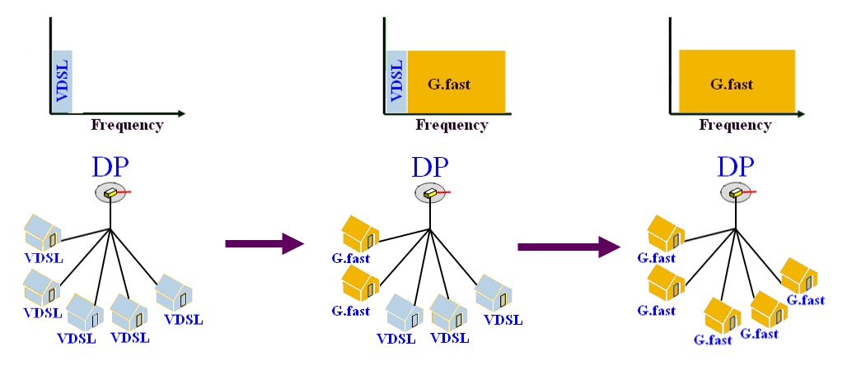
Migration example
Coexistence with xDSL: VDSL2 to G.fast migration

Slide 13
Standards time-line
September 2010: Broadband Forum (BBF) Service Provider Action Council (SPAC) agreed to develop a white paper capturing network operators’ potential requirements.
January 2011: At request of BBF, ITU-T Q4/15 agreed to study the transceiver aspects of FTTdp, and issued a call for papers.
February 2011: Q4/15 opened G.fast project and assigned an Associate Rapporteur/Editor
June 2011: Q4/15 agreed to develop a new Recommendation
Recommendation ITU-T G.9700 (Power spectral density specification) – approved in March, 2014
Recommendation ITU-T G.9701 (Physical layer specification) – approved in December 2014

Slide 14
Standards body cooperation
Close cooperation between standards groups is needed:
ITU-T Q4/15 for G.fast transceiver aspects
ITU-T Q2/15 for PON related aspects
Broadband Forum (FAN and E2E Architecture WGs) for architectural aspects
Broadband Forum addresses certification and interoperability testing of equipment based on ITU-T G-PON and DSL Recommendations, and
ETSI TM6 for reverse power feeding aspects

Slide 15
PON (Passive Optical Networks) (Q2/15) and optical fibres for FTTH (Q5/15)

Slide 16
PON Evolution
G-PON (Gigabit-capable PON)
NG-PON1 = XG-PON (10Gbit-capablePON)
NG-PON2 = TWDM-PON (40Gbit-capable PON)

Slide 17
Capacity Trend for PON
Bandwidth
250G
250G
100G
100G
40G
40G
40G
10G
Downstream
Upstream
10G
2.5G
0.6G
0.15G
0.05G
Generation
1994
TPON
1999
A-PON
B-PON
2004
G-PON
GEPON
2009
NG-PON1
XG-PON
10GEPON
2014
NG-PON2
TWDM-PON
2020+
NG-PON3
?

Slide 18
G-PON: Widely deployed
G-PON: Gigabit-capable passive optical networks
System defined in the Recommendation ITU-T G.984 series
Recommendation ITU-T G.984.1: System requirements
Recommendation ITU-T G.984.2: PMD specifications
Recommendation ITU-T G.984.3: TC specifications
Recommendation ITU-T G.984.4: OMCI - Subsumed by Recommendation ITU-T G.988
Now used for all ITU PONs and P2P systems
Recommendation ITU-T G.984.5: WDM matters for the future
Recommendation ITU-T G.984.6: Reach extension
Recommendation ITU-T G.984.7: Long reach
Plus supplements…
Standards considered stable and mature
Minor optional enhancements continue even now

Slide 19
XG-PON
XG-PON: 10-Gigabit-capable passive optical networks
System defined in the Recommendation ITU-T G.987 series
Recommendation ITU-T G.987: Definitions, abbreviations and acronyms
Recommendation ITU-T G.987.1: General requirements
Recommendation ITU-T G.987.2: Physical media dependent (PMD) layer specification
Recommendation ITU-T G.987.3: Transmission convergence (TC) layer specification
Recommendation ITU-T G.987.4: Reach extension

Slide 20
XG-PON system (ITU-T G.987 series) coexisting with G-PON
GPON OLT
GPON ONU
GPON
OLT
MAC
Logic
OLT Tx
1490nm
ONU Rx
1490nm
GPON
ONU
MAC
Logic
NNI
Data
I/O
UNI
Data
I/O
WDM
1490nm
WDM
OLT Rx
1310nm
1577nm
ONU Tx
1310nm
XG-PON OLT
WDM1
XG-PON ONU
XGPON
OLT
MAC
Logic
OLT Tx
1577nm
1310nm
ONU Rx
1577nm
XGPON
ONU
MAC
Logic
NNI
Data
I/O
1270nm
UNI
Data
I/O
WDM
WDM
OLT Rx
1270nm
ONU Tx
1270nm

Slide 21
NG-PON2
NG-PON2: 40-Gigabit-capable passive optical networks
System defined in the Recommendation ITU-T G.989 series
Recommendation ITU-T G.989 : Definitions and conventions
Recommendation ITU-T G.989.1: General requirements
Recommendation ITU-T G.989.2: Physical media dependent (PMD) layer specification
Recommendation ITU-T G.989.3: Transmission convergence (TC) layer specification (draft in progress)
Based on G.987.3, with wavelength control and 10G upstream added
Recommendation ITU-T G.9802 (ex. G.multi) = Wavelength control layer (consented in December 2014)
Meant as a general framework for TWDM-systems, of which G.989 is one
Recommendation ITU-T G.984.5 = Wavelength coexistence
Recommendation ITU-T G.988 = ONU management and control interface
Standard in force, can be easily reused for TWDM

Slide 22
NG-PON2 Wavelength Plans (ITU-T G.989.2)
Wavelength Compatible Systems | TWDM |  | PtP WDM PON
 | Downstream | Upstream | Upstream/Downstream
GPON, RF Video, XG-PON1 | 1596-1603 nm | Wide Range 1524-1544 nm Reduced Range 1528-1540 nm Narrow Range 1532-1540 nm | Shared Spectrum 1603-1625 nm Expanded Spectrum 1524-1625 nm

Slide 23
Evolution in the recommendation for Recommendation ITU-T G.652 fibers
Existing Recommendation ITU-T G.652.D category is already optimized to be used with G-PON and XG-PON systems, with the necessity to define attenuation attribute in the range of interest (1260 nm - 1650 nm)
A new category has been proposed with enhanced behavior in attenuation and bending loss for both transport and access networks applications
Proposals under evaluation:
to reduce the existing MFD range in order to improve the compatibility with other single mode categories (e.g. Recommendation ITU-T G.657)
to improve the geometrical requirements in order to enable the use of low cost connectors or splicing machines in access network
necessity to define attenuation attribute in the range of interest in access network: 1260 nm e 1650 nm

Slide 24
Evolution in the recommendation for Recommendation ITU-T G.657 fibers
Optimization of B2/B3 categories (not necessary compliant with Recommendation ITU-T G.652) has been developed:
improved compatibility with other Recommendation ITU-T G.657 categories and with Recommendation ITU-T G.652 with the reduction of MFD range (Minimum typical MFD was modified from 6.3 μm to 8.6 μm)
Definition of methods to measure MPI in Recommendation ITU-T G.650.1
Proposals under evaluation:
Proposal to reduce existing MFD range also for A1/A2 subcategories in order to improve the compatibility with other single mode categories (e.g. Recommendation ITU-T G.652) and to harmonize with Cenelec standards on connectors. That would result in an improvement in OTDR unidirectional measurements interpretation (this measurement could be necessary to be used on PON networks where bidirectional test is not usable to localize faults).
Necessity to go deep in the study of mechanical reliability related to the FTTH installation conditions

Slide 25

Thank you
xx.xxx@itu.int
hiroshi.ota@itu.int

