Slide 1
DATA SCIENCE Class 3: data Mining
Notes:
~15-20 min on initial stuff
Note: example DS problem…write down some features, how could you build a predictive model from these?

Slide 2
I. Quick Review II. Getting data: Unstructured vs. Structured III. Parsing HTML with Regular expressions iV. Api / wrappers
AGENDA
Notes:
All of our classes will involve some hands-on work (in the exercises section)

Slide 3
20 Minutes: Open 00_python_review.py
AGENDA
Notes:
All of our classes will involve some hands-on work (in the exercises section)

Slide 4
i. Getting data
INTRO TO DATA SCIENCE
Notes:
~15-20 min for this section?

Slide 5
GETTING DATA
Data lives all over the internet
The question is whether or not the author of the data makes it easy for us to grab it.
Notes:
~15-20 min for this section?

Slide 6
STRUCTURED VS. UNSTRUCTURED DATA
Structured Data:
Data that’s formatted in a way which allows it to be accessed and queried quickly, often automatically by a computer or algorithm.
Structured data usually adheres to a Data Model (often known as a schema)
Unstructured Data:
Pretty much everything else. Generally unstructured data is intended to be read/parsed/processed by humans.
Notes:
~15-20 min for this section?

Slide 7
STRUCTURED VS. UNSTRUCTURED DATA
Structured Data:
Data that’s formatted in a way which allows it to be accessed and queried quickly, often automatically by a computer or algorithm.
Structured data usually adheres to a Data Model (often known as a schema)
Unstructured Data:
Pretty much everything else. Generally unstructured data is intended to be read/parsed/processed by humans.
Websites
Books
Magazines
Movie/Audio data
In other words, most of the stuff you interact with every day.
Examples?
Notes:
~15-20 min for this section?

Slide 8
GETTING DATA
Much of data mining involves converting unstructured information into structured information.
Notes:
~15-20 min for this section?

Slide 9
ii. REGEX / Requests
INTRO TO DATA SCIENCE
Notes:
~15-20 min for this section?

Slide 10
Regex / requests
REGular EXpressions
are how we capture patterns in text
Notes:
~15-20 min for this section?

Slide 11
Regex / requests
REGular EXpressions
are how we capture patterns in text
Like an extended form of text search
Visit https://regex101.com/#python to follow the example
Notes:
~15-20 min for this section?

Slide 12
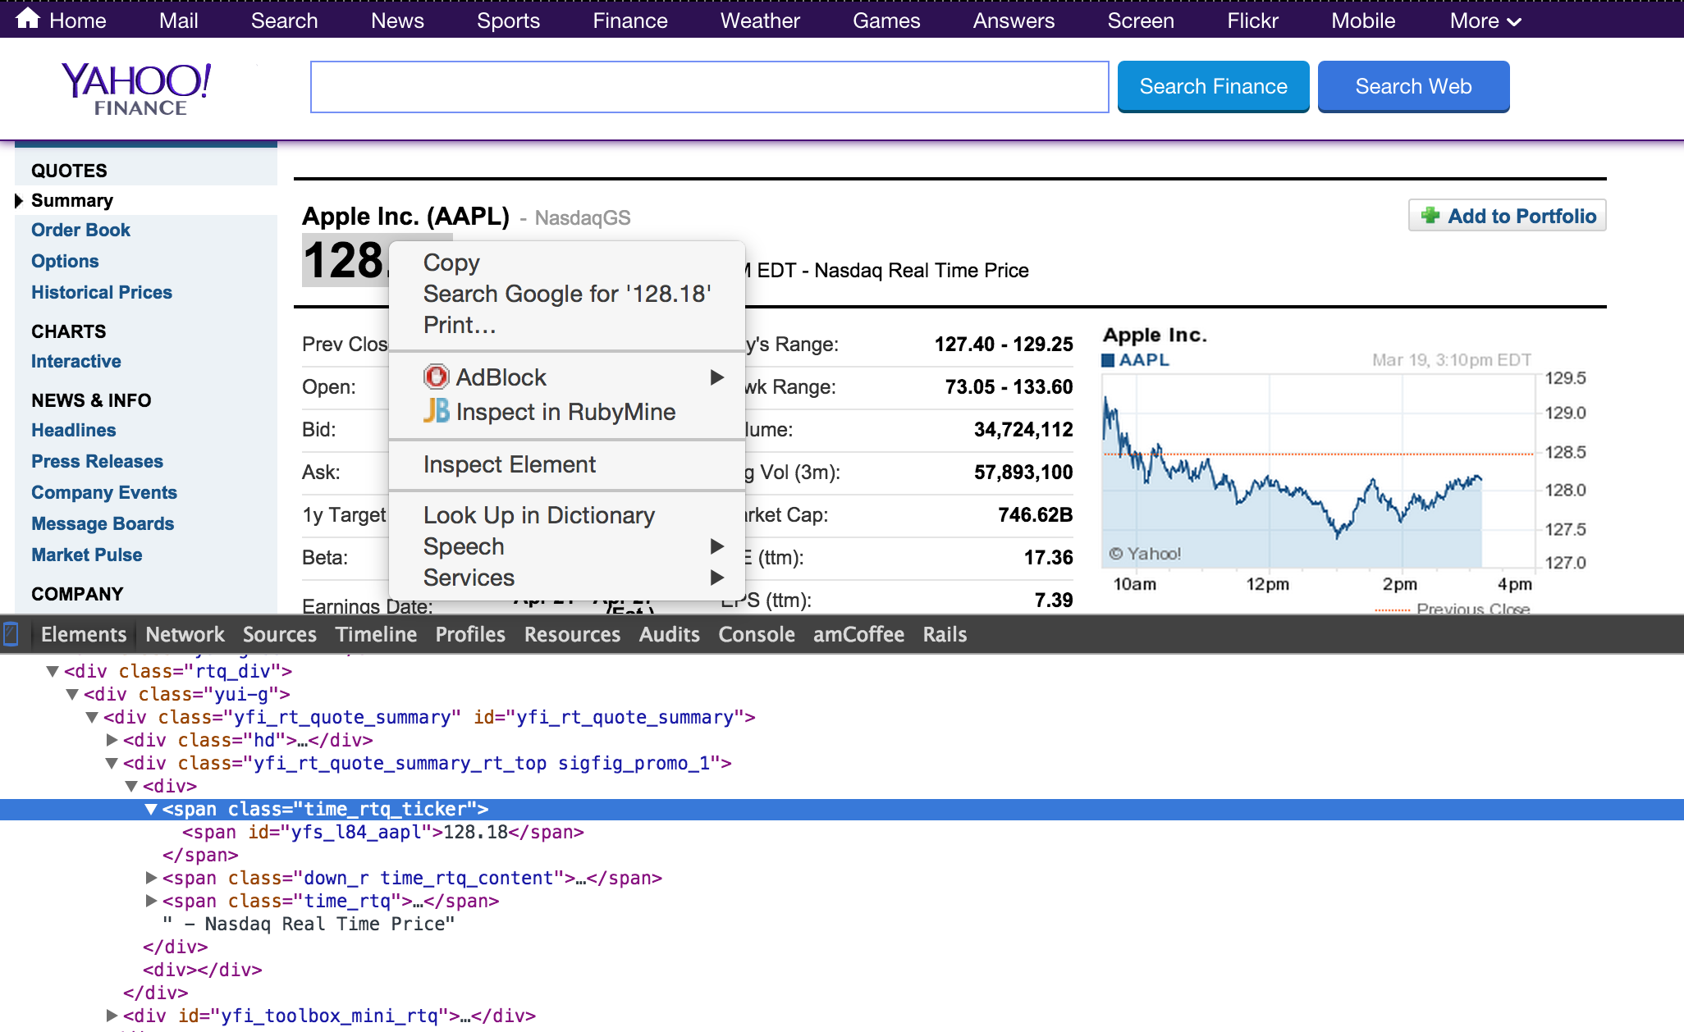
WHO IS A DATA SCIENTIST?
Notes:
~15-20 min for this section?

Slide 13
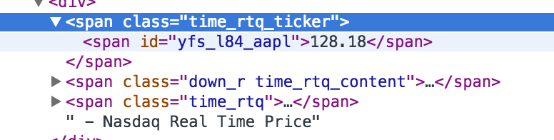
REGEX / Requests
What regex can we use to capture this?

Slide 14
beautifulsoup
REGEX / Requests
Is a python based HTML parser.

Slide 15
Web crawlers
REGEX / Requests
We just built one!
Hacking OKCupid: http://www.wired.com/2014/01/how-to-hack-okcupid/all/

Slide 16
Iii. APIs and Wrappers
INTRO TO DATA SCIENCE
Notes:
~15-20 min for this section?
So what does data science look like?

Slide 17
API / Wrappers
HTML Parsing vs. API
Structured Data:
Data is already processed or
partially processed for us.
Results are given in a dictionary (JSON) format through key => value pairs.
Unstructured Data:
Must call using requests and BeautifulSoup (imitate human behavior)
http://www.pythonforbeginners.com/api/list-of-python-apis

Slide 18
API / Wrappers
API (n):
Application Programming Interface
Easing access into a web based software

Slide 19
API / Wrappers
Examples of API’s:
Amazon (price data)
Twitter (tweets)
Facebook (social network)
Sentiment Analysis

Slide 20
API / Wrappers
Examples of API’s:
Amazon (price data)
Twitter (tweets)
Facebook (social network)
Sentiment Analysis
Mashape.com has an extensive collection

Slide 21
API / Wrappers
APIs use HTTP just like anything else over the web.
Examples:
http://www.reddit.com/r/dataisbeautiful/
http://www.reddit.com/r/dataisbeautiful.json (Look closely at the response)
Mashape.com has an extensive collection

Slide 22
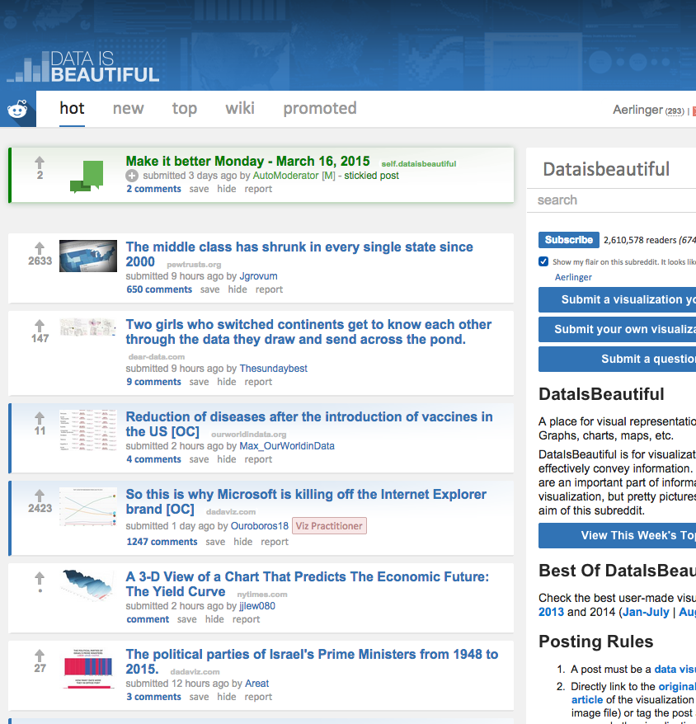
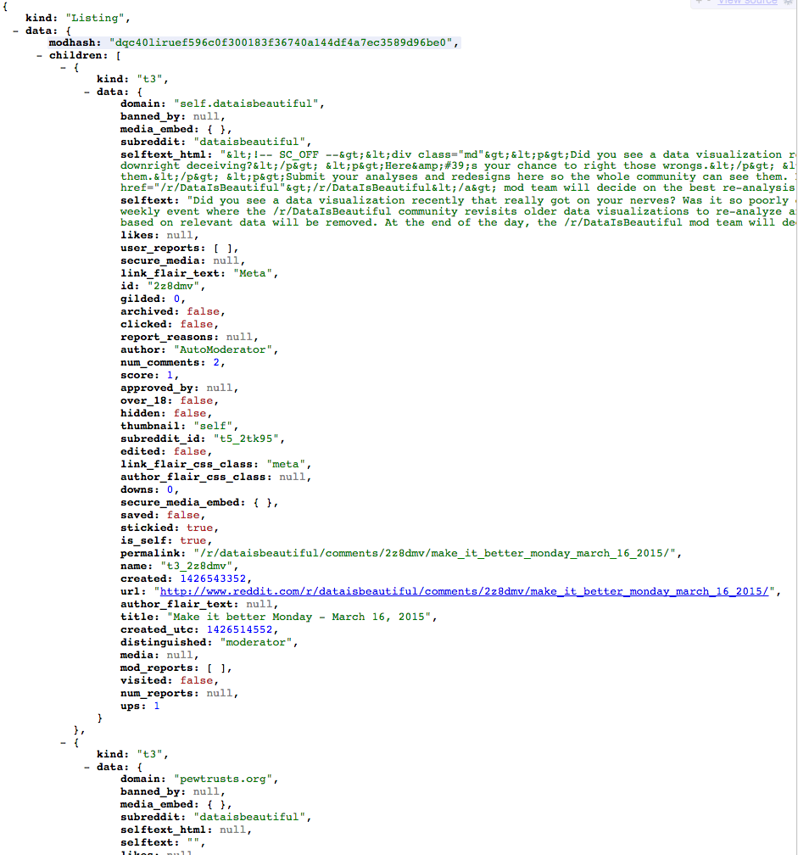
API
APIs allow us to get structured results from a source of data:
HTML format
JSON (dictionary) format

Slide 23
API / Wrappers
API vs. API wrapper
Uses raw HTTP requests
May still be a bit confusing how to call the right page.
Not coupled to any specific language or implementation.
Translates API into a specific programming language. Gives us Python functions.
http://www.pythonforbeginners.com/api/list-of-python-apis

Slide 24
API / Wrappers
Conclusion
Data is all over the web, but we must be polite and conscious of what data is available to us.

Slide 25
API / Wrappers
Homework
See Assignment3 in the class repository

