Slide 1
INTRO to DATA SCIENCE logistic regression

Slide 2
0. BASIC FORM I. Interpretation II. Exercise: Predicting Default Rates III. Q&A
agenda

Slide 3
0. Basic Form
INTRO TO DATA SCIENCE

Slide 4
BASIC FORM
continuous categorical
supervised ??? ???
unsupervised ??? ???
Q: Where does logistic regression belong in this diagram?
Notes:
The y-axis: Is the data labeled?
The x-axis: Is the output a category or a continuous value?

Slide 5

BASIC FORM
continuous categorical
supervised regression classification
unsupervised dimension reduction clustering

Slide 6
BASIC FORM
Q: What is logistic regression?

Slide 7
BASIC FORM
Q: What is logistic regression?
A: A generalization of the linear regression model to classification problems.

Slide 8
BASIC FORM
In linear regression, we used a set of input variables to predict the value of a continuous response variable.

Slide 9
BASIC FORM
In linear regression, we used a set of input variables to predict the value of a continuous response variable.
In logistic regression, we use a set of input variables to predict probabilities of class membership.

Slide 10

BASIC FORM
In linear regression, we used a set of input variables to predict the value of a continuous response variable.
In logistic regression, we use a set of input variables to predict probabilities of class membership.
NOTE
Class membership is not always binary, however, that is what we will focus on for this class.

Slide 11
BASIC FORM
In linear regression, we used a set of input variables to predict the value of a continuous response variable.
In logistic regression, we use a set of input variables to predict probabilities of class membership.
These probabilities can then mapped to class labels, thus predicting the class for each observation.

Slide 12
BASIC FORM
When performing linear regression, we use the following function:
When performing logistic regression, we use the following form:

Slide 13
BASIC FORM
When performing linear regression, we use the following function:
When performing logistic regression, we use the following form:
Probability of y = 1, given x

Slide 14
BASIC FORM
Quiz: Create a plot of the logistic function.

Slide 15
BASIC FORM
Quiz: Create a plot of the logistic function.
How would you describe the shape of the function?

Slide 16
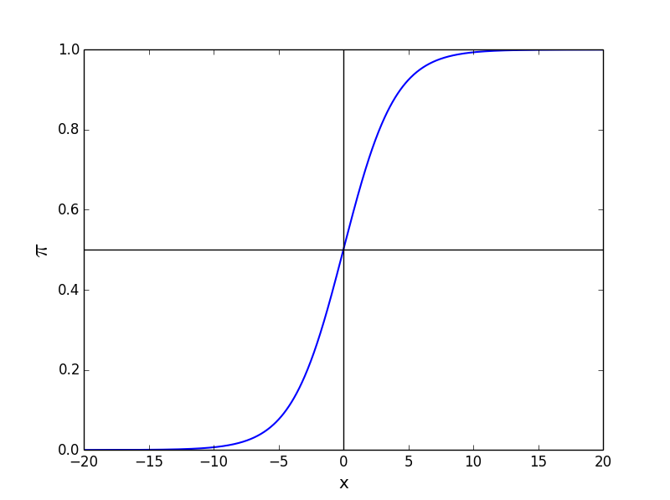
BASIC FORM
The logistic function takes on an “S” shape, where y is bounded by [0,1]

Slide 17
BASIC FORM
The logistic function takes on an “S” shape, where y is bounded by [0,1]
NOTE
Think about why this is a sensible shape
Notes:
This is a sensible shape because:
You want to return a value between 0 and 1 for all possible values of x, because probability less than 0 or greater than 1 does not make sense. However, this would be the case for a linear regression.
You want the model to reflect different probabilities based on the value of x to reflect that as you increase x, you increase probability, and vice-versa.

Slide 18
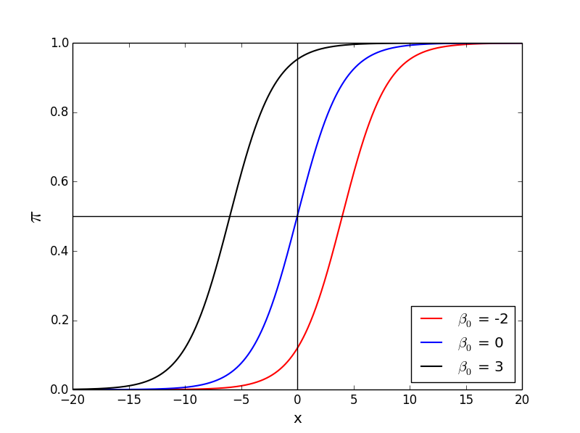
BASIC FORM
Changing the β₀ value shifts the function horizontally.

Slide 19
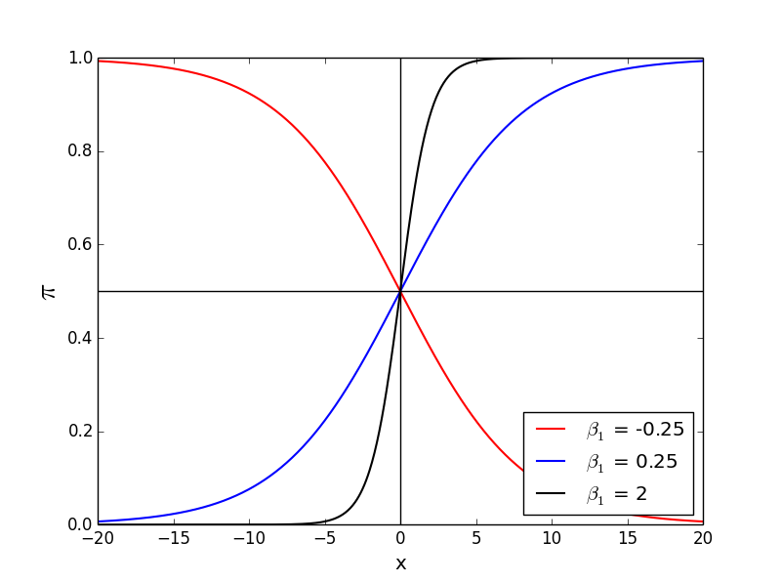
BASIC FORM
Changing the β₁ value changes the slope of the curve

Slide 20
I. Interpretation
INTRO TO DATA SCIENCE

Slide 21
Interpreting results
In order to interpret the outputs of a logistic function we must understand the difference between probability and odds.
Notes:
Complement: 1 – p

Slide 22
Interpreting results
In order to interpret the outputs of a logistic function we must understand the difference between probability and odds.
The odds of an event are given by the ratio of the probability of the event by its complement:
Notes:
Complement: 1 – p

Slide 23
Interpreting results
In order to interpret the outputs of a logistic function we must understand the difference between probability and odds.
The odds of an event are given by the ratio of the probability of the event by its complement:
Notes:
Complement: 1 – p

Slide 24
Interpreting results
In order to interpret the outputs of a logistic function we must understand the difference between probability and odds.
The odds of an event are given by the ratio of the probability of the event by its complement:
QUESTION
What is the range of the odds?
Notes:
Q: What is the range of probability?
Q: What is the range of the odds ratio?

Slide 25
Interpreting results
Quiz: You’re trying to determine whether a customer will convert or not. The customer conversion rate is 33.33%. what are the odds that a customer will convert?
Take 2 minutes and work this out.
Notes:
Complement: 1 – p

Slide 26
Interpreting results
Quiz: You’re trying to determine whether a customer will convert or not. The customer conversion rate is 33.33%. what are the odds that a customer will convert?
Take 2 minutes and work this out.

Slide 27
Interpreting results
Quiz: You’re trying to determine whether a customer will convert or not. The customer conversion rate is 33.33%. what are the odds that a customer will convert?
Take 2 minutes and work this out.
Notes:
Q: What does this mean?

Slide 28
Interpreting results
Quiz: You’re trying to determine whether a customer will convert or not. The customer conversion rate is 33.33%. what are the odds that a customer will convert?
Take 2 minutes and work this out.
NOTE
This means that for every customer that converts you will have two customers that do not convert
Notes:
Q: What would have happened if we represented out customer conversion event as 0? Would it have changed our odds result? Would it have changed our interpretation?

Slide 29
Interpreting results
What would happen if we took the odds of the logistic function?

Slide 30
Interpreting results
What would happen if we took the odds of the logistic function?

Slide 31
Interpreting results
Notice if we take the logarithm of the odds, we return a linear equation
Notes:
The process we just went through is known as the logit transformation. The output form is referred to as the logit function and also the log-odds function. Note that the base used here is Eulers number (e).

Slide 32
Interpreting results
Notice if we take the logarithm of the odds, we return a linear equation
NOTE
What is the range of the logit function?
Notes:
The process we just went through is known as the logit transformation. The output form is referred to as the logit function and also the log-odds function. Note that the base used here is Eulers number (e).

Slide 33
Interpreting results
Notice if we take the logarithm of the odds, we return a linear equation
This simple relationship between the odds ratio and the parameter β is what makes logistic regression such a powerful tool.
Notes:
The process we just went through is known as the logit transformation. The output form is referred to as the logit function and also the log-odds function.

Slide 34
Interpreting results
In linear regression, the parameter β₁ represents the change in the response variable for a unit change in x.
Notes:
Q: What do you think that the b1 represents in the case of the logistic function?

Slide 35
Interpreting results
In linear regression, the parameter β₁ represents the change in the response variable for a unit change in x.
In logistic regression, β₁ represents the change in the log-odds for a unit change in x.
Notes:
Q: How to we change the b1 value from log-odds, to the odds?

Slide 36
Interpreting results
In linear regression, the parameter β₁ represents the change in the response variable for a unit change in x.
In logistic regression, β₁ represents the change in the log-odds for a unit change in x.
This means that gives us the change in the odds for a unit change in x.

Slide 37
Interpreting results
Q: How to determine whether a coefficient is significant?
A: This is based off of the p-value, just as with the linear regression

Slide 38
Interpreting results
Example: Suppose we are interested in mobile purchase behavior. Let y be a class label denoting purchase/no purchase, and let x denote whether phone was an iPhone.

Slide 39
Interpreting results
Example: Suppose we are interested in mobile purchase behavior. Let y be a class label denoting purchase/no purchase, and let x denote whether phone was an iPhone.
We perform a logistic regression, and we get β₁ = 0.693.

Slide 40
Interpreting results
Example: Suppose we are interested in mobile purchase behavior. Let y be a class label denoting purchase/no purchase, and let x denote whether phone was an iPhone.
We perform a logistic regression, and we get β₁ = 0.693.
Q: What does this mean?

Slide 41
Interpreting results
Example: Suppose we are interested in mobile purchase behavior. Let y be a class label denoting purchase/no purchase, and let x denote whether phone was an iPhone.
We perform a logistic regression, and we get β₁ = 0.693.
In this case the odds ratio is exp(0.693) = 2, meaning the likelihood of purchase is twice as high if the phone is an iPhone.

Slide 42
Interpreting results
Once we understand the basic form for logistic regression, we can easily extend the definition to include multiple input values.
Logit function
Notes:
The logit function

Slide 43
Interpreting results
Once we understand the basic form for logistic regression, we can easily extend the definition to include multiple input values.
Logistic function
Notes:
The logistic regression equation

Slide 44
II. Exercise: PREDICTING DEFAULT
INTRO TO DATA SCIENCE
Notes:
Leave 1 hours for this exercise

Slide 45
EXERCISE
This data set contains 10,000 records associated with credit card accounts with the following four fields:
Default | Binary variable indicating whether the credit card holder defaulted on their credit card obligations
Student | Binary variable indicating whether the credit card holder is a student
Balance | Continuous variable recording the credit card holders current outstanding balance
Income | Continuous variable representing the total annual income for the credit card holder

Slide 46
EXERCISE
Part I: Exploration
Read in Default.csv and convert all data to numeric
Split the data into train and test sets
Create a histogram of all variables
Create a scatter plot of the income vs. balance
Mark defaults with a different color (and symbol)
What can you infer from this plot?

Slide 47
EXERCISE
Part II: Logistic Regression
Run a logistic regression on the balance variable
Use the training set
Use the statsmodels.formula.api module and smf.logit() function
Is the β value associated with balance significant?
Predict the probability of default for someone with a balance of $1.2k and $1.5k
Plot the fitted logistic function overtop of the data points
Create predictions using the test set
Compute the overall accuracy, the sensitivity and specificity

Slide 48
III. Q&A
INTRO TO DATA SCIENCE

Slide 49
Q&A
Q: What is a Generalized Linear Model (GLM)?
A: Briefly, GLMs generalize the distribution of the error term, and allow the conditional mean of the response variable to be related to the linear model by a link function.

Slide 50
Q&A
Q: What is the error distribution and link function for the logistic regression?
A: The error term follows a Bernoulli distribution, and the logit is the link function that connects us to the linear predictor.

Slide 51
Q&A
Q: Is the logit the only link function used for the Bernoulli distribution?
A: No, other link functions include the probit the tobit model. However, the logit simplifies things nicely and is probably the most commonly used.

Slide 52
Q&A
Q: What is the difference between and ?
A: Nothing, these are equivalent expressions.
If you want to prove this to yourself (a) plot both equations, or (b) multiply both numerator and denominator by .

Slide 53
Q&A
Q: Why not use a linear regression to predict probabilities of class membership?
A: The linear regression will make predictions that don’t make sense (e.g., probability outside of [0,1])
A: Transforming the linear regression into a step function will produce heteroskedastic errors

Slide 54
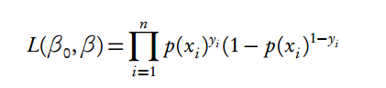
Q&A
Q: How do we derive coefficients using maximum likelihood?
A: We find the coefficients that are the most likely, given the observed data. Formally, we estimate the coefficients that maximize the likelihood function. This is done using an iterative procedure.
Check out this link, for details on the estimation of the coefficients.
Notation for the product of a series

