Slide 1
DATA SCIENCE Model Evaluation

Slide 2
I. EVALUATION Procedures iI. EVALUATION Metrics
agenda

Slide 3
I. Evaluation PROCEDURES
DATA SCIENCE

Slide 4
Training error
Q: What’s wrong with training error?
Thought experiment:
Suppose we train our model using the entire dataset.
Q: How low can we push the training error?
We can make the model arbitrarily complex (effectively
“memorizing” the entire training set).
A: Down to zero!

Slide 5

Training error
Q: What’s wrong with training error?
Thought experiment:
Suppose we train our model using the entire dataset.
Q: How low can we push the training error?
We can make the model arbitrarily complex (effectively
“memorizing” the entire training set).
A: Down to zero!
NOTE
This phenomenon
is called
overfitting.

Slide 6
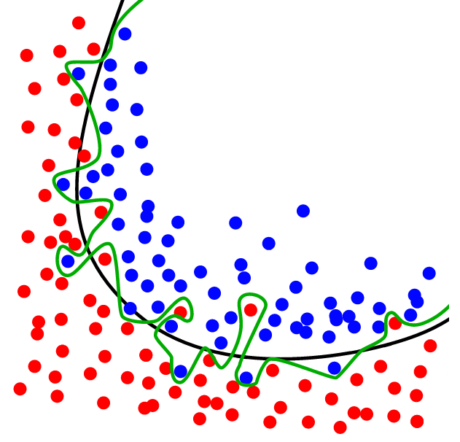
Overfitting
Source: http://www.dtreg.com

Slide 7
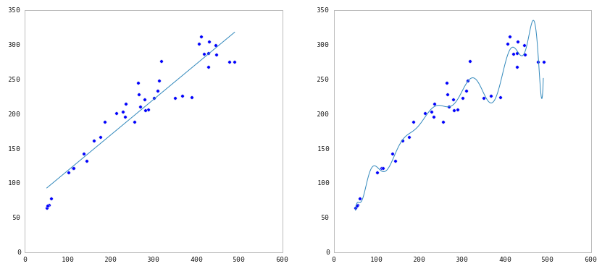
Underfitting and Overfitting
Source: http://nbviewer.ipython.org/github/fonnesbeck/Bios366/blob/master/notebooks/Section6_3-Model-Selection-and-Validation.ipynb

Slide 8
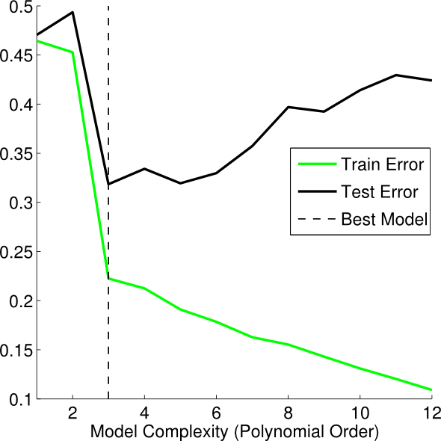
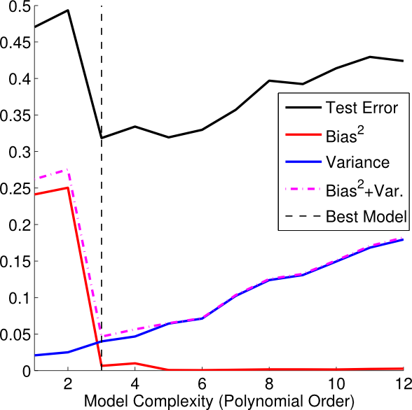
Underfitting and Overfitting
Source: http://theclevermachine.wordpress.com/2013/04/21/model-selection-underfitting-overfitting-and-the-bias-variance-tradeoff/

Slide 9
Training error
Q: What’s wrong with training error?
Thought experiment:
Suppose we train our model using the entire dataset.
Q: How low can we push the training error?
We can make the model arbitrarily complex (effectively
“memorizing” the entire training set).
A: Down to zero!
A: Training error is not a good estimate of accuracy beyond training data.
NOTE
This phenomenon
is called
overfitting.

Slide 10

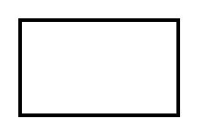
Test Set Approach
Q: How can we make a model that generalizes well?
model
dataset

Slide 11
Test Set Approach
Q: How can we make a model that generalizes well?
1) split dataset
model
dataset

Slide 12

Test Set Approach
Q: How can we make a model that generalizes well?
1) split dataset
2) train model
training set
model
dataset

Slide 13
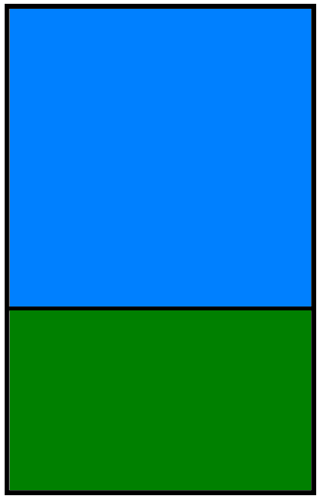
Test Set Approach
Q: How can we make a model that generalizes well?
1) split dataset
2) train model
3) test model
training set
model
test set
dataset

Slide 14
Test Set Approach
Q: How can we make a model that generalizes well?
1) split dataset
2) train model
3) test model
4) parameter tuning
training set
model
test set
dataset

Slide 15
Test Set Approach
Q: How can we make a model that generalizes well?
1) split dataset
2) train model
3) test model
4) parameter tuning
5) choose final model
training set
model
test set
dataset

Slide 16
Test Set Approach
Q: How can we make a model that generalizes well?
1) split dataset
2) train model
3) test model
4) parameter tuning
5) choose final model
6) train on all data
training set
model
test set
dataset

Slide 17
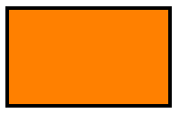
Test Set Approach
Q: How can we make a model that generalizes well?
1) split dataset
2) train model
3) test model
4) parameter tuning
5) choose final model
6) train on all data
7) make predictions
training set
model
test set
new data
dataset

Slide 18
Test Set Approach
Q: How can we make a model that generalizes well?
1) split dataset
2) train model
3) test model
4) parameter tuning
5) choose final model
6) train on all data
7) make predictions
NOTE
This new data is called out of sample data. We don’t know the labels for these OOS records!
We want to estimate OOS prediction error so we know what to expect from our model.
training set
model
test set
new data
dataset

Slide 19
Test Set error
Suppose we do the train/test split.
Q: How well does test set error predict OOS accuracy?
Thought experiment:
Suppose we had done a different train/test split.
Q: Would the test set error remain the same?
A: Of course not!
A: On its own, not very well.

Slide 20
Test Set error
Suppose we do the train/test split.
Q: How well does test set error predict OOS accuracy?
Thought experiment:
Suppose we had done a different train/test split.
Q: Would the test set error remain the same?
A: Of course not!
A: On its own, not very well.
NOTE
The test set error gives a high-variance estimate of OOS accuracy.

Slide 21
Test Set error
Something is still missing!
Q: How can we do better?
Thought experiment:
Different train/test splits will give us different test set errors.
Q: What if we did a bunch of these and took the average?
A: Now you’re talking!
A: Cross-validation.

Slide 22
Cross-validation
Steps for K-fold cross-validation:
1) Randomly split the dataset into K equal partitions.
2) Use partition 1 as test set & union of other partitions as training set.
3) Calculate test set error.
4) Repeat steps 2-3 using a different partition as the test set at each iteration.
5) Take the average test set error as the estimate of OOS accuracy.

Slide 23
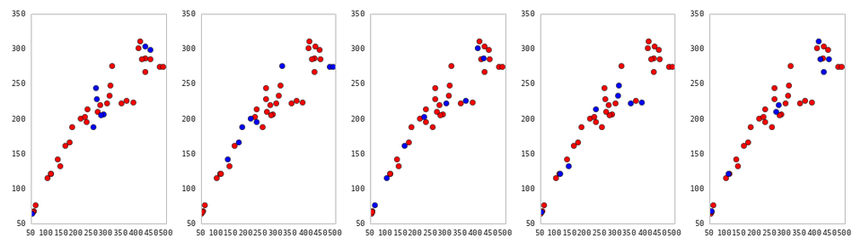
Cross-Validation
5-fold cross-validation: red = training folds, blue = test fold
Source: http://nbviewer.ipython.org/github/fonnesbeck/Bios366/blob/master/notebooks/Section6_3-Model-Selection-and-Validation.ipynb

Slide 24
Cross-validation
Features of K-fold cross-validation:
1) More accurate estimate of OOS prediction error.
2) More efficient use of data than single train/test split.
- Each record in our dataset is used for both training and testing.
3) Presents tradeoff between efficiency and computational expense.
- 10-fold CV is 10x more expensive than a single train/test split
4) Can be used for parameter tuning and model selection.

Slide 25
Cross-validation
Features of K-fold cross-validation:
1) More accurate estimate of OOS prediction error.
2) More efficient use of data than single train/test split.
- Each record in our dataset is used for both training and testing.
3) Presents tradeoff between efficiency and computational expense.
- 10-fold CV is 10x more expensive than a single train/test split
4) Can be used for parameter tuning and model selection.
NOTE
Leave one out cross-validation (LOOCV) is a special case of K-fold cross-validation.

Slide 26
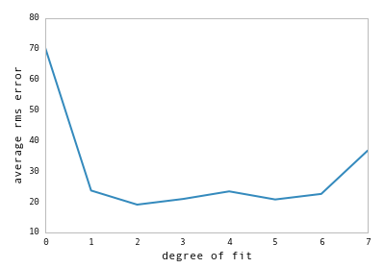
Cross-Validation
Model selection using cross-validation:
lowest predicted OOS error at degree = 2
Source: http://nbviewer.ipython.org/github/fonnesbeck/Bios366/blob/master/notebooks/Section6_3-Model-Selection-and-Validation.ipynb

Slide 27
II. Evaluation METRICS
DATA SCIENCE

Slide 28
EVALUATION METRICS
Classification:
Confusion Matrix
ROC Curve (and AUC)
Regression:
Root Mean Squared Error

Slide 29
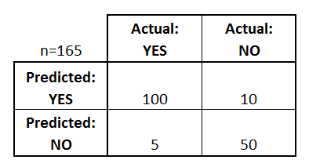
Confusion Matrix
Confusion Matrix: table to describe the performance of a classifier
How many classes are there?
How many patients?
How many predictions of disease?
How many patients actually have the disease?
Example: Test for presence of disease
YES = positive test = True = 1
NO = negative test = False = 0

Slide 30
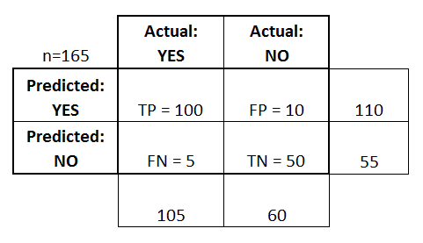
Confusion Matrix
Basic Terminology:
True Positives (TP)
True Negatives (TN)
False Positives (FP)
False Negatives (FN)
Accuracy:
Overall, how often is it correct?
(TP + TN) / total = 150/165 = 0.91
Misclassification Rate (Error Rate):
Overall, how often is it wrong?
1 - accuracy = 1 - 0.91 = 0.09

Slide 31
Confusion Matrix
True Positive Rate:
TP / actual yes = 100/105 = 0.95
“sensitivity” or “recall”
False Positive Rate:
FP / actual no = 10/60 = 0.17
Precision:
TP / predicted yes = 100/110 = 0.91
Specificity:
1 - FPR = 1 - 0.17 = 0.83

Slide 32
ROC Curve / AUC
Every email gets a spamminess score.
Choosing a cut-off, this becomes a classification.
How do we choose a cut-off?
How do we evaluate the ranking without choosing a cut-off?
Email Number | Score | True Label
5 | 0.93 | Spam
8 | 0.91 | Spam
2 | 0.84 | Spam
1 | 0.6 | Ham
7 | 0.54 | Spam
3 | 0.22 | Ham
4 | 0.10 | Ham
6 | 0.02 | Ham

Slide 33
ROC CURVE / AUC
ROC curve
Email Number | Score | True Label
5 | 0.93 | Spam
8 | 0.91 | Spam
2 | 0.84 | Spam
1 | 0.6 | Ham
7 | 0.54 | Spam
3 | 0.22 | Ham
4 | 0.10 | Ham
6 | 0.02 | Ham
TPR
FPR

Slide 34
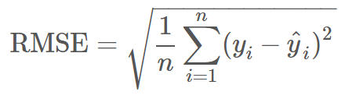
Root Mean Squared Error
Used for regression problems
Square root of the mean of the squared errors
Easily interpretable (in the “y” units)
“Punishes” larger errors

Slide 35
Root Mean Squared Error
Example:
y_true = [100, 50, 30]
y_preds = [90, 50, 50]
RMSE = np.sqrt((10**2 + 0**2 + 20**2) / 3) = 12.88

Slide 36
DATA SCIENCE

