Slide 1
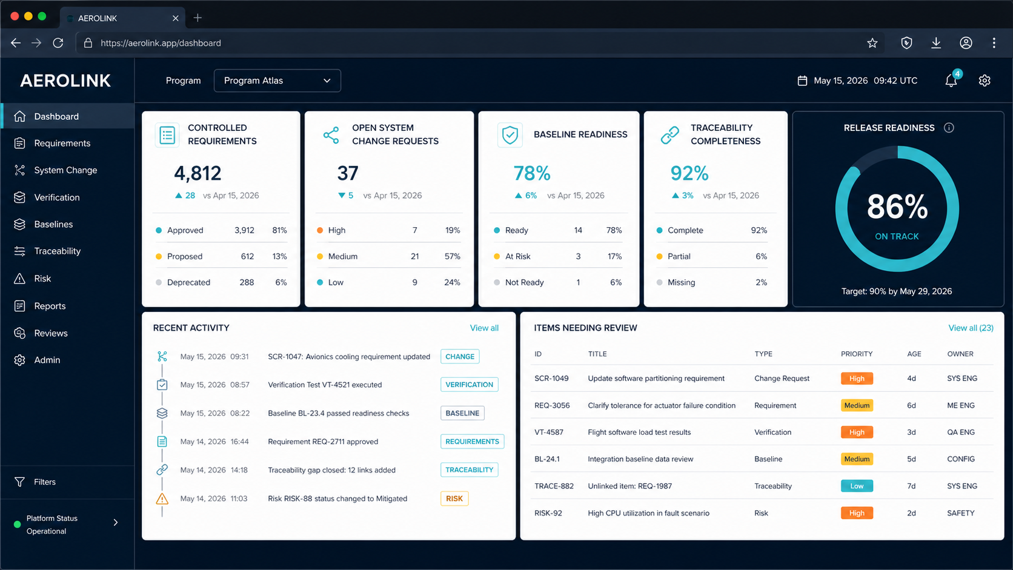
WORKING CONCEPT
AeroLink
One controlled story from change request to released evidence.
A concept for an on-premises aerospace development-assurance platform
MANAGER CONCEPT DECK
July 2026

Slide 2
THE OPPORTUNITY
02
Today’s evidence story is fragmented
The risk is not a lack of data—it is proving that the right data, revision, approval and result belong together.
01
REQUIREMENTS
Documents and spreadsheets obscure stable identity and revision history.
02
CHANGE
Rationale, approval and release selection live in separate workflows.
03
VERIFICATION
Procedures, configurations, results and evidence are hard to reconcile.
04
TRACEABILITY
Static matrices show links, but rarely explain impact or suspect status.
Management question: can we reconstruct a released requirement’s complete story—quickly, accurately and years later?
Product definition source: project documentation baseline, 11 July 2026
AEROLINK • CONCEPT

Slide 3
THE PROPOSITION
03
A single controlled chain—not another document repository
Structured artifacts become the source of truth; documents are reproducible outputs from approved baselines.
SCR
REQUIREMENT
BASELINE
PROCEDURE
EXECUTION
EVIDENCE
Why it changed
What is approved
What is effective
How it is verified
What was run
What proves it
Every node has a stable identity, immutable revision history, review state, owner, exact links and an append-only audit trail.
First prove this chain at system level. Then extend the same control model to HLRs, LLRs and PRs.
Concept scope: system-level vertical slice first
AEROLINK • CONCEPT

Slide 4
CONCEPT EXPERIENCE
04
A manager sees readiness—not document hunting
One view surfaces release health, review demand, baseline readiness and traceability completeness.
Illustrative interface concept • values shown are fictional
AEROLINK • CONCEPT

Slide 5
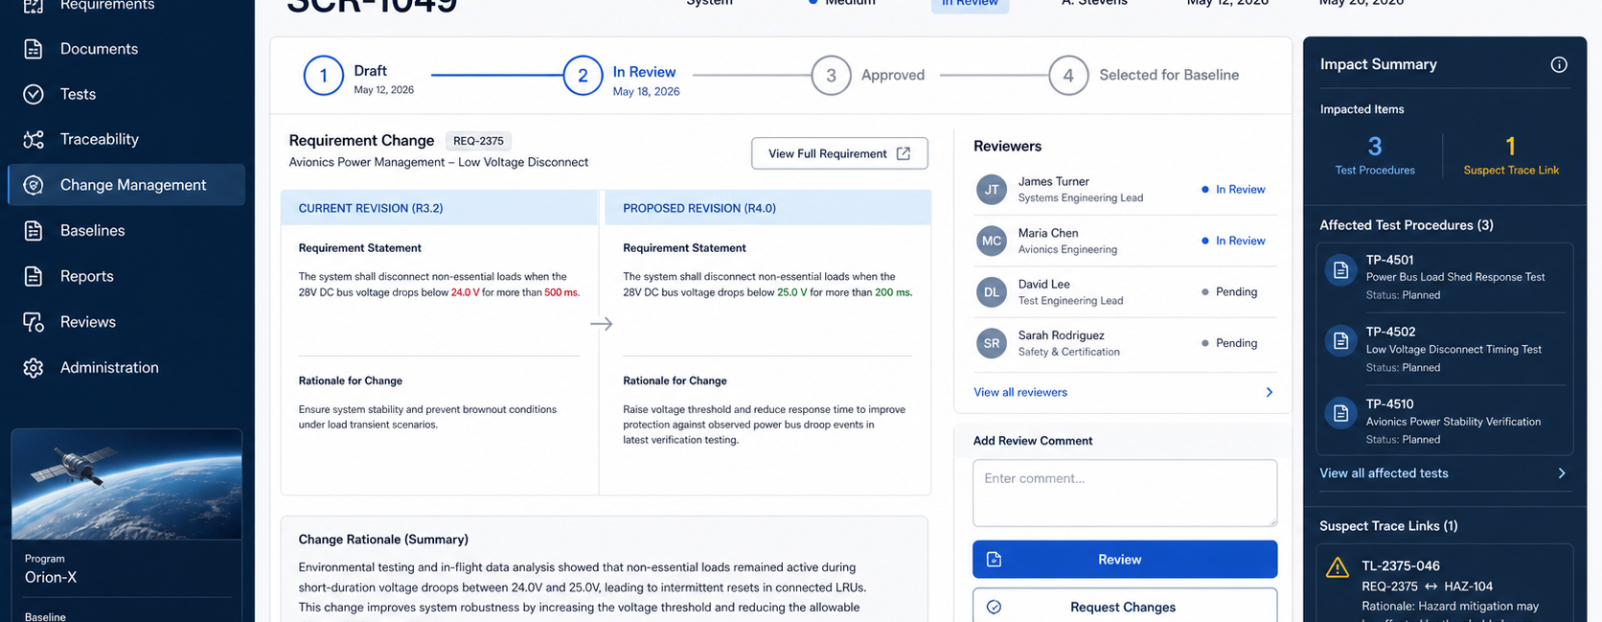
CONTROLLED CHANGE
05
The SCR makes change reviewable before it becomes effective
Reviewers compare revisions, see affected verification and resolve suspect links before approval or baseline selection.
Illustrative interface concept • approval and baseline inclusion remain separate decisions
AEROLINK • CONCEPT

Slide 6
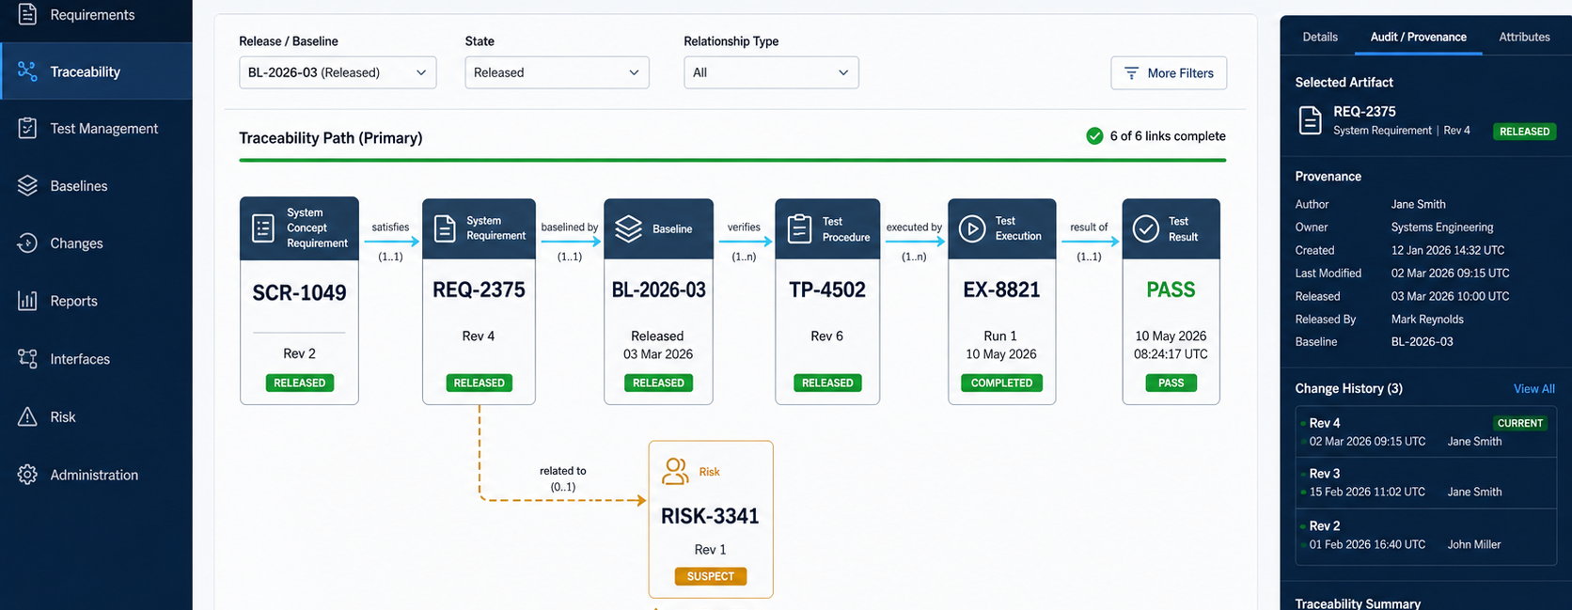
TRACEABILITY
06
Traceability becomes an answer, not a static matrix
Navigate the released path, identify suspect relationships, and inspect exact provenance without losing context.
Illustrative interface concept • typed and version-aware relationships
AEROLINK • CONCEPT

Slide 7
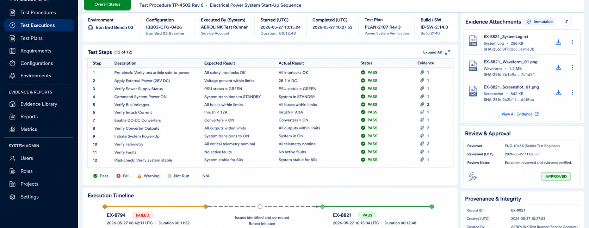
VERIFICATION EVIDENCE
07
A retest can close the issue without erasing the failure
Each external execution retains its exact procedure, configuration, evidence, review and relationship to prior attempts.
Illustrative interface concept • test execution remains outside the platform initially
AEROLINK • CONCEPT

Slide 8
LOW-RISK PATH
08
Prove the hardest controls in three deliberate increments
Each increment ends with evidence that the model works before the scope expands.
01
02
03
CONTROLLED REQUIREMENTS
CHANGE + BASELINES
VERIFICATION + TRACE
Programs, roles, stable IDs, revisions, images, search and audit
SCR review, approval, deferral, candidate baselines and controlled SYSRD
Procedures, external results, evidence, suspect links and release traceability
Prove history cannot be overwritten
Prove effective content is exact
Prove the full released story
Later: HLRs • LLRs • SWCRs • PR management • selected integrations • optional local AI
Roadmap is capability-driven, not calendar-driven
AEROLINK • CONCEPT

Slide 9
DECISION
09
The next step is focused discovery
Authorize a focused validation effort that turns this concept into a credible Phase 1 proposal.
1
SPONSOR
Confirm the business problem and intended organizational outcome.
THE OUTPUT
A decision-ready Phase 1 proposal
2
NOMINATE
Identify requirements, verification, CM and quality subject-matter reviewers.
• validated workflows
• prioritized requirements
• technical options and risks
• pilot scope and success gates
• evidence-based delivery estimate
3
PROVIDE
Select a representative SYSRD, SCR and test evidence set for a paper pilot.
A controlled story is the product.
Sources: internal product-definition baseline (11 Jul 2026); W3C WCAG 2.2 design reference
AEROLINK • CONCEPT

